Slide 1

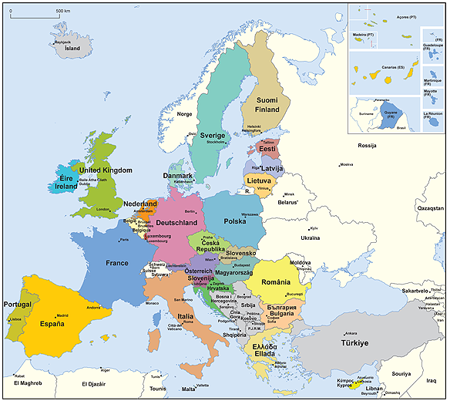

MODULE 1:
PROJECT PREPARATION
“From idea to realization”

Slide 2
Work plan
Activities | Time
Presentations of the trainers and participants | 09:15-09:30
1. Project idea development, EC project life cycle, identification of call for proposals and application guide | 09:30-10:45
2. Project documents preparation and submission of proposals | 10:45-11:00
Coffee break | 11:00-11:15
3. Planning the implementation phase of the proposal (work plan preparation, management structure, consortium, resources to be committed ) | 11:15-12:45
Lunch break | 12:45-13:15
4. Budget preparation | 13:15-14:30
5. Evaluation of proposal & contracting | 14:30-14:45
6. Developing effective partnership | 15:00-16:15
7. Lobbying, EU structure, EU budget for 2020 and beyond | 16:15-16:30
Q&A and evaluation | 16:30-17:.00

Slide 3

1. Project idea development,
EC Project Life Cycle and call identification
09:30-10:45
Goran Stojanovic
Mila Marinkovic
Vesna Mandic

Slide 4

Overview of the Grant Mechanism
Project idea development & EC project life cycle (G.S. / 09:30-10:15)
Identification of call for proposals (M.M)
Application guide (V.M.)
Project documents preparation and submission of proposal (G.S.)
Planning the implementation phase of proposal (G.S.)
Budget planning (V.M.)
Evaluation & contract signing (G.S)
Developing effective partnership (V.M.)
Lobbying, EU structure, EU budget for 2020 and beyond (M.F.)
Notes:
The European Union is a unique institution where Member States voluntarily cede national sovereignty in many areas to carry out common policies and governance in order to gain strength and the benefits from cooperation.
Single market: The Single Market refers to the EU as one territory without any internal borders or other regulatory obstacles to the free movement of goods and services. A functioning Single Market stimulates competition and trade, improves efficiency, raises quality, and helps cut prices. The European Single Market is one of the EU’s greatest achievements. It has fuelled economic growth and made the everyday life of European businesses and consumers easier. (SM of goods, SM of services, Digital SM, etc.)
Euro: The euro is the most tangible proof of European integration – the common currency in 19 out of 28 EU countries and used by some 338.6 million people every day. The euro was launched on 1 January 1999. Banknotes and coins were introduced on 1 January 2002. The benefits of the common currency are immediately obvious to anyone travelling abroad or shopping online on websites based in another EU country.
6 countries non-EU use the euro: Vatican, San Marino, Monaco, Andorra, Montenegro and Kosovo.
Schengen area: 26 members (22 from the EU, 4 non-EU (Norway, Iceland, Switzerland and Lichtenstein). 3 microstates are de facto members because they do not have borders (Monaco, Vatican and San Marino). 2 EU MS are not in the Schengen area: UK and Ireland. 4 EU MS are working on implementing the Schengen area rules to be full members: Cyprus, Croatia, Bulgaria and Romania.
The EU has exclusive competences in:
-Customs Union
-Competition rules
-Monetary policy for the Eurozone
-Conservation of marine biology
-Concluding international agreements

Slide 5
A project is a temporary organisational structure set up to create a unique product or service (output) within certain constraints such as time, cost and quality:
Temporary means that the project has a well-defined start and end
Unique output means that the project’s product or service has not been created before. It may be similar to another product, but there will always be a degree of uniqueness / originality / innovativeness
A project’s output may be a product (e.g. a new application) or a service (e.g. a consulting service, a conference or a training programme)
.
M
Notes:
The European Union is a unique institution where Member States voluntarily cede national sovereignty in many areas to carry out common policies and governance in order to gain strength and the benefits from cooperation.
Single market: The Single Market refers to the EU as one territory without any internal borders or other regulatory obstacles to the free movement of goods and services. A functioning Single Market stimulates competition and trade, improves efficiency, raises quality, and helps cut prices. The European Single Market is one of the EU’s greatest achievements. It has fuelled economic growth and made the everyday life of European businesses and consumers easier. (SM of goods, SM of services, Digital SM, etc.)
Euro: The euro is the most tangible proof of European integration – the common currency in 19 out of 28 EU countries and used by some 338.6 million people every day. The euro was launched on 1 January 1999. Banknotes and coins were introduced on 1 January 2002. The benefits of the common currency are immediately obvious to anyone travelling abroad or shopping online on websites based in another EU country.
6 countries non-EU use the euro: Vatican, San Marino, Monaco, Andorra, Montenegro and Kosovo.
Schengen area: 26 members (22 from the EU, 4 non-EU (Norway, Iceland, Switzerland and Lichtenstein). 3 microstates are de facto members because they do not have borders (Monaco, Vatican and San Marino). 2 EU MS are not in the Schengen area: UK and Ireland. 4 EU MS are working on implementing the Schengen area rules to be full members: Cyprus, Croatia, Bulgaria and Romania.
The EU has exclusive competences in:
-Customs Union
-Competition rules
-Monetary policy for the Eurozone
-Conservation of marine biology
-Concluding international agreements

Slide 6

Every project starts with an idea which is provoked by a need or a problem that has been insufficiently solved or not solved at all. The analysis of the problem that forms the starting point of the project idea
The project idea should represent an agreement of what is to change, where and for whom
Our strategic priorities as an organization, institution or an individual should be established and the problem that our project idea will intervene should be defined clearly
Project idea has to relate to the priorities of the Specific Programme. The only successful ideas are those which will contribute to the programme results
Notes:
The European Union is a unique institution where Member States voluntarily cede national sovereignty in many areas to carry out common policies and governance in order to gain strength and the benefits from cooperation.
Single market: The Single Market refers to the EU as one territory without any internal borders or other regulatory obstacles to the free movement of goods and services. A functioning Single Market stimulates competition and trade, improves efficiency, raises quality, and helps cut prices. The European Single Market is one of the EU’s greatest achievements. It has fuelled economic growth and made the everyday life of European businesses and consumers easier. (SM of goods, SM of services, Digital SM, etc.)
Euro: The euro is the most tangible proof of European integration – the common currency in 19 out of 28 EU countries and used by some 338.6 million people every day. The euro was launched on 1 January 1999. Banknotes and coins were introduced on 1 January 2002. The benefits of the common currency are immediately obvious to anyone travelling abroad or shopping online on websites based in another EU country.
6 countries non-EU use the euro: Vatican, San Marino, Monaco, Andorra, Montenegro and Kosovo.
Schengen area: 26 members (22 from the EU, 4 non-EU (Norway, Iceland, Switzerland and Lichtenstein). 3 microstates are de facto members because they do not have borders (Monaco, Vatican and San Marino). 2 EU MS are not in the Schengen area: UK and Ireland. 4 EU MS are working on implementing the Schengen area rules to be full members: Cyprus, Croatia, Bulgaria and Romania.
The EU has exclusive competences in:
-Customs Union
-Competition rules
-Monetary policy for the Eurozone
-Conservation of marine biology
-Concluding international agreements

Slide 7

In practice, project ideas would result from the identification of:
a discrete set of activities identified as important within programme-based activities
problems or constraints in the development process caused by shortages of essential facilities, services, and material or HR and by institutional or other obstacles
unused or underused material or human resources and opportunities for their conversion to more productive purposes; or, conversely, overused natural resources that need to be conserved or restored
unsatisfied demands or needs and possible means to meet them including opportunities arising from new technology or technological development
the need to complement other investments/ projects
M
Notes:
The European Union is a unique institution where Member States voluntarily cede national sovereignty in many areas to carry out common policies and governance in order to gain strength and the benefits from cooperation.
Single market: The Single Market refers to the EU as one territory without any internal borders or other regulatory obstacles to the free movement of goods and services. A functioning Single Market stimulates competition and trade, improves efficiency, raises quality, and helps cut prices. The European Single Market is one of the EU’s greatest achievements. It has fuelled economic growth and made the everyday life of European businesses and consumers easier. (SM of goods, SM of services, Digital SM, etc.)
Euro: The euro is the most tangible proof of European integration – the common currency in 19 out of 28 EU countries and used by some 338.6 million people every day. The euro was launched on 1 January 1999. Banknotes and coins were introduced on 1 January 2002. The benefits of the common currency are immediately obvious to anyone travelling abroad or shopping online on websites based in another EU country.
6 countries non-EU use the euro: Vatican, San Marino, Monaco, Andorra, Montenegro and Kosovo.
Schengen area: 26 members (22 from the EU, 4 non-EU (Norway, Iceland, Switzerland and Lichtenstein). 3 microstates are de facto members because they do not have borders (Monaco, Vatican and San Marino). 2 EU MS are not in the Schengen area: UK and Ireland. 4 EU MS are working on implementing the Schengen area rules to be full members: Cyprus, Croatia, Bulgaria and Romania.
The EU has exclusive competences in:
-Customs Union
-Competition rules
-Monetary policy for the Eurozone
-Conservation of marine biology
-Concluding international agreements

Slide 8
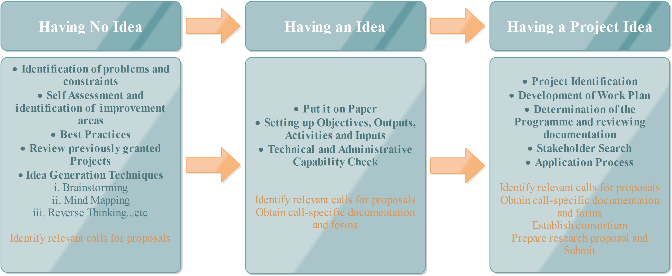
Notes:
The European Union is a unique institution where Member States voluntarily cede national sovereignty in many areas to carry out common policies and governance in order to gain strength and the benefits from cooperation.
Single market: The Single Market refers to the EU as one territory without any internal borders or other regulatory obstacles to the free movement of goods and services. A functioning Single Market stimulates competition and trade, improves efficiency, raises quality, and helps cut prices. The European Single Market is one of the EU’s greatest achievements. It has fuelled economic growth and made the everyday life of European businesses and consumers easier. (SM of goods, SM of services, Digital SM, etc.)
Euro: The euro is the most tangible proof of European integration – the common currency in 19 out of 28 EU countries and used by some 338.6 million people every day. The euro was launched on 1 January 1999. Banknotes and coins were introduced on 1 January 2002. The benefits of the common currency are immediately obvious to anyone travelling abroad or shopping online on websites based in another EU country.
6 countries non-EU use the euro: Vatican, San Marino, Monaco, Andorra, Montenegro and Kosovo.
Schengen area: 26 members (22 from the EU, 4 non-EU (Norway, Iceland, Switzerland and Lichtenstein). 3 microstates are de facto members because they do not have borders (Monaco, Vatican and San Marino). 2 EU MS are not in the Schengen area: UK and Ireland. 4 EU MS are working on implementing the Schengen area rules to be full members: Cyprus, Croatia, Bulgaria and Romania.
The EU has exclusive competences in:
-Customs Union
-Competition rules
-Monetary policy for the Eurozone
-Conservation of marine biology
-Concluding international agreements

Slide 9

From Idea to Application
Already developed project idea /concept
Selection of the suitable Call that matches your project idea
Consortium building (different roles: Coordinator or Project partner)
Register in ECAS (get a PIC number and validate your institution)
Resource planning
Project preparatory meeting “Brain-storming-meeting” with all partners
Prepare the detailed project outline including draft budget calculation
Read the latest EU documents related to your topic:
Work programme
Europe 2020 strategy
EU policies
Read the latest scientific papers related to your topic
Notes:
The European Union is a unique institution where Member States voluntarily cede national sovereignty in many areas to carry out common policies and governance in order to gain strength and the benefits from cooperation.
Single market: The Single Market refers to the EU as one territory without any internal borders or other regulatory obstacles to the free movement of goods and services. A functioning Single Market stimulates competition and trade, improves efficiency, raises quality, and helps cut prices. The European Single Market is one of the EU’s greatest achievements. It has fuelled economic growth and made the everyday life of European businesses and consumers easier. (SM of goods, SM of services, Digital SM, etc.)
Euro: The euro is the most tangible proof of European integration – the common currency in 19 out of 28 EU countries and used by some 338.6 million people every day. The euro was launched on 1 January 1999. Banknotes and coins were introduced on 1 January 2002. The benefits of the common currency are immediately obvious to anyone travelling abroad or shopping online on websites based in another EU country.
6 countries non-EU use the euro: Vatican, San Marino, Monaco, Andorra, Montenegro and Kosovo.
Schengen area: 26 members (22 from the EU, 4 non-EU (Norway, Iceland, Switzerland and Lichtenstein). 3 microstates are de facto members because they do not have borders (Monaco, Vatican and San Marino). 2 EU MS are not in the Schengen area: UK and Ireland. 4 EU MS are working on implementing the Schengen area rules to be full members: Cyprus, Croatia, Bulgaria and Romania.
The EU has exclusive competences in:
-Customs Union
-Competition rules
-Monetary policy for the Eurozone
-Conservation of marine biology
-Concluding international agreements

Slide 10
In order to test the strength of the project idea, you could carry out the following activities:
Background research and review of existing studies, with particular focus on target groups’ needs and the identification of gaps in existing services/products, as well as thematic gaps identified by the programmes.
Check complementarity and duplication compared to previously funded projects: ideas should complement (and not duplicate) other projects being carried out in the programme area.
If possible, pilot the project idea (or parts of the project idea) in order to identify any potential weaknesses or areas where the project idea can be further strengthened.
Project Idea should be consulted regularly for advice and feedback on the idea, and for partnership development. These clarifications contribute to a better understanding for both project developers and programme management.
Notes:
The European Union is a unique institution where Member States voluntarily cede national sovereignty in many areas to carry out common policies and governance in order to gain strength and the benefits from cooperation.
Single market: The Single Market refers to the EU as one territory without any internal borders or other regulatory obstacles to the free movement of goods and services. A functioning Single Market stimulates competition and trade, improves efficiency, raises quality, and helps cut prices. The European Single Market is one of the EU’s greatest achievements. It has fuelled economic growth and made the everyday life of European businesses and consumers easier. (SM of goods, SM of services, Digital SM, etc.)
Euro: The euro is the most tangible proof of European integration – the common currency in 19 out of 28 EU countries and used by some 338.6 million people every day. The euro was launched on 1 January 1999. Banknotes and coins were introduced on 1 January 2002. The benefits of the common currency are immediately obvious to anyone travelling abroad or shopping online on websites based in another EU country.
6 countries non-EU use the euro: Vatican, San Marino, Monaco, Andorra, Montenegro and Kosovo.
Schengen area: 26 members (22 from the EU, 4 non-EU (Norway, Iceland, Switzerland and Lichtenstein). 3 microstates are de facto members because they do not have borders (Monaco, Vatican and San Marino). 2 EU MS are not in the Schengen area: UK and Ireland. 4 EU MS are working on implementing the Schengen area rules to be full members: Cyprus, Croatia, Bulgaria and Romania.
The EU has exclusive competences in:
-Customs Union
-Competition rules
-Monetary policy for the Eurozone
-Conservation of marine biology
-Concluding international agreements

Slide 11
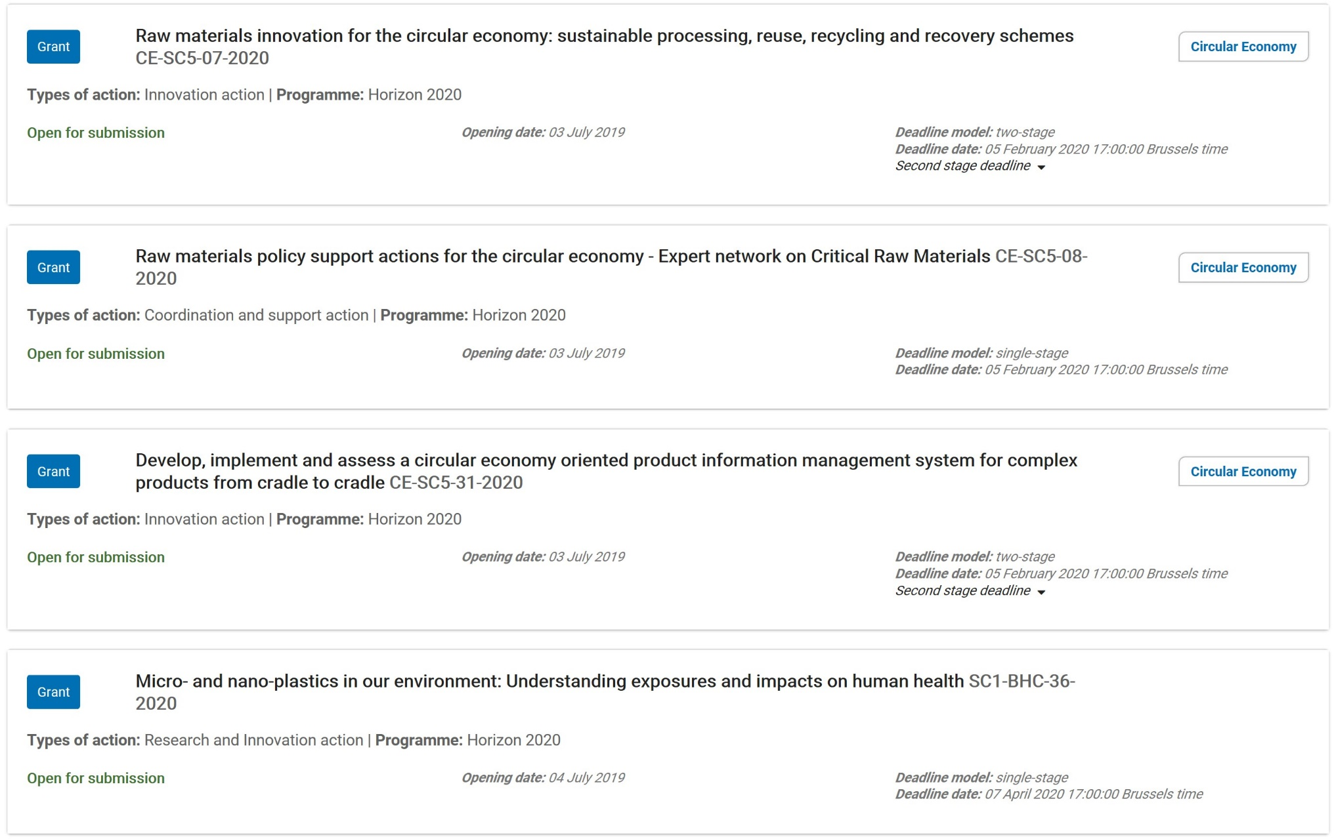
Examples of top-down calls
Notes:
11

Slide 12
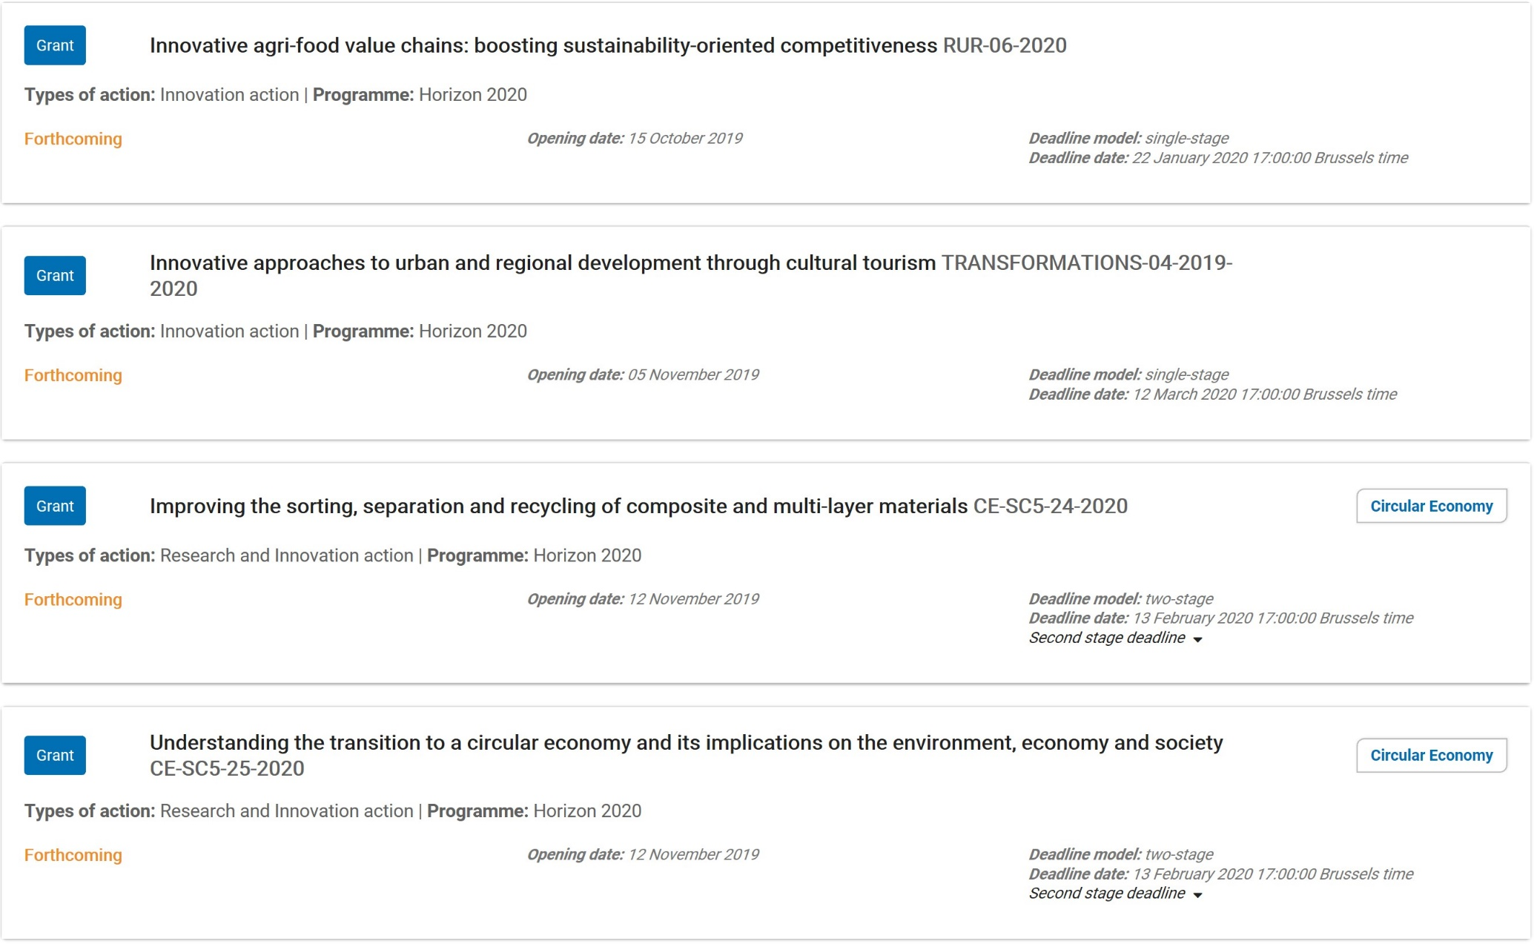
Examples of top-down calls
Notes:
12

Slide 13
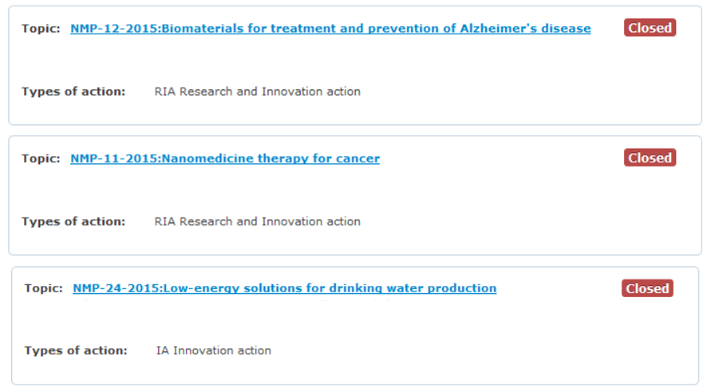
Examples of top-down calls

Slide 14
From idea to project proposal

Slide 15
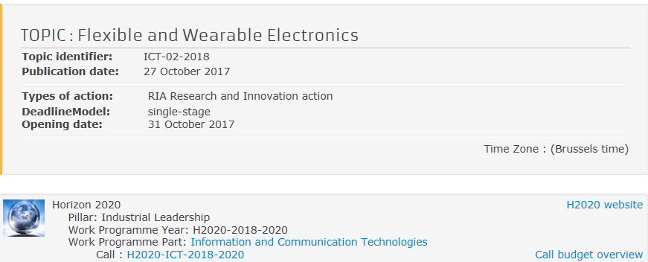
Example of top-down call

Slide 16
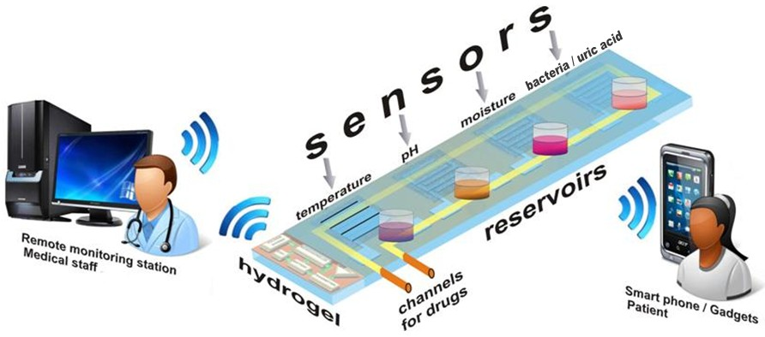

From idea to project proposal

Slide 17
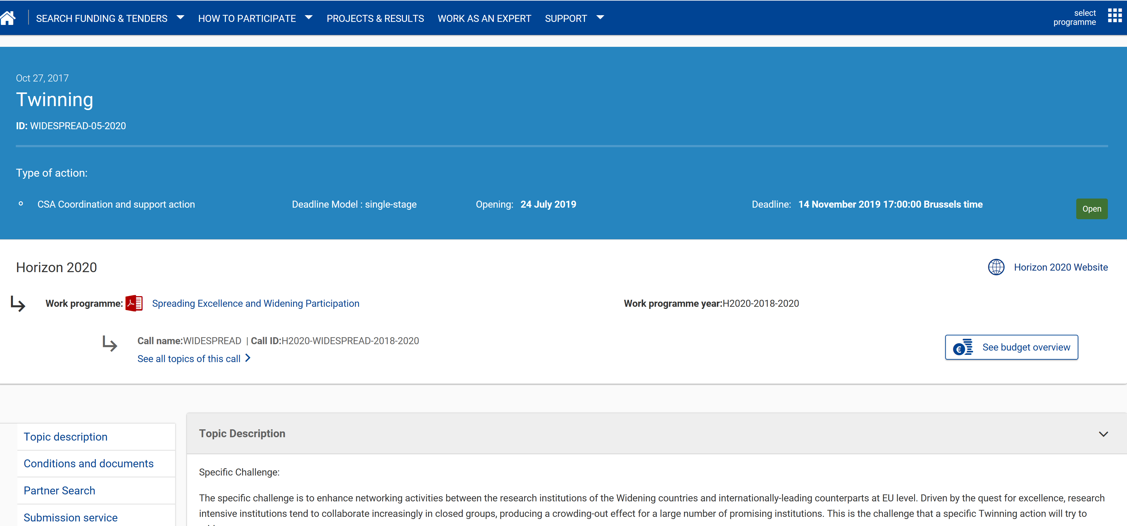
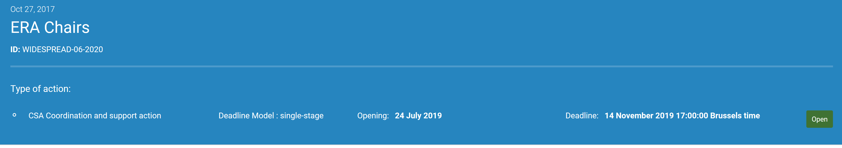
Examples of bottom-up calls
Notes:
17

Slide 18
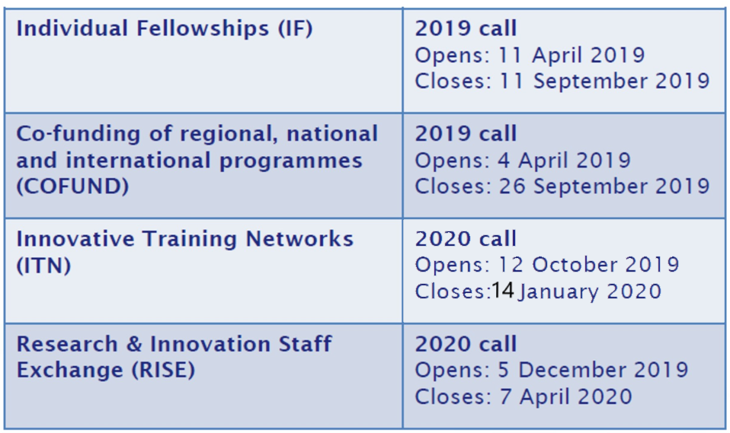

Slide 19
Brainstorming: from idea to project proposal

Slide 20
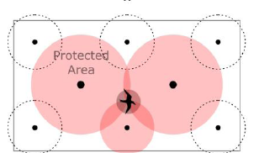

Slide 21
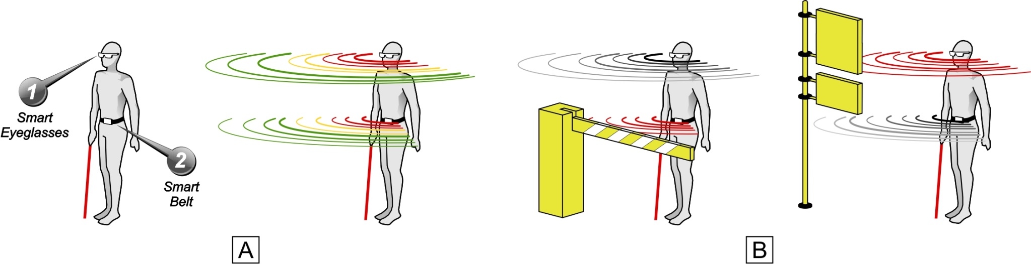
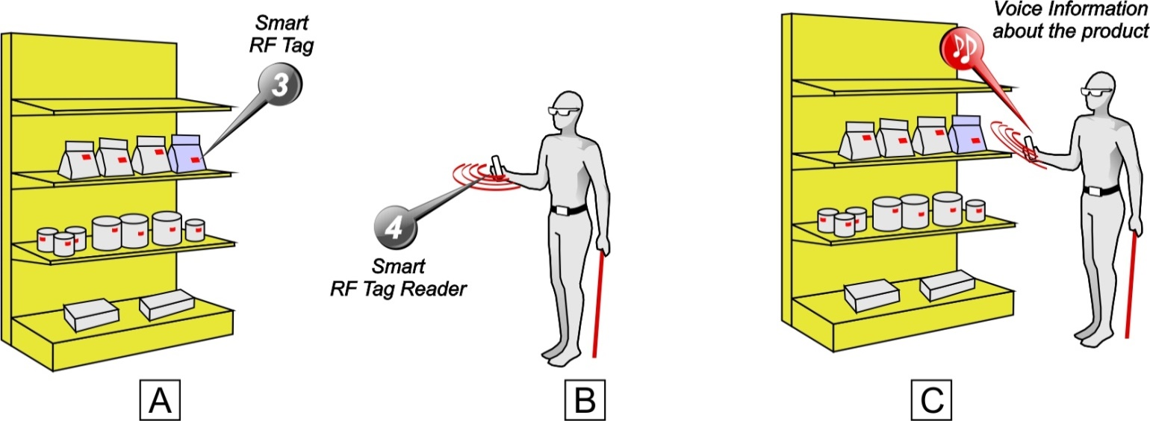
Idea for proposal
D

Slide 22
From idea to project proposal

Slide 23

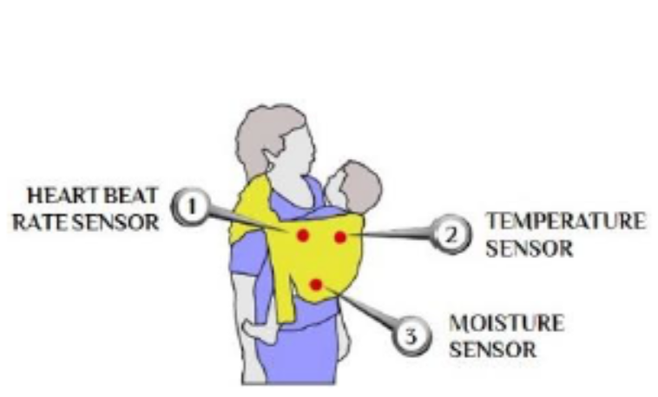
The basic idea for a winning proposal
Notes:
23

Slide 24
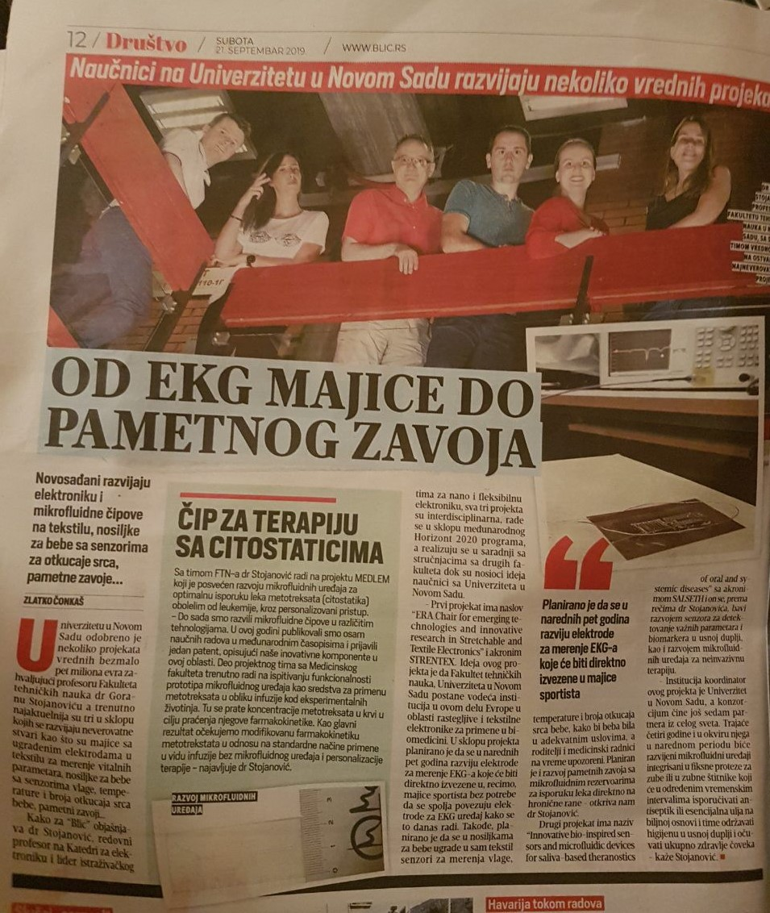
Notes:
24

Slide 25
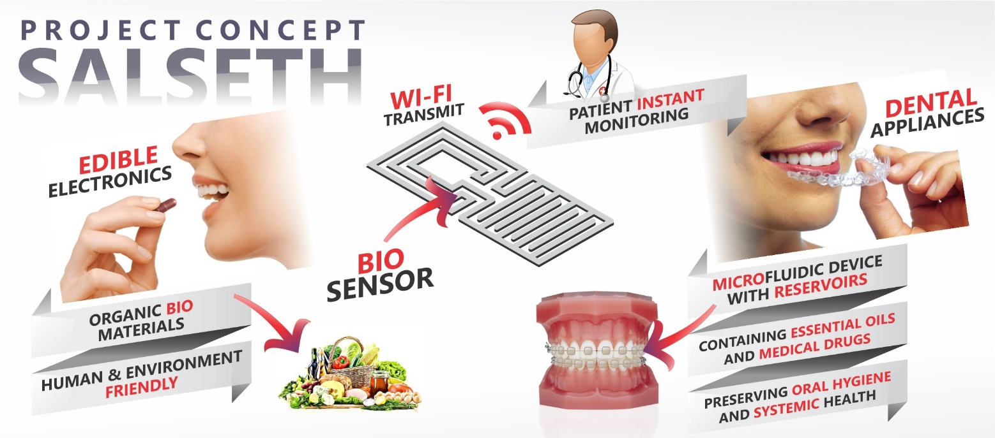

The basic idea for a winning proposal
Notes:
25

Slide 26

From Idea to Application
Key rules
Project objectives (one general and 3-5 specific) should be clear, realistic, measurable and achievable
Activities should be credible
Institutions should have sufficient capacity (human resources, financial resources, infrastructure, etc.)
Activity and budget alignment is necessary
M
Notes:
The European Union is a unique institution where Member States voluntarily cede national sovereignty in many areas to carry out common policies and governance in order to gain strength and the benefits from cooperation.
Single market: The Single Market refers to the EU as one territory without any internal borders or other regulatory obstacles to the free movement of goods and services. A functioning Single Market stimulates competition and trade, improves efficiency, raises quality, and helps cut prices. The European Single Market is one of the EU’s greatest achievements. It has fuelled economic growth and made the everyday life of European businesses and consumers easier. (SM of goods, SM of services, Digital SM, etc.)
Euro: The euro is the most tangible proof of European integration – the common currency in 19 out of 28 EU countries and used by some 338.6 million people every day. The euro was launched on 1 January 1999. Banknotes and coins were introduced on 1 January 2002. The benefits of the common currency are immediately obvious to anyone travelling abroad or shopping online on websites based in another EU country.
6 countries non-EU use the euro: Vatican, San Marino, Monaco, Andorra, Montenegro and Kosovo.
Schengen area: 26 members (22 from the EU, 4 non-EU (Norway, Iceland, Switzerland and Lichtenstein). 3 microstates are de facto members because they do not have borders (Monaco, Vatican and San Marino). 2 EU MS are not in the Schengen area: UK and Ireland. 4 EU MS are working on implementing the Schengen area rules to be full members: Cyprus, Croatia, Bulgaria and Romania.
The EU has exclusive competences in:
-Customs Union
-Competition rules
-Monetary policy for the Eurozone
-Conservation of marine biology
-Concluding international agreements

Slide 27
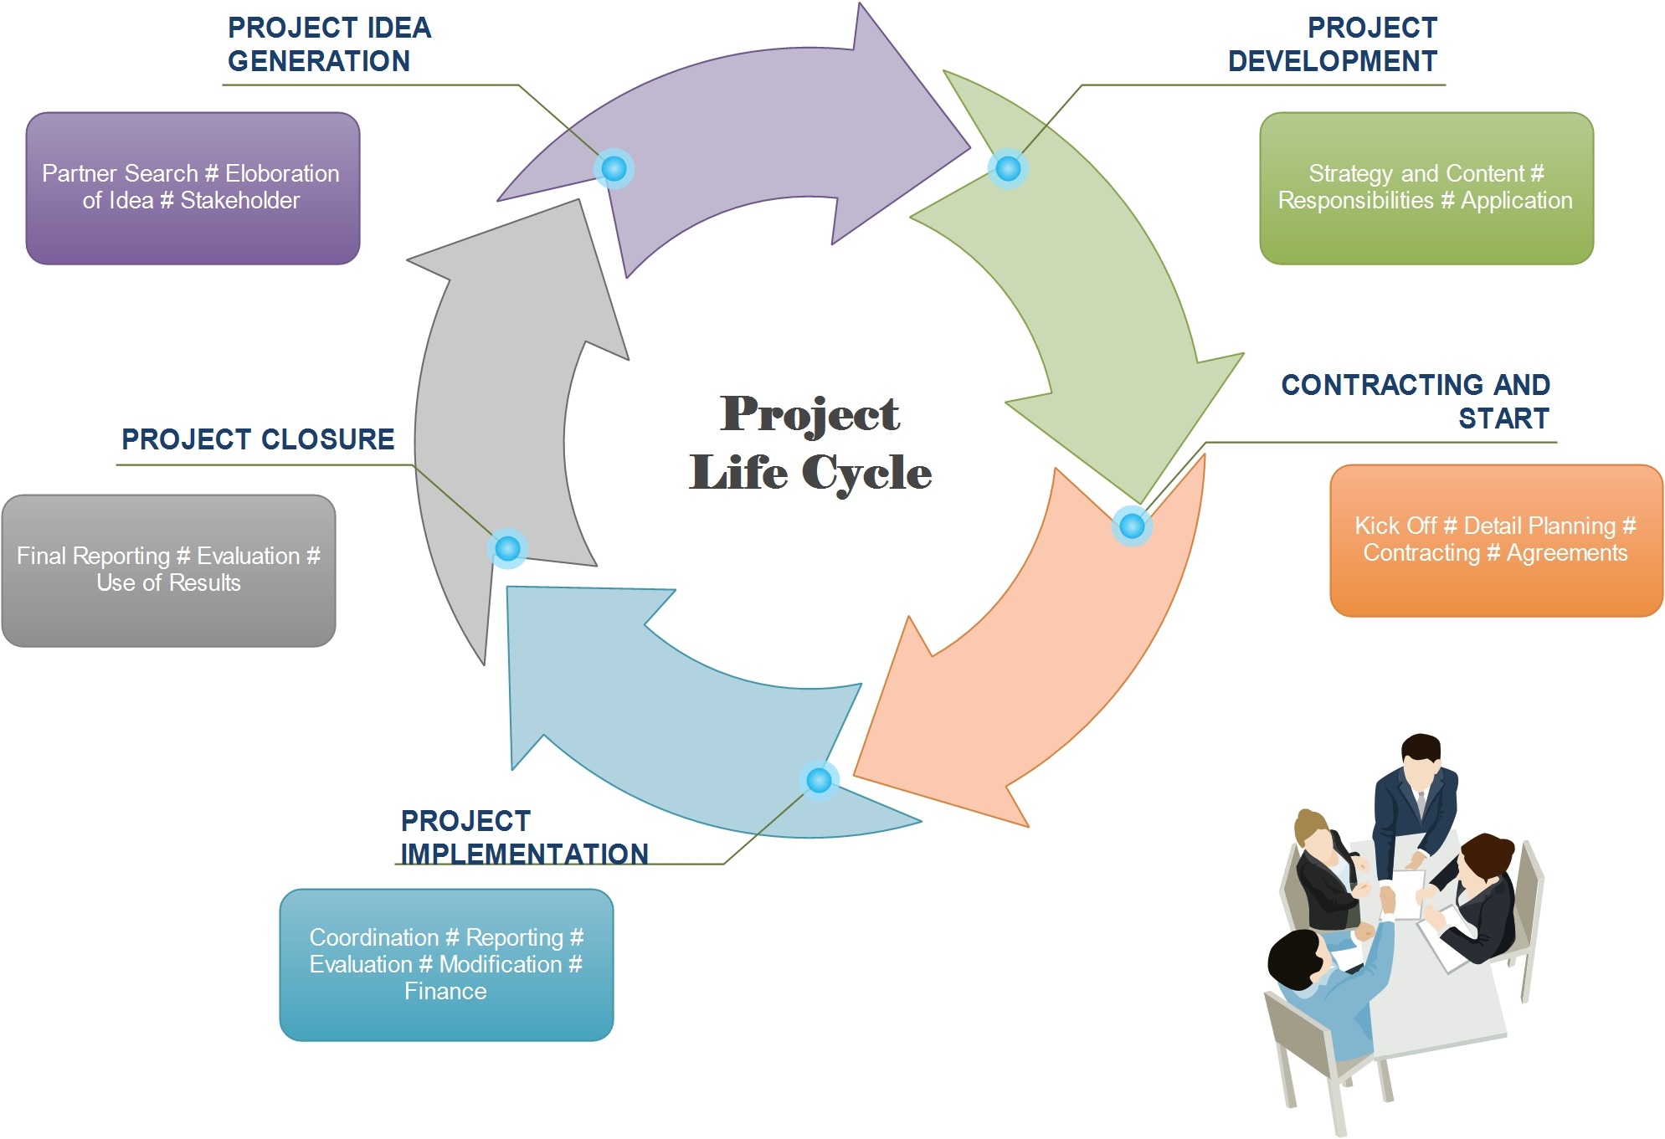
M

Slide 28
Project Idea Generation
This is the time when an idea is being shared among potential partners until the moment it becomes clear that the project is necessary and relevant to the improvement of a certain condition in the programme area.
To establish the need for a project
To establish the baseline; i.e., what has already been carried out and how we capitalise on this
To start the search and involvement of partners
To outline the scope and content of the project
To test the project idea relevance through research, possible pilot activities and the involvement of key stakeholders.
To contact the programme and check if the project idea fits the programme strategy and requirements
Project Development
During this stage partners consolidate the idea into a concrete Project proposal, by defining the strategic and operational details as well as the responsibilities among partners. At the end of this stage the application form is submitted to the programme.
To organize the responsibilities and accountabilities in the partnership and agree on who will take the role of lead partner
To develop the project intervention logic; i.e., Project objectives, results and outputs
To work in detail on the project proposal, its justification and expected contribution to the programme strategy
To prepare the project budget
To keep regular contact with the programme to get support for the development of the project and the application
To submit the application form to the programme
Notes:
The European Union is a unique institution where Member States voluntarily cede national sovereignty in many areas to carry out common policies and governance in order to gain strength and the benefits from cooperation.
Single market: The Single Market refers to the EU as one territory without any internal borders or other regulatory obstacles to the free movement of goods and services. A functioning Single Market stimulates competition and trade, improves efficiency, raises quality, and helps cut prices. The European Single Market is one of the EU’s greatest achievements. It has fuelled economic growth and made the everyday life of European businesses and consumers easier. (SM of goods, SM of services, Digital SM, etc.)
Euro: The euro is the most tangible proof of European integration – the common currency in 19 out of 28 EU countries and used by some 338.6 million people every day. The euro was launched on 1 January 1999. Banknotes and coins were introduced on 1 January 2002. The benefits of the common currency are immediately obvious to anyone travelling abroad or shopping online on websites based in another EU country.
6 countries non-EU use the euro: Vatican, San Marino, Monaco, Andorra, Montenegro and Kosovo.
Schengen area: 26 members (22 from the EU, 4 non-EU (Norway, Iceland, Switzerland and Lichtenstein). 3 microstates are de facto members because they do not have borders (Monaco, Vatican and San Marino). 2 EU MS are not in the Schengen area: UK and Ireland. 4 EU MS are working on implementing the Schengen area rules to be full members: Cyprus, Croatia, Bulgaria and Romania.
The EU has exclusive competences in:
-Customs Union
-Competition rules
-Monetary policy for the Eurozone
-Conservation of marine biology
-Concluding international agreements

Slide 29
Contracting and Start
At this stage the programme has taken a decision on the funding of the project, thus the contractual agreements are signed and the project can officially start off:
Sign subsidy contract with programme authorities
Finalize the project partnership agreement and to have it signed by all partners
Set up the project coordination and decision-making structures, milestones and project meetings
Plan tasks and partner responsibilities in detail for the first part of the implementation period
Project Implementation
During this stage the project partners carry out the work planned to produce the desired outputs. Regular administration, management, monitoring and reporting activities take place, along with communication and promotion tasks. Changes to the plan are managed by exception in agreement with the partners and the programme:
Carry out project activities and achieve objectives
Carry out quality control to produce the best possible outputs
Set up smooth monitoring and reporting procedures and report to the programme as required
Manage risks and project modifications in agreement with the partners and the programme
Manage the partnership
Communicate and promote project work and achievements
Build up a network of relevant contacts and initiate the uptake and use of project knowledge and outputs after closure
Notes:
The European Union is a unique institution where Member States voluntarily cede national sovereignty in many areas to carry out common policies and governance in order to gain strength and the benefits from cooperation.
Single market: The Single Market refers to the EU as one territory without any internal borders or other regulatory obstacles to the free movement of goods and services. A functioning Single Market stimulates competition and trade, improves efficiency, raises quality, and helps cut prices. The European Single Market is one of the EU’s greatest achievements. It has fuelled economic growth and made the everyday life of European businesses and consumers easier. (SM of goods, SM of services, Digital SM, etc.)
Euro: The euro is the most tangible proof of European integration – the common currency in 19 out of 28 EU countries and used by some 338.6 million people every day. The euro was launched on 1 January 1999. Banknotes and coins were introduced on 1 January 2002. The benefits of the common currency are immediately obvious to anyone travelling abroad or shopping online on websites based in another EU country.
6 countries non-EU use the euro: Vatican, San Marino, Monaco, Andorra, Montenegro and Kosovo.
Schengen area: 26 members (22 from the EU, 4 non-EU (Norway, Iceland, Switzerland and Lichtenstein). 3 microstates are de facto members because they do not have borders (Monaco, Vatican and San Marino). 2 EU MS are not in the Schengen area: UK and Ireland. 4 EU MS are working on implementing the Schengen area rules to be full members: Cyprus, Croatia, Bulgaria and Romania.
The EU has exclusive competences in:
-Customs Union
-Competition rules
-Monetary policy for the Eurozone
-Conservation of marine biology
-Concluding international agreements

Slide 30
Project Closure
At this stage the project content activities should be completed and all outputs delivered. The partnership takes care of the final administrative provisions before the funding is over. The project and the programme reflect together on the results and lessons learned.
Finalise the rules for the use of results after the end of the project with all involved parties
Ensure all partners are aware of what is expected by the end date of the project, also in terms of audit and responsibilities after the end of the project
Draft the final report and submit it to the programme
Develop follow-up activities, if relevant
Notes:
The European Union is a unique institution where Member States voluntarily cede national sovereignty in many areas to carry out common policies and governance in order to gain strength and the benefits from cooperation.
Single market: The Single Market refers to the EU as one territory without any internal borders or other regulatory obstacles to the free movement of goods and services. A functioning Single Market stimulates competition and trade, improves efficiency, raises quality, and helps cut prices. The European Single Market is one of the EU’s greatest achievements. It has fuelled economic growth and made the everyday life of European businesses and consumers easier. (SM of goods, SM of services, Digital SM, etc.)
Euro: The euro is the most tangible proof of European integration – the common currency in 19 out of 28 EU countries and used by some 338.6 million people every day. The euro was launched on 1 January 1999. Banknotes and coins were introduced on 1 January 2002. The benefits of the common currency are immediately obvious to anyone travelling abroad or shopping online on websites based in another EU country.
6 countries non-EU use the euro: Vatican, San Marino, Monaco, Andorra, Montenegro and Kosovo.
Schengen area: 26 members (22 from the EU, 4 non-EU (Norway, Iceland, Switzerland and Lichtenstein). 3 microstates are de facto members because they do not have borders (Monaco, Vatican and San Marino). 2 EU MS are not in the Schengen area: UK and Ireland. 4 EU MS are working on implementing the Schengen area rules to be full members: Cyprus, Croatia, Bulgaria and Romania.
The EU has exclusive competences in:
-Customs Union
-Competition rules
-Monetary policy for the Eurozone
-Conservation of marine biology
-Concluding international agreements

Slide 31
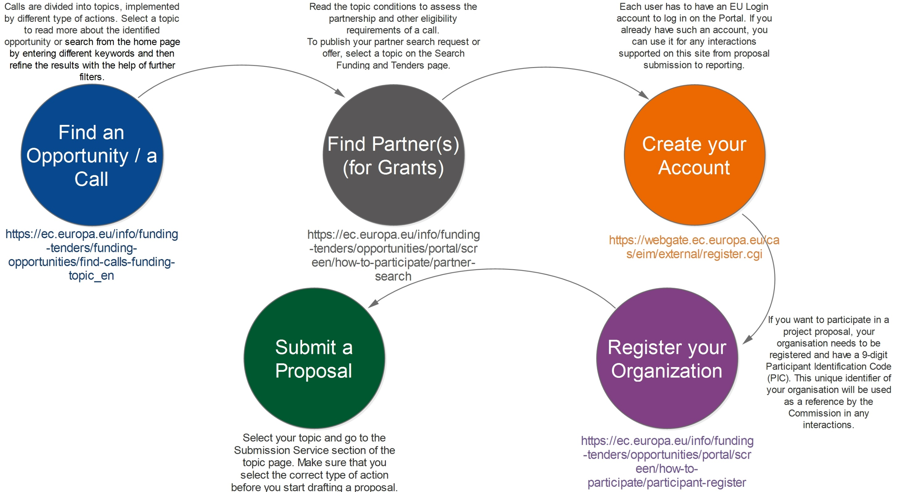
M

Slide 32
Overview of the Grant Mechanism
Project idea development & EC project life cycle (G.S.)
Identification of call for proposals (M.M / 10:15-10:25)
Application guide (V.M.)
Project documents preparation and submission of proposal (G.S.)
Planning the implementation phase of proposal (G.S.)
Budget planning (V.M.)
Evaluation & contract signing (G.S)
Developing effective partnership (V.M.)
Lobbying, EU structure, EU budget for 2020 and beyond(M.F.)
Notes:
The European Union is a unique institution where Member States voluntarily cede national sovereignty in many areas to carry out common policies and governance in order to gain strength and the benefits from cooperation.
Single market: The Single Market refers to the EU as one territory without any internal borders or other regulatory obstacles to the free movement of goods and services. A functioning Single Market stimulates competition and trade, improves efficiency, raises quality, and helps cut prices. The European Single Market is one of the EU’s greatest achievements. It has fuelled economic growth and made the everyday life of European businesses and consumers easier. (SM of goods, SM of services, Digital SM, etc.)
Euro: The euro is the most tangible proof of European integration – the common currency in 19 out of 28 EU countries and used by some 338.6 million people every day. The euro was launched on 1 January 1999. Banknotes and coins were introduced on 1 January 2002. The benefits of the common currency are immediately obvious to anyone travelling abroad or shopping online on websites based in another EU country.
6 countries non-EU use the euro: Vatican, San Marino, Monaco, Andorra, Montenegro and Kosovo.
Schengen area: 26 members (22 from the EU, 4 non-EU (Norway, Iceland, Switzerland and Lichtenstein). 3 microstates are de facto members because they do not have borders (Monaco, Vatican and San Marino). 2 EU MS are not in the Schengen area: UK and Ireland. 4 EU MS are working on implementing the Schengen area rules to be full members: Cyprus, Croatia, Bulgaria and Romania.
The EU has exclusive competences in:
-Customs Union
-Competition rules
-Monetary policy for the Eurozone
-Conservation of marine biology
-Concluding international agreements

Slide 33

A number of different contracts and grants are regularly made available under different programmes for individuals, companies, institutions or organisations to apply for funding.
A call for proposals is a public procedure addressed to clearly identified categories of applicants, to promote actions falling within the framework of a specific EU programme.
Every call for tender or for proposals sets out the conditions for taking part, including the profile that applicants need to match. The managing authorities assess the project proposals submitted and decide whether to grant funding.
Direct funding grants, including union programmes, may be made available by the European Commission or its executive agencies for projects with specific objectives (environment, research, training, etc.). For tenders and grants managed centrally by the Commission’s departments and agencies, it is advisable to visit the websites.
Notes:
The European Union is a unique institution where Member States voluntarily cede national sovereignty in many areas to carry out common policies and governance in order to gain strength and the benefits from cooperation.
Single market: The Single Market refers to the EU as one territory without any internal borders or other regulatory obstacles to the free movement of goods and services. A functioning Single Market stimulates competition and trade, improves efficiency, raises quality, and helps cut prices. The European Single Market is one of the EU’s greatest achievements. It has fuelled economic growth and made the everyday life of European businesses and consumers easier. (SM of goods, SM of services, Digital SM, etc.)
Euro: The euro is the most tangible proof of European integration – the common currency in 19 out of 28 EU countries and used by some 338.6 million people every day. The euro was launched on 1 January 1999. Banknotes and coins were introduced on 1 January 2002. The benefits of the common currency are immediately obvious to anyone travelling abroad or shopping online on websites based in another EU country.
6 countries non-EU use the euro: Vatican, San Marino, Monaco, Andorra, Montenegro and Kosovo.
Schengen area: 26 members (22 from the EU, 4 non-EU (Norway, Iceland, Switzerland and Lichtenstein). 3 microstates are de facto members because they do not have borders (Monaco, Vatican and San Marino). 2 EU MS are not in the Schengen area: UK and Ireland. 4 EU MS are working on implementing the Schengen area rules to be full members: Cyprus, Croatia, Bulgaria and Romania.
The EU has exclusive competences in:
-Customs Union
-Competition rules
-Monetary policy for the Eurozone
-Conservation of marine biology
-Concluding international agreements

Slide 34
Find a suitable call for proposals
The EC and its funding bodies publish calls for proposals on the Funding & Tenders Portal -
You may start your search from the home page by entering different keywords that characterize best your field of interest, and then refine the results with the help of further filters
You may start your search by selecting one of the EU funding programmes listed on the home page, and then navigate via the quick links to the calls for proposals of a specific programme
Calls are divided into topics, implemented by different type of actions. Select a topic to read more about the identified opportunity: the topic-related documents, guidance and other instructions are available on a topic page
M
Notes:
The European Union is a unique institution where Member States voluntarily cede national sovereignty in many areas to carry out common policies and governance in order to gain strength and the benefits from cooperation.
Single market: The Single Market refers to the EU as one territory without any internal borders or other regulatory obstacles to the free movement of goods and services. A functioning Single Market stimulates competition and trade, improves efficiency, raises quality, and helps cut prices. The European Single Market is one of the EU’s greatest achievements. It has fuelled economic growth and made the everyday life of European businesses and consumers easier. (SM of goods, SM of services, Digital SM, etc.)
Euro: The euro is the most tangible proof of European integration – the common currency in 19 out of 28 EU countries and used by some 338.6 million people every day. The euro was launched on 1 January 1999. Banknotes and coins were introduced on 1 January 2002. The benefits of the common currency are immediately obvious to anyone travelling abroad or shopping online on websites based in another EU country.
6 countries non-EU use the euro: Vatican, San Marino, Monaco, Andorra, Montenegro and Kosovo.
Schengen area: 26 members (22 from the EU, 4 non-EU (Norway, Iceland, Switzerland and Lichtenstein). 3 microstates are de facto members because they do not have borders (Monaco, Vatican and San Marino). 2 EU MS are not in the Schengen area: UK and Ireland. 4 EU MS are working on implementing the Schengen area rules to be full members: Cyprus, Croatia, Bulgaria and Romania.
The EU has exclusive competences in:
-Customs Union
-Competition rules
-Monetary policy for the Eurozone
-Conservation of marine biology
-Concluding international agreements

Slide 35
The Commission’s calls are published on the websites of its various directorates-general on the EU’s web portal, Europa. They are also published in the Supplement to the Official Journal of the European Union and its online format, the TED database.
Calls for Proposals and Calls for Tenders
https://ec.europa.eu/info/funding-tenders_en
Calls for Proposals and Calls for Tenders
https://ted.europa.eu/TED/main/HomePage.do
Publication of calls & topics
Related key documents & guidance
News about upcoming calls/topics
Page for each topic where you can start submitting your proposal
M
Notes:
The European Union is a unique institution where Member States voluntarily cede national sovereignty in many areas to carry out common policies and governance in order to gain strength and the benefits from cooperation.
Single market: The Single Market refers to the EU as one territory without any internal borders or other regulatory obstacles to the free movement of goods and services. A functioning Single Market stimulates competition and trade, improves efficiency, raises quality, and helps cut prices. The European Single Market is one of the EU’s greatest achievements. It has fuelled economic growth and made the everyday life of European businesses and consumers easier. (SM of goods, SM of services, Digital SM, etc.)
Euro: The euro is the most tangible proof of European integration – the common currency in 19 out of 28 EU countries and used by some 338.6 million people every day. The euro was launched on 1 January 1999. Banknotes and coins were introduced on 1 January 2002. The benefits of the common currency are immediately obvious to anyone travelling abroad or shopping online on websites based in another EU country.
6 countries non-EU use the euro: Vatican, San Marino, Monaco, Andorra, Montenegro and Kosovo.
Schengen area: 26 members (22 from the EU, 4 non-EU (Norway, Iceland, Switzerland and Lichtenstein). 3 microstates are de facto members because they do not have borders (Monaco, Vatican and San Marino). 2 EU MS are not in the Schengen area: UK and Ireland. 4 EU MS are working on implementing the Schengen area rules to be full members: Cyprus, Croatia, Bulgaria and Romania.
The EU has exclusive competences in:
-Customs Union
-Competition rules
-Monetary policy for the Eurozone
-Conservation of marine biology
-Concluding international agreements

Slide 36


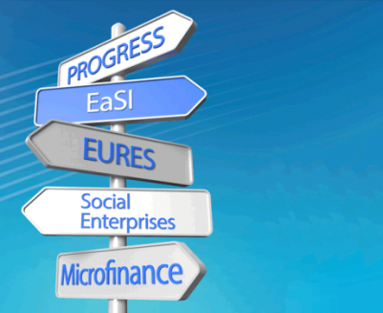








Find a suitable call for proposals

Slide 37
Find a suitable call for proposals
https://eacea.ec.europa.eu/europe-for-citizens_en
What are you looking for? ….. “Funding”
Filter:
“status” (opened / closed) (tip: you may check which organisation won the projects in previous calls, also the way to find a partner)
“call reference”

Slide 38
Example: Europe for Citizens Programme
https://eacea.ec.europa.eu/europe-for-citizens/funding_en
Calls for proposals | Strands | Status | Deadline for application | Call reference
Civil Society Projects 2020 | Civil society projects Europe for Citizens | Open | 01/09/2020 - 17:00 (CET/CEST, Brussels time) | EACEA/52/2019
Networks of Towns 2020 – Round 1 | Networks of towns Europe for Citizens | Open | 03/03/2020 - 17:00 (CET/CEST, Brussels time) | EACEA/52/2019
European Remembrance 2020 | European remembrance Europe for Citizens | Open | 04/02/2020 - 17:00 (CET/CEST, Brussels time) | EACEA/52/2019
Town Twinning 2020 – Round 1 | Town twinning Europe for Citizens | Open | 04/02/2020 - 17:00 (CET/CEST, Brussels time) | EACEA/52/2019
Networks of Towns 2019 – Round 2 | Networks of towns Europe for Citizens | Closed | 02/09/2019 - 12:00 (CET/CEST, Brussels time) | EACEA/51/2018

Slide 39
Example 2: Europe for Citizens Programme Call for proposals No EACEA-52/2019: Europe for Citizens programme — actions grants 2020 (2019/C 420/09)
1. Introduction and objectives
2. Actions
3. Eligibility
4. Budget and duration of projects
5. Deadline for the submission of applications
6. Notification and publication of the evaluation results
7. Full details
https://eacea.ec.europa.eu/sites/eacea-site/files/celex_c2019_420_09_en_txt.pdf

Slide 40
Example 1: CREATIVE EUROPE (2014-2020) Culture Sub-programme Call for proposals EACEA 39/2019 Cultural Cooperation Projects in the Western Balkans “Strengthening cultural cooperation with and competiveness of cultural and creative industries in the Western Balkans”
1. Introduction
2. Objectives and priorities
3. Eligibility criteria
3.1. Eligible participants and countries
3.2 Eligible projects
3.3 Eligible activities
4. Award Criteria
5. Budget
6. Deadline for applications
https://eacea.ec.europa.eu/creative-europe/funding_en
http://kultura.kreativnaevropa.rs/blog/vesti/конкурс-јачање-културне-сарадње-и-ко/
https://eacea.ec.europa.eu/sites/ipa/funding/coopwb_en

Slide 41
ELIGIBILITY
There are four elements of your application which must meet eligibility criteria, before the application will be considered:
Eligibility of applicants
Partnerships and eligibility of partners
Eligible actions - actions for which an application may be made
Eligibility of costs - costs which may be taken into consideration for the grant
M
Notes:
The European Union is a unique institution where Member States voluntarily cede national sovereignty in many areas to carry out common policies and governance in order to gain strength and the benefits from cooperation.
Single market: The Single Market refers to the EU as one territory without any internal borders or other regulatory obstacles to the free movement of goods and services. A functioning Single Market stimulates competition and trade, improves efficiency, raises quality, and helps cut prices. The European Single Market is one of the EU’s greatest achievements. It has fuelled economic growth and made the everyday life of European businesses and consumers easier. (SM of goods, SM of services, Digital SM, etc.)
Euro: The euro is the most tangible proof of European integration – the common currency in 19 out of 28 EU countries and used by some 338.6 million people every day. The euro was launched on 1 January 1999. Banknotes and coins were introduced on 1 January 2002. The benefits of the common currency are immediately obvious to anyone travelling abroad or shopping online on websites based in another EU country.
6 countries non-EU use the euro: Vatican, San Marino, Monaco, Andorra, Montenegro and Kosovo.
Schengen area: 26 members (22 from the EU, 4 non-EU (Norway, Iceland, Switzerland and Lichtenstein). 3 microstates are de facto members because they do not have borders (Monaco, Vatican and San Marino). 2 EU MS are not in the Schengen area: UK and Ireland. 4 EU MS are working on implementing the Schengen area rules to be full members: Cyprus, Croatia, Bulgaria and Romania.
The EU has exclusive competences in:
-Customs Union
-Competition rules
-Monetary policy for the Eurozone
-Conservation of marine biology
-Concluding international agreements

Slide 42
Overview of the Grant Mechanism
Project idea development & EC project life cycle (G.S.)
Identification of call for proposals (M.M)
Application guide (V.M. / 10:25-10:45)
Project documents preparation and submission of proposal (G.S.)
Planning the implementation phase of proposal (G.S.)
Budget planning (V.M.)
Evaluation & contract signing (G.S)
Developing effective partnership (V.M.)
Lobbying, EU structure, EU budget for 2020 and beyond (M.F.)
Notes:
The European Union is a unique institution where Member States voluntarily cede national sovereignty in many areas to carry out common policies and governance in order to gain strength and the benefits from cooperation.
Single market: The Single Market refers to the EU as one territory without any internal borders or other regulatory obstacles to the free movement of goods and services. A functioning Single Market stimulates competition and trade, improves efficiency, raises quality, and helps cut prices. The European Single Market is one of the EU’s greatest achievements. It has fuelled economic growth and made the everyday life of European businesses and consumers easier. (SM of goods, SM of services, Digital SM, etc.)
Euro: The euro is the most tangible proof of European integration – the common currency in 19 out of 28 EU countries and used by some 338.6 million people every day. The euro was launched on 1 January 1999. Banknotes and coins were introduced on 1 January 2002. The benefits of the common currency are immediately obvious to anyone travelling abroad or shopping online on websites based in another EU country.
6 countries non-EU use the euro: Vatican, San Marino, Monaco, Andorra, Montenegro and Kosovo.
Schengen area: 26 members (22 from the EU, 4 non-EU (Norway, Iceland, Switzerland and Lichtenstein). 3 microstates are de facto members because they do not have borders (Monaco, Vatican and San Marino). 2 EU MS are not in the Schengen area: UK and Ireland. 4 EU MS are working on implementing the Schengen area rules to be full members: Cyprus, Croatia, Bulgaria and Romania.
The EU has exclusive competences in:
-Customs Union
-Competition rules
-Monetary policy for the Eurozone
-Conservation of marine biology
-Concluding international agreements

Slide 43

How to apply and the procedures to follow
Pay careful attention to the parts of the Guidelines which include:
the Application Form
where and how to send the Applications
deadline for submission of Applications
further information for the Application
M
Notes:
The European Union is a unique institution where Member States voluntarily cede national sovereignty in many areas to carry out common policies and governance in order to gain strength and the benefits from cooperation.
Single market: The Single Market refers to the EU as one territory without any internal borders or other regulatory obstacles to the free movement of goods and services. A functioning Single Market stimulates competition and trade, improves efficiency, raises quality, and helps cut prices. The European Single Market is one of the EU’s greatest achievements. It has fuelled economic growth and made the everyday life of European businesses and consumers easier. (SM of goods, SM of services, Digital SM, etc.)
Euro: The euro is the most tangible proof of European integration – the common currency in 19 out of 28 EU countries and used by some 338.6 million people every day. The euro was launched on 1 January 1999. Banknotes and coins were introduced on 1 January 2002. The benefits of the common currency are immediately obvious to anyone travelling abroad or shopping online on websites based in another EU country.
6 countries non-EU use the euro: Vatican, San Marino, Monaco, Andorra, Montenegro and Kosovo.
Schengen area: 26 members (22 from the EU, 4 non-EU (Norway, Iceland, Switzerland and Lichtenstein). 3 microstates are de facto members because they do not have borders (Monaco, Vatican and San Marino). 2 EU MS are not in the Schengen area: UK and Ireland. 4 EU MS are working on implementing the Schengen area rules to be full members: Cyprus, Croatia, Bulgaria and Romania.
The EU has exclusive competences in:
-Customs Union
-Competition rules
-Monetary policy for the Eurozone
-Conservation of marine biology
-Concluding international agreements

Slide 44
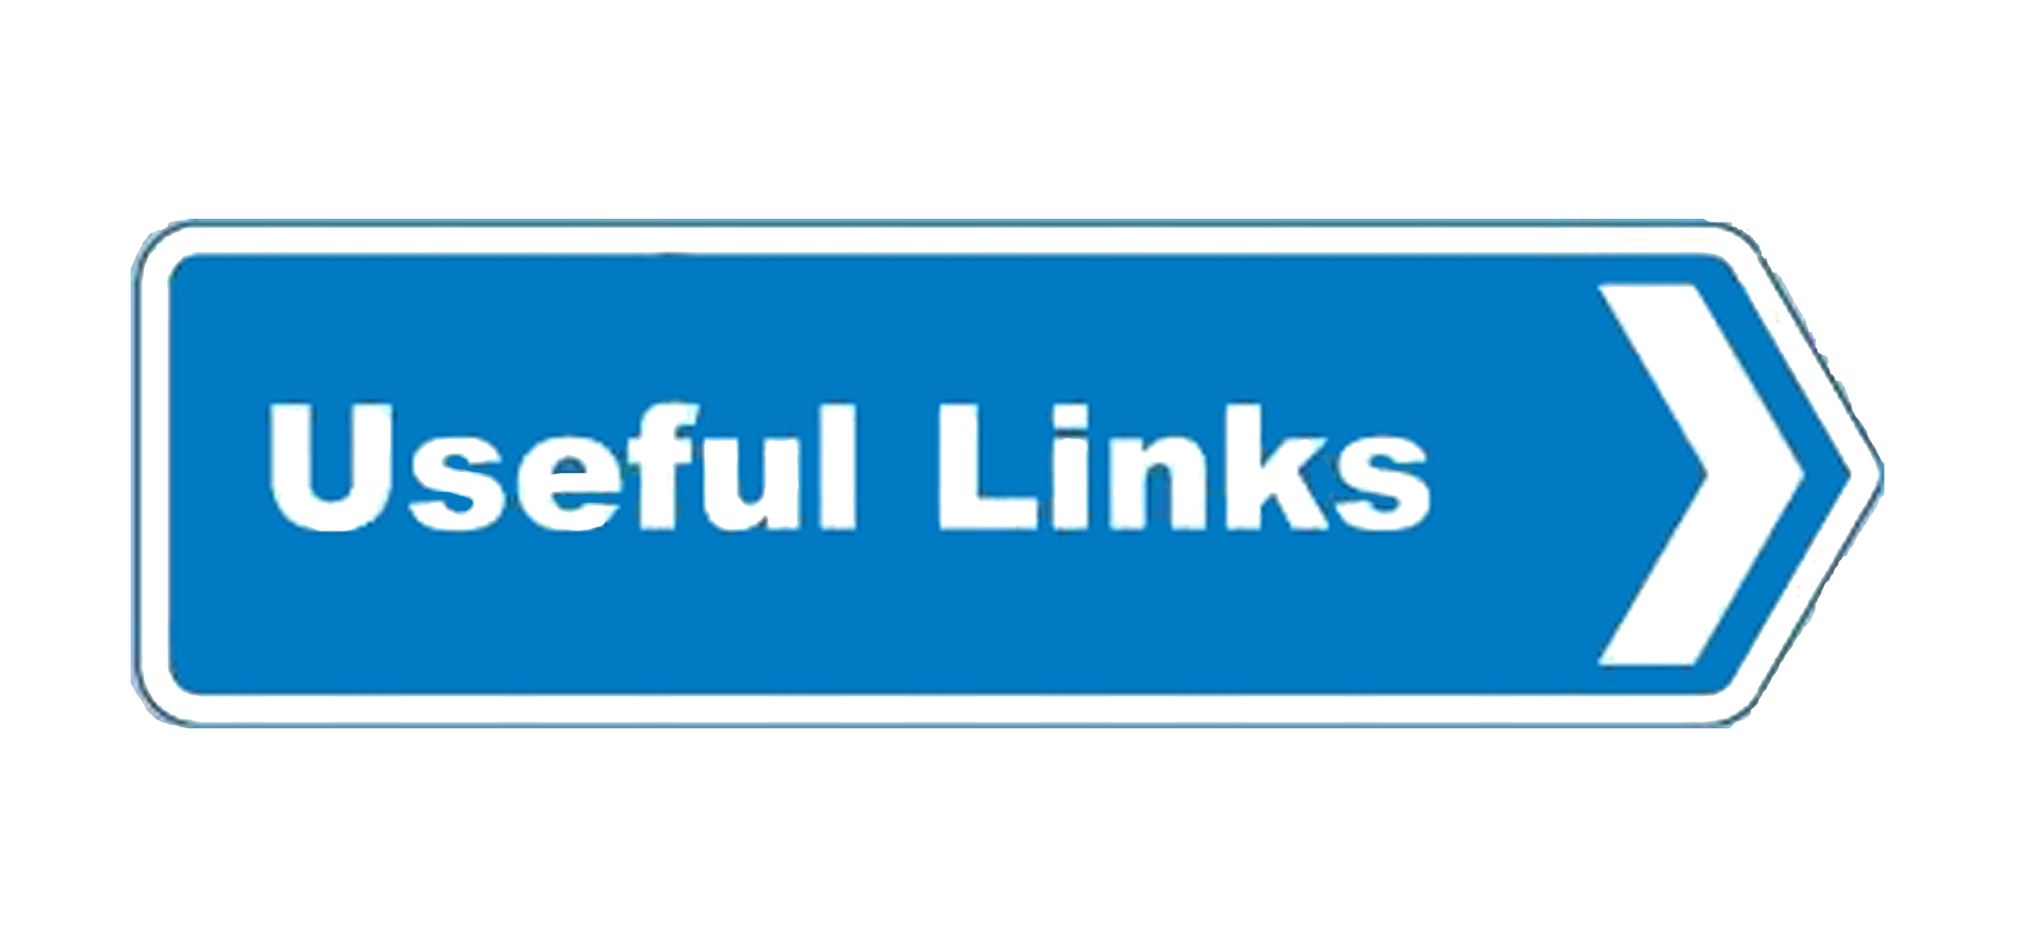
How to apply
Find an Opportunity / a Call: https://ec.europa.eu/info/funding-tenders/funding-opportunities/find-calls-funding-topic_en
Find Partner(s) (for Grants): https://ec.europa.eu/info/funding-tenders/opportunities/portal/screen/how-to-participate/partner-search
Create your Account: https://webgate.ec.europa.eu/cas/eim/external/register.cgi
Register your Organization: https://ec.europa.eu/info/funding-tenders/opportunities/portal/screen/how-to-participate/participant-register
Submit a Proposal: Select your topic and go to the Submission Service section of the topic page. Make sure that you select the correct type of action before you start drafting a proposal. The link to the submission system is available, if the status of the call is 'open'. A login with your EU Login account is required.
M

Slide 45
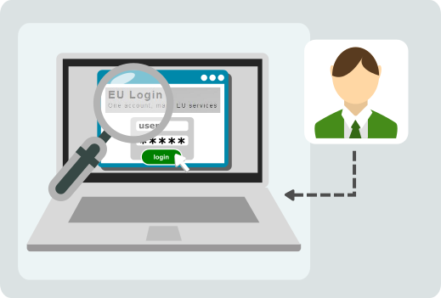
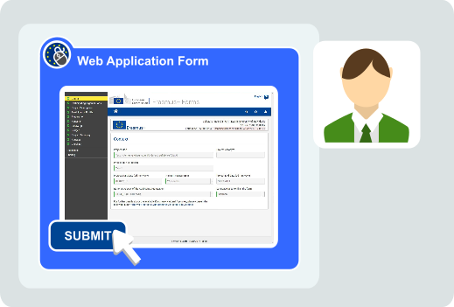
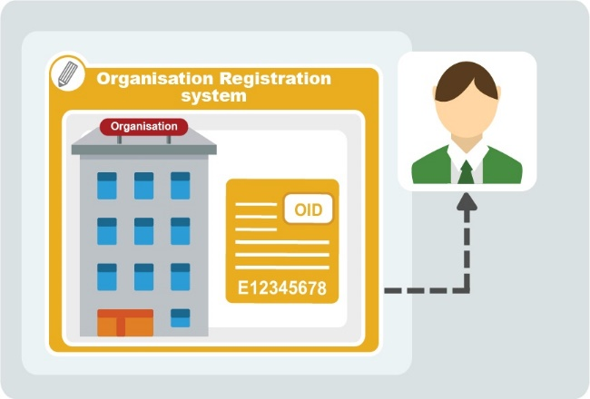
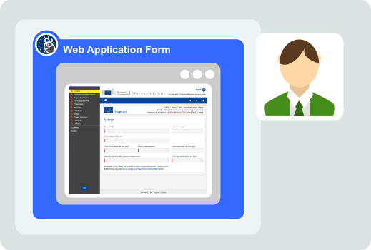
How to apply
1. EU login (access parameters are as for former ECAS)
2. PIC number
3. Selection of call and Aplication Form
4. Submit proposal
M

Slide 46
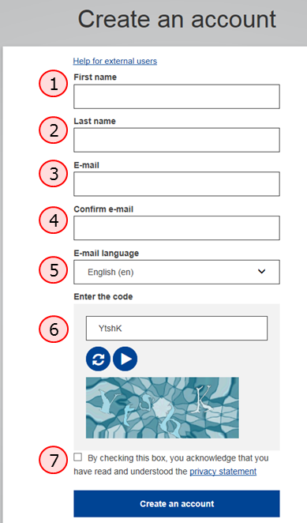
How to apply
1. EU login
https://webgate.ec.europa.eu/fpfis/wikis/display/NAITDOC/EU+Login+-+European+Commission+Authentication+Service
https://webgate.ec.europa.eu/cas/eim/external/register.cgi
M

Slide 47
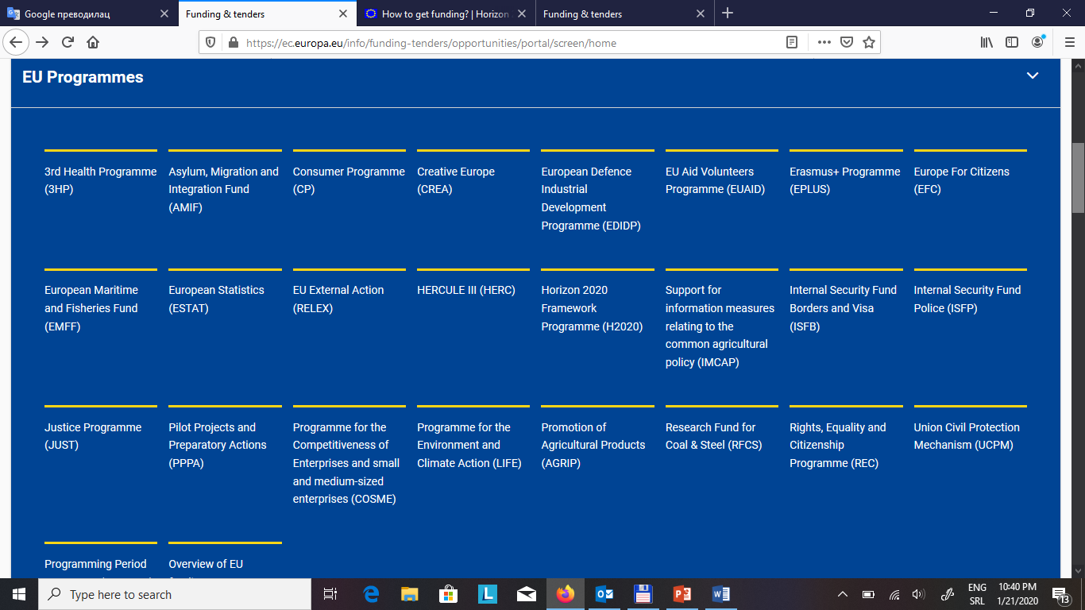
How to apply
Find an Opportunity / a Call: https://ec.europa.eu/info/funding-tenders/funding-opportunities/find-calls-funding-topic_en
M

Slide 48
How to apply
Find an Opportunity / a Call: https://eacea.ec.europa.eu/documents/eforms_en
ERASMUS KA203 CBHE – application to EACEA
M

Slide 49
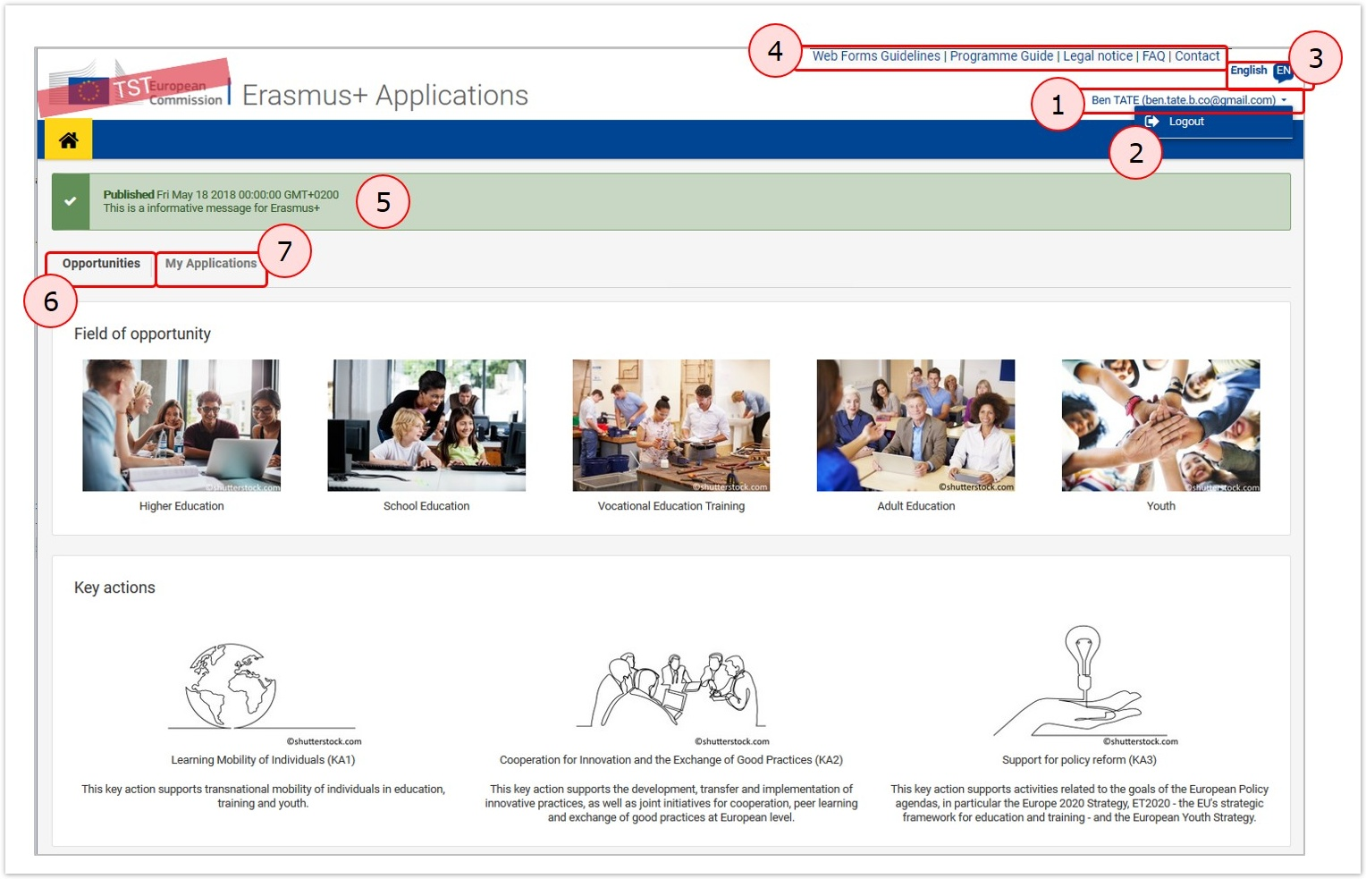
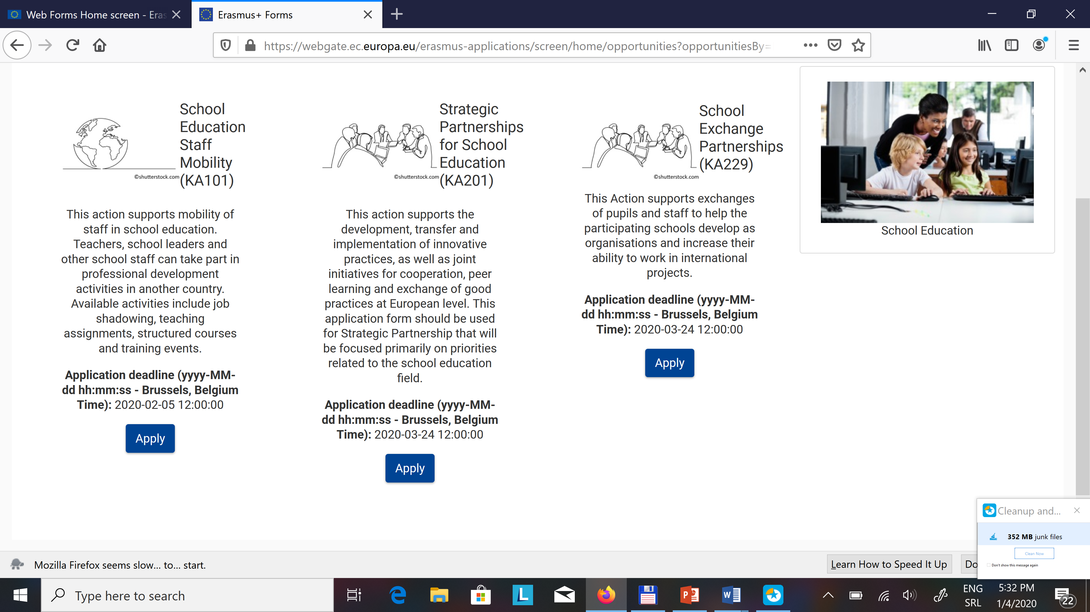
How to apply
Find an Opportunity / a Call: https://webgate.ec.europa.eu/erasmus-applications/screen/home ERASMUS – Application to NEO (decentralized calls) (e.g. Strategic partnerships …)
M

Slide 50
Instructions
Funding opportunities under programmes are set out in annual /multiannual «Work Programmes» , which cover the large majority of support available (e.g. Horizon 2020, Erasmus etc.).
Annual Work Programmes for Grants identify the grants that are planned to be awarded during the year/s, notably through Calls for proposals.
Each thematic section is self-contained, and describes the overall objectives, the respective calls for proposals, and the topics within each call.
It comprises an introduction, sections and the general annexes describing general rules such as:
standard admissibility conditions and eligibility criteria,
selection and award criteria, etc.
Notes:
The European Union is a unique institution where Member States voluntarily cede national sovereignty in many areas to carry out common policies and governance in order to gain strength and the benefits from cooperation.
Single market: The Single Market refers to the EU as one territory without any internal borders or other regulatory obstacles to the free movement of goods and services. A functioning Single Market stimulates competition and trade, improves efficiency, raises quality, and helps cut prices. The European Single Market is one of the EU’s greatest achievements. It has fuelled economic growth and made the everyday life of European businesses and consumers easier. (SM of goods, SM of services, Digital SM, etc.)
Euro: The euro is the most tangible proof of European integration – the common currency in 19 out of 28 EU countries and used by some 338.6 million people every day. The euro was launched on 1 January 1999. Banknotes and coins were introduced on 1 January 2002. The benefits of the common currency are immediately obvious to anyone travelling abroad or shopping online on websites based in another EU country.
6 countries non-EU use the euro: Vatican, San Marino, Monaco, Andorra, Montenegro and Kosovo.
Schengen area: 26 members (22 from the EU, 4 non-EU (Norway, Iceland, Switzerland and Lichtenstein). 3 microstates are de facto members because they do not have borders (Monaco, Vatican and San Marino). 2 EU MS are not in the Schengen area: UK and Ireland. 4 EU MS are working on implementing the Schengen area rules to be full members: Cyprus, Croatia, Bulgaria and Romania.
The EU has exclusive competences in:
-Customs Union
-Competition rules
-Monetary policy for the Eurozone
-Conservation of marine biology
-Concluding international agreements

Slide 51
Instructions
In case individual call for proposal refers to some specific document «Guidelines for grant applicants» and its annexes are the basis for review and reference for this specific call when applying for a grant scheme.
The grant guideline with its annexes provides information on the subject of the grant, explaining the rationale and purpose of the grant call.
This is the reference document providing basic information and guidance to the applicants such as procedure and requirements for submission.
Grant Contract Format, General Conditions, Legal Identity Form, Financial Identification Form are some of the documents in the annexes that the applicant is given.
Notes:
The European Union is a unique institution where Member States voluntarily cede national sovereignty in many areas to carry out common policies and governance in order to gain strength and the benefits from cooperation.
Single market: The Single Market refers to the EU as one territory without any internal borders or other regulatory obstacles to the free movement of goods and services. A functioning Single Market stimulates competition and trade, improves efficiency, raises quality, and helps cut prices. The European Single Market is one of the EU’s greatest achievements. It has fuelled economic growth and made the everyday life of European businesses and consumers easier. (SM of goods, SM of services, Digital SM, etc.)
Euro: The euro is the most tangible proof of European integration – the common currency in 19 out of 28 EU countries and used by some 338.6 million people every day. The euro was launched on 1 January 1999. Banknotes and coins were introduced on 1 January 2002. The benefits of the common currency are immediately obvious to anyone travelling abroad or shopping online on websites based in another EU country.
6 countries non-EU use the euro: Vatican, San Marino, Monaco, Andorra, Montenegro and Kosovo.
Schengen area: 26 members (22 from the EU, 4 non-EU (Norway, Iceland, Switzerland and Lichtenstein). 3 microstates are de facto members because they do not have borders (Monaco, Vatican and San Marino). 2 EU MS are not in the Schengen area: UK and Ireland. 4 EU MS are working on implementing the Schengen area rules to be full members: Cyprus, Croatia, Bulgaria and Romania.
The EU has exclusive competences in:
-Customs Union
-Competition rules
-Monetary policy for the Eurozone
-Conservation of marine biology
-Concluding international agreements

Slide 52
A grant guideline usually includes:
The current status of the grant scheme, the reason that the grant scheme was opened, and what problems are required to be solved through the projects
Objectives of the specific programme and priority areas
Upper and lower limits of the amount and rates of financial assistance to be provided under the Programme
Eligibility requirements for Applicants (Leaders) and Partners
Implementation period of the grant projects
Project types and activities to be supported together with the activities not supported
In which countries, regions and provinces the projects can be implemented
Which costs are eligible for the projects to be implemented
How and where the application should be made,
What documents should be submitted
Evaluation Procedure for applications
Notes:
The European Union is a unique institution where Member States voluntarily cede national sovereignty in many areas to carry out common policies and governance in order to gain strength and the benefits from cooperation.
Single market: The Single Market refers to the EU as one territory without any internal borders or other regulatory obstacles to the free movement of goods and services. A functioning Single Market stimulates competition and trade, improves efficiency, raises quality, and helps cut prices. The European Single Market is one of the EU’s greatest achievements. It has fuelled economic growth and made the everyday life of European businesses and consumers easier. (SM of goods, SM of services, Digital SM, etc.)
Euro: The euro is the most tangible proof of European integration – the common currency in 19 out of 28 EU countries and used by some 338.6 million people every day. The euro was launched on 1 January 1999. Banknotes and coins were introduced on 1 January 2002. The benefits of the common currency are immediately obvious to anyone travelling abroad or shopping online on websites based in another EU country.
6 countries non-EU use the euro: Vatican, San Marino, Monaco, Andorra, Montenegro and Kosovo.
Schengen area: 26 members (22 from the EU, 4 non-EU (Norway, Iceland, Switzerland and Lichtenstein). 3 microstates are de facto members because they do not have borders (Monaco, Vatican and San Marino). 2 EU MS are not in the Schengen area: UK and Ireland. 4 EU MS are working on implementing the Schengen area rules to be full members: Cyprus, Croatia, Bulgaria and Romania.
The EU has exclusive competences in:
-Customs Union
-Competition rules
-Monetary policy for the Eurozone
-Conservation of marine biology
-Concluding international agreements

Slide 53

The Work Programmes and Grant Guidelines should be reviewed to determine whether the project idea is appropriate for the grant scheme and, if appropriate, the project idea is transformed into a project draft.
In case of non-existence of Project idea, they would be the source of information for developing Project idea.
Notes:
The European Union is a unique institution where Member States voluntarily cede national sovereignty in many areas to carry out common policies and governance in order to gain strength and the benefits from cooperation.
Single market: The Single Market refers to the EU as one territory without any internal borders or other regulatory obstacles to the free movement of goods and services. A functioning Single Market stimulates competition and trade, improves efficiency, raises quality, and helps cut prices. The European Single Market is one of the EU’s greatest achievements. It has fuelled economic growth and made the everyday life of European businesses and consumers easier. (SM of goods, SM of services, Digital SM, etc.)
Euro: The euro is the most tangible proof of European integration – the common currency in 19 out of 28 EU countries and used by some 338.6 million people every day. The euro was launched on 1 January 1999. Banknotes and coins were introduced on 1 January 2002. The benefits of the common currency are immediately obvious to anyone travelling abroad or shopping online on websites based in another EU country.
6 countries non-EU use the euro: Vatican, San Marino, Monaco, Andorra, Montenegro and Kosovo.
Schengen area: 26 members (22 from the EU, 4 non-EU (Norway, Iceland, Switzerland and Lichtenstein). 3 microstates are de facto members because they do not have borders (Monaco, Vatican and San Marino). 2 EU MS are not in the Schengen area: UK and Ireland. 4 EU MS are working on implementing the Schengen area rules to be full members: Cyprus, Croatia, Bulgaria and Romania.
The EU has exclusive competences in:
-Customs Union
-Competition rules
-Monetary policy for the Eurozone
-Conservation of marine biology
-Concluding international agreements

Slide 54

Project Stages
Programmes
Priorities
Call for Proposal
Areas
Instruments
Regulations - Work Programme
Practical Guides
Checklist
Project Idea
Consortium
Proposal
M
Notes:
The European Union is a unique institution where Member States voluntarily cede national sovereignty in many areas to carry out common policies and governance in order to gain strength and the benefits from cooperation.
Single market: The Single Market refers to the EU as one territory without any internal borders or other regulatory obstacles to the free movement of goods and services. A functioning Single Market stimulates competition and trade, improves efficiency, raises quality, and helps cut prices. The European Single Market is one of the EU’s greatest achievements. It has fuelled economic growth and made the everyday life of European businesses and consumers easier. (SM of goods, SM of services, Digital SM, etc.)
Euro: The euro is the most tangible proof of European integration – the common currency in 19 out of 28 EU countries and used by some 338.6 million people every day. The euro was launched on 1 January 1999. Banknotes and coins were introduced on 1 January 2002. The benefits of the common currency are immediately obvious to anyone travelling abroad or shopping online on websites based in another EU country.
6 countries non-EU use the euro: Vatican, San Marino, Monaco, Andorra, Montenegro and Kosovo.
Schengen area: 26 members (22 from the EU, 4 non-EU (Norway, Iceland, Switzerland and Lichtenstein). 3 microstates are de facto members because they do not have borders (Monaco, Vatican and San Marino). 2 EU MS are not in the Schengen area: UK and Ireland. 4 EU MS are working on implementing the Schengen area rules to be full members: Cyprus, Croatia, Bulgaria and Romania.
The EU has exclusive competences in:
-Customs Union
-Competition rules
-Monetary policy for the Eurozone
-Conservation of marine biology
-Concluding international agreements

Slide 55
The applicant may only submit the documents of the grant scheme to which he / she applied and prepare its proposal according to these documents.
To be considered the application must:
be submitted on time - before the closing date specified in the call - through the electronic submission system
be complete – accompanied by the relevant administrative forms, proposal description and any supporting documents specified in the call
be concise - the proposal template will specify a maximum number of pages
Regardless of the type of call for proposals, the grant guideline should be read carefully in the preparation of the proposal and relevance of the project idea, activities and eligibility of the applicant/s should be checked and the steps of Project Cycle Management logic should be followed which is explained further on.
Notes:
The European Union is a unique institution where Member States voluntarily cede national sovereignty in many areas to carry out common policies and governance in order to gain strength and the benefits from cooperation.
Single market: The Single Market refers to the EU as one territory without any internal borders or other regulatory obstacles to the free movement of goods and services. A functioning Single Market stimulates competition and trade, improves efficiency, raises quality, and helps cut prices. The European Single Market is one of the EU’s greatest achievements. It has fuelled economic growth and made the everyday life of European businesses and consumers easier. (SM of goods, SM of services, Digital SM, etc.)
Euro: The euro is the most tangible proof of European integration – the common currency in 19 out of 28 EU countries and used by some 338.6 million people every day. The euro was launched on 1 January 1999. Banknotes and coins were introduced on 1 January 2002. The benefits of the common currency are immediately obvious to anyone travelling abroad or shopping online on websites based in another EU country.
6 countries non-EU use the euro: Vatican, San Marino, Monaco, Andorra, Montenegro and Kosovo.
Schengen area: 26 members (22 from the EU, 4 non-EU (Norway, Iceland, Switzerland and Lichtenstein). 3 microstates are de facto members because they do not have borders (Monaco, Vatican and San Marino). 2 EU MS are not in the Schengen area: UK and Ireland. 4 EU MS are working on implementing the Schengen area rules to be full members: Cyprus, Croatia, Bulgaria and Romania.
The EU has exclusive competences in:
-Customs Union
-Competition rules
-Monetary policy for the Eurozone
-Conservation of marine biology
-Concluding international agreements

Slide 56
The application form may differs for the each Grant Calls so that can be “restricted call for proposals” or “open call for proposals”
In “Restricted call for proposals” the preliminary proposal should be submitted at the first stage. Who have passed the pre-proposal stage are required to complete the full proposal including form, logical framework, budget and other documents requested in grant guidelines. Then the process ends with evaluation and selection.
“Open call for proposals” are taken, evaluated and selected in one step.
Depending on the technical nature of the field, the budget available and the expected number of proposals, the application procedure can involve one stage or two. Under the 1-stage procedure, you will submit a full application at the outset of the process. Under the 2-stage procedure, you must first submit an initial summary proposal. If your proposal is shortlisted, you will be invited to submit a full application in the second phase.
Notes:
The European Union is a unique institution where Member States voluntarily cede national sovereignty in many areas to carry out common policies and governance in order to gain strength and the benefits from cooperation.
Single market: The Single Market refers to the EU as one territory without any internal borders or other regulatory obstacles to the free movement of goods and services. A functioning Single Market stimulates competition and trade, improves efficiency, raises quality, and helps cut prices. The European Single Market is one of the EU’s greatest achievements. It has fuelled economic growth and made the everyday life of European businesses and consumers easier. (SM of goods, SM of services, Digital SM, etc.)
Euro: The euro is the most tangible proof of European integration – the common currency in 19 out of 28 EU countries and used by some 338.6 million people every day. The euro was launched on 1 January 1999. Banknotes and coins were introduced on 1 January 2002. The benefits of the common currency are immediately obvious to anyone travelling abroad or shopping online on websites based in another EU country.
6 countries non-EU use the euro: Vatican, San Marino, Monaco, Andorra, Montenegro and Kosovo.
Schengen area: 26 members (22 from the EU, 4 non-EU (Norway, Iceland, Switzerland and Lichtenstein). 3 microstates are de facto members because they do not have borders (Monaco, Vatican and San Marino). 2 EU MS are not in the Schengen area: UK and Ireland. 4 EU MS are working on implementing the Schengen area rules to be full members: Cyprus, Croatia, Bulgaria and Romania.
The EU has exclusive competences in:
-Customs Union
-Competition rules
-Monetary policy for the Eurozone
-Conservation of marine biology
-Concluding international agreements

Slide 57

2. Project documents preparation and submission of proposals
10:45-11:00
Goran Stojanovic

Slide 58
Overview of the Grant Mechanism
Project idea development & EC project life cycle (G.S.)
Identification of call for proposals (M.M)
Application guide (V.M.)
Project documents preparation and submission of proposal (G.S.)
Planning the implementation phase of proposal (G.S.)
Budget planning (V.M.)
Evaluation & contract signing (G.S)
Developing effective partnership (V.M.)
Lobbying, EU structure, EU budget for 2020 and beyond(M.F.)
Notes:
The European Union is a unique institution where Member States voluntarily cede national sovereignty in many areas to carry out common policies and governance in order to gain strength and the benefits from cooperation.
Single market: The Single Market refers to the EU as one territory without any internal borders or other regulatory obstacles to the free movement of goods and services. A functioning Single Market stimulates competition and trade, improves efficiency, raises quality, and helps cut prices. The European Single Market is one of the EU’s greatest achievements. It has fuelled economic growth and made the everyday life of European businesses and consumers easier. (SM of goods, SM of services, Digital SM, etc.)
Euro: The euro is the most tangible proof of European integration – the common currency in 19 out of 28 EU countries and used by some 338.6 million people every day. The euro was launched on 1 January 1999. Banknotes and coins were introduced on 1 January 2002. The benefits of the common currency are immediately obvious to anyone travelling abroad or shopping online on websites based in another EU country.
6 countries non-EU use the euro: Vatican, San Marino, Monaco, Andorra, Montenegro and Kosovo.
Schengen area: 26 members (22 from the EU, 4 non-EU (Norway, Iceland, Switzerland and Lichtenstein). 3 microstates are de facto members because they do not have borders (Monaco, Vatican and San Marino). 2 EU MS are not in the Schengen area: UK and Ireland. 4 EU MS are working on implementing the Schengen area rules to be full members: Cyprus, Croatia, Bulgaria and Romania.
The EU has exclusive competences in:
-Customs Union
-Competition rules
-Monetary policy for the Eurozone
-Conservation of marine biology
-Concluding international agreements

Slide 59
Programmes award grants to projects on the basis of competitive calls where several Project proposals are assessed and the best ones selected for approval and implementation. The programme selects those projects that are more likely to make a contribution to the results sought. Programmes assess the project contribution to the programme objectives and the operational feasibility of the proposal. Good project applications are generally the result of detailed preparation and teamwork between all partners.
Every programme has slightly different requirements for how the project proposal should be presented in the application form, and the level of detail required. Look at the application form as early as possible to see what is needed. The application form template is defined by each programme, and is usually available all year round on the programme’s website.
All the documents and templates you will need to use will be listed in the guidelines for your chosen call. Be sure to follow these guidelines closely. If you fail to do so, the Commission might disqualify your proposal as inadmissible.
The formal act to submit a proposal to the Commission via a web based application. Proposals can be modified and submitted several times as long as the call has not been closed. After call closure the submission is prohibited and proposals are locked. Eligible proposals are thereafter made available to the evaluation system. The Submission System is the tool used for sending a proposal for an open call. It is accessible via Funding & Tenders Portal, and it is often referred as SEP IT System.
Applicant may find a wealth of information including the Online Manual and numerous Reference Documents, comprehensive set of support documentation in via Funding & Tenders Portal for each programme . They should read through all these resources prior to starting your Submission process.
Notes:
The European Union is a unique institution where Member States voluntarily cede national sovereignty in many areas to carry out common policies and governance in order to gain strength and the benefits from cooperation.
Single market: The Single Market refers to the EU as one territory without any internal borders or other regulatory obstacles to the free movement of goods and services. A functioning Single Market stimulates competition and trade, improves efficiency, raises quality, and helps cut prices. The European Single Market is one of the EU’s greatest achievements. It has fuelled economic growth and made the everyday life of European businesses and consumers easier. (SM of goods, SM of services, Digital SM, etc.)
Euro: The euro is the most tangible proof of European integration – the common currency in 19 out of 28 EU countries and used by some 338.6 million people every day. The euro was launched on 1 January 1999. Banknotes and coins were introduced on 1 January 2002. The benefits of the common currency are immediately obvious to anyone travelling abroad or shopping online on websites based in another EU country.
6 countries non-EU use the euro: Vatican, San Marino, Monaco, Andorra, Montenegro and Kosovo.
Schengen area: 26 members (22 from the EU, 4 non-EU (Norway, Iceland, Switzerland and Lichtenstein). 3 microstates are de facto members because they do not have borders (Monaco, Vatican and San Marino). 2 EU MS are not in the Schengen area: UK and Ireland. 4 EU MS are working on implementing the Schengen area rules to be full members: Cyprus, Croatia, Bulgaria and Romania.
The EU has exclusive competences in:
-Customs Union
-Competition rules
-Monetary policy for the Eurozone
-Conservation of marine biology
-Concluding international agreements

Slide 60
The application form (AF) is an official document binding in similar terms as a contract would. It describes the project (objectives, results, outputs, partnership) and gives detailed information on the work plan and financial figures. The AF has to be submitted during the selection process and is assessed by the programme bodies, in order to select the projects to be funded by the programme.
Once the project has been approved, the AF becomes the reference document for the whole implementation of the project until its closure. The content of it may change to a certain extent during the implementation, but only according to the programme's project modification rules and procedures.
Most application forms are split at least into the content part of the project (explaining project strategy, context and work plan) and the finance part (showing resources needed to implement the project). In addition, programmes require information on partner organisations and several supporting documents, depending on the nature of the project.
The preparation of a good proposal should be seen as an investment in increasing the chances of an application being successful. Any potential project developer has to bear in mind that without sufficient internal resources the preparation of successful proposals is impossible.
Notes:
The European Union is a unique institution where Member States voluntarily cede national sovereignty in many areas to carry out common policies and governance in order to gain strength and the benefits from cooperation.
Single market: The Single Market refers to the EU as one territory without any internal borders or other regulatory obstacles to the free movement of goods and services. A functioning Single Market stimulates competition and trade, improves efficiency, raises quality, and helps cut prices. The European Single Market is one of the EU’s greatest achievements. It has fuelled economic growth and made the everyday life of European businesses and consumers easier. (SM of goods, SM of services, Digital SM, etc.)
Euro: The euro is the most tangible proof of European integration – the common currency in 19 out of 28 EU countries and used by some 338.6 million people every day. The euro was launched on 1 January 1999. Banknotes and coins were introduced on 1 January 2002. The benefits of the common currency are immediately obvious to anyone travelling abroad or shopping online on websites based in another EU country.
6 countries non-EU use the euro: Vatican, San Marino, Monaco, Andorra, Montenegro and Kosovo.
Schengen area: 26 members (22 from the EU, 4 non-EU (Norway, Iceland, Switzerland and Lichtenstein). 3 microstates are de facto members because they do not have borders (Monaco, Vatican and San Marino). 2 EU MS are not in the Schengen area: UK and Ireland. 4 EU MS are working on implementing the Schengen area rules to be full members: Cyprus, Croatia, Bulgaria and Romania.
The EU has exclusive competences in:
-Customs Union
-Competition rules
-Monetary policy for the Eurozone
-Conservation of marine biology
-Concluding international agreements

Slide 61
As mentioned before, In preparation for your online application submission process, you must go through the following steps:
Decide on the funding opportunity that you want to apply for. Funding Opportunities are categorized as Work Programmes, Calls, Topics and Types of Actions
Select your Partners. Most calls require a consortium of many organisations (i.e. participants). Relevant information can be found on the Funding & Tenders Portal
Register as a user in the European Commission Authentication Service (EU Login)
Your organization and your Partner organisations must register in the Participant register through the Funding & Tenders Portal and receive a Participant Identification Code (PIC)
Notes:
The European Union is a unique institution where Member States voluntarily cede national sovereignty in many areas to carry out common policies and governance in order to gain strength and the benefits from cooperation.
Single market: The Single Market refers to the EU as one territory without any internal borders or other regulatory obstacles to the free movement of goods and services. A functioning Single Market stimulates competition and trade, improves efficiency, raises quality, and helps cut prices. The European Single Market is one of the EU’s greatest achievements. It has fuelled economic growth and made the everyday life of European businesses and consumers easier. (SM of goods, SM of services, Digital SM, etc.)
Euro: The euro is the most tangible proof of European integration – the common currency in 19 out of 28 EU countries and used by some 338.6 million people every day. The euro was launched on 1 January 1999. Banknotes and coins were introduced on 1 January 2002. The benefits of the common currency are immediately obvious to anyone travelling abroad or shopping online on websites based in another EU country.
6 countries non-EU use the euro: Vatican, San Marino, Monaco, Andorra, Montenegro and Kosovo.
Schengen area: 26 members (22 from the EU, 4 non-EU (Norway, Iceland, Switzerland and Lichtenstein). 3 microstates are de facto members because they do not have borders (Monaco, Vatican and San Marino). 2 EU MS are not in the Schengen area: UK and Ireland. 4 EU MS are working on implementing the Schengen area rules to be full members: Cyprus, Croatia, Bulgaria and Romania.
The EU has exclusive competences in:
-Customs Union
-Competition rules
-Monetary policy for the Eurozone
-Conservation of marine biology
-Concluding international agreements

Slide 62
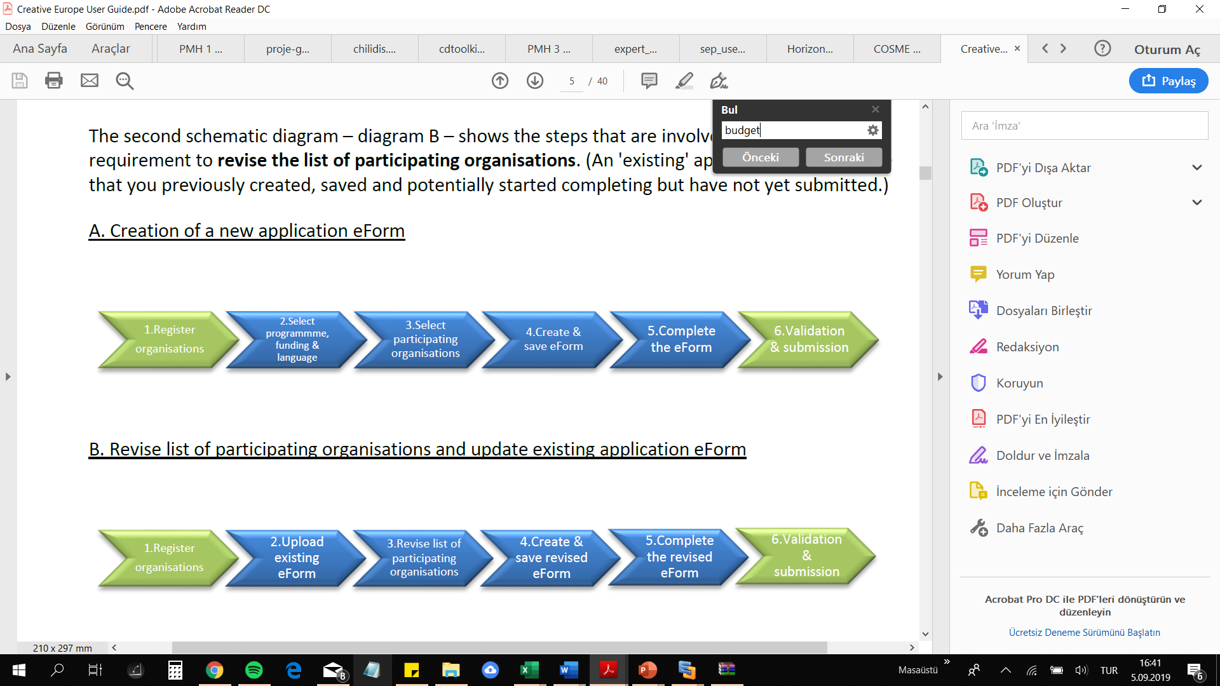
The following basic tasks summarize in the online submission process.
Login to the Funding & Tenders Portal and Select your Programme/Call/Topic
Select Programme - Create a draft for your proposal
Manage Your Related Parties (i.e. proposal consortium). Your Partners will be invited to the process by the system
Edit the proposal draft form, download templates, complete all required information. Engage the partners
Upload all parts and the rest of annex files and validate and submit your proposal
Following submission, you can re-edit, download or withdraw your proposal until closure date is reached
M
Notes:
The European Union is a unique institution where Member States voluntarily cede national sovereignty in many areas to carry out common policies and governance in order to gain strength and the benefits from cooperation.
Single market: The Single Market refers to the EU as one territory without any internal borders or other regulatory obstacles to the free movement of goods and services. A functioning Single Market stimulates competition and trade, improves efficiency, raises quality, and helps cut prices. The European Single Market is one of the EU’s greatest achievements. It has fuelled economic growth and made the everyday life of European businesses and consumers easier. (SM of goods, SM of services, Digital SM, etc.)
Euro: The euro is the most tangible proof of European integration – the common currency in 19 out of 28 EU countries and used by some 338.6 million people every day. The euro was launched on 1 January 1999. Banknotes and coins were introduced on 1 January 2002. The benefits of the common currency are immediately obvious to anyone travelling abroad or shopping online on websites based in another EU country.
6 countries non-EU use the euro: Vatican, San Marino, Monaco, Andorra, Montenegro and Kosovo.
Schengen area: 26 members (22 from the EU, 4 non-EU (Norway, Iceland, Switzerland and Lichtenstein). 3 microstates are de facto members because they do not have borders (Monaco, Vatican and San Marino). 2 EU MS are not in the Schengen area: UK and Ireland. 4 EU MS are working on implementing the Schengen area rules to be full members: Cyprus, Croatia, Bulgaria and Romania.
The EU has exclusive competences in:
-Customs Union
-Competition rules
-Monetary policy for the Eurozone
-Conservation of marine biology
-Concluding international agreements

Slide 63
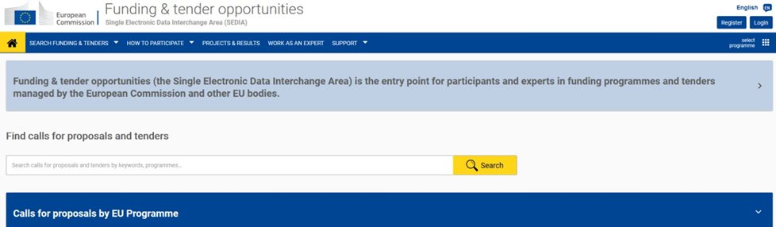
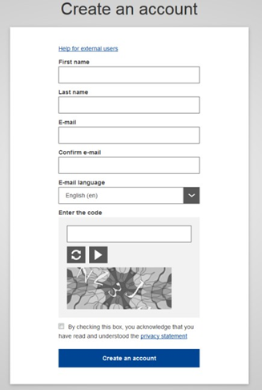
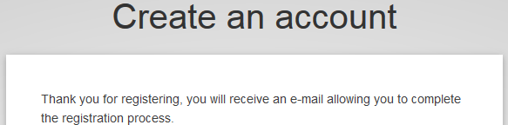
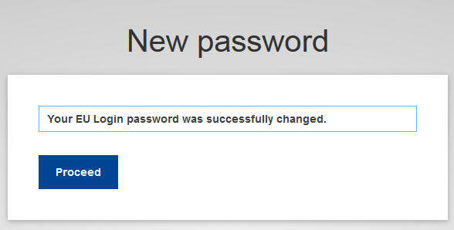
To use the Online Submission Service, you need to have a personal user
account with the EC Authentication Service (i.e. an EU Login).
1. Go to the Funding & Tenders Portal:
https://ec.europa.eu/info/funding-tenders/opportunities/portal/screen/home
2. Click Register
The EU Login – Create an Account screen will be displayed, fill in the fields accordingly. Enter all requested information. Press «Create an Account» button. The message will appear to confirm that your account has successfully been created
The system will send you a confirmation email to the email address you provided in the sign-up form. Open the email and click the activation link provided to activate your account. You have a maximum of 24h, starting from the time the message was sent, to create your password.
Enter a valid password. Click on Proceed to log in automatically to your new account, or go back to the Funding & Tenders Portal. Then click «Login»
Please refer https://ec.europa.eu/research/participants/data/support/sep_usermanual.pdf#page=75&zoom=100,0,357 for details. For H2020 programme, please make sure to fill in the H2020 and FP7 section in the Participant Register. Additionally, for actions where the SME status is an eligibility criterion (like, e.g. the SME Instrument) you must also carry out the SME self-assessment.
Notes:
The European Union is a unique institution where Member States voluntarily cede national sovereignty in many areas to carry out common policies and governance in order to gain strength and the benefits from cooperation.
Single market: The Single Market refers to the EU as one territory without any internal borders or other regulatory obstacles to the free movement of goods and services. A functioning Single Market stimulates competition and trade, improves efficiency, raises quality, and helps cut prices. The European Single Market is one of the EU’s greatest achievements. It has fuelled economic growth and made the everyday life of European businesses and consumers easier. (SM of goods, SM of services, Digital SM, etc.)
Euro: The euro is the most tangible proof of European integration – the common currency in 19 out of 28 EU countries and used by some 338.6 million people every day. The euro was launched on 1 January 1999. Banknotes and coins were introduced on 1 January 2002. The benefits of the common currency are immediately obvious to anyone travelling abroad or shopping online on websites based in another EU country.
6 countries non-EU use the euro: Vatican, San Marino, Monaco, Andorra, Montenegro and Kosovo.
Schengen area: 26 members (22 from the EU, 4 non-EU (Norway, Iceland, Switzerland and Lichtenstein). 3 microstates are de facto members because they do not have borders (Monaco, Vatican and San Marino). 2 EU MS are not in the Schengen area: UK and Ireland. 4 EU MS are working on implementing the Schengen area rules to be full members: Cyprus, Croatia, Bulgaria and Romania.
The EU has exclusive competences in:
-Customs Union
-Competition rules
-Monetary policy for the Eurozone
-Conservation of marine biology
-Concluding international agreements

Slide 64
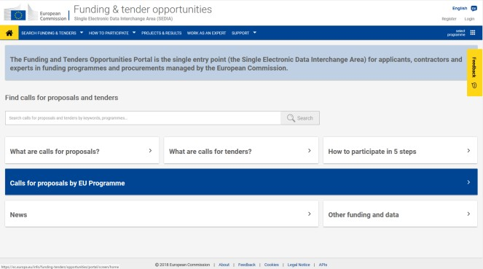
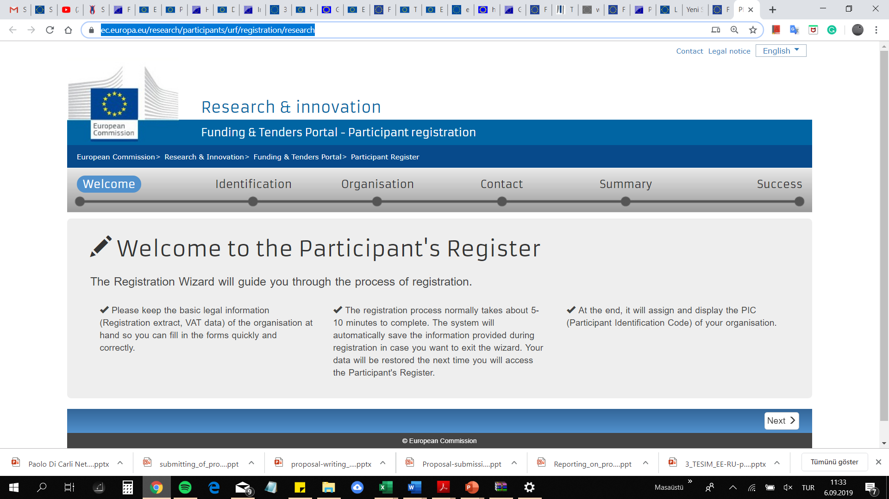
To log in:
Go to the Funding & Tenders Portal (F&T Portal) if necessary: https://ec.europa.eu/info/funding-tenders/opportunities/portal/screen/home
Register your Organization – Participant/Beneficiary Register (PIC number creation) https://ec.europa.eu/research/participants/urf/registration/research
Guidance on Registration ;https://webgate.ec.europa.eu/fpfis/wikis/pages/viewpage.action?pageId=311133198
Notes:
The European Union is a unique institution where Member States voluntarily cede national sovereignty in many areas to carry out common policies and governance in order to gain strength and the benefits from cooperation.
Single market: The Single Market refers to the EU as one territory without any internal borders or other regulatory obstacles to the free movement of goods and services. A functioning Single Market stimulates competition and trade, improves efficiency, raises quality, and helps cut prices. The European Single Market is one of the EU’s greatest achievements. It has fuelled economic growth and made the everyday life of European businesses and consumers easier. (SM of goods, SM of services, Digital SM, etc.)
Euro: The euro is the most tangible proof of European integration – the common currency in 19 out of 28 EU countries and used by some 338.6 million people every day. The euro was launched on 1 January 1999. Banknotes and coins were introduced on 1 January 2002. The benefits of the common currency are immediately obvious to anyone travelling abroad or shopping online on websites based in another EU country.
6 countries non-EU use the euro: Vatican, San Marino, Monaco, Andorra, Montenegro and Kosovo.
Schengen area: 26 members (22 from the EU, 4 non-EU (Norway, Iceland, Switzerland and Lichtenstein). 3 microstates are de facto members because they do not have borders (Monaco, Vatican and San Marino). 2 EU MS are not in the Schengen area: UK and Ireland. 4 EU MS are working on implementing the Schengen area rules to be full members: Cyprus, Croatia, Bulgaria and Romania.
The EU has exclusive competences in:
-Customs Union
-Competition rules
-Monetary policy for the Eurozone
-Conservation of marine biology
-Concluding international agreements

Slide 65
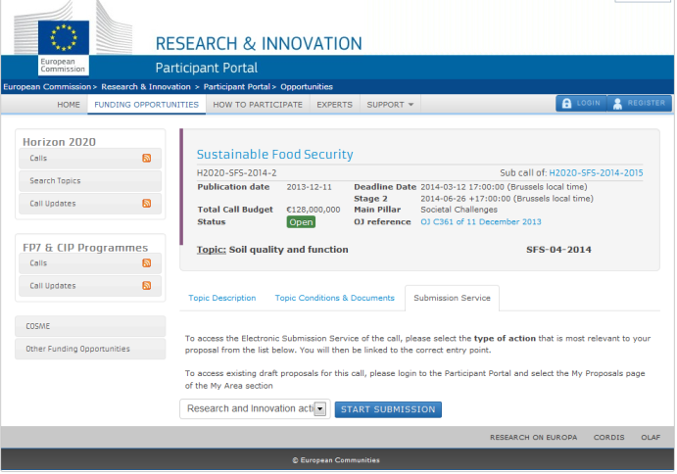
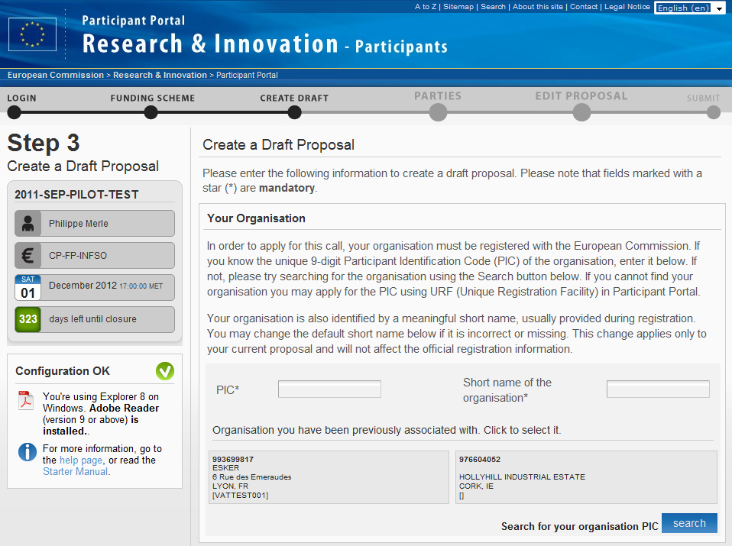
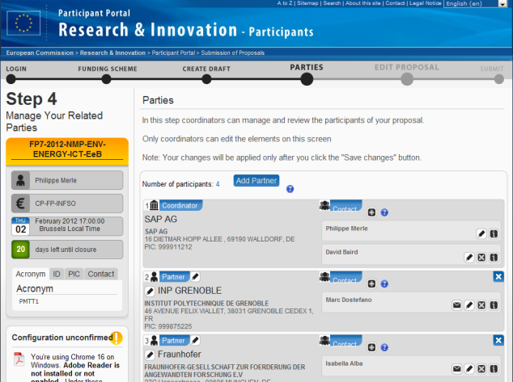
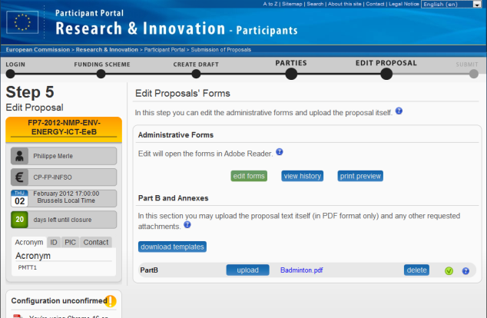
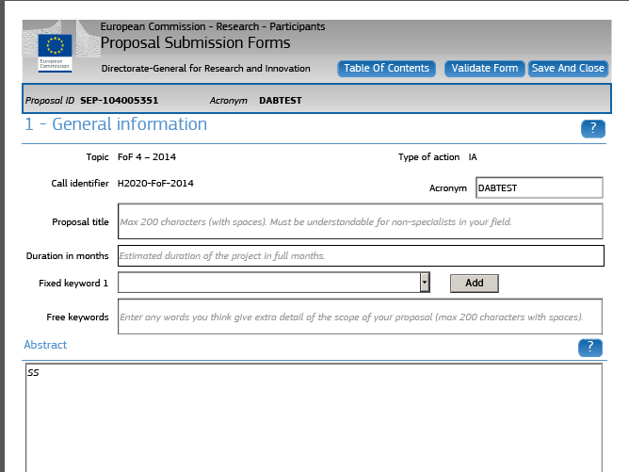
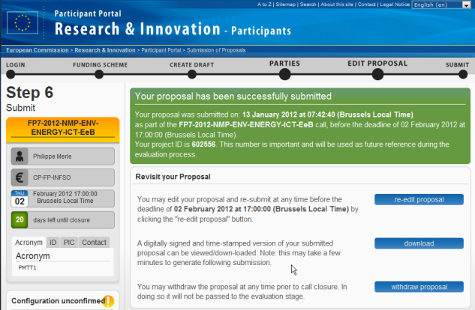
Proposal submission step-by-step
Select topic and type of action
Login
Pre-registration
Consortium set-up
Administrative form & Part B or Annexes
Form filling
Submission
Notes:
The European Union is a unique institution where Member States voluntarily cede national sovereignty in many areas to carry out common policies and governance in order to gain strength and the benefits from cooperation.
Single market: The Single Market refers to the EU as one territory without any internal borders or other regulatory obstacles to the free movement of goods and services. A functioning Single Market stimulates competition and trade, improves efficiency, raises quality, and helps cut prices. The European Single Market is one of the EU’s greatest achievements. It has fuelled economic growth and made the everyday life of European businesses and consumers easier. (SM of goods, SM of services, Digital SM, etc.)
Euro: The euro is the most tangible proof of European integration – the common currency in 19 out of 28 EU countries and used by some 338.6 million people every day. The euro was launched on 1 January 1999. Banknotes and coins were introduced on 1 January 2002. The benefits of the common currency are immediately obvious to anyone travelling abroad or shopping online on websites based in another EU country.
6 countries non-EU use the euro: Vatican, San Marino, Monaco, Andorra, Montenegro and Kosovo.
Schengen area: 26 members (22 from the EU, 4 non-EU (Norway, Iceland, Switzerland and Lichtenstein). 3 microstates are de facto members because they do not have borders (Monaco, Vatican and San Marino). 2 EU MS are not in the Schengen area: UK and Ireland. 4 EU MS are working on implementing the Schengen area rules to be full members: Cyprus, Croatia, Bulgaria and Romania.
The EU has exclusive competences in:
-Customs Union
-Competition rules
-Monetary policy for the Eurozone
-Conservation of marine biology
-Concluding international agreements

Slide 66
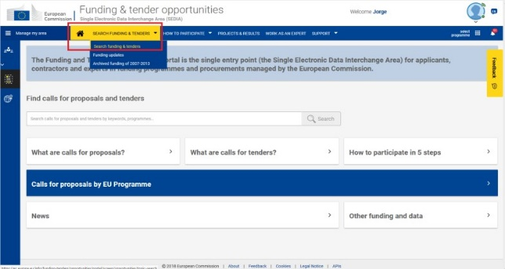
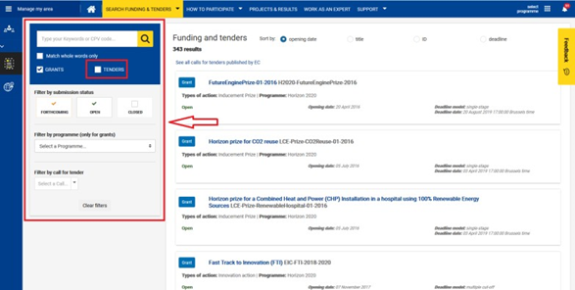
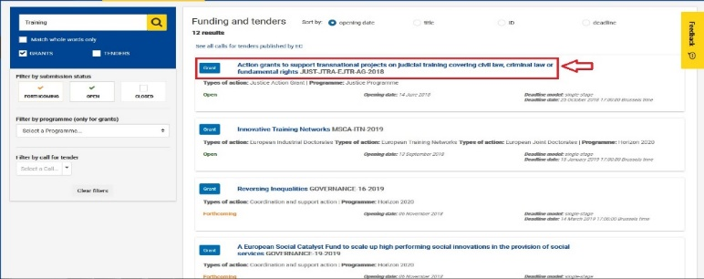
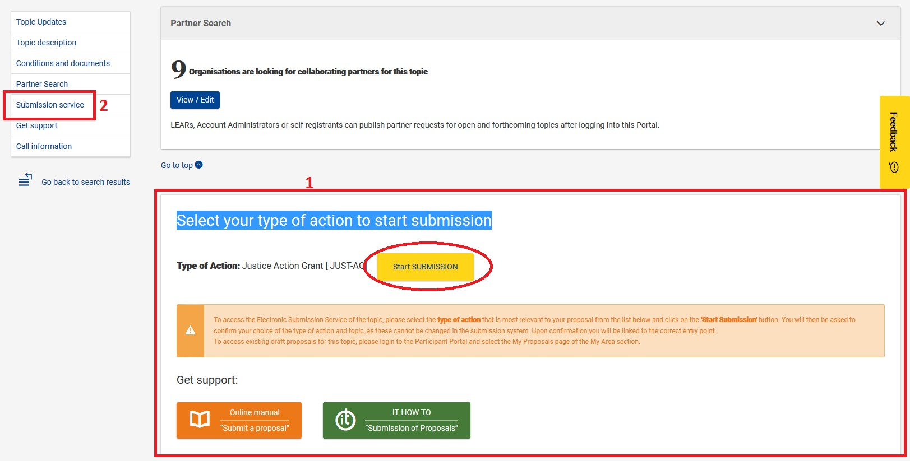
After register your organization, you will need to select the Call Topic for which you will submit your proposal. Please note that a Programme may comprise many Calls and each Call can have one or more Topics. A submitted proposal is always for one Topic.
Click on Search funding & tenders (Filters are displayed on the left side, between the elements of Manage my area and the results, which are displayed on the right side.)
Select a specific programme from the list. Click on the Topic title to access the call description page.
Either scroll down to the "Select your type of action to start submission" in the call page (1), or select Submission Service in the table of contents on the left (2). Then click on the Start Submission button next to the selected type of action.
Notes:
The European Union is a unique institution where Member States voluntarily cede national sovereignty in many areas to carry out common policies and governance in order to gain strength and the benefits from cooperation.
Single market: The Single Market refers to the EU as one territory without any internal borders or other regulatory obstacles to the free movement of goods and services. A functioning Single Market stimulates competition and trade, improves efficiency, raises quality, and helps cut prices. The European Single Market is one of the EU’s greatest achievements. It has fuelled economic growth and made the everyday life of European businesses and consumers easier. (SM of goods, SM of services, Digital SM, etc.)
Euro: The euro is the most tangible proof of European integration – the common currency in 19 out of 28 EU countries and used by some 338.6 million people every day. The euro was launched on 1 January 1999. Banknotes and coins were introduced on 1 January 2002. The benefits of the common currency are immediately obvious to anyone travelling abroad or shopping online on websites based in another EU country.
6 countries non-EU use the euro: Vatican, San Marino, Monaco, Andorra, Montenegro and Kosovo.
Schengen area: 26 members (22 from the EU, 4 non-EU (Norway, Iceland, Switzerland and Lichtenstein). 3 microstates are de facto members because they do not have borders (Monaco, Vatican and San Marino). 2 EU MS are not in the Schengen area: UK and Ireland. 4 EU MS are working on implementing the Schengen area rules to be full members: Cyprus, Croatia, Bulgaria and Romania.
The EU has exclusive competences in:
-Customs Union
-Competition rules
-Monetary policy for the Eurozone
-Conservation of marine biology
-Concluding international agreements

Slide 67
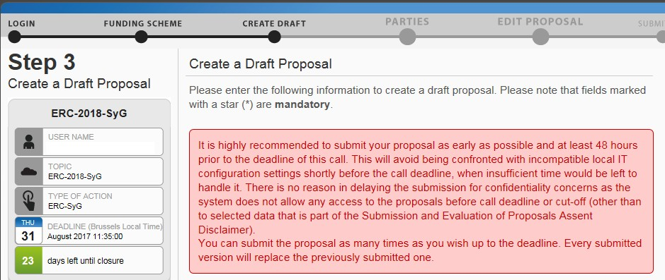
Create a Draft of your Proposal
You are now in the Online Submission Service wizard. Carry out the following steps to create your call proposal. Please note, proposals coordinators are advised to submit their proposals at least 48h before call closure.
Enter your organisation's PIC.
Select your role: Main contact or Contact person. (You would typically select the top-level role (Main contact for most calls) for the Proposal Coordinator organisation during the initial proposal draft creation. If you select the Contact person role (or another role if the call uses specific roles), make sure to add the top-level role (Main contact) in the next steps before you submit your proposal. Some calls may require more specific roles.
Fill in the Summary field and Click on Next and Accept the disclaimer
The following message confirms that your draft proposal has been created, and your draft will be given a temporary Proposal ID. You will also receive a confirmation email.
You can Proceed or postpone the action
Notes:
The European Union is a unique institution where Member States voluntarily cede national sovereignty in many areas to carry out common policies and governance in order to gain strength and the benefits from cooperation.
Single market: The Single Market refers to the EU as one territory without any internal borders or other regulatory obstacles to the free movement of goods and services. A functioning Single Market stimulates competition and trade, improves efficiency, raises quality, and helps cut prices. The European Single Market is one of the EU’s greatest achievements. It has fuelled economic growth and made the everyday life of European businesses and consumers easier. (SM of goods, SM of services, Digital SM, etc.)
Euro: The euro is the most tangible proof of European integration – the common currency in 19 out of 28 EU countries and used by some 338.6 million people every day. The euro was launched on 1 January 1999. Banknotes and coins were introduced on 1 January 2002. The benefits of the common currency are immediately obvious to anyone travelling abroad or shopping online on websites based in another EU country.
6 countries non-EU use the euro: Vatican, San Marino, Monaco, Andorra, Montenegro and Kosovo.
Schengen area: 26 members (22 from the EU, 4 non-EU (Norway, Iceland, Switzerland and Lichtenstein). 3 microstates are de facto members because they do not have borders (Monaco, Vatican and San Marino). 2 EU MS are not in the Schengen area: UK and Ireland. 4 EU MS are working on implementing the Schengen area rules to be full members: Cyprus, Croatia, Bulgaria and Romania.
The EU has exclusive competences in:
-Customs Union
-Competition rules
-Monetary policy for the Eurozone
-Conservation of marine biology
-Concluding international agreements

Slide 68
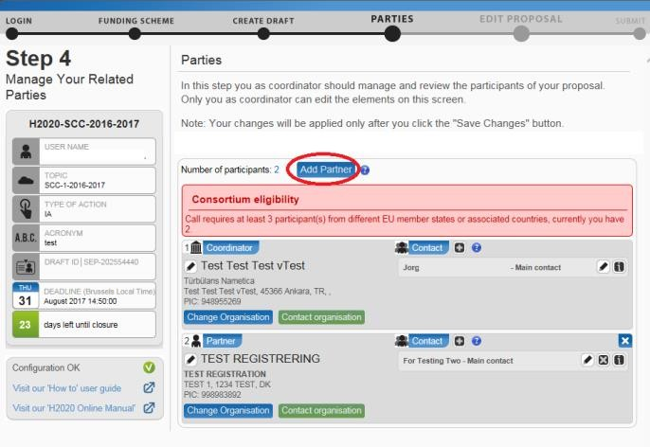
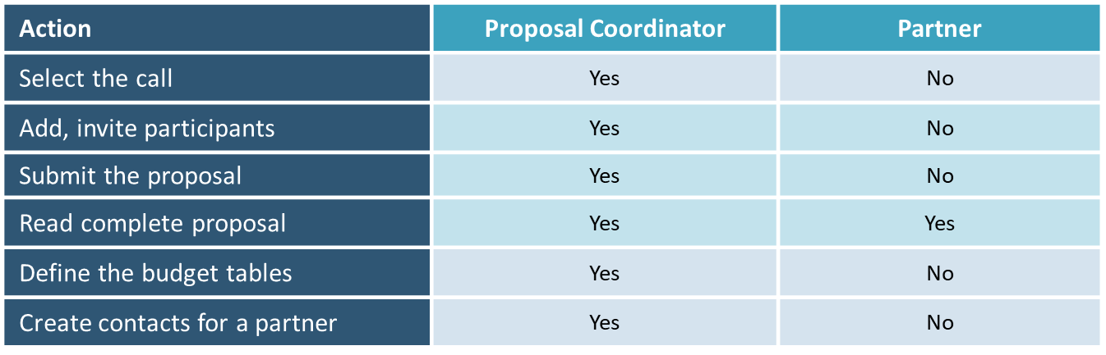
Manage Your Related Parties and/or Edit Contact Details
After creation of draft proposal you can add, remove, and manage additional partner organisations and their contact persons (roles). You can also edit the contact person's details of the main organisation.
In order to manage your related Parties, click Continue with the proposal after Step 3. You will see the Step 4 – Manage Your Related Parties screen, similar to the following one. Click on Add Partner button to add or change the partners for the proposal
The requirements for a minimum number of participants are specific for each call. A message specifying the Consortium Eligibility requirements will be displayed under the «add partner» button, if applicable.
Enter your Partner organization's name or PIC and click on search button. This will give you a list of organisations matching the term in the search field: Make sure to select an organisation with a valid PIC from the list of search results.
Find your Partner organisation and click the Use button. The Add Contact window will be displayed now. Select the appropriate project role of the Partner Contact
Select the access rights that you want to grant to your Partner contact. Only the person assigned the Main Contact role and having full access rights can submit an application. Repeat the same steps for the remaining Partner organisations.
Notes:
The European Union is a unique institution where Member States voluntarily cede national sovereignty in many areas to carry out common policies and governance in order to gain strength and the benefits from cooperation.
Single market: The Single Market refers to the EU as one territory without any internal borders or other regulatory obstacles to the free movement of goods and services. A functioning Single Market stimulates competition and trade, improves efficiency, raises quality, and helps cut prices. The European Single Market is one of the EU’s greatest achievements. It has fuelled economic growth and made the everyday life of European businesses and consumers easier. (SM of goods, SM of services, Digital SM, etc.)
Euro: The euro is the most tangible proof of European integration – the common currency in 19 out of 28 EU countries and used by some 338.6 million people every day. The euro was launched on 1 January 1999. Banknotes and coins were introduced on 1 January 2002. The benefits of the common currency are immediately obvious to anyone travelling abroad or shopping online on websites based in another EU country.
6 countries non-EU use the euro: Vatican, San Marino, Monaco, Andorra, Montenegro and Kosovo.
Schengen area: 26 members (22 from the EU, 4 non-EU (Norway, Iceland, Switzerland and Lichtenstein). 3 microstates are de facto members because they do not have borders (Monaco, Vatican and San Marino). 2 EU MS are not in the Schengen area: UK and Ireland. 4 EU MS are working on implementing the Schengen area rules to be full members: Cyprus, Croatia, Bulgaria and Romania.
The EU has exclusive competences in:
-Customs Union
-Competition rules
-Monetary policy for the Eurozone
-Conservation of marine biology
-Concluding international agreements

Slide 69
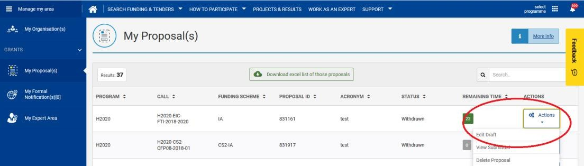
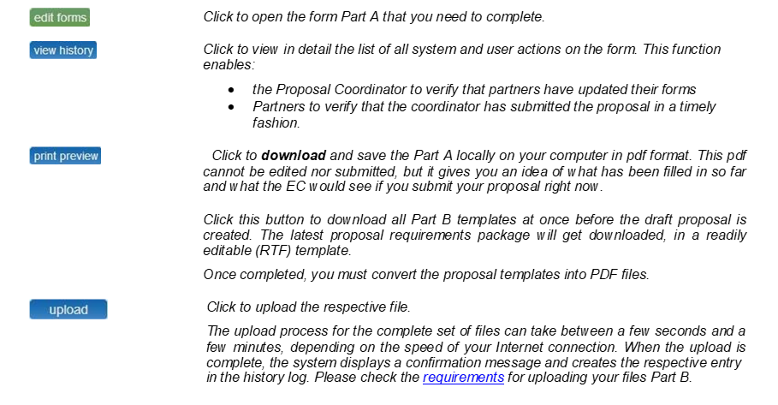
Edit and Complete Proposal Draft Form, Download Templates and Complete all Required Information, Upload Files, Validate and Submit your Proposal
This step is the core of the submission process. Click on next in the submission wizard if you just created the draft proposal, or, you can access a previously saved draft proposal form. In the Funding & Tenders Portal, click on the Actions button next to the proposal and select Edit Draft that open the Form PART A.
Notes:
The European Union is a unique institution where Member States voluntarily cede national sovereignty in many areas to carry out common policies and governance in order to gain strength and the benefits from cooperation.
Single market: The Single Market refers to the EU as one territory without any internal borders or other regulatory obstacles to the free movement of goods and services. A functioning Single Market stimulates competition and trade, improves efficiency, raises quality, and helps cut prices. The European Single Market is one of the EU’s greatest achievements. It has fuelled economic growth and made the everyday life of European businesses and consumers easier. (SM of goods, SM of services, Digital SM, etc.)
Euro: The euro is the most tangible proof of European integration – the common currency in 19 out of 28 EU countries and used by some 338.6 million people every day. The euro was launched on 1 January 1999. Banknotes and coins were introduced on 1 January 2002. The benefits of the common currency are immediately obvious to anyone travelling abroad or shopping online on websites based in another EU country.
6 countries non-EU use the euro: Vatican, San Marino, Monaco, Andorra, Montenegro and Kosovo.
Schengen area: 26 members (22 from the EU, 4 non-EU (Norway, Iceland, Switzerland and Lichtenstein). 3 microstates are de facto members because they do not have borders (Monaco, Vatican and San Marino). 2 EU MS are not in the Schengen area: UK and Ireland. 4 EU MS are working on implementing the Schengen area rules to be full members: Cyprus, Croatia, Bulgaria and Romania.
The EU has exclusive competences in:
-Customs Union
-Competition rules
-Monetary policy for the Eurozone
-Conservation of marine biology
-Concluding international agreements

Slide 70
Note that in order to complete Part A and in case of actions submitted by several applicants:
the coordinator is responsible for submitting the application
all other applicants (not subcontractors) must be registered in the Beneficiary Register and communicate the PIC to the coordinator
all other applicants must have performed a financial viability self-check via: http://ec.europa.eu/research/participants/portal/desktop/en/organisations/lfv.html
the coordinator must have the action budget per applicant
Notes:
The European Union is a unique institution where Member States voluntarily cede national sovereignty in many areas to carry out common policies and governance in order to gain strength and the benefits from cooperation.
Single market: The Single Market refers to the EU as one territory without any internal borders or other regulatory obstacles to the free movement of goods and services. A functioning Single Market stimulates competition and trade, improves efficiency, raises quality, and helps cut prices. The European Single Market is one of the EU’s greatest achievements. It has fuelled economic growth and made the everyday life of European businesses and consumers easier. (SM of goods, SM of services, Digital SM, etc.)
Euro: The euro is the most tangible proof of European integration – the common currency in 19 out of 28 EU countries and used by some 338.6 million people every day. The euro was launched on 1 January 1999. Banknotes and coins were introduced on 1 January 2002. The benefits of the common currency are immediately obvious to anyone travelling abroad or shopping online on websites based in another EU country.
6 countries non-EU use the euro: Vatican, San Marino, Monaco, Andorra, Montenegro and Kosovo.
Schengen area: 26 members (22 from the EU, 4 non-EU (Norway, Iceland, Switzerland and Lichtenstein). 3 microstates are de facto members because they do not have borders (Monaco, Vatican and San Marino). 2 EU MS are not in the Schengen area: UK and Ireland. 4 EU MS are working on implementing the Schengen area rules to be full members: Cyprus, Croatia, Bulgaria and Romania.
The EU has exclusive competences in:
-Customs Union
-Competition rules
-Monetary policy for the Eurozone
-Conservation of marine biology
-Concluding international agreements

Slide 71





Administrative forms – PART A (Example of H2020)
General information
Participants & contacts
Budget
Ethics
Call-specific questions
How to fill in the forms; The administrative forms must be filled in for each proposal using the templates available in the submission system. Some data fields in the administrative forms are pre-filled based on the steps in the submission wizard.
Notes:
The European Union is a unique institution where Member States voluntarily cede national sovereignty in many areas to carry out common policies and governance in order to gain strength and the benefits from cooperation.
Single market: The Single Market refers to the EU as one territory without any internal borders or other regulatory obstacles to the free movement of goods and services. A functioning Single Market stimulates competition and trade, improves efficiency, raises quality, and helps cut prices. The European Single Market is one of the EU’s greatest achievements. It has fuelled economic growth and made the everyday life of European businesses and consumers easier. (SM of goods, SM of services, Digital SM, etc.)
Euro: The euro is the most tangible proof of European integration – the common currency in 19 out of 28 EU countries and used by some 338.6 million people every day. The euro was launched on 1 January 1999. Banknotes and coins were introduced on 1 January 2002. The benefits of the common currency are immediately obvious to anyone travelling abroad or shopping online on websites based in another EU country.
6 countries non-EU use the euro: Vatican, San Marino, Monaco, Andorra, Montenegro and Kosovo.
Schengen area: 26 members (22 from the EU, 4 non-EU (Norway, Iceland, Switzerland and Lichtenstein). 3 microstates are de facto members because they do not have borders (Monaco, Vatican and San Marino). 2 EU MS are not in the Schengen area: UK and Ireland. 4 EU MS are working on implementing the Schengen area rules to be full members: Cyprus, Croatia, Bulgaria and Romania.
The EU has exclusive competences in:
-Customs Union
-Competition rules
-Monetary policy for the Eurozone
-Conservation of marine biology
-Concluding international agreements

Slide 72
Application form: Part A – Administrative information; Part A comprises fields of required information, checklists and declarations to be filled and must be completed directly via the online submission tool
General Information: In this section, you should provide the acronym, proposal title, duration, free keywords as well as an abstract of your proposal in English.
Participants & contacts: The coordinator will encode the PIC code of his/her organization and of every other applicant. Part of the administrative data will be filled in automatically after encoding the PIC code.
Budget: Under this section, you must fill a budget overview table. Each row of the budget table represents the total estimated expenditure for each applicant.
Eligible costs are:
direct personnel cost (column a): only for personnel cost of the applicants
direct cost of subcontracting (column b): all invoices from the implementing bodies as well as any other subcontractors; Subcontracting costs generated by entities with a structural link with the beneficiary (contracts awarded without a profit margin – please refer to chapter 1.1.3 above) should also be included here;
other direct costs (column c): costs that applicants incur and that are not linked to personnel or subcontracting costs, including costs for travel, audit certificate, pre-financing guarantee, equipment, and costs generated in order to acquire other goods and services
indirect costs (column d): these costs are calculated by the system
Please make sure that the amount of each cost category and totals in Part A are equal to the corresponding amounts given in the individual budget analysis under Part B
Notes:
The European Union is a unique institution where Member States voluntarily cede national sovereignty in many areas to carry out common policies and governance in order to gain strength and the benefits from cooperation.
Single market: The Single Market refers to the EU as one territory without any internal borders or other regulatory obstacles to the free movement of goods and services. A functioning Single Market stimulates competition and trade, improves efficiency, raises quality, and helps cut prices. The European Single Market is one of the EU’s greatest achievements. It has fuelled economic growth and made the everyday life of European businesses and consumers easier. (SM of goods, SM of services, Digital SM, etc.)
Euro: The euro is the most tangible proof of European integration – the common currency in 19 out of 28 EU countries and used by some 338.6 million people every day. The euro was launched on 1 January 1999. Banknotes and coins were introduced on 1 January 2002. The benefits of the common currency are immediately obvious to anyone travelling abroad or shopping online on websites based in another EU country.
6 countries non-EU use the euro: Vatican, San Marino, Monaco, Andorra, Montenegro and Kosovo.
Schengen area: 26 members (22 from the EU, 4 non-EU (Norway, Iceland, Switzerland and Lichtenstein). 3 microstates are de facto members because they do not have borders (Monaco, Vatican and San Marino). 2 EU MS are not in the Schengen area: UK and Ireland. 4 EU MS are working on implementing the Schengen area rules to be full members: Cyprus, Croatia, Bulgaria and Romania.
The EU has exclusive competences in:
-Customs Union
-Competition rules
-Monetary policy for the Eurozone
-Conservation of marine biology
-Concluding international agreements

Slide 73


Edit and Complete Proposal Draft Form, Download Templates and Complete all Required Information, Upload Files, Validate and Submit your Proposal
Validation: The form has built in checks and gives error or warning messages in case fields are not completed. ease click the «validation» button to check your data. Errors and warnings will be listed at the end of the form.
Clicking the button saves your input at any moment. Please note that no data is actually saved until you perform the saving action. You can continue editing after clicking on Save.
Before closing the form, click the «save & close» button. It just saves the data and closes the form for further editing later on, but it does not mean that the proposal is submitted yet.
Notes:
The European Union is a unique institution where Member States voluntarily cede national sovereignty in many areas to carry out common policies and governance in order to gain strength and the benefits from cooperation.
Single market: The Single Market refers to the EU as one territory without any internal borders or other regulatory obstacles to the free movement of goods and services. A functioning Single Market stimulates competition and trade, improves efficiency, raises quality, and helps cut prices. The European Single Market is one of the EU’s greatest achievements. It has fuelled economic growth and made the everyday life of European businesses and consumers easier. (SM of goods, SM of services, Digital SM, etc.)
Euro: The euro is the most tangible proof of European integration – the common currency in 19 out of 28 EU countries and used by some 338.6 million people every day. The euro was launched on 1 January 1999. Banknotes and coins were introduced on 1 January 2002. The benefits of the common currency are immediately obvious to anyone travelling abroad or shopping online on websites based in another EU country.
6 countries non-EU use the euro: Vatican, San Marino, Monaco, Andorra, Montenegro and Kosovo.
Schengen area: 26 members (22 from the EU, 4 non-EU (Norway, Iceland, Switzerland and Lichtenstein). 3 microstates are de facto members because they do not have borders (Monaco, Vatican and San Marino). 2 EU MS are not in the Schengen area: UK and Ireland. 4 EU MS are working on implementing the Schengen area rules to be full members: Cyprus, Croatia, Bulgaria and Romania.
The EU has exclusive competences in:
-Customs Union
-Competition rules
-Monetary policy for the Eurozone
-Conservation of marine biology
-Concluding international agreements

Slide 74


Edit and Complete Proposal Draft Form, Download Templates and Complete all Required Information, Upload Files, Validate and Submit your Proposal
You can upload the Technical Annex and any additional documents. Click on «download Templates» to download all the latest proposal requirements templates as readily editable files. You will need to complete this package as thoroughly as possible. You may want to also check with Enterprise Europe Network and your National Contacts Point for assistance (see the Support menu of the Funding & Tenders Portal).
When you complete the annex forms, you must prepare them for uploading. Only the coordinator of the proposal can upload. All annexes must be in PDF format. The breach of certain limitations, such as document size limits, graphical resolution, could result in failure to upload. As a result you may need to amend the documents and upload them again.
To make sure that your application meets the requirements run a validation of your draft proposal. When you run a validation from the submission application via validate, you run a validation of your whole draft proposal. This includes all documents. Part A and Part B
And finally reaching Step 6 means that your proposal has been successfully submitted and therefore sent to the European Commission services for evaluation.
Notes:
The European Union is a unique institution where Member States voluntarily cede national sovereignty in many areas to carry out common policies and governance in order to gain strength and the benefits from cooperation.
Single market: The Single Market refers to the EU as one territory without any internal borders or other regulatory obstacles to the free movement of goods and services. A functioning Single Market stimulates competition and trade, improves efficiency, raises quality, and helps cut prices. The European Single Market is one of the EU’s greatest achievements. It has fuelled economic growth and made the everyday life of European businesses and consumers easier. (SM of goods, SM of services, Digital SM, etc.)
Euro: The euro is the most tangible proof of European integration – the common currency in 19 out of 28 EU countries and used by some 338.6 million people every day. The euro was launched on 1 January 1999. Banknotes and coins were introduced on 1 January 2002. The benefits of the common currency are immediately obvious to anyone travelling abroad or shopping online on websites based in another EU country.
6 countries non-EU use the euro: Vatican, San Marino, Monaco, Andorra, Montenegro and Kosovo.
Schengen area: 26 members (22 from the EU, 4 non-EU (Norway, Iceland, Switzerland and Lichtenstein). 3 microstates are de facto members because they do not have borders (Monaco, Vatican and San Marino). 2 EU MS are not in the Schengen area: UK and Ireland. 4 EU MS are working on implementing the Schengen area rules to be full members: Cyprus, Croatia, Bulgaria and Romania.
The EU has exclusive competences in:
-Customs Union
-Competition rules
-Monetary policy for the Eurozone
-Conservation of marine biology
-Concluding international agreements

Slide 75

Administrative Forms (PART A) and Technical Annexes (Part B) may vary from programme to programme.
H2020 (subject to given examples in this presentation) the most elaborative programme in the sense of documentation requested
Notes:
The European Union is a unique institution where Member States voluntarily cede national sovereignty in many areas to carry out common policies and governance in order to gain strength and the benefits from cooperation.
Single market: The Single Market refers to the EU as one territory without any internal borders or other regulatory obstacles to the free movement of goods and services. A functioning Single Market stimulates competition and trade, improves efficiency, raises quality, and helps cut prices. The European Single Market is one of the EU’s greatest achievements. It has fuelled economic growth and made the everyday life of European businesses and consumers easier. (SM of goods, SM of services, Digital SM, etc.)
Euro: The euro is the most tangible proof of European integration – the common currency in 19 out of 28 EU countries and used by some 338.6 million people every day. The euro was launched on 1 January 1999. Banknotes and coins were introduced on 1 January 2002. The benefits of the common currency are immediately obvious to anyone travelling abroad or shopping online on websites based in another EU country.
6 countries non-EU use the euro: Vatican, San Marino, Monaco, Andorra, Montenegro and Kosovo.
Schengen area: 26 members (22 from the EU, 4 non-EU (Norway, Iceland, Switzerland and Lichtenstein). 3 microstates are de facto members because they do not have borders (Monaco, Vatican and San Marino). 2 EU MS are not in the Schengen area: UK and Ireland. 4 EU MS are working on implementing the Schengen area rules to be full members: Cyprus, Croatia, Bulgaria and Romania.
The EU has exclusive competences in:
-Customs Union
-Competition rules
-Monetary policy for the Eurozone
-Conservation of marine biology
-Concluding international agreements

Slide 76

11:00-11:15

Slide 77

3. Planning the Implementation Phase of Proposal
Work Plan Preparation, Management Structure, Consortium and Resources to be Committed
11:15-12:45
Goran Stojanovic

Slide 78
Overview of the Grant Mechanism
Project idea development & EC project life cycle (G.S.)
Identification of call for proposals (M.M)
Application guide (V.M.)
Project documents preparation and submission of proposal (G.S.)
Planning the implementation phase of proposal (G.S.)
Budget planning (V.M.)
Evaluation & contract signing (G.S)
Developing effective partnership (V.M.)
Lobbying, EU structure, EU budget for 2020 and beyond (M.F.)
Notes:
The European Union is a unique institution where Member States voluntarily cede national sovereignty in many areas to carry out common policies and governance in order to gain strength and the benefits from cooperation.
Single market: The Single Market refers to the EU as one territory without any internal borders or other regulatory obstacles to the free movement of goods and services. A functioning Single Market stimulates competition and trade, improves efficiency, raises quality, and helps cut prices. The European Single Market is one of the EU’s greatest achievements. It has fuelled economic growth and made the everyday life of European businesses and consumers easier. (SM of goods, SM of services, Digital SM, etc.)
Euro: The euro is the most tangible proof of European integration – the common currency in 19 out of 28 EU countries and used by some 338.6 million people every day. The euro was launched on 1 January 1999. Banknotes and coins were introduced on 1 January 2002. The benefits of the common currency are immediately obvious to anyone travelling abroad or shopping online on websites based in another EU country.
6 countries non-EU use the euro: Vatican, San Marino, Monaco, Andorra, Montenegro and Kosovo.
Schengen area: 26 members (22 from the EU, 4 non-EU (Norway, Iceland, Switzerland and Lichtenstein). 3 microstates are de facto members because they do not have borders (Monaco, Vatican and San Marino). 2 EU MS are not in the Schengen area: UK and Ireland. 4 EU MS are working on implementing the Schengen area rules to be full members: Cyprus, Croatia, Bulgaria and Romania.
The EU has exclusive competences in:
-Customs Union
-Competition rules
-Monetary policy for the Eurozone
-Conservation of marine biology
-Concluding international agreements

Slide 79

Application form: Part B - Technical content: Part B concerns the technical content of the proposal. To facilitate its preparation, applicants should use the standard template provided in Annex II of this guide and follow the specific instructions given in this chapter. It is important to fill in all pre-defined sections and to address questions mentioned in the present document; they are meant to guide the applicants in the preparation of a proposal and cover all important aspects of a proposal. This will enable the independent experts to make an effective assessment against the award criteria.

Slide 80
1. Excellence 1.1 Objectives: Describe the specific objectives for your action, which should be clear, measurable, realistic and achievable. Objectives should be consistent with the expected exploitation and impact of the action (see section 2. Impact) and with the innovation strategy of the partners of the consortium; Explain the industrial/economic/social challenges and the market opportunity you address; Objectives should be SMART: Specific: objectives must be precise in order to be understood clearly Measurable: it should be possible to measure the progress towards the achievement of the objectives based on a pre-defined set of quantifiable indicators Achievable: objectives must be attainable with the resources allocated, and within the duration of the planned action Results-focused: the goals should measure outcomes, not activities Time-bound: objectives must have a clear time-frame, a deadline by which they are to be achieved. 1.2 Relation to the work programme: Indicate why your proposal would fit under the section European Innovation Council pilot of the Work Programme. 1.3 Concept and methodology (a) Concept Explain the overall concept underpinning your proposal. Describe the main ideas, models or assumptions. Highlight trans-disciplinary considerations and the methodology that you intend to follow. Set out your activities; Specify the starting point and the level of maturity of your proposal by positioning it in the spectrum from ‘idea to application’, or from ‘lab to market’; Show the European dimension of your proposal and how it will add value to Europe. (b) Methodology: Explain how your proposal will lead to market take-up and what will be required to achieve that; Where relevant, describe how sex and/or gender issues are taken into account. 1.4 Ambition: Describe your proposal’s innovation potential / the advance it would provide beyond the state-of-the-art, and the extent it is ambitious / a game-changer. You could refer to the break-through nature of the objectives, the concepts, issues and problems to be addressed, and the approaches and methods you will use. Where relevant, compare with to products and services already available on the market. Please refer to the results of any patent search carried out.
Technical Annexes Content (Example of H2020)

Slide 81
1.1 Objectives
There are five Objectives (Obj.) identified in the framework of the project proposal. They comprise:
Obj1. To attract and maintain high quality human resources;
Obj2. To better use installed and create new research capacities;
Obj3. To increase skills and improve innovation performance;
Obj4. To exchange knowledge at national, WBC and international level;
Obj5. To increase the visibility (within EU and worldwide) of the ERA Chair team excellence.

Slide 82
Objectives
From technical point of view the following objectives have been identified:
to develop innovative and cost-effective disposable sensors on rigid substrate as well as on flexible substrate for detection of heavy metals concentration after floods;
to find optimal distribution of these sensors on-site and to install them in the soil and around the plants;
to develop intelligent wireless system (with high flexibility) for acquisition, processing and displaying data about the quality of soil and agricultural crops after flooding;
to develop electronic sound system for rejecting animals (especially bees) from the plants with higher concentration of heavy metals then allowed ones.
to develop electrokinetic’s system for remediation of flooded area from heavy metals.

Slide 83

Concept and methodology
…and describe here ONLY RESARCH WORK PACKAGES in the context of methods, materials, algorithms, experiments, instruments, testing, application, economic analysis, case study, etc.
Include figure of the concept of your project as well as small figure related to each research WP

Slide 84
2. Impact 2.1 Expected impacts: Please be specific, and provide only information that applies to the proposal and its objectives. Wherever possible, use quantified indicators and targets. Describe how your action will contribute; Show which user needs or challenge you have identified and how these will be met by your proposal; Describe the type of market you target (e.g. niche or high volume); Show the economic relevance of your solution, in particular for the scale-up of the industry partner(s) in the consortium (turnover, market share, employment creation, longer-term sales expectations, return on investment and profit; In the context of your proposal, elaborate on your capital investment policy for the next three years of operation; Describe any barriers/obstacles, and any framework conditions 2.2 Measures to maximize impact a) Dissemination and exploitation of results; Provide a draft ‘plan for the dissemination and exploitation of the action's results; Explain which stakeholders should be involved in the last stretch towards a successful commercial exploitation of your proposal, in addition to those already present in the consortium and/or in the validation process of the proposal; Elaborate on how you intend to position yourself in the market over time; On the basis of your expected result, elaborate on the possible further development strategy for your innovation to ensure your future competitiveness; Add any other factors of relevance related to dissemination and exploitation of results that could increase impact and explain how. b) Intellectual Property, knowledge protection and regulatory issues c) Communication activities; Describe the communication measures for promoting your work during the period of the grant. Measures should be proportionate to the scale of the activity, with clear objectives. They should be tailored to the needs of various audiences, including groups beyond your own community.
Technical Annexes Content (Example of H2020)

Slide 85

Impact - Expected impacts

Slide 86
Measures to maximize impact

Slide 87

Project web site

Slide 88



Posters

Slide 89


Videos and TV interviews
From Science to Industry – TV Vojvodina – 30 minutes story about MEDLEM project, including interviews with key personnel
TV interview about the completion of the MEDLEM project https://www.youtube.com/watch?v=1ILgZ-iarKE&feature=youtu.be

Slide 90


Billboards

Slide 91


International Festivals of Science and Education

Slide 92


Researchers’ nights

Slide 93

FABelgrade2018
MEDLEM team presented developed microfluidic chips on FABelgrade2018, a biennial regional convention dedicated to promotion of digital fabrication and fab lab concept and their application in various fields

Slide 94


Maker Fest 2018

Slide 95

Publications

Slide 96




International conferences

Slide 97


Exploitation of results - Patent
“Textile-based microfluidic chip for detection of methotrexate from sweet” - 2019

Slide 98
3. Implementation 3.1 Work plan — Work packages, deliverables and milestones; brief presentation of the overall structure of the work plan; timing of the different work packages and their components (Gantt chart or similar); detailed work description. Use ready format tables; graphical presentation of the components showing how they inter-relate (Pert chart or similar). 3.2 Management structure and procedures: Describe the organisational structure and the decision-making; Explain why the organisational structure and decision-making mechanisms are appropriate to the complexity and scale of the action; Describe, where relevant, how effective innovation management will be addressed in the management structure and work plan. 3.3 Consortium as a whole: The individual members of the consortium are described in a separate section 4. There is no need to repeat that information here; Describe the consortium. How will it match the action’s objectives? How do the members complement one another (and cover the value chain, where appropriate)? In what way does each of them contribute to the action? How will they be able to work effectively together? 3.4 Resources to be committed: Please make sure the information in this section matches the costs as stated in the budget table in section 3 of the administrative proposal forms, and the number of person/months, shown in the detailed work package descriptions. Please provide the following: Ready table showing number of person/months required; Ready table showing ‘other direct costs’ for participants
Technical Annexes Content (Example of H2020)

Slide 99
The work plan should: Reflect the methodology explained in the previous sections and translate it into concrete actions = Work Packages and Tasks 'Work package’ means a major sub-division of the proposed project. Number of work packages should be proportionate to the scale and complexity of the project Be logically distributed across work packages in terms of content and time Give enough detail in each work package description to justify the resources assigned The interaction between WPs should be clearly explained e.g. by graphical presentation (Pert chart or similar) Explaining how they inter-relate - this could include tasks, deliverables and milestone Harmonise the writing and the presentation of the different WPs
M

Slide 100
Work package No | Work Package Title | Lead Participant No | Lead Participant Short Name | Person-Months | Start Month | End month
 |  |  |  | Total person- months
List of work packages
(H2020)
Define WP leaders, resources and timing

Slide 101

Implementation - Work packages

Slide 102

Implementation - Work packages

Slide 103
Explain the subdivison in tasks and how the work/tasks
results in deliverables
Work package description
(H2020)
• Tasks: define task leaders and partners involved

Slide 104


Slide 105
Deliverables are different from milestones
‘Deliverable’ means a distinct output of the project, meaningful in terms of the project's overall objectives and constituted by a report, a document, a technical diagram, a software etc.
‘Milestones’ means control points in the project that help to chart progress:
may correspond to the completion of a key deliverable, allowing the next phase of the work to begin
they may also be needed at intermediary points so that, if problems have arisen, corrective measures can be taken
may be a critical decision point in the project where, for example, the consortium must decide which of several technologies to adopt for further development
M

Slide 106
Deliverables:
A useful output of a task to be used inside the project or outside (e.g. by stakeholders) - should not be considered as a burden for the consortium
Number of deliverables should be aligned and linked with the tasks, objectives and impacts
Timing:
deliverables should be distributed across the project timeline (not all at the end of the project)
Also linked to interactions between WPs: e.g. if WP X - task Y needs to feed in to other WP/task -> timing should be well thought of to enable this

Slide 107
Deliverable (number) | Deliverable name | Work package number | Short name of lead participant | Type | Dissemination level | Delivery date (in months)
List of Deliverables (H2020)
Select appropriate type:
- R: Document, report (excluding periodic and final reports)
- DEM: Demonstrator, pilot, prototype, plan, designs
- DEC: websites, patents filing, press and media actions, videos, …
- OTHER: software, technical diagram, …
Select appropriate dissemination level:
- PU = Public, fully open
- CO = Confidential, restricted under conditions set out in Model Grant Agreement
- CI = Classified (actions involving security-related activities)

Slide 108

List of Deliverables - example

Slide 109
Management structure, milestones and procedures
Describe the organisational structure and the decision-making including a list of milestones
Describe the Milestones
List of
Milestones
(H2020)
M

Slide 110

Implementation - Milestones

Slide 111
Management structure, milestones and procedures
Explain why the organisational structure and decision-making mechanisms are appropriate to the complexity and scale of the project.
What is assessed? - Clear and straight forward management structure (a diagram can be useful) - Role, composition, interactions of the different bodies - If there is an Advisory Body – composition (even if not definitive, and not necessarily the names of the members but the sectors/fields represented), role, and how it will be involved should be explained - Outline of the decision making rules, the conflict resolution rules even though they are going to be elaborated in the CA.

Slide 112

Implementation – 3.2 Management structure and procedures

Slide 113
Consortium as a whole (H2020)
How will it match the project’s objectives, and bring together the necessary expertise?
How do the members complement one another (and cover the value chain, where appropriate)?
In what way does each of them contribute to the project? Show that each has a valid role, and adequate resources in the project to fulfil that role.
Propose the right expertise in terms of project management, innovation management, communication/dissemination/exploitation

Slide 114

Consortium as a whole

Slide 115
Resources to be committed (H2020)
Summary of staff effort: Please indicate the number of person/months over the whole duration of the planned work, for each work package, for each participant. Identify the work-package leader for each WP by showing the relevant person-month figure in bold.
‘Other direct cost’: Please complete the table below for each participant if the sum of the costs for’ travel’, ‘equipment’, and ‘goods and services’ exceeds 15% of the personnel costs for that participant (according to the budget table in section 3 of the proposal administrative forms).
 | WPn | WPn+1 | WPn+2 | Total Person-Months per Participant
Participant Number/Short Name
ParticipantNumber/ Short Name
Participant Number/ Short Name
Total Person/Months
Participant Number/Short Name | Cost (€) | Justification
Travel
Equipment
Other goods and services
Total
• Please make sure the information in this section matches the costs as stated in the budget table in section 3 of the administrative proposal forms (Part A), and the number of person months, shown in the detailed work package descriptions. • Consider planning sufficient resources for: - Project management - Data management - Dissemination/exploitation/communication

Slide 116
Section 4: Members of the consortium 4.1. Participants (applicants) Please provide, for each participant, the following (if available): • a description of the legal entity and its main tasks, with an explanation of how its profile matches the tasks in the proposal • a curriculum vitae or description of the profile of the persons, including their gender, who will be primarily responsible for carrying out the proposed research and/or innovation activities • a list of up to 5 relevant publications, and/or products, services (including widely-used datasets or software), or other achievements relevant to the call content • a description of any significant infrastructure and/or any major items of technical equipment, relevant to the proposed work •if operational capacity cannot be demonstrated at the time of submitting the proposal, describe the concrete measures that will be taken to obtain it by the time of the implementation of the task 4.2. Third parties involved in the project (including use of third party resources); Please complete, for each participant, ready table (or simply state "No third parties involved", if applicable)

Slide 117


Slide 118
Section 5: Ethics and Security 5.1 Ethics If you have entered any ethics issues in the ethical issue table in the administrative proposal forms, you must: a) submit an ethics self-assessment, which describes how the proposal meets the national legal and ethical requirements of the country or countries where the tasks raising ethical issues are to be carried out; explains in detail how you intend to address the issues in the ethical issues table, in particular as regards: research objectives, research methodology , the potential impact of the research b) provide the documents that you need under national law(if you already have them), e.g.: an ethics committee opinion; the document notifying activities raising ethical issues or authorising such activities 5.2 Security Please indicate if your project will involve: activities or results raising security issues: (YES/NO), 'EU-classified information' as background or results: (YES/NO)
Technical Annexes Content (Example of H2020)

Slide 119
Multiple entities can be involved in the implementation of an action and each of them has a different role and responsibility:
The coordinator is notably the entity responsible for the following tasks:
Submit the proposal on behalf of all the proposing organisations involved
Monitor that the action is implemented properly
Act as the intermediary for all communications between the beneficiaries and the Competent National Authority, unless specified otherwise
Request from the co-applicants/co-beneficiaries and review any documents or information required by the Competent National Authority and verify their completeness and correctness before passing them on
Submit the deliverables and reports during the action implementation to the Competent National Authority
Ensure that all payments are made to co-beneficiaries in due time
Inform the Competent National Authority of the amounts paid to each co-beneficiary, when required
M
Notes:
The European Union is a unique institution where Member States voluntarily cede national sovereignty in many areas to carry out common policies and governance in order to gain strength and the benefits from cooperation.
Single market: The Single Market refers to the EU as one territory without any internal borders or other regulatory obstacles to the free movement of goods and services. A functioning Single Market stimulates competition and trade, improves efficiency, raises quality, and helps cut prices. The European Single Market is one of the EU’s greatest achievements. It has fuelled economic growth and made the everyday life of European businesses and consumers easier. (SM of goods, SM of services, Digital SM, etc.)
Euro: The euro is the most tangible proof of European integration – the common currency in 19 out of 28 EU countries and used by some 338.6 million people every day. The euro was launched on 1 January 1999. Banknotes and coins were introduced on 1 January 2002. The benefits of the common currency are immediately obvious to anyone travelling abroad or shopping online on websites based in another EU country.
6 countries non-EU use the euro: Vatican, San Marino, Monaco, Andorra, Montenegro and Kosovo.
Schengen area: 26 members (22 from the EU, 4 non-EU (Norway, Iceland, Switzerland and Lichtenstein). 3 microstates are de facto members because they do not have borders (Monaco, Vatican and San Marino). 2 EU MS are not in the Schengen area: UK and Ireland. 4 EU MS are working on implementing the Schengen area rules to be full members: Cyprus, Croatia, Bulgaria and Romania.
The EU has exclusive competences in:
-Customs Union
-Competition rules
-Monetary policy for the Eurozone
-Conservation of marine biology
-Concluding international agreements

Slide 120
Other beneficiaries/applicants are notably responsible for the following tasks:
Keep information stored in the Beneficiary Register (in the electronic exchange system) up to date
Inform the coordinator immediately of any events or circumstances likely to affect significantly or delay the implementation of the action
Submit to the coordinator in good time:
Individual financial statements and, if required, certificates on the financial statements
The data needed to draw up the reports
Any other document(s) or information required by the National Competent Authority, the Agency or the Commission, unless it requires the beneficiary to submit this information directly to the National Competent Authority, the Agency or the Commission
M
Notes:
The European Union is a unique institution where Member States voluntarily cede national sovereignty in many areas to carry out common policies and governance in order to gain strength and the benefits from cooperation.
Single market: The Single Market refers to the EU as one territory without any internal borders or other regulatory obstacles to the free movement of goods and services. A functioning Single Market stimulates competition and trade, improves efficiency, raises quality, and helps cut prices. The European Single Market is one of the EU’s greatest achievements. It has fuelled economic growth and made the everyday life of European businesses and consumers easier. (SM of goods, SM of services, Digital SM, etc.)
Euro: The euro is the most tangible proof of European integration – the common currency in 19 out of 28 EU countries and used by some 338.6 million people every day. The euro was launched on 1 January 1999. Banknotes and coins were introduced on 1 January 2002. The benefits of the common currency are immediately obvious to anyone travelling abroad or shopping online on websites based in another EU country.
6 countries non-EU use the euro: Vatican, San Marino, Monaco, Andorra, Montenegro and Kosovo.
Schengen area: 26 members (22 from the EU, 4 non-EU (Norway, Iceland, Switzerland and Lichtenstein). 3 microstates are de facto members because they do not have borders (Monaco, Vatican and San Marino). 2 EU MS are not in the Schengen area: UK and Ireland. 4 EU MS are working on implementing the Schengen area rules to be full members: Cyprus, Croatia, Bulgaria and Romania.
The EU has exclusive competences in:
-Customs Union
-Competition rules
-Monetary policy for the Eurozone
-Conservation of marine biology
-Concluding international agreements

Slide 121
Subcontractor(s)
They are not parties to the grant agreement and do not have a contractual relationship with the Competent National Authorities
Implementing bodies mentioned in Art. 13 of Regulation 1144/2014 are considered as subcontractors
They must be selected ensuring the best value for money or, if appropriate, the lowest price as well as absence of conflict of interest. Applicants/Beneficiaries considered as "bodies governed by public law" should follow National legislation on public procurement that transposes Directive 2004/118/EC or 2014/24/EU
Subcontracts may be directly awarded to entities that have a structural link with the beneficiary (e.g. legal or capital link), but only if the price offered to the beneficiary is limited to the actual costs incurred by the entity providing the service (i.e. without any profit margin)
M
Notes:
The European Union is a unique institution where Member States voluntarily cede national sovereignty in many areas to carry out common policies and governance in order to gain strength and the benefits from cooperation.
Single market: The Single Market refers to the EU as one territory without any internal borders or other regulatory obstacles to the free movement of goods and services. A functioning Single Market stimulates competition and trade, improves efficiency, raises quality, and helps cut prices. The European Single Market is one of the EU’s greatest achievements. It has fuelled economic growth and made the everyday life of European businesses and consumers easier. (SM of goods, SM of services, Digital SM, etc.)
Euro: The euro is the most tangible proof of European integration – the common currency in 19 out of 28 EU countries and used by some 338.6 million people every day. The euro was launched on 1 January 1999. Banknotes and coins were introduced on 1 January 2002. The benefits of the common currency are immediately obvious to anyone travelling abroad or shopping online on websites based in another EU country.
6 countries non-EU use the euro: Vatican, San Marino, Monaco, Andorra, Montenegro and Kosovo.
Schengen area: 26 members (22 from the EU, 4 non-EU (Norway, Iceland, Switzerland and Lichtenstein). 3 microstates are de facto members because they do not have borders (Monaco, Vatican and San Marino). 2 EU MS are not in the Schengen area: UK and Ireland. 4 EU MS are working on implementing the Schengen area rules to be full members: Cyprus, Croatia, Bulgaria and Romania.
The EU has exclusive competences in:
-Customs Union
-Competition rules
-Monetary policy for the Eurozone
-Conservation of marine biology
-Concluding international agreements

Slide 122
Proposal Submission User Guides
https://ec.europa.eu/research/participants/docs/h2020-funding-guide/grants/applying-for-funding/submit-proposals_en.htm Online H2020
https://ec.europa.eu/research/participants/data/ref/other_eu_prog/cosme/guide/call/cosme-call-proposal-tour-15_en.pdf COSME Programme
https://eacea.ec.europa.eu/sites/eacea-site/files/userguides/eform_user_guide_version_media_ag_2018.pdf CREATIVE EUROPE Programme
M
Notes:
The European Union is a unique institution where Member States voluntarily cede national sovereignty in many areas to carry out common policies and governance in order to gain strength and the benefits from cooperation.
Single market: The Single Market refers to the EU as one territory without any internal borders or other regulatory obstacles to the free movement of goods and services. A functioning Single Market stimulates competition and trade, improves efficiency, raises quality, and helps cut prices. The European Single Market is one of the EU’s greatest achievements. It has fuelled economic growth and made the everyday life of European businesses and consumers easier. (SM of goods, SM of services, Digital SM, etc.)
Euro: The euro is the most tangible proof of European integration – the common currency in 19 out of 28 EU countries and used by some 338.6 million people every day. The euro was launched on 1 January 1999. Banknotes and coins were introduced on 1 January 2002. The benefits of the common currency are immediately obvious to anyone travelling abroad or shopping online on websites based in another EU country.
6 countries non-EU use the euro: Vatican, San Marino, Monaco, Andorra, Montenegro and Kosovo.
Schengen area: 26 members (22 from the EU, 4 non-EU (Norway, Iceland, Switzerland and Lichtenstein). 3 microstates are de facto members because they do not have borders (Monaco, Vatican and San Marino). 2 EU MS are not in the Schengen area: UK and Ireland. 4 EU MS are working on implementing the Schengen area rules to be full members: Cyprus, Croatia, Bulgaria and Romania.
The EU has exclusive competences in:
-Customs Union
-Competition rules
-Monetary policy for the Eurozone
-Conservation of marine biology
-Concluding international agreements

Slide 123

12:45-13:15

Slide 124

4. Budget planning
13:15-14:30
Vesna Mandic

Slide 125
Overview of the Grant Mechanism
Project idea development & EC project life cycle (G.S.)
Identification of call for proposals (M.M)
Application guide (V.M.)
Project documents preparation and submission of proposal (G.S.)
Planning the implementation phase of proposal (G.S.)
Budget planning (V.M.)
Evaluation & contract signing (G.S)
Developing effective partnership (V.M.)
Lobbying, EU structure, EU budget for 2020 and beyond(M.F.)
Notes:
The European Union is a unique institution where Member States voluntarily cede national sovereignty in many areas to carry out common policies and governance in order to gain strength and the benefits from cooperation.
Single market: The Single Market refers to the EU as one territory without any internal borders or other regulatory obstacles to the free movement of goods and services. A functioning Single Market stimulates competition and trade, improves efficiency, raises quality, and helps cut prices. The European Single Market is one of the EU’s greatest achievements. It has fuelled economic growth and made the everyday life of European businesses and consumers easier. (SM of goods, SM of services, Digital SM, etc.)
Euro: The euro is the most tangible proof of European integration – the common currency in 19 out of 28 EU countries and used by some 338.6 million people every day. The euro was launched on 1 January 1999. Banknotes and coins were introduced on 1 January 2002. The benefits of the common currency are immediately obvious to anyone travelling abroad or shopping online on websites based in another EU country.
6 countries non-EU use the euro: Vatican, San Marino, Monaco, Andorra, Montenegro and Kosovo.
Schengen area: 26 members (22 from the EU, 4 non-EU (Norway, Iceland, Switzerland and Lichtenstein). 3 microstates are de facto members because they do not have borders (Monaco, Vatican and San Marino). 2 EU MS are not in the Schengen area: UK and Ireland. 4 EU MS are working on implementing the Schengen area rules to be full members: Cyprus, Croatia, Bulgaria and Romania.
The EU has exclusive competences in:
-Customs Union
-Competition rules
-Monetary policy for the Eurozone
-Conservation of marine biology
-Concluding international agreements

Slide 126
Grant applications must include a detailed estimated budget presented in Euro
The budget estimate must be properly balanced: the two totals (income and expenditure) must be the same, since the available income (including the grant requested from the Commission) will have to finance the planned expenditure
Expenditure must include the estimated costs exclusively for the implementation of the action
M

Slide 127
Step 1 Work plan | Step 2 Resource planning | Step 3 Cost estimating | Step 4 Allocation of costs
Who will do what and for how long? | What do you need to get the job done? | How much does each of your resources cost and what associated costs do they bring? | Organise each of the different costs you have calculated under the programme budget lines and according to the spending period or year.
Decide what you will need to do to deliver main outputs and build a group of activities (i.e., work packages) around them. The work packages need to be further broken down into activities indicating who will do the work, when and what will be delivered. | Develop an estimate of the resources (i.e., people, equipment and materials) needed to complete project activities and deliver outputs. The more concrete you are, the easier it will be to estimate the cost of each resource | The next step is to try and work out how much it will all cost. Estimate the cost for each resource. Some costs are reasonably easy to calculate. For example, you will know the number and type of staff required and the standard salary for this type of staff. Other costs are more difficult. For example, if you plan a pilot activity based on the results of initial research carried out by the project, it will be impossible to know the exact costs at the start. The best approach is to define a realistic maximum price for the activity, but be aware that different programmes have very different degrees of flexibility on this issue. | You should know the main activities, which partners will carry them out, the estimated start and end dates and the estimated resources (and therefore budget) required. The final step involves re-organising these figures to match the budget lines used by the programmes.

Slide 128
General criteria for eligibility of costs
In order to be eligible for EU funding, costs must meet the following criteria:
be incurred by the beneficiary during the duration of the action, with the exception of costs relating to final reports and audit certificates
be indicated in the estimated overall budget of the action attached to the grant agreement
be necessary for the implementation of the action which is the subject of the grant
be identifiable and verifiable, in particular being recorded in the accounting records of the beneficiary and determined according to the applicable accounting standards of the country where the beneficiary is/are established and according to the usual cost-accounting practices of the beneficiary
comply with the requirements of applicable tax and social legislation
be reasonable, justified and comply with the principle of sound financial management, in particular regarding economy and efficiency.

Slide 129

Direct personnel costs
Other direct costs
Travel
Equipment
Other goods & services
Subcontracting
Main Cost Categories
(H2020)

Slide 130
FORMS OF COSTS |  | BUDGET CATEGORIES
 |  | DIRECT COSTS |  |  |  |  |  |  |  | INDIRECT COSTS |  | SPECIFIC CATETORIES OF COSTS
 |  | Personnel |  | Subcontracting |  | Financial support to 3rd parties |  | Other
 |  | YES |  | YES |  | YES |  | YES
Actual costs
 |  | Yes for - Average personnel costs - SME owners & natural persons without a salary |  |  |  |  |  |  |  |  |  | Yes if foreseen by Comm. Decision
Unit costs
 |  |  |  |  |  |  |  |  |  | YES
Flat-rate costs
 |  |  |  |  |  |  |  |  |  |  |  | Yes if foreseen by Comm. Decision
Lump sum costs
(H2020)

Slide 131

The eligible direct costs for the action are those costs which, provided that they satisfy the criteria of eligibility set out above, are identifiable as specific costs directly linked to the performance of the action and which can therefore be attributed to it directly.
M

Slide 132
European Commission
Direct Cost
Indirect Cost
Project Cost
Project Coordinator
Partner
Partner
M

Slide 133
PM Amount
PM Rate
Personnel Cost
Direct personnel costs
Structuring the budget of Personnel Budget:
Identify the tasks to be carried out by the beneficiary
Identify the persons/ researchers suitable for implementation of these tasks
Level (manager, professor, researcher, post-doc, technician, administrative, …)
Employment status (permanent, temporary, natural persons with direct contract, SME owners, …)
Consider the start date of the project
Consider internal rules for personnel costs when participating in H2020 projects
Estimate their effort in the project (Person Months, PMs)
Identify the average monthly rate of the specific persons according to the organisation’s usual practices
Estimate Personnel costs according to the above
M

Slide 134
Types of personnel
1. Employees (both permanent staff and temporary)
2. Personnel seconded by a third party against payment
3. Natural persons working under a direct contract. The person must work under conditions similar to those of an employee (similar way of organising and supervising the work + similar presence requirements + reliable time recording )
SMEs owners not receiving a salary / natural persons participating as beneficiaries
Costs for SME owners without salary
Costs for beneficiaries that are natural persons without salary

Slide 135
Personnel costs for employees or equivalent - i.e. persons working for the beneficiary on the basis of an employment contract or equivalent appointing act (civil servants)
BASIC REMUNERATION - the payments for the employee’s normal work and participation in projects – up to what is the beneficiary’s usual remuneration practice for National projects
Cover the payment + social security contributions (mandatory employer and employee contributions) + taxes included in the remuneration (e.g. income tax)…
should be paid in accordance with national law and the employment contract/ equivalent appointing act
Must exclude arbitrary bonuses (i.e. bonuses which are not part of the beneficiary’s usual remuneration practices and/or which are not based on objective conditions)
M

Slide 136
Annual Personnel costs - structure
TOTAL REMUNERATION
Standard remuneration
Additional remuneration
Basic Salary
COMPLEMENTS
OTHER BONUS
Hourly rate
M

Slide 137
Annual productive hours - options
1 720
Fixed for full-time employees (and pro-rata for employees working part-time).
Formula: annual workable hours of the employee + overtime - absences
Annual workable hours’ - employment contract of the person concerned or
-applicable collective labour agreement or national law on working time
Individual annual productive hours
Standard annual productive hours
Generally applied by the beneficiary for its personnel, in accordance with its usual cost accounting practices
The method of calculation is consistently/ Accord. National legislation/ The number of standard annual productive hours is at least 90% of ‘standard annual workable hours’.
Can be used in all cases; any beneficiary can use this option
M

Slide 138
=
Budget calculation-personnel
Estimated annual personnel costs
= HOURLY RATE
Annual productive hours
Hourly rate
Estimated hours to the project
= STAFF COSTS
Estimated hours to the project
X 12 = EFFORT IN PM
Annual productive hours
Conversation into euro http://ec.europa.eu/budget/contracts_grants/info_contracts/inforeuro/inforeuro_en.cfm
M

Slide 139
=
ERASMUS - Budget calculation-personnel
Work Package Ref.nr | Partner nr | Partner acronym | Country | Number of staff days ☒ |  |  |  |  | Role and tasks in the work package
 |  |  |  | Category 1 | Category 2 | Category 3 | Category 4 | Total
PREPARATION | P1 | UKG | Serbia | 0 | 25 | 0 | 0 | 25 | Participation in activities: 1.1, 1.2, 1.3, 1.4, 1.5
 | P2 | UBG | Serbia | 10 | 15 | 0 | 0 | 25 | Task leader of act. 1.4, Participation in activities: 1.1, 1.2, 1.3, 1.4, 1.5
 | P3 | UNS | Serbia | 0 | 15 | 0 | 0 | 15 | Participation in activities: 1.1, 1.2, 1.3, 1.4, 1.5
 | P4 | UNI | Serbia | 0 | 15 | 0 | 0 | 15 | Participation in activities: 1.1, 1.2, 1.3, 1.4, 1.5
 | P5 | SUNP | Serbia | 20 | 15 | 0 | 0 | 35 | WP1 leader, Participation in activities: 1.1, 1.2, 1.3, 1.4, 1.5
 | P6 | TCAS | Serbia | 0 | 2 | 0 | 0 | 2 | Participation in activities: 1.1, 1.2, 1.3, 1.4, 1.5
 | P7 | UoB | United Kingdom | 0 | 20 | 0 | 0 | 20 | Participation in activities: 1.1, 1.2, 1.5
 | P8 | DUK | Austria | 0 | 18 | 0 | 0 | 18 | Participation in activities: 1.1, 1.2, 1.5
 | P9 | IST | Portugal | 10 | 23 | 0 | 0 | 33 | Task leader of act. 1.1, Participation in activities: 1.1, 1.2, 1.5
 | P10 | MEST | Serbia | 10 | 20 | 0 | 0 | 30 | Task leader of act. 1.3, Participation in activities: 1.1, 1.2, 1.3, 1.5
 | P11 | IPOS | Serbia | 0 | 20 | 0 | 0 | 20 | Participation in activities: 1.2, 1.3, 1.5
 | P12 | BICKG | Serbia | 0 | 5 | 0 | 0 | 5 | Participation in activities: 1.5
 | P13 | BITF | Serbia | 0 | 5 | 0 | 0 | 5 | Participation in activities: 1.5
 | P14 | BINS | Serbia | 0 | 5 | 0 | 0 | 5 | Participation in activities: 1.5
M

Slide 140
=
ERASMUS - Budget calculation-personnel
M

Slide 141
SUBCONTRACTING
Based on ‘business conditions’ (subcontractor charges a price, which usually includes profit)
The beneficiaries must base their subcontracts on the ‘best value for money’ – competitive selection procedures – requesting several offers)
Only limited part of the action may be subcontracted
The majority of the work done by the subcontractor(s) must be located in the EU MS or AC
Subcontracting may not cover core tasks of the action
Recourse to the award of subcontracts must be justified in relation to the nature of the action and what is necessary for its implementation;
The tasks to be subcontracted must be set out in the description of the action and the corresponding estimated costs must be set out in detail in the budget estimate
Concern implementation of project tasks described in Annex 1 and Annex 2 for H2020. If not, approval is required (perhaps amendment)
Specific rules may be set by the Authorizing Officer (EC) for subcontracts higher than 60.000 EUR
M

Slide 142
Other Direct Costs
Travel
Purchase of Goods and Services
Equipment
M

Slide 143
Other direct costs
Important points when structuring the budget of Travel costs (H2020)
Travels for Project implementation, communication and dissemination (Visits to research sites, Conferences, Info days, Events, Exhibitions, …)
Travels for Project meetings of partners (General Assembly, Steering Committee, Consortium Board, Advisory Board, WP Leaders meetings, …)
Travels for Project meetings with the EC (Project reviews)
Travels of external experts/ invited speakers
Take into account the usual practices of the beneficiary (only in H2020)
Number of Travels
Av.Travel Cost
Total Travel Cost

Slide 144

Other direct costs
Important points when structuring the budget of Travel costs (ERASMUS)

Slide 145
Other direct costs
Important points when structuring the budget of Equipment (H2020):
Equipment to be used according to the needs of the project (if any)
Reimbursed ONLY on the basis of depreciation costs (except if foreseen in the call) (in H2020)
Reimbursed ONLY for the % of actual use in the specific project
Decide:
Purchase of new equipment?
Use of existing equipment? (if eligible!)
Rent or lease equipment instead of purchasing? (if eligible!)
Equipment = asset according to national and international accounting standards. If not asset Other goods & services
Take into account internal rules for the purchase of equipment which may cause delays in the actual use (in H2020)

Slide 146
Other direct costs
Costs for other goods and services can be (H2020):
• Consumables and supplies
• Dissemination, translations and publications
• Protection of results/ IPR
• Organisation of meetings, events, workshops
• Certificates on the Financial Statements (if required)
• Certificates on the methodology
• Any other costs required for implementation
• Detailed breakdown in the proposal and periodic report

Slide 147
The total funding is the maximum amount that can be paid by the EC. It is no way a guarantee.
If the proposal is selected for a grant, the Commission will calculate the EU contribution as a percentage of the total eligible costs as shown in the estimated budget for the implementation of the action.
The Commission reserves the right to invite the applicant to correct the grant requested if the proposal is acceptable but includes ineligible costs or requires non-substantial adjustments to optimise cost-effectiveness (e.g. reduction of number of working days if these are estimated to be too high, elimination of non-essential activities, etc.).
If you spent less than planned you will receive less funding
Example: You estimated 300 000 EUR of total costs on 70% funding - this would mean 210 000 EUR from the EC. You only spent 200 000 EUR at the end of the project, so you will receive 140 000 EUR (200 000 EUR x 70%).
• The budget can be transferred between cost categories and partners during project realization on confirmation

Slide 148
Indirect costs
Indirect costs are costs that cannot be identified as specific costs directly linked to the performance of the action.
In practice, they are costs whose link to the action can NOT be, or has not be measured directly.
Indirect costs are general administrative costs – overhead costs incurred in connection with the eligible direct costs of the action.
They are limited to a flat-rate of 7% of the total eligible direct costs for the action.
These can include maintenance, stationery, photocopying, mailing postage, telephone, internet and fax costs, heating, electricity or other forms of energy, water, office furniture, insurance and any other expenditure necessary for the successful completion of the project
Indirect costs are eligible if they are declared on the basis of the flat-rate of 25% of the eligible direct costs (H2020).
25% of Total Direct costs excluding:
Subcontracting
costs of in-kind contributions incurred by 3rd parties outside the beneficiary’s premises
costs of providing financial support to 3rd parties

Slide 149
Cost categories and cost eligibility (H2020)
To be eligible costs must be:
Actually incurred by the beneficiary AND in the period of implementation
Indicated in the estimated budget
In connection with the action as described
Connected to the action and necessary
Recorded, identifiable and verifiable with the beneficiary’s accounts
Calculated according to accounting rules and the beneficiary's usual cost accounting practices
In compliance with national laws on taxes, labour and social security
Reasonable, justified , in accordance with sound financial management (not excessive, in line with good housekeeping practice)
Costs approved in proposal budget NOT automatically eligible during report/ audit:
Evaluators approve the NECESSITY for the activity and the related cost
ELIGIBILITY of the cost is determined on the basis of the procedures followed for the realisation of the cost (modalities of implementation)

Slide 150
Cost categories and cost eligibility (H2020)
Ineligible costs:
• Costs for drafting the Consortium Agreement
• Depreciation costs for equipment bought before the action’s start (if the equipment has been fully depreciated)
• Costs for preparing, submitting and negotiating the proposal
• Bank costs charged by the beneficiary’s bank for transfers from the EC
• Currency exchange losses
• Excessive or reckless expenditure
• Deductible VAT
• Costs incurred during suspension of the implementation
• Costs declared under another EU or Euratom grant

Slide 151
M
Options for all four cost forms
Actual costs (i.e. costs which are real and not estimated or budgeted) for:
personnel costs (unless declared as unit cost; see below) Example: EUR 62 500 actual yearly salary for senior researcher A
subcontracting costs - Example: The actual price paid for the subcontracting of a clinical study
costs of providing financial support to third parties (if option applies) Example: The financial support actually paid to third parties
Other direct costs (— unless declared as unit cost; see below) Example: EUR 2 000 actual price for a computer
Unit costs (i.e. an amount per unit) for:
personnel costs of SME owners/natural persons not receiving a salary
personnel costs calculated by the beneficiaries in accordance with their usual cost accounting practices (average personnel costs)
costs of internally invoiced goods and services calculated by the beneficiaries in accordance with their usual cost accounting practices
specific unit costs for: costs for energy efficiency measures in buildings, access costs for providing trans-national access to research infrastructure, access costs for providing virtual access to research infrastructure, costs for clinical studies
Flat-rate costs (i.e. costs calculated by applying a percentage fixed in advance to other types of eligible costs) for: indirect costs (25% flat-rate for indirect costs; new in Horizon 2020)
Lump sum costs (i.e. a global amount deemed to cover all costs of the action or a specific category of costs).

Slide 152
M
Options for all four cost forms
(example in ERASMUS program)

Slide 153
M
Options for all four cost forms
(example in ERASMUS program)

Slide 154
Possible actions by the EU
• Rejection of ineligible costs
• Reduction of the grant
• Recovery of undue amounts
• Administrative and financial penalties
• Suspension of payments
• Suspension of the action implementation
• Termination of the participation of the beneficiary in the grant agreement
• Termination of the grant agreement
• Extension of Findings (only during Audits)

Slide 155
Obligation to keep records and other supporting documentation
Keep records and other supporting evidence and documentation to prove proper implementation and eligibility of costs for 5 years after the payment of the balance (3 for low value grants EUR 60.000)
Digital/ electronic documents acceptable if National Legislation exists allowing it and considering them of equal validity as originals
Digital/ electronic time sheets acceptable as long as reliable according to European Commission’s specifications
No time sheets required for persons working exclusively in one project (with supporting statement by the beneficiary)
M

Slide 156
Payments will be made to the beneficiary or to the beneficiary acting as co-ordinator in the case of proposals submitted by a consortium
The payment procedures will be laid down in the grant agreement
Payment of the grant will be made in pre-financing instalments and a final payment (the balance).
The aim of the pre-financing is to provide the beneficiaries with a float.
The pre-financing remains the property of the Union until the payment of the balance.
The frequency and size of pre-financing and balance payment will in principle be as described hereafter but may be adjusted according to the risk assessment of the responsible authorising officer

Slide 157
Example: Erasmus CBHE KA203
Grant Agreement
I. Special Conditions
Payment cycle (Član I.4)
1st pre-financing: 50%
After GA signing 
After spending 70% of the first installment
60 days after Final report approval
Statement of the costs
+
Request for Payment
Progress Report
Due date:
14/10/XX – 2 years
14/04/XX – 3 years
2nd pre-financing: 40%
 half-way through the project lifetime
balance: max 10%
Financial Statement
+
Request for Payment
Final Report
Due date:
14/12/XX – 2 years
14/12/XX – 3 years
Audit Report
Required for all grants
 Max 2 months after the project ends

Slide 158

5. Evaluation of proposal & contracting
14:30-14:45
Goran Stojanovic

Slide 159
Overview of the Grant Mechanism
Project idea development & EC project life cycle (G.S.)
Identification of call for proposals (M.M.)
Application guide (V.M.)
Project documents preparation and submission of proposals (G.S.)
Planning the implementation phase of proposal (G.S.)
Budget planning (V.M.)
Evaluation & contract signing (G.S.)
Developing effective partnership (V.M.)
Lobbying, EU structure, EU budget for 2020 and beyond(M.F.)
Notes:
The European Union is a unique institution where Member States voluntarily cede national sovereignty in many areas to carry out common policies and governance in order to gain strength and the benefits from cooperation.
Single market: The Single Market refers to the EU as one territory without any internal borders or other regulatory obstacles to the free movement of goods and services. A functioning Single Market stimulates competition and trade, improves efficiency, raises quality, and helps cut prices. The European Single Market is one of the EU’s greatest achievements. It has fuelled economic growth and made the everyday life of European businesses and consumers easier. (SM of goods, SM of services, Digital SM, etc.)
Euro: The euro is the most tangible proof of European integration – the common currency in 19 out of 28 EU countries and used by some 338.6 million people every day. The euro was launched on 1 January 1999. Banknotes and coins were introduced on 1 January 2002. The benefits of the common currency are immediately obvious to anyone travelling abroad or shopping online on websites based in another EU country.
6 countries non-EU use the euro: Vatican, San Marino, Monaco, Andorra, Montenegro and Kosovo.
Schengen area: 26 members (22 from the EU, 4 non-EU (Norway, Iceland, Switzerland and Lichtenstein). 3 microstates are de facto members because they do not have borders (Monaco, Vatican and San Marino). 2 EU MS are not in the Schengen area: UK and Ireland. 4 EU MS are working on implementing the Schengen area rules to be full members: Cyprus, Croatia, Bulgaria and Romania.
The EU has exclusive competences in:
-Customs Union
-Competition rules
-Monetary policy for the Eurozone
-Conservation of marine biology
-Concluding international agreements

Slide 160
The process for assessing applications follows the following order:
receipt and registration of proposals
opening session and administrative check
evaluation of proposal
verification of eligibility
conclusions of the Evaluation
One of the most important and most useful sections of the Guidelines under any Call for Proposals is the section which explains the process of scoring a proposal. It is strongly advised that organisations should ‘test’ their own draft proposal using Evaluation Grid, before they finalize their application
M
Notes:
The European Union is a unique institution where Member States voluntarily cede national sovereignty in many areas to carry out common policies and governance in order to gain strength and the benefits from cooperation.
Single market: The Single Market refers to the EU as one territory without any internal borders or other regulatory obstacles to the free movement of goods and services. A functioning Single Market stimulates competition and trade, improves efficiency, raises quality, and helps cut prices. The European Single Market is one of the EU’s greatest achievements. It has fuelled economic growth and made the everyday life of European businesses and consumers easier. (SM of goods, SM of services, Digital SM, etc.)
Euro: The euro is the most tangible proof of European integration – the common currency in 19 out of 28 EU countries and used by some 338.6 million people every day. The euro was launched on 1 January 1999. Banknotes and coins were introduced on 1 January 2002. The benefits of the common currency are immediately obvious to anyone travelling abroad or shopping online on websites based in another EU country.
6 countries non-EU use the euro: Vatican, San Marino, Monaco, Andorra, Montenegro and Kosovo.
Schengen area: 26 members (22 from the EU, 4 non-EU (Norway, Iceland, Switzerland and Lichtenstein). 3 microstates are de facto members because they do not have borders (Monaco, Vatican and San Marino). 2 EU MS are not in the Schengen area: UK and Ireland. 4 EU MS are working on implementing the Schengen area rules to be full members: Cyprus, Croatia, Bulgaria and Romania.
The EU has exclusive competences in:
-Customs Union
-Competition rules
-Monetary policy for the Eurozone
-Conservation of marine biology
-Concluding international agreements

Slide 161

Duration of the evaluation process

Slide 162
The Commission relies on the expertise of specialists to evaluate proposals. These can be members of the Commission staff or independent specialists recruited for a specific call because of their skills, experience and knowledge in the field of the call
Proposals are evaluated against the criteria listed in the call
Different funding programmes may have different evaluation procedures. For more detail, please refer to a specific call for proposals relevant to you. The number of proposals selected will depend on the available budget
Notes:
The European Union is a unique institution where Member States voluntarily cede national sovereignty in many areas to carry out common policies and governance in order to gain strength and the benefits from cooperation.
Single market: The Single Market refers to the EU as one territory without any internal borders or other regulatory obstacles to the free movement of goods and services. A functioning Single Market stimulates competition and trade, improves efficiency, raises quality, and helps cut prices. The European Single Market is one of the EU’s greatest achievements. It has fuelled economic growth and made the everyday life of European businesses and consumers easier. (SM of goods, SM of services, Digital SM, etc.)
Euro: The euro is the most tangible proof of European integration – the common currency in 19 out of 28 EU countries and used by some 338.6 million people every day. The euro was launched on 1 January 1999. Banknotes and coins were introduced on 1 January 2002. The benefits of the common currency are immediately obvious to anyone travelling abroad or shopping online on websites based in another EU country.
6 countries non-EU use the euro: Vatican, San Marino, Monaco, Andorra, Montenegro and Kosovo.
Schengen area: 26 members (22 from the EU, 4 non-EU (Norway, Iceland, Switzerland and Lichtenstein). 3 microstates are de facto members because they do not have borders (Monaco, Vatican and San Marino). 2 EU MS are not in the Schengen area: UK and Ireland. 4 EU MS are working on implementing the Schengen area rules to be full members: Cyprus, Croatia, Bulgaria and Romania.
The EU has exclusive competences in:
-Customs Union
-Competition rules
-Monetary policy for the Eurozone
-Conservation of marine biology
-Concluding international agreements

Slide 163
Evaluation Principles
• Fair and equal treatment of all proposers
• Based on the criteria announced in the Call
• Confidential process, no conflicts of interest
• Independent external experts
Evaluation – Key Points
Excellence: Proposals must demonstrate high quality in relation to the topics and criteria set out in the calls
Transparency: Funding decisions must be based on clearly described rules and procedures, and applicants should receive adequate feedback on the outcome of the evaluation
Fairness and impartiality: All proposals submitted in response to a call are treated equally and evaluated impartially on their merits, irrespective of their origin or the identity of the applicants
Efficiency and speed: Evaluation, award and grant preparation should be done as quickly as possible without compromising quality or neglecting the rules
Ethics and security: Proposals must not contravene fundamental ethical principles or relevant security procedures
Notes:
The European Union is a unique institution where Member States voluntarily cede national sovereignty in many areas to carry out common policies and governance in order to gain strength and the benefits from cooperation.
Single market: The Single Market refers to the EU as one territory without any internal borders or other regulatory obstacles to the free movement of goods and services. A functioning Single Market stimulates competition and trade, improves efficiency, raises quality, and helps cut prices. The European Single Market is one of the EU’s greatest achievements. It has fuelled economic growth and made the everyday life of European businesses and consumers easier. (SM of goods, SM of services, Digital SM, etc.)
Euro: The euro is the most tangible proof of European integration – the common currency in 19 out of 28 EU countries and used by some 338.6 million people every day. The euro was launched on 1 January 1999. Banknotes and coins were introduced on 1 January 2002. The benefits of the common currency are immediately obvious to anyone travelling abroad or shopping online on websites based in another EU country.
6 countries non-EU use the euro: Vatican, San Marino, Monaco, Andorra, Montenegro and Kosovo.
Schengen area: 26 members (22 from the EU, 4 non-EU (Norway, Iceland, Switzerland and Lichtenstein). 3 microstates are de facto members because they do not have borders (Monaco, Vatican and San Marino). 2 EU MS are not in the Schengen area: UK and Ireland. 4 EU MS are working on implementing the Schengen area rules to be full members: Cyprus, Croatia, Bulgaria and Romania.
The EU has exclusive competences in:
-Customs Union
-Competition rules
-Monetary policy for the Eurozone
-Conservation of marine biology
-Concluding international agreements

Slide 164
Usually 8 panels for evaluation
Submitted (eligible) project proposals will normally be evaluated by one of eight 'main evaluation panels':
Chemistry (CHE),
Social Sciences and Humanities (SOC),
Economic Sciences (ECO),
Information Science and Engineering (ENG),
Environment and Geosciences (ENV),
Life Sciences (LIF),
Mathematics (MAT),
Physics (PHY).

Slide 165

Evaluation Criteria

Slide 166

Overview of the evaluation process

Slide 167

Evaluation process

Slide 168

Evaluation process

Slide 169

Scoring

Slide 170

Evaluation Summary Report

Slide 171

Evaulation Summary Report

Slide 172

Evaulation Summary Report

Slide 173
Organizations should ensure about two main capabilities:
- Financial capacity, Stable and sufficient sources of finance to ensure the continuity. ) https://ec.europa.eu/research/participants/lfv/lfvSimulation.do Financial Capacity Self Check ) - Operational capacity- Capacity to manage activities corresponding to the size of the project for which a grant is requested; capacity to complete the operation, Adequate professional qualifications and experience.
If your organisation cannot demonstrate that it does have the appropriate capacity, it will not meet the selection criteria of the Call for Proposals and therefore the application will be rejected.
Even if your organisation can demonstrate the relevant capacity, if it is not operationally ready to take on the management of a grant, it may face internal management problems which can have very negative effects on the long term future of the organisation.
M
Self Evaluation Form H2020
https://ec.europa.eu/research/participants/data/ref/h2020/
call_ptef/ef/2016-2017/h2020-call-ef-ria-ia-csa-2016-17_en.pdf
Notes:
The European Union is a unique institution where Member States voluntarily cede national sovereignty in many areas to carry out common policies and governance in order to gain strength and the benefits from cooperation.
Single market: The Single Market refers to the EU as one territory without any internal borders or other regulatory obstacles to the free movement of goods and services. A functioning Single Market stimulates competition and trade, improves efficiency, raises quality, and helps cut prices. The European Single Market is one of the EU’s greatest achievements. It has fuelled economic growth and made the everyday life of European businesses and consumers easier. (SM of goods, SM of services, Digital SM, etc.)
Euro: The euro is the most tangible proof of European integration – the common currency in 19 out of 28 EU countries and used by some 338.6 million people every day. The euro was launched on 1 January 1999. Banknotes and coins were introduced on 1 January 2002. The benefits of the common currency are immediately obvious to anyone travelling abroad or shopping online on websites based in another EU country.
6 countries non-EU use the euro: Vatican, San Marino, Monaco, Andorra, Montenegro and Kosovo.
Schengen area: 26 members (22 from the EU, 4 non-EU (Norway, Iceland, Switzerland and Lichtenstein). 3 microstates are de facto members because they do not have borders (Monaco, Vatican and San Marino). 2 EU MS are not in the Schengen area: UK and Ireland. 4 EU MS are working on implementing the Schengen area rules to be full members: Cyprus, Croatia, Bulgaria and Romania.
The EU has exclusive competences in:
-Customs Union
-Competition rules
-Monetary policy for the Eurozone
-Conservation of marine biology
-Concluding international agreements

Slide 174
Before any grant can be awarded to an organization, there will be a check of a range of supporting documents which demonstrate that the organization does indeed meet the eligibility and selection criteria.
These documents will relate to the legal status of the organization, its accounts and banking arrangements, evidence of up-to-date social security and tax payments (where relevant), and other operational documentation. Thus, your organization must ensure that it has all such documentation available.
The eligibility and selection criteria will also be applied to any partners in a grant application, thus it is essential that your partners are also well prepared and have the appropriate capacities and competences.
Notes:
The European Union is a unique institution where Member States voluntarily cede national sovereignty in many areas to carry out common policies and governance in order to gain strength and the benefits from cooperation.
Single market: The Single Market refers to the EU as one territory without any internal borders or other regulatory obstacles to the free movement of goods and services. A functioning Single Market stimulates competition and trade, improves efficiency, raises quality, and helps cut prices. The European Single Market is one of the EU’s greatest achievements. It has fuelled economic growth and made the everyday life of European businesses and consumers easier. (SM of goods, SM of services, Digital SM, etc.)
Euro: The euro is the most tangible proof of European integration – the common currency in 19 out of 28 EU countries and used by some 338.6 million people every day. The euro was launched on 1 January 1999. Banknotes and coins were introduced on 1 January 2002. The benefits of the common currency are immediately obvious to anyone travelling abroad or shopping online on websites based in another EU country.
6 countries non-EU use the euro: Vatican, San Marino, Monaco, Andorra, Montenegro and Kosovo.
Schengen area: 26 members (22 from the EU, 4 non-EU (Norway, Iceland, Switzerland and Lichtenstein). 3 microstates are de facto members because they do not have borders (Monaco, Vatican and San Marino). 2 EU MS are not in the Schengen area: UK and Ireland. 4 EU MS are working on implementing the Schengen area rules to be full members: Cyprus, Croatia, Bulgaria and Romania.
The EU has exclusive competences in:
-Customs Union
-Competition rules
-Monetary policy for the Eurozone
-Conservation of marine biology
-Concluding international agreements

Slide 175
A standard Grant Contract is made up of the following parts:
Special Conditions - which describe the specific context and parameters of the Call for Proposals, detailing the cost eligibility criteria, criteria for eligible actions, as well as the duration and location of the action, and information about the two contact parties
Annex I: Description of the Action - the project proposal as described by the completed Application Form. Although no major changes can be made to the Application Form, prior to contract signature the Contracting Authority may negotiate with the Applicant to make minor changes (for example, to account for any contextual changes due to a lapse in time between the date of application and date of award of the grant.)
Annex II: General Conditions - universal conditions set by the EU, based on PRAG
Annex III: Budget for the Action - as included in the Application, but may be modified by negotiation with the Contracting Authority prior to contract signature. The budget is a breakdown of all eligible project related costs. It is important to have a clear and easy to understand budget attached to the contract as it directly impacts on the smooth implementation of the project. It should also be remembered that the budget is only an estimate of costs and that the final disbursement will depend upon actual project outputs and their related eligible costs
Annex IV: Contract-award Procedures
Annex V: Standard ‘Request’ templates for Payment and Financial Identification Form
Annex VI: Template for Reports
Annex VII: Expenditure Verification Report.
Notes:
The European Union is a unique institution where Member States voluntarily cede national sovereignty in many areas to carry out common policies and governance in order to gain strength and the benefits from cooperation.
Single market: The Single Market refers to the EU as one territory without any internal borders or other regulatory obstacles to the free movement of goods and services. A functioning Single Market stimulates competition and trade, improves efficiency, raises quality, and helps cut prices. The European Single Market is one of the EU’s greatest achievements. It has fuelled economic growth and made the everyday life of European businesses and consumers easier. (SM of goods, SM of services, Digital SM, etc.)
Euro: The euro is the most tangible proof of European integration – the common currency in 19 out of 28 EU countries and used by some 338.6 million people every day. The euro was launched on 1 January 1999. Banknotes and coins were introduced on 1 January 2002. The benefits of the common currency are immediately obvious to anyone travelling abroad or shopping online on websites based in another EU country.
6 countries non-EU use the euro: Vatican, San Marino, Monaco, Andorra, Montenegro and Kosovo.
Schengen area: 26 members (22 from the EU, 4 non-EU (Norway, Iceland, Switzerland and Lichtenstein). 3 microstates are de facto members because they do not have borders (Monaco, Vatican and San Marino). 2 EU MS are not in the Schengen area: UK and Ireland. 4 EU MS are working on implementing the Schengen area rules to be full members: Cyprus, Croatia, Bulgaria and Romania.
The EU has exclusive competences in:
-Customs Union
-Competition rules
-Monetary policy for the Eurozone
-Conservation of marine biology
-Concluding international agreements

Slide 176
Evaluation Grid Sample
M
Notes:
The European Union is a unique institution where Member States voluntarily cede national sovereignty in many areas to carry out common policies and governance in order to gain strength and the benefits from cooperation.
Single market: The Single Market refers to the EU as one territory without any internal borders or other regulatory obstacles to the free movement of goods and services. A functioning Single Market stimulates competition and trade, improves efficiency, raises quality, and helps cut prices. The European Single Market is one of the EU’s greatest achievements. It has fuelled economic growth and made the everyday life of European businesses and consumers easier. (SM of goods, SM of services, Digital SM, etc.)
Euro: The euro is the most tangible proof of European integration – the common currency in 19 out of 28 EU countries and used by some 338.6 million people every day. The euro was launched on 1 January 1999. Banknotes and coins were introduced on 1 January 2002. The benefits of the common currency are immediately obvious to anyone travelling abroad or shopping online on websites based in another EU country.
6 countries non-EU use the euro: Vatican, San Marino, Monaco, Andorra, Montenegro and Kosovo.
Schengen area: 26 members (22 from the EU, 4 non-EU (Norway, Iceland, Switzerland and Lichtenstein). 3 microstates are de facto members because they do not have borders (Monaco, Vatican and San Marino). 2 EU MS are not in the Schengen area: UK and Ireland. 4 EU MS are working on implementing the Schengen area rules to be full members: Cyprus, Croatia, Bulgaria and Romania.
The EU has exclusive competences in:
-Customs Union
-Competition rules
-Monetary policy for the Eurozone
-Conservation of marine biology
-Concluding international agreements

Slide 177

“They didn't know it was impossible so they did it”
D

Slide 178
14:45-15:00

Slide 179

6. Developing Effective Partnership
15:00-16:15
Vesna Mandic

Slide 180
Overview of the Grant Mechanism
Project idea development & EC project life cycle
Identification of call for proposals
Application guide
Project documents preparation and submission of proposal
Planning the implementation phase of proposal
Budget planning
Evaluation & contract signing
Developing effective partnership
Notes:
The European Union is a unique institution where Member States voluntarily cede national sovereignty in many areas to carry out common policies and governance in order to gain strength and the benefits from cooperation.
Single market: The Single Market refers to the EU as one territory without any internal borders or other regulatory obstacles to the free movement of goods and services. A functioning Single Market stimulates competition and trade, improves efficiency, raises quality, and helps cut prices. The European Single Market is one of the EU’s greatest achievements. It has fuelled economic growth and made the everyday life of European businesses and consumers easier. (SM of goods, SM of services, Digital SM, etc.)
Euro: The euro is the most tangible proof of European integration – the common currency in 19 out of 28 EU countries and used by some 338.6 million people every day. The euro was launched on 1 January 1999. Banknotes and coins were introduced on 1 January 2002. The benefits of the common currency are immediately obvious to anyone travelling abroad or shopping online on websites based in another EU country.
6 countries non-EU use the euro: Vatican, San Marino, Monaco, Andorra, Montenegro and Kosovo.
Schengen area: 26 members (22 from the EU, 4 non-EU (Norway, Iceland, Switzerland and Lichtenstein). 3 microstates are de facto members because they do not have borders (Monaco, Vatican and San Marino). 2 EU MS are not in the Schengen area: UK and Ireland. 4 EU MS are working on implementing the Schengen area rules to be full members: Cyprus, Croatia, Bulgaria and Romania.
The EU has exclusive competences in:
-Customs Union
-Competition rules
-Monetary policy for the Eurozone
-Conservation of marine biology
-Concluding international agreements

Slide 181
Overview of the Grant Mechanism
Project idea development & EC project life cycle
Identification of call for proposals (M.M)
Application guide (V.M.)
Project documents preparation and submission of proposal (G.S.)
Planning the implementation phase of proposal (G.S.)
Budget planning (V.M.)
Evaluation & contract signing (G.S)
Developing effective partnership (V.M.)
Lobbying, EU structure, EU budget for 2020 and beyond(M.F.)
Notes:
The European Union is a unique institution where Member States voluntarily cede national sovereignty in many areas to carry out common policies and governance in order to gain strength and the benefits from cooperation.
Single market: The Single Market refers to the EU as one territory without any internal borders or other regulatory obstacles to the free movement of goods and services. A functioning Single Market stimulates competition and trade, improves efficiency, raises quality, and helps cut prices. The European Single Market is one of the EU’s greatest achievements. It has fuelled economic growth and made the everyday life of European businesses and consumers easier. (SM of goods, SM of services, Digital SM, etc.)
Euro: The euro is the most tangible proof of European integration – the common currency in 19 out of 28 EU countries and used by some 338.6 million people every day. The euro was launched on 1 January 1999. Banknotes and coins were introduced on 1 January 2002. The benefits of the common currency are immediately obvious to anyone travelling abroad or shopping online on websites based in another EU country.
6 countries non-EU use the euro: Vatican, San Marino, Monaco, Andorra, Montenegro and Kosovo.
Schengen area: 26 members (22 from the EU, 4 non-EU (Norway, Iceland, Switzerland and Lichtenstein). 3 microstates are de facto members because they do not have borders (Monaco, Vatican and San Marino). 2 EU MS are not in the Schengen area: UK and Ireland. 4 EU MS are working on implementing the Schengen area rules to be full members: Cyprus, Croatia, Bulgaria and Romania.
The EU has exclusive competences in:
-Customs Union
-Competition rules
-Monetary policy for the Eurozone
-Conservation of marine biology
-Concluding international agreements

Slide 182

Selecting Partner and Building a Partnership
The first success in a good partnership should be the discovery of unexpected insights, resources and knowledge within the partnership and improvements to the original Project proposal on this basis.
Strong focus should be given on the need to involve ‘the right partners’ as it is important to identify the precise needs that every project partner is hoping to address through the project, and the capacity that they bring to the partnership as a whole to help it achieve its objectives.
When developing project partnership for your project you need to consider:
the programme’s minimum requirements for project partnership (number, location eligibility…etc.)
which project partners are needed to be able to achieve project objectives and results.
Notes:
The European Union is a unique institution where Member States voluntarily cede national sovereignty in many areas to carry out common policies and governance in order to gain strength and the benefits from cooperation.
Single market: The Single Market refers to the EU as one territory without any internal borders or other regulatory obstacles to the free movement of goods and services. A functioning Single Market stimulates competition and trade, improves efficiency, raises quality, and helps cut prices. The European Single Market is one of the EU’s greatest achievements. It has fuelled economic growth and made the everyday life of European businesses and consumers easier. (SM of goods, SM of services, Digital SM, etc.)
Euro: The euro is the most tangible proof of European integration – the common currency in 19 out of 28 EU countries and used by some 338.6 million people every day. The euro was launched on 1 January 1999. Banknotes and coins were introduced on 1 January 2002. The benefits of the common currency are immediately obvious to anyone travelling abroad or shopping online on websites based in another EU country.
6 countries non-EU use the euro: Vatican, San Marino, Monaco, Andorra, Montenegro and Kosovo.
Schengen area: 26 members (22 from the EU, 4 non-EU (Norway, Iceland, Switzerland and Lichtenstein). 3 microstates are de facto members because they do not have borders (Monaco, Vatican and San Marino). 2 EU MS are not in the Schengen area: UK and Ireland. 4 EU MS are working on implementing the Schengen area rules to be full members: Cyprus, Croatia, Bulgaria and Romania.
The EU has exclusive competences in:
-Customs Union
-Competition rules
-Monetary policy for the Eurozone
-Conservation of marine biology
-Concluding international agreements

Slide 183

Building a Partnership
Tips when considering the right partnership mix:
Eligible partners:
The organisations which are eligible for funding, and these vary from programme to programme. There are rules about the type and the location of the organisation
Partnership size:
The size of partnership can impact the efficiency of project implementation, particularly in terms of reporting and financial management, where large amounts of information will need to be collected and coordinated, and delays from some partners are almost inevitable.
Example: ERASMUS CBHE KA203 projects
M
Notes:
The European Union is a unique institution where Member States voluntarily cede national sovereignty in many areas to carry out common policies and governance in order to gain strength and the benefits from cooperation.
Single market: The Single Market refers to the EU as one territory without any internal borders or other regulatory obstacles to the free movement of goods and services. A functioning Single Market stimulates competition and trade, improves efficiency, raises quality, and helps cut prices. The European Single Market is one of the EU’s greatest achievements. It has fuelled economic growth and made the everyday life of European businesses and consumers easier. (SM of goods, SM of services, Digital SM, etc.)
Euro: The euro is the most tangible proof of European integration – the common currency in 19 out of 28 EU countries and used by some 338.6 million people every day. The euro was launched on 1 January 1999. Banknotes and coins were introduced on 1 January 2002. The benefits of the common currency are immediately obvious to anyone travelling abroad or shopping online on websites based in another EU country.
6 countries non-EU use the euro: Vatican, San Marino, Monaco, Andorra, Montenegro and Kosovo.
Schengen area: 26 members (22 from the EU, 4 non-EU (Norway, Iceland, Switzerland and Lichtenstein). 3 microstates are de facto members because they do not have borders (Monaco, Vatican and San Marino). 2 EU MS are not in the Schengen area: UK and Ireland. 4 EU MS are working on implementing the Schengen area rules to be full members: Cyprus, Croatia, Bulgaria and Romania.
The EU has exclusive competences in:
-Customs Union
-Competition rules
-Monetary policy for the Eurozone
-Conservation of marine biology
-Concluding international agreements

Slide 184
Building a Partnership
Tips when considering the right partnership mix:
Partnership composition:
Project partners should have the right expertise and knowledge to contribute to the project’s development and, later, implementation of the project.
The project idea should be in line with the strategic focus of partner organisations, to ensure that partner organisations (rather than just individuals) are motivated to take an active part in project development and implementation.
Type of epertise:
Similar expertise of partners helps ensure that joint project activities can be efficiently implemented in each partner country, and that partners have a similar understanding of key issues.
Complementarity expertise of partners means that the skills of one partner match the needs of other partners. It is of course unusual to find a perfect match, but looking for complementarity between partner specialisations can be useful for ensuring successful exchange of experience between partners
M
Notes:
The European Union is a unique institution where Member States voluntarily cede national sovereignty in many areas to carry out common policies and governance in order to gain strength and the benefits from cooperation.
Single market: The Single Market refers to the EU as one territory without any internal borders or other regulatory obstacles to the free movement of goods and services. A functioning Single Market stimulates competition and trade, improves efficiency, raises quality, and helps cut prices. The European Single Market is one of the EU’s greatest achievements. It has fuelled economic growth and made the everyday life of European businesses and consumers easier. (SM of goods, SM of services, Digital SM, etc.)
Euro: The euro is the most tangible proof of European integration – the common currency in 19 out of 28 EU countries and used by some 338.6 million people every day. The euro was launched on 1 January 1999. Banknotes and coins were introduced on 1 January 2002. The benefits of the common currency are immediately obvious to anyone travelling abroad or shopping online on websites based in another EU country.
6 countries non-EU use the euro: Vatican, San Marino, Monaco, Andorra, Montenegro and Kosovo.
Schengen area: 26 members (22 from the EU, 4 non-EU (Norway, Iceland, Switzerland and Lichtenstein). 3 microstates are de facto members because they do not have borders (Monaco, Vatican and San Marino). 2 EU MS are not in the Schengen area: UK and Ireland. 4 EU MS are working on implementing the Schengen area rules to be full members: Cyprus, Croatia, Bulgaria and Romania.
The EU has exclusive competences in:
-Customs Union
-Competition rules
-Monetary policy for the Eurozone
-Conservation of marine biology
-Concluding international agreements

Slide 185

Building a Partnership
Tips when considering the right partnership mix:
Example:
www.if4tm.kg.ac.rs
M
Notes:
The European Union is a unique institution where Member States voluntarily cede national sovereignty in many areas to carry out common policies and governance in order to gain strength and the benefits from cooperation.
Single market: The Single Market refers to the EU as one territory without any internal borders or other regulatory obstacles to the free movement of goods and services. A functioning Single Market stimulates competition and trade, improves efficiency, raises quality, and helps cut prices. The European Single Market is one of the EU’s greatest achievements. It has fuelled economic growth and made the everyday life of European businesses and consumers easier. (SM of goods, SM of services, Digital SM, etc.)
Euro: The euro is the most tangible proof of European integration – the common currency in 19 out of 28 EU countries and used by some 338.6 million people every day. The euro was launched on 1 January 1999. Banknotes and coins were introduced on 1 January 2002. The benefits of the common currency are immediately obvious to anyone travelling abroad or shopping online on websites based in another EU country.
6 countries non-EU use the euro: Vatican, San Marino, Monaco, Andorra, Montenegro and Kosovo.
Schengen area: 26 members (22 from the EU, 4 non-EU (Norway, Iceland, Switzerland and Lichtenstein). 3 microstates are de facto members because they do not have borders (Monaco, Vatican and San Marino). 2 EU MS are not in the Schengen area: UK and Ireland. 4 EU MS are working on implementing the Schengen area rules to be full members: Cyprus, Croatia, Bulgaria and Romania.
The EU has exclusive competences in:
-Customs Union
-Competition rules
-Monetary policy for the Eurozone
-Conservation of marine biology
-Concluding international agreements

Slide 186

Building a Partnership
Tips when considering the right partnership mix:
Example:
www.if4tm.kg.ac.rs
M
Notes:
The European Union is a unique institution where Member States voluntarily cede national sovereignty in many areas to carry out common policies and governance in order to gain strength and the benefits from cooperation.
Single market: The Single Market refers to the EU as one territory without any internal borders or other regulatory obstacles to the free movement of goods and services. A functioning Single Market stimulates competition and trade, improves efficiency, raises quality, and helps cut prices. The European Single Market is one of the EU’s greatest achievements. It has fuelled economic growth and made the everyday life of European businesses and consumers easier. (SM of goods, SM of services, Digital SM, etc.)
Euro: The euro is the most tangible proof of European integration – the common currency in 19 out of 28 EU countries and used by some 338.6 million people every day. The euro was launched on 1 January 1999. Banknotes and coins were introduced on 1 January 2002. The benefits of the common currency are immediately obvious to anyone travelling abroad or shopping online on websites based in another EU country.
6 countries non-EU use the euro: Vatican, San Marino, Monaco, Andorra, Montenegro and Kosovo.
Schengen area: 26 members (22 from the EU, 4 non-EU (Norway, Iceland, Switzerland and Lichtenstein). 3 microstates are de facto members because they do not have borders (Monaco, Vatican and San Marino). 2 EU MS are not in the Schengen area: UK and Ireland. 4 EU MS are working on implementing the Schengen area rules to be full members: Cyprus, Croatia, Bulgaria and Romania.
The EU has exclusive competences in:
-Customs Union
-Competition rules
-Monetary policy for the Eurozone
-Conservation of marine biology
-Concluding international agreements

Slide 187
Building a Partnership
When new partners-to-be come together they are normally enthusiastic about the new challenges and contacts that the project will bring.
The partner that proposes the idea often – but not always – becomes the facilitator of the various ideas and inputs from partners.
The facilitator’s role will be to maintain this motivation while making sure that it does not result in unrealistic expectations about the project.
This is particularly important during discussions about the purpose and scope, the foundation of any project, which should be focused and clear.
Notes:
The European Union is a unique institution where Member States voluntarily cede national sovereignty in many areas to carry out common policies and governance in order to gain strength and the benefits from cooperation.
Single market: The Single Market refers to the EU as one territory without any internal borders or other regulatory obstacles to the free movement of goods and services. A functioning Single Market stimulates competition and trade, improves efficiency, raises quality, and helps cut prices. The European Single Market is one of the EU’s greatest achievements. It has fuelled economic growth and made the everyday life of European businesses and consumers easier. (SM of goods, SM of services, Digital SM, etc.)
Euro: The euro is the most tangible proof of European integration – the common currency in 19 out of 28 EU countries and used by some 338.6 million people every day. The euro was launched on 1 January 1999. Banknotes and coins were introduced on 1 January 2002. The benefits of the common currency are immediately obvious to anyone travelling abroad or shopping online on websites based in another EU country.
6 countries non-EU use the euro: Vatican, San Marino, Monaco, Andorra, Montenegro and Kosovo.
Schengen area: 26 members (22 from the EU, 4 non-EU (Norway, Iceland, Switzerland and Lichtenstein). 3 microstates are de facto members because they do not have borders (Monaco, Vatican and San Marino). 2 EU MS are not in the Schengen area: UK and Ireland. 4 EU MS are working on implementing the Schengen area rules to be full members: Cyprus, Croatia, Bulgaria and Romania.
The EU has exclusive competences in:
-Customs Union
-Competition rules
-Monetary policy for the Eurozone
-Conservation of marine biology
-Concluding international agreements

Slide 188
Building a Partnership
Notes:
The European Union is a unique institution where Member States voluntarily cede national sovereignty in many areas to carry out common policies and governance in order to gain strength and the benefits from cooperation.
Single market: The Single Market refers to the EU as one territory without any internal borders or other regulatory obstacles to the free movement of goods and services. A functioning Single Market stimulates competition and trade, improves efficiency, raises quality, and helps cut prices. The European Single Market is one of the EU’s greatest achievements. It has fuelled economic growth and made the everyday life of European businesses and consumers easier. (SM of goods, SM of services, Digital SM, etc.)
Euro: The euro is the most tangible proof of European integration – the common currency in 19 out of 28 EU countries and used by some 338.6 million people every day. The euro was launched on 1 January 1999. Banknotes and coins were introduced on 1 January 2002. The benefits of the common currency are immediately obvious to anyone travelling abroad or shopping online on websites based in another EU country.
6 countries non-EU use the euro: Vatican, San Marino, Monaco, Andorra, Montenegro and Kosovo.
Schengen area: 26 members (22 from the EU, 4 non-EU (Norway, Iceland, Switzerland and Lichtenstein). 3 microstates are de facto members because they do not have borders (Monaco, Vatican and San Marino). 2 EU MS are not in the Schengen area: UK and Ireland. 4 EU MS are working on implementing the Schengen area rules to be full members: Cyprus, Croatia, Bulgaria and Romania.
The EU has exclusive competences in:
-Customs Union
-Competition rules
-Monetary policy for the Eurozone
-Conservation of marine biology
-Concluding international agreements

Slide 189
Building a Partnership
Key criteria for partners are:
Shared needs with other partners and complementary expertise (to support exchange of experience)
Knowledge of the relevant issues, in order to contribute to the content of the project
Commitment, enthusiasm and trust towards other partners (willingness to take part actively already during project development)
Financial resources (in order to participate in project preparation, pre-finance project activities ahead of each claim and secure their own contribution)
Notes:
The European Union is a unique institution where Member States voluntarily cede national sovereignty in many areas to carry out common policies and governance in order to gain strength and the benefits from cooperation.
Single market: The Single Market refers to the EU as one territory without any internal borders or other regulatory obstacles to the free movement of goods and services. A functioning Single Market stimulates competition and trade, improves efficiency, raises quality, and helps cut prices. The European Single Market is one of the EU’s greatest achievements. It has fuelled economic growth and made the everyday life of European businesses and consumers easier. (SM of goods, SM of services, Digital SM, etc.)
Euro: The euro is the most tangible proof of European integration – the common currency in 19 out of 28 EU countries and used by some 338.6 million people every day. The euro was launched on 1 January 1999. Banknotes and coins were introduced on 1 January 2002. The benefits of the common currency are immediately obvious to anyone travelling abroad or shopping online on websites based in another EU country.
6 countries non-EU use the euro: Vatican, San Marino, Monaco, Andorra, Montenegro and Kosovo.
Schengen area: 26 members (22 from the EU, 4 non-EU (Norway, Iceland, Switzerland and Lichtenstein). 3 microstates are de facto members because they do not have borders (Monaco, Vatican and San Marino). 2 EU MS are not in the Schengen area: UK and Ireland. 4 EU MS are working on implementing the Schengen area rules to be full members: Cyprus, Croatia, Bulgaria and Romania.
The EU has exclusive competences in:
-Customs Union
-Competition rules
-Monetary policy for the Eurozone
-Conservation of marine biology
-Concluding international agreements

Slide 190
Partner Identification
Existing contacts:
Existing contacts often form the core of the partnership.
The familiar partners can often identify new partners through organisations where they have contacts.
Strong contacts like this can facilitate preparation of the Project proposal, as there is a pre-existing understanding of working methods and goals, and less need for trust-building.
New partners:
Completely new partnerships can develop and successfully deliver the project.
Most programmes run partner search events, programme websites , dedicated websites and programme support services to assist this process.
Building a partnership from the start does, however, require more time and preparatory work (including regular partnership meetings), and it becomes even more important to be clear and open about the objectives and activities of the project.
Notes:
The European Union is a unique institution where Member States voluntarily cede national sovereignty in many areas to carry out common policies and governance in order to gain strength and the benefits from cooperation.
Single market: The Single Market refers to the EU as one territory without any internal borders or other regulatory obstacles to the free movement of goods and services. A functioning Single Market stimulates competition and trade, improves efficiency, raises quality, and helps cut prices. The European Single Market is one of the EU’s greatest achievements. It has fuelled economic growth and made the everyday life of European businesses and consumers easier. (SM of goods, SM of services, Digital SM, etc.)
Euro: The euro is the most tangible proof of European integration – the common currency in 19 out of 28 EU countries and used by some 338.6 million people every day. The euro was launched on 1 January 1999. Banknotes and coins were introduced on 1 January 2002. The benefits of the common currency are immediately obvious to anyone travelling abroad or shopping online on websites based in another EU country.
6 countries non-EU use the euro: Vatican, San Marino, Monaco, Andorra, Montenegro and Kosovo.
Schengen area: 26 members (22 from the EU, 4 non-EU (Norway, Iceland, Switzerland and Lichtenstein). 3 microstates are de facto members because they do not have borders (Monaco, Vatican and San Marino). 2 EU MS are not in the Schengen area: UK and Ireland. 4 EU MS are working on implementing the Schengen area rules to be full members: Cyprus, Croatia, Bulgaria and Romania.
The EU has exclusive competences in:
-Customs Union
-Competition rules
-Monetary policy for the Eurozone
-Conservation of marine biology
-Concluding international agreements

Slide 191
MANAGING AUTHORITY OF THE PROGRAMME
Grant Contract
LEAD PARTNER
Partnership Agreement
PARTNER
PARTNER
M
Notes:
The European Union is a unique institution where Member States voluntarily cede national sovereignty in many areas to carry out common policies and governance in order to gain strength and the benefits from cooperation.
Single market: The Single Market refers to the EU as one territory without any internal borders or other regulatory obstacles to the free movement of goods and services. A functioning Single Market stimulates competition and trade, improves efficiency, raises quality, and helps cut prices. The European Single Market is one of the EU’s greatest achievements. It has fuelled economic growth and made the everyday life of European businesses and consumers easier. (SM of goods, SM of services, Digital SM, etc.)
Euro: The euro is the most tangible proof of European integration – the common currency in 19 out of 28 EU countries and used by some 338.6 million people every day. The euro was launched on 1 January 1999. Banknotes and coins were introduced on 1 January 2002. The benefits of the common currency are immediately obvious to anyone travelling abroad or shopping online on websites based in another EU country.
6 countries non-EU use the euro: Vatican, San Marino, Monaco, Andorra, Montenegro and Kosovo.
Schengen area: 26 members (22 from the EU, 4 non-EU (Norway, Iceland, Switzerland and Lichtenstein). 3 microstates are de facto members because they do not have borders (Monaco, Vatican and San Marino). 2 EU MS are not in the Schengen area: UK and Ireland. 4 EU MS are working on implementing the Schengen area rules to be full members: Cyprus, Croatia, Bulgaria and Romania.
The EU has exclusive competences in:
-Customs Union
-Competition rules
-Monetary policy for the Eurozone
-Conservation of marine biology
-Concluding international agreements

Slide 192

Notes:
The European Union is a unique institution where Member States voluntarily cede national sovereignty in many areas to carry out common policies and governance in order to gain strength and the benefits from cooperation.
Single market: The Single Market refers to the EU as one territory without any internal borders or other regulatory obstacles to the free movement of goods and services. A functioning Single Market stimulates competition and trade, improves efficiency, raises quality, and helps cut prices. The European Single Market is one of the EU’s greatest achievements. It has fuelled economic growth and made the everyday life of European businesses and consumers easier. (SM of goods, SM of services, Digital SM, etc.)
Euro: The euro is the most tangible proof of European integration – the common currency in 19 out of 28 EU countries and used by some 338.6 million people every day. The euro was launched on 1 January 1999. Banknotes and coins were introduced on 1 January 2002. The benefits of the common currency are immediately obvious to anyone travelling abroad or shopping online on websites based in another EU country.
6 countries non-EU use the euro: Vatican, San Marino, Monaco, Andorra, Montenegro and Kosovo.
Schengen area: 26 members (22 from the EU, 4 non-EU (Norway, Iceland, Switzerland and Lichtenstein). 3 microstates are de facto members because they do not have borders (Monaco, Vatican and San Marino). 2 EU MS are not in the Schengen area: UK and Ireland. 4 EU MS are working on implementing the Schengen area rules to be full members: Cyprus, Croatia, Bulgaria and Romania.
The EU has exclusive competences in:
-Customs Union
-Competition rules
-Monetary policy for the Eurozone
-Conservation of marine biology
-Concluding international agreements

Slide 193
Terminology applicable in the application stage
Applicant:
The organization which submits the proposal.
Depending on the requirements of each call, the Applicant may submit an application on its own, or in partnership with Partners and/or Associate Partners.
Partner:
The organization which, in cooperation with the Applicant, participates in designing the project activities and participates in the partnership which submits the application.
The Partner (unlike the Associate Partner) aims to receive Union co-financing for the costs it incurs during the implementation of the project.
At application stage the Partner must sign the Partner Declaration Form (or Mandates, in Erasmus).
Notes:
The European Union is a unique institution where Member States voluntarily cede national sovereignty in many areas to carry out common policies and governance in order to gain strength and the benefits from cooperation.
Single market: The Single Market refers to the EU as one territory without any internal borders or other regulatory obstacles to the free movement of goods and services. A functioning Single Market stimulates competition and trade, improves efficiency, raises quality, and helps cut prices. The European Single Market is one of the EU’s greatest achievements. It has fuelled economic growth and made the everyday life of European businesses and consumers easier. (SM of goods, SM of services, Digital SM, etc.)
Euro: The euro is the most tangible proof of European integration – the common currency in 19 out of 28 EU countries and used by some 338.6 million people every day. The euro was launched on 1 January 1999. Banknotes and coins were introduced on 1 January 2002. The benefits of the common currency are immediately obvious to anyone travelling abroad or shopping online on websites based in another EU country.
6 countries non-EU use the euro: Vatican, San Marino, Monaco, Andorra, Montenegro and Kosovo.
Schengen area: 26 members (22 from the EU, 4 non-EU (Norway, Iceland, Switzerland and Lichtenstein). 3 microstates are de facto members because they do not have borders (Monaco, Vatican and San Marino). 2 EU MS are not in the Schengen area: UK and Ireland. 4 EU MS are working on implementing the Schengen area rules to be full members: Cyprus, Croatia, Bulgaria and Romania.
The EU has exclusive competences in:
-Customs Union
-Competition rules
-Monetary policy for the Eurozone
-Conservation of marine biology
-Concluding international agreements

Slide 194
Terminology applicable in the application stage
Associate partner:
The organisation which participates in or is associated to the project, but will not receive Union co-financing for the costs it incurs during the implementation of the project.
Associate partners are generally organisations which either do not comply with the criteria for being an Applicant or a Partner (see eligibility criteria in the relevant call) or do not wish or need to receive co-funding from the Union for their participation in the project.
At application stage the Associate Partner must sign the Associate Partner Declaration Form.
Notes:
The European Union is a unique institution where Member States voluntarily cede national sovereignty in many areas to carry out common policies and governance in order to gain strength and the benefits from cooperation.
Single market: The Single Market refers to the EU as one territory without any internal borders or other regulatory obstacles to the free movement of goods and services. A functioning Single Market stimulates competition and trade, improves efficiency, raises quality, and helps cut prices. The European Single Market is one of the EU’s greatest achievements. It has fuelled economic growth and made the everyday life of European businesses and consumers easier. (SM of goods, SM of services, Digital SM, etc.)
Euro: The euro is the most tangible proof of European integration – the common currency in 19 out of 28 EU countries and used by some 338.6 million people every day. The euro was launched on 1 January 1999. Banknotes and coins were introduced on 1 January 2002. The benefits of the common currency are immediately obvious to anyone travelling abroad or shopping online on websites based in another EU country.
6 countries non-EU use the euro: Vatican, San Marino, Monaco, Andorra, Montenegro and Kosovo.
Schengen area: 26 members (22 from the EU, 4 non-EU (Norway, Iceland, Switzerland and Lichtenstein). 3 microstates are de facto members because they do not have borders (Monaco, Vatican and San Marino). 2 EU MS are not in the Schengen area: UK and Ireland. 4 EU MS are working on implementing the Schengen area rules to be full members: Cyprus, Croatia, Bulgaria and Romania.
The EU has exclusive competences in:
-Customs Union
-Competition rules
-Monetary policy for the Eurozone
-Conservation of marine biology
-Concluding international agreements

Slide 195

Partner Cooperation
Influence
Competence
Previous cooperation
Legal status
Reputation
Available expertise
Relevance
Experience
Notes:
The European Union is a unique institution where Member States voluntarily cede national sovereignty in many areas to carry out common policies and governance in order to gain strength and the benefits from cooperation.
Single market: The Single Market refers to the EU as one territory without any internal borders or other regulatory obstacles to the free movement of goods and services. A functioning Single Market stimulates competition and trade, improves efficiency, raises quality, and helps cut prices. The European Single Market is one of the EU’s greatest achievements. It has fuelled economic growth and made the everyday life of European businesses and consumers easier. (SM of goods, SM of services, Digital SM, etc.)
Euro: The euro is the most tangible proof of European integration – the common currency in 19 out of 28 EU countries and used by some 338.6 million people every day. The euro was launched on 1 January 1999. Banknotes and coins were introduced on 1 January 2002. The benefits of the common currency are immediately obvious to anyone travelling abroad or shopping online on websites based in another EU country.
6 countries non-EU use the euro: Vatican, San Marino, Monaco, Andorra, Montenegro and Kosovo.
Schengen area: 26 members (22 from the EU, 4 non-EU (Norway, Iceland, Switzerland and Lichtenstein). 3 microstates are de facto members because they do not have borders (Monaco, Vatican and San Marino). 2 EU MS are not in the Schengen area: UK and Ireland. 4 EU MS are working on implementing the Schengen area rules to be full members: Cyprus, Croatia, Bulgaria and Romania.
The EU has exclusive competences in:
-Customs Union
-Competition rules
-Monetary policy for the Eurozone
-Conservation of marine biology
-Concluding international agreements

Slide 196

Checklist for Partnership
Be precise about what your organisation needs from a partnership (e.g. expertise, project management experiences, access to networks, lobbying support, financial resources), then write down these needs
What kind of organisation are you looking for?
Big or small?
Service-oriented, or one that concentrates on advocacy?
In the same or a different sector?
Beware of ‘mismatches’
Have you considered the location of the partner and how are you going to communicate?
Do you have a written introduction to your organisation and team?
Do you have resources to establish the partnership? (For example to cover travel costs to have face-to-face meetings)
Notes:
The European Union is a unique institution where Member States voluntarily cede national sovereignty in many areas to carry out common policies and governance in order to gain strength and the benefits from cooperation.
Single market: The Single Market refers to the EU as one territory without any internal borders or other regulatory obstacles to the free movement of goods and services. A functioning Single Market stimulates competition and trade, improves efficiency, raises quality, and helps cut prices. The European Single Market is one of the EU’s greatest achievements. It has fuelled economic growth and made the everyday life of European businesses and consumers easier. (SM of goods, SM of services, Digital SM, etc.)
Euro: The euro is the most tangible proof of European integration – the common currency in 19 out of 28 EU countries and used by some 338.6 million people every day. The euro was launched on 1 January 1999. Banknotes and coins were introduced on 1 January 2002. The benefits of the common currency are immediately obvious to anyone travelling abroad or shopping online on websites based in another EU country.
6 countries non-EU use the euro: Vatican, San Marino, Monaco, Andorra, Montenegro and Kosovo.
Schengen area: 26 members (22 from the EU, 4 non-EU (Norway, Iceland, Switzerland and Lichtenstein). 3 microstates are de facto members because they do not have borders (Monaco, Vatican and San Marino). 2 EU MS are not in the Schengen area: UK and Ireland. 4 EU MS are working on implementing the Schengen area rules to be full members: Cyprus, Croatia, Bulgaria and Romania.
The EU has exclusive competences in:
-Customs Union
-Competition rules
-Monetary policy for the Eurozone
-Conservation of marine biology
-Concluding international agreements

Slide 197
Checklist for Partnership
What networks or intermediaries can help you?
Present the potential partner with a clear written request
Establish contact with an appropriately authorised person
Be clear about timelines and deadlines
Make your partner well-informed, clear on any resource issues, and empowered
Notes:
The European Union is a unique institution where Member States voluntarily cede national sovereignty in many areas to carry out common policies and governance in order to gain strength and the benefits from cooperation.
Single market: The Single Market refers to the EU as one territory without any internal borders or other regulatory obstacles to the free movement of goods and services. A functioning Single Market stimulates competition and trade, improves efficiency, raises quality, and helps cut prices. The European Single Market is one of the EU’s greatest achievements. It has fuelled economic growth and made the everyday life of European businesses and consumers easier. (SM of goods, SM of services, Digital SM, etc.)
Euro: The euro is the most tangible proof of European integration – the common currency in 19 out of 28 EU countries and used by some 338.6 million people every day. The euro was launched on 1 January 1999. Banknotes and coins were introduced on 1 January 2002. The benefits of the common currency are immediately obvious to anyone travelling abroad or shopping online on websites based in another EU country.
6 countries non-EU use the euro: Vatican, San Marino, Monaco, Andorra, Montenegro and Kosovo.
Schengen area: 26 members (22 from the EU, 4 non-EU (Norway, Iceland, Switzerland and Lichtenstein). 3 microstates are de facto members because they do not have borders (Monaco, Vatican and San Marino). 2 EU MS are not in the Schengen area: UK and Ireland. 4 EU MS are working on implementing the Schengen area rules to be full members: Cyprus, Croatia, Bulgaria and Romania.
The EU has exclusive competences in:
-Customs Union
-Competition rules
-Monetary policy for the Eurozone
-Conservation of marine biology
-Concluding international agreements

Slide 198
Partnership Search
CORDIS | IDEAL-IST | EEN | NMP | IMI
CORDIS Partner Service | Idealist Partner Search | Enterprise Europe Network Cooperation Opportunities Database | Partner Search for Nanosciences and Nanotechnologies, Materials and New Production Technologies (NMP) | Partner Search for Health Programmes
https://ec.europa.eu/info/funding-tenders/opportunities/portal/screen/how-to-participate/partner-search | http://www.ideal-ist.eu/partner-search | http://een.ec.europa.eu/tools/services/SearchCenter/Search/ProfileSimpleSearch | https://www.nmp-partnersearch.eu/index.php | https://cloud.imi.europa.eu/web/eimi-ps
Notes:
The European Union is a unique institution where Member States voluntarily cede national sovereignty in many areas to carry out common policies and governance in order to gain strength and the benefits from cooperation.
Single market: The Single Market refers to the EU as one territory without any internal borders or other regulatory obstacles to the free movement of goods and services. A functioning Single Market stimulates competition and trade, improves efficiency, raises quality, and helps cut prices. The European Single Market is one of the EU’s greatest achievements. It has fuelled economic growth and made the everyday life of European businesses and consumers easier. (SM of goods, SM of services, Digital SM, etc.)
Euro: The euro is the most tangible proof of European integration – the common currency in 19 out of 28 EU countries and used by some 338.6 million people every day. The euro was launched on 1 January 1999. Banknotes and coins were introduced on 1 January 2002. The benefits of the common currency are immediately obvious to anyone travelling abroad or shopping online on websites based in another EU country.
6 countries non-EU use the euro: Vatican, San Marino, Monaco, Andorra, Montenegro and Kosovo.
Schengen area: 26 members (22 from the EU, 4 non-EU (Norway, Iceland, Switzerland and Lichtenstein). 3 microstates are de facto members because they do not have borders (Monaco, Vatican and San Marino). 2 EU MS are not in the Schengen area: UK and Ireland. 4 EU MS are working on implementing the Schengen area rules to be full members: Cyprus, Croatia, Bulgaria and Romania.
The EU has exclusive competences in:
-Customs Union
-Competition rules
-Monetary policy for the Eurozone
-Conservation of marine biology
-Concluding international agreements

Slide 199
Partnership Search
N4S | EU Partner Search | Up2europe | SPIRE - | NCPS Care
Net4Society Partner Search Platform | Erasmus + Partner Search | Ideas and artner Search | SPIRE - Sustainable Process Industry | Horizon 2020 Work programme of the Societal Challenge 5 "Climate action, environment, resource efficiency and raw materials"
https://www.net4society.eu/ | http://eupartnersearch.com/Default.aspx | https://www.up2europe.eu/ | https://www.spire2030.eu | http://partnersearch.ncps-care.eu/
Notes:
The European Union is a unique institution where Member States voluntarily cede national sovereignty in many areas to carry out common policies and governance in order to gain strength and the benefits from cooperation.
Single market: The Single Market refers to the EU as one territory without any internal borders or other regulatory obstacles to the free movement of goods and services. A functioning Single Market stimulates competition and trade, improves efficiency, raises quality, and helps cut prices. The European Single Market is one of the EU’s greatest achievements. It has fuelled economic growth and made the everyday life of European businesses and consumers easier. (SM of goods, SM of services, Digital SM, etc.)
Euro: The euro is the most tangible proof of European integration – the common currency in 19 out of 28 EU countries and used by some 338.6 million people every day. The euro was launched on 1 January 1999. Banknotes and coins were introduced on 1 January 2002. The benefits of the common currency are immediately obvious to anyone travelling abroad or shopping online on websites based in another EU country.
6 countries non-EU use the euro: Vatican, San Marino, Monaco, Andorra, Montenegro and Kosovo.
Schengen area: 26 members (22 from the EU, 4 non-EU (Norway, Iceland, Switzerland and Lichtenstein). 3 microstates are de facto members because they do not have borders (Monaco, Vatican and San Marino). 2 EU MS are not in the Schengen area: UK and Ireland. 4 EU MS are working on implementing the Schengen area rules to be full members: Cyprus, Croatia, Bulgaria and Romania.
The EU has exclusive competences in:
-Customs Union
-Competition rules
-Monetary policy for the Eurozone
-Conservation of marine biology
-Concluding international agreements

Slide 200
Partnership Search
BioHorizon | C-Energy 2020 | ETNA 2020 | LINKEDIN | Sis.Net2
Partner search for Horizon 2020 'Food Security, Sustainable Agriculture and Forestry, Marine, Maritime and Inland Water Research and the Bioeconomy' | Partner search for Horizon 2020 'Secure, clean and efficient energy' | Partner search for Horizon 2020 'Smart, Green and Integrated Transport' | Partner Search Groups on Linkedin | Partner search for Horizon 2020 “Science with and for Society”
http://www.ncp-biohorizon.net/profiles | http://www.partnersearch.c-energy2020.eu/ | http://www.transport-ncps.net/ | https://www.linkedin.com | http://www.sisnetwork.eu/about/partner-search/
Notes:
The European Union is a unique institution where Member States voluntarily cede national sovereignty in many areas to carry out common policies and governance in order to gain strength and the benefits from cooperation.
Single market: The Single Market refers to the EU as one territory without any internal borders or other regulatory obstacles to the free movement of goods and services. A functioning Single Market stimulates competition and trade, improves efficiency, raises quality, and helps cut prices. The European Single Market is one of the EU’s greatest achievements. It has fuelled economic growth and made the everyday life of European businesses and consumers easier. (SM of goods, SM of services, Digital SM, etc.)
Euro: The euro is the most tangible proof of European integration – the common currency in 19 out of 28 EU countries and used by some 338.6 million people every day. The euro was launched on 1 January 1999. Banknotes and coins were introduced on 1 January 2002. The benefits of the common currency are immediately obvious to anyone travelling abroad or shopping online on websites based in another EU country.
6 countries non-EU use the euro: Vatican, San Marino, Monaco, Andorra, Montenegro and Kosovo.
Schengen area: 26 members (22 from the EU, 4 non-EU (Norway, Iceland, Switzerland and Lichtenstein). 3 microstates are de facto members because they do not have borders (Monaco, Vatican and San Marino). 2 EU MS are not in the Schengen area: UK and Ireland. 4 EU MS are working on implementing the Schengen area rules to be full members: Cyprus, Croatia, Bulgaria and Romania.
The EU has exclusive competences in:
-Customs Union
-Competition rules
-Monetary policy for the Eurozone
-Conservation of marine biology
-Concluding international agreements

Slide 201
 | Success criteria | Yes | No | Comments
Testing Project’s Partnership Project idea | Project is demand-driven: Identified target groups will be able to benefit from the project. | ☐ | ☐
 | Project is result-oriented: Project will make a change by addressing the need of the target groups. | ☐ | ☐
 | Project is relevant: Project contributes to the programme objectives and results as identified in the Cooperation Programme. | ☐ | ☐
 | Project requires cooperation: The project would not succeed without international cooperation. | ☐ | ☐
 | The relevant organisations needed to address the need and achieve project objectives are involved. | ☐ | ☐
 | The partnership is balanced with respect to levels, sectors and territory. | ☐ | ☐
 | Partner organisations have experience and competence in the thematic field concerned, as well as the necessary capacity to implement the project. | ☐ | ☐
 | Potential project’s stakeholders and their roles have been identified. | ☐ | ☐
 | Stakeholders to be addressed have been prioritised. | ☐ | ☐
 | Core stakeholders have been contacted and engaged according to their interests. | ☐ | ☐
 | The partners have made use of available knowledge, and built the project on existing results and practices. | ☐ | ☐
 | The programme has been consulted and comments taken into account. | ☐ | ☐
 | If relevant, the project idea has been tested. | ☐ | ☐

Slide 202

Example – selection of appropriate partners
The overall objective of MBM2SME project is to facilitate knowledge transfer between academia (2 partners) and industry (2 parners)
The project is aimed at establishing Collaborative Web Platform (CWP) that will integrate key enabling technologies into the model-based manufacturing.
This collaborative and product-oriented platform will allow its members from different sectors and fields to take advantage of each other, in terms of reliable and ubiquitous access to necessary knowledge, services, research, infrastructure for rapid product development, expertise and needed equipment.

Slide 203
Example – selection of appropriate partners
Overall objective of COMPES is to contribute to the improvement of competitiveness of enterprises in Serbia, in metal and non-metal processing sectors, in order to increase employment and safeguard existing jobs.
Expected results
1. Service providers' network for provision of customized vocational trainings and innovative services in the area of product and process development is established and functional.
2. Technology transfer capacity of partners is upgraded through procurement of additional equipment and accreditation of laboratory for quality control and measurement
3. 6 vocational 40-hour training modules developed and delivered focusing on SME needs identified through a comprehensive TSNA conducted in Serbia
4. 5 Pilot projects were realized with selected domestic enterprises, aimed at developing new products, components or software, by using up-to-date design approach and new technologies supported by modern equipment and software unique in Serbia
5. Sustainable partnership among universities, enterprises and employment agencies through implementation of new industrial fellowship program established

Slide 204
Example –appropriate partners, stakeholders and end users
COMPES project proposal is a logical continuation of the long-term and fruitful cooperation among the project partners.
There is a consensus among partners that mutual cooperation in offering compatible services is required.
In the 4th quarter of 2009 and the 1st quarter of 2010, a number of thematic roundtable discussions attended by MFKG, UOK, FTS, CLUS and NEA was held.
A general conclusion is that through a sustainable public-private partnership it is possible to contribute to enhancement of competitiveness of SMEs.
WHAT IS YOUR PROPOSAL FOR PARTNERSHIP AT THIS PROJECT?

Slide 205
Roles of partners
Projects are typically carried out by a number of partners, of whom one acts as the lead partner.
The lead partner/coordinator forms the formal link between the project partners, as the respective programme (as many EU Programmes) requires involvement of organisations from Member and Associated countries.
The lead partner/coordinator is generally the only contact between the project partnership and programme management bodies.
Communication is usually managed through the lead partner.
The lead partner will play a key role in the partnership building process and lead the process of formulating objectives, project plan and structure of activities.
The role also involves coordinating between project partners, keeping them involved and ensuring that their suggestions are taken on board.
All project partners are responsible for fulfilling their own tasks as described in the application, and for ensuring that funds are only spent on the activities laid out in the application.

Slide 206
Roles of partners – delegated activities and responsibilities

Slide 207
Project partnership agreement
Project partnership agreement is a commitment complementary to the Grant Agreement signed and to the mandates signed by each beneficiary.
All obligations deriving from the grant agreement is applicable.
Additional provisions to be negotiated between partners (e.g. decision making, preparation costs)
The objective of the Partnership Agreement is to ensure that:
the provisions for project implementation and for interactions between beneficiaries are clearly agreed and communicated to all partners;
the relevant authorities of the participating organisations agree on its implementation aspects from an academic, administrative, legal and financial point of view;
potential disputes/misunderstandings between participating organisations are avoided and/or resolved through the dispositions contained in the Partnership Agreement.
M

Slide 208
Partnership Agreement
Project partnership agreement
Project management and decision-making process
Quality Assurance
Communication
Partners' roles and responsibilities
Conflict resolution
Financial aspects

Slide 209
Project partnership agreement
The Partnership Agreement should provide a comprehensive description of:
beneficiaries' rights and obligations within the framework of the project and the Grant Agreement
beneficiaries' role and responsibilities in carrying out the work programme
management and governance modalities
financial management and related rules, in particular for what concerns the budget structure (co-financing, breakdown of budget per activity and beneficiary, modalities of transfer of funds, etc.)
remuneration policy for staff
payment modalities (reimbursement for travels and costs of stay, etc.)
Template for Partnership Agreement (H2020):
https://ec.europa.eu/europeaid/tags/framework-partnership-agreements_en

Slide 210
Project partnership agreement
The Partnership Agreement should provide a comprehensive description of:
reporting mechanisms
conflict management mechanisms in case of problems or tasks/activities not properly implemented;
communication strategy (project website, promotional material and its dissemination, dissemination and exploitation plan)
sustainability strategy
any other relevant topic for the efficient implementation of the project
Template for Partnership Agreement (H2020):
https://ec.europa.eu/europeaid/tags/framework-partnership-agreements_en

Slide 211
Project partnership agreement
Example
In case of inactivity of some partners or late delivery of project deliverables, activities are re-allocatied to another partner
Reallocation of activities are followed by corresponding reallocation of budget
These issues should be discussed and adopted at the Steering Committee meetings
From Partnership Agreement: The beneficiaries:
(a) are jointly responsible for carrying out the activities attributed to them, and shall conduct the work in accordance with the work programme and schedule set forth in the Grant Agreement and approved application, working to the best of their abilities to achieve the defined results and taking full responsibility for their work in accordance with accepted professional principles;
(b) undertake to comply with all the provisions of the Grant Agreement and its annexes, with all the provisions of this Agreement, as well as with EU and national legislation;
(c) are jointly responsible for complying with any legal obligations incumbent on them jointly or individually;
(d) shall provide staff, facilities, equipment and material to the extent needed for executing the activities as specified in the work programme;

Slide 212
Terminology applicable for the implementation stage when the grant is awarded to
more than one entity
Coordinator: When an application is submitted on behalf of more than one entity and the grant is awarded, the Applicant becomes the Coordinator (and is referred to as such in the relevant multi-beneficiaries Grant Agreement and any project-related documentation). The Coordinator receives mandates from all Co-beneficiaries participating in the project to act on their behalf.
Co-beneficiary: When an application is submitted on behalf of more than one entity and the grant is awarded, then all Partners become "Co-beneficiaries" (and are referred to as such in the relevant multi-beneficiaries Grant Agreement and any project-related documentation). The Co-beneficiary (unlike the Associate Partner) aims to receive Union co-financing for the costs it incurs during the implementation of the project. Each Co-beneficiary provides a mandate to the Coordinator authorizing him to act on its behalf and undertakes contractual and financial responsibility towards the Commission for the implementation of the project.
The Beneficiaries: Beneficiary/Coordinator and Co-beneficiaries, individually or collectively.
Associate Partner: The organisation which participates in or is associated to the project, but will not receive Union co-financing for the costs it incurs during the implementation of the project. Associate partners are generally organisations which either do not comply with the criteria for being an Applicant or a Partner (see eligibility criteria in the relevant call) or do not wish or need to receive co-funding from the Union for their participation in the project. The Associate Partners have no contractual or financial obligation towards the Commission.
Notes:
The European Union is a unique institution where Member States voluntarily cede national sovereignty in many areas to carry out common policies and governance in order to gain strength and the benefits from cooperation.
Single market: The Single Market refers to the EU as one territory without any internal borders or other regulatory obstacles to the free movement of goods and services. A functioning Single Market stimulates competition and trade, improves efficiency, raises quality, and helps cut prices. The European Single Market is one of the EU’s greatest achievements. It has fuelled economic growth and made the everyday life of European businesses and consumers easier. (SM of goods, SM of services, Digital SM, etc.)
Euro: The euro is the most tangible proof of European integration – the common currency in 19 out of 28 EU countries and used by some 338.6 million people every day. The euro was launched on 1 January 1999. Banknotes and coins were introduced on 1 January 2002. The benefits of the common currency are immediately obvious to anyone travelling abroad or shopping online on websites based in another EU country.
6 countries non-EU use the euro: Vatican, San Marino, Monaco, Andorra, Montenegro and Kosovo.
Schengen area: 26 members (22 from the EU, 4 non-EU (Norway, Iceland, Switzerland and Lichtenstein). 3 microstates are de facto members because they do not have borders (Monaco, Vatican and San Marino). 2 EU MS are not in the Schengen area: UK and Ireland. 4 EU MS are working on implementing the Schengen area rules to be full members: Cyprus, Croatia, Bulgaria and Romania.
The EU has exclusive competences in:
-Customs Union
-Competition rules
-Monetary policy for the Eurozone
-Conservation of marine biology
-Concluding international agreements

Slide 213
Terminology applicable in the implementation stage when the grant is awarded to a
single entity
Mono-Beneficiary Grant Agreement: Grant Agreement signed for projects where one single entity (the
Beneficiary) implements a project and enters in a contractual relationship with the Commission.
Beneficiary: When the grant is awarded, the Applicant becomes the Beneficiary (and is referred to as such in the relevant mono-beneficiary Grant Agreement and any project-related documentation).
Associate Partner: The organisation which participates in or is associated to the project, but will not receive Union co-financing for the costs it incurs during the implementation of the project. Associate partners are generally organisations which either do not comply with the criteria for being an Applicant (see eligibility criteria in the relevant call) or do not wish or need to receive co-funding from the Union for their participation in the project. The Associate Partners have no contractual or financial obligation towards the Commission. They are third parties to the grant agrement.
Notes:
The European Union is a unique institution where Member States voluntarily cede national sovereignty in many areas to carry out common policies and governance in order to gain strength and the benefits from cooperation.
Single market: The Single Market refers to the EU as one territory without any internal borders or other regulatory obstacles to the free movement of goods and services. A functioning Single Market stimulates competition and trade, improves efficiency, raises quality, and helps cut prices. The European Single Market is one of the EU’s greatest achievements. It has fuelled economic growth and made the everyday life of European businesses and consumers easier. (SM of goods, SM of services, Digital SM, etc.)
Euro: The euro is the most tangible proof of European integration – the common currency in 19 out of 28 EU countries and used by some 338.6 million people every day. The euro was launched on 1 January 1999. Banknotes and coins were introduced on 1 January 2002. The benefits of the common currency are immediately obvious to anyone travelling abroad or shopping online on websites based in another EU country.
6 countries non-EU use the euro: Vatican, San Marino, Monaco, Andorra, Montenegro and Kosovo.
Schengen area: 26 members (22 from the EU, 4 non-EU (Norway, Iceland, Switzerland and Lichtenstein). 3 microstates are de facto members because they do not have borders (Monaco, Vatican and San Marino). 2 EU MS are not in the Schengen area: UK and Ireland. 4 EU MS are working on implementing the Schengen area rules to be full members: Cyprus, Croatia, Bulgaria and Romania.
The EU has exclusive competences in:
-Customs Union
-Competition rules
-Monetary policy for the Eurozone
-Conservation of marine biology
-Concluding international agreements

Slide 214

7. Lobbying, EU Structure, EU Budget for 2020 and beyond
16:15-16:30
Maximilian Foedinger

Slide 215

The EU institutions
European Council (summit)
European Parliament
Council of Ministers
(The Council)
European Commission
Court of Justice
Court of Auditors
Economic and Social Committee
Committee of the Regions
European Investment Bank
Agencies
European Central Bank

Slide 216

Priorities for 2020
Notes:
The European Union is a unique institution where Member States voluntarily cede national sovereignty in many areas to carry out common policies and governance in order to gain strength and the benefits from cooperation.
Single market: The Single Market refers to the EU as one territory without any internal borders or other regulatory obstacles to the free movement of goods and services. A functioning Single Market stimulates competition and trade, improves efficiency, raises quality, and helps cut prices. The European Single Market is one of the EU’s greatest achievements. It has fuelled economic growth and made the everyday life of European businesses and consumers easier. (SM of goods, SM of services, Digital SM, etc.)
Euro: The euro is the most tangible proof of European integration – the common currency in 19 out of 28 EU countries and used by some 338.6 million people every day. The euro was launched on 1 January 1999. Banknotes and coins were introduced on 1 January 2002. The benefits of the common currency are immediately obvious to anyone travelling abroad or shopping online on websites based in another EU country.
6 countries non-EU use the euro: Vatican, San Marino, Monaco, Andorra, Montenegro and Kosovo.
Schengen area: 26 members (22 from the EU, 4 non-EU (Norway, Iceland, Switzerland and Lichtenstein). 3 microstates are de facto members because they do not have borders (Monaco, Vatican and San Marino). 2 EU MS are not in the Schengen area: UK and Ireland. 4 EU MS are working on implementing the Schengen area rules to be full members: Cyprus, Croatia, Bulgaria and Romania.
The EU has exclusive competences in:
-Customs Union
-Competition rules
-Monetary policy for the Eurozone
-Conservation of marine biology
-Concluding international agreements

Slide 217


The new Multiannual Financial Framework 2021-2027
M
Notes:
The European Union is a unique institution where Member States voluntarily cede national sovereignty in many areas to carry out common policies and governance in order to gain strength and the benefits from cooperation.
Single market: The Single Market refers to the EU as one territory without any internal borders or other regulatory obstacles to the free movement of goods and services. A functioning Single Market stimulates competition and trade, improves efficiency, raises quality, and helps cut prices. The European Single Market is one of the EU’s greatest achievements. It has fuelled economic growth and made the everyday life of European businesses and consumers easier. (SM of goods, SM of services, Digital SM, etc.)
Euro: The euro is the most tangible proof of European integration – the common currency in 19 out of 28 EU countries and used by some 338.6 million people every day. The euro was launched on 1 January 1999. Banknotes and coins were introduced on 1 January 2002. The benefits of the common currency are immediately obvious to anyone travelling abroad or shopping online on websites based in another EU country.
6 countries non-EU use the euro: Vatican, San Marino, Monaco, Andorra, Montenegro and Kosovo.
Schengen area: 26 members (22 from the EU, 4 non-EU (Norway, Iceland, Switzerland and Lichtenstein). 3 microstates are de facto members because they do not have borders (Monaco, Vatican and San Marino). 2 EU MS are not in the Schengen area: UK and Ireland. 4 EU MS are working on implementing the Schengen area rules to be full members: Cyprus, Croatia, Bulgaria and Romania.
The EU has exclusive competences in:
-Customs Union
-Competition rules
-Monetary policy for the Eurozone
-Conservation of marine biology
-Concluding international agreements

Slide 218

Definitions
1. ‘Lobbying’ – the term should cover any direct or indirect communication with a public official that is made, managed or directed with the purpose of influencing public decision-making.
2. ‘Public Official’ – shall include any individual with decision-making powers (and their advisors), who are elected, appointed or employed within the executive or legislative branches of power at national, sub-national, or supra-national levels; within private bodies performing public functions; and within public international organisations domiciled or operational in the country concerned.
3. ‘Lobbyist’ – should entail any natural or legal person who engages in lobbying activities, whether for private, public or collective ends, whether for compensation or without.
4. ‘Public decision-making’ – shall include the creation and amendment of legislation or any other regulatory measures; the development, modification and implementation of public policies, strategies and programmes; and the awarding of government contracts or grants, administrative decisions or any other public spending decisions.

Slide 219
In the European context, lobbying enables anyone that is working on EU affairs, to get involved with the EU Institutions, participate in the debate, contribute to the EU decision making, by influencing.
Networking: provide the individuals the opportunity to enhance this influencing potential and maximise the impacts, by bringing together individual resources, skills and interests.

Slide 220
Targets
L o b b y i n g
Methods
Channells
Direct: targets are the actual decision-makers
Intermediate: targets “transmit the message”
Indirect: targets are individuals and organisations that can influence direct targets
Policy brief
Personal letters
Personal meetings, exchanges
Participation in consultation (experts)
Strategic litigation
Informal contacts
Working visits with decision-makers
Participation in public hearings
Drafting joint strategies
Financial Support Strategies
Etc.
Internal meetings
National authorities’ documents
Meetings with industry
Written briefing material
Site visits
Meetings with NGOs
EU institutions
Public consultations
Web search
Conferences
Personal networks
Traditional media
Traditional media websites
Social media
M
Notes:
The European Union is a unique institution where Member States voluntarily cede national sovereignty in many areas to carry out common policies and governance in order to gain strength and the benefits from cooperation.
Single market: The Single Market refers to the EU as one territory without any internal borders or other regulatory obstacles to the free movement of goods and services. A functioning Single Market stimulates competition and trade, improves efficiency, raises quality, and helps cut prices. The European Single Market is one of the EU’s greatest achievements. It has fuelled economic growth and made the everyday life of European businesses and consumers easier. (SM of goods, SM of services, Digital SM, etc.)
Euro: The euro is the most tangible proof of European integration – the common currency in 19 out of 28 EU countries and used by some 338.6 million people every day. The euro was launched on 1 January 1999. Banknotes and coins were introduced on 1 January 2002. The benefits of the common currency are immediately obvious to anyone travelling abroad or shopping online on websites based in another EU country.
6 countries non-EU use the euro: Vatican, San Marino, Monaco, Andorra, Montenegro and Kosovo.
Schengen area: 26 members (22 from the EU, 4 non-EU (Norway, Iceland, Switzerland and Lichtenstein). 3 microstates are de facto members because they do not have borders (Monaco, Vatican and San Marino). 2 EU MS are not in the Schengen area: UK and Ireland. 4 EU MS are working on implementing the Schengen area rules to be full members: Cyprus, Croatia, Bulgaria and Romania.
The EU has exclusive competences in:
-Customs Union
-Competition rules
-Monetary policy for the Eurozone
-Conservation of marine biology
-Concluding international agreements

Slide 221
Euro Groups: These organizations generally include industry, trade and sector organizations operating in the member states, different memberships formed by the merger of professional groups, various associations and unions. They are involved in the European legislative process on the issues they are interested.
Direct Lobbyist: In particular, national associations representing the private sector and some large companies themselves they prefer to open an office and lobby. This initiative is called direct lobbying. The task of the direct lobbyists is to work with European groups and to try to direct them in their own interests.
Professional Lobbyists: There are two types of professional lobbyists operating in Brussels. The first is law, public large consultancy companies specializing in relations, media relations; the second is professional lobbyists who provide individual advice on the subject of specialization.

Slide 222
Q&A
16:30-17:00

Slide 223


