Slide 1

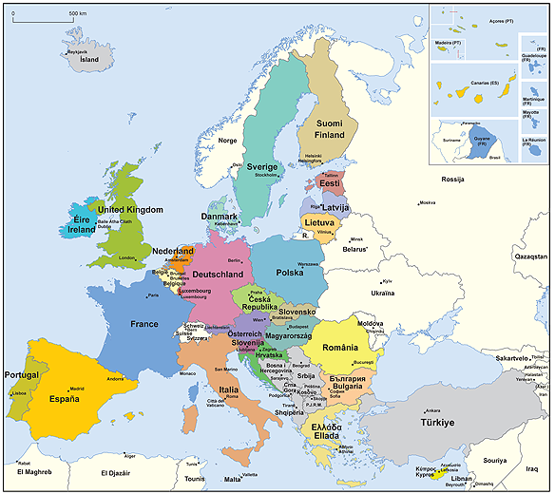

PROJECT MANAGEMENT and IMPLEMENTATION

Slide 2
Work plan
Activities | Time
Presentations of the trainers and participants. Summary of Module 1 and 2 (M. M.) | 09:15-09:30
1. Project management in general and roles (3-29) (G. S.) | 09:30-10:00
2. Life cycle and first steps and contractual management (30-78) (G. S.) | 10:00-11:00
Coffee break | 11:00-11:15
3. Financial management (80-109) (V. M.) | 11:15-12:15
4. Monitoring and audits (110-120) (V. M.) | 12:15-13:00
Break | 13:00-14:00
5. Risk management (122-131) (V. M.) | 14:00-14:45
6. IPR (132-135) (G. S.) | 14:45-14:55
7. Communication and dissemination (136-174) (G. S.) | 14:55-15:15
8. PRAG rules (175-180) (V. M.) | 15:15-15:30
Q&A and evaluation | 15:30-16:00

Slide 3

Project Management in General and Roles
Goran Stojanović
09:30-09:45

Slide 4
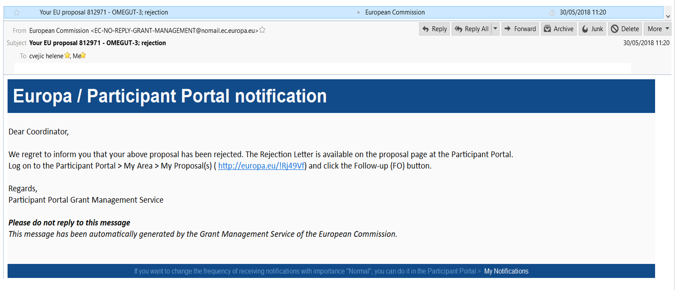
Possibilities

Slide 5
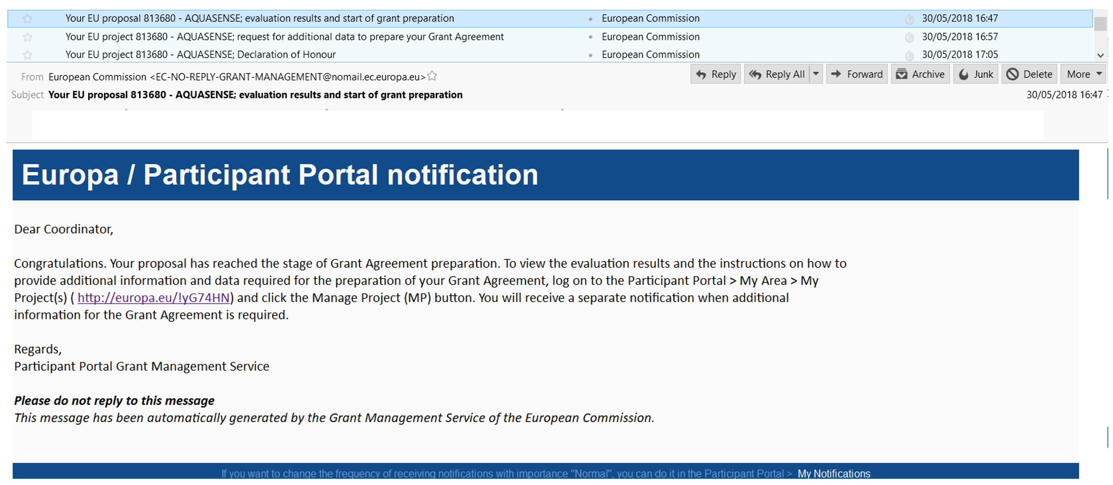
Possibilities

Slide 6
Main list Reserve list Below available budget Below threshold
Possibilities

Slide 7
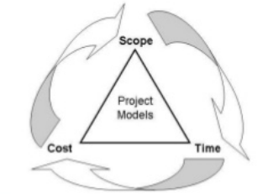

Everything is ready and your project has finally started. All you need to do now is to put your knowledge and know-how into action. If you had to remember only one thing about project implementation, it would be the fact that you and your partners have to fulfil their commitments, especially your project objectives that you defined during the development phase.

Slide 8
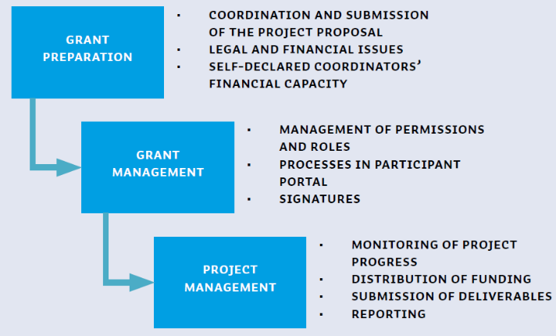

Slide 9
It is possible to reduce budget It is possible that some partners to be expelled from the consortium It is possible to be invited in Brussels The result of this phase is signed contract with European Commission This phase (grant agreement preparation phase) is timely limited
Grant agreement preparation

Slide 13
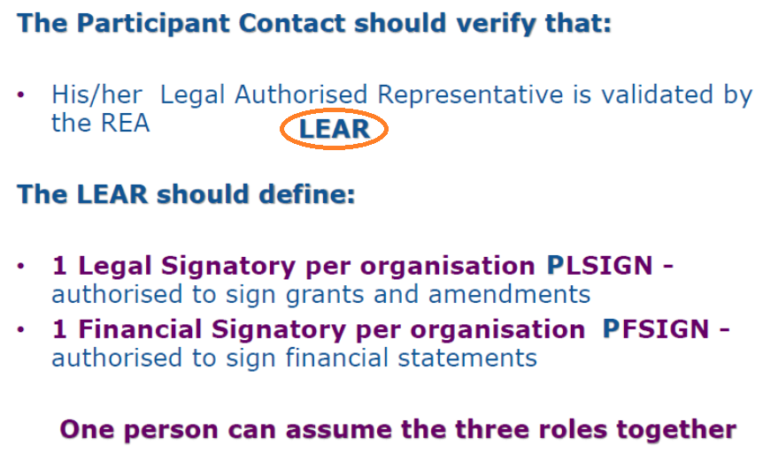

Slide 14

The grant management phase is mainly facilitated on the online Participant Portal. The approved consortium is invited by the European Commission (EC) to prepare and sign a grant agreement, which is a standard contract established between the EC and the project coordinator. The project coordinator performs grant agreement revisions and associated material.
In case of H2020 and many other programmes (indicated in separate Excel Sheet) Grant management is only organised electronically, in the Participant Portal. The European Commission (EC) has launched a Participant Portal for H2020-funded projects. It gathers together the whole project process, from the application period until the end of the project. The Participant Portal is a single gateway for all exchanges

Slide 15
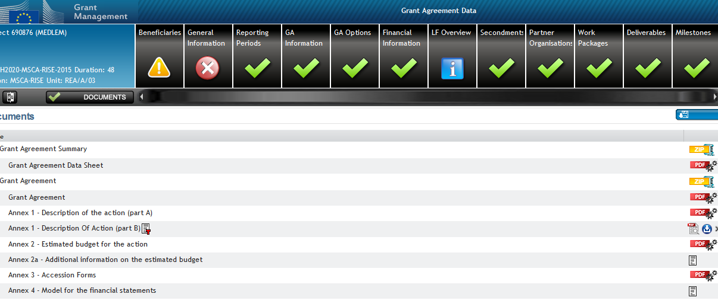

Slide 16
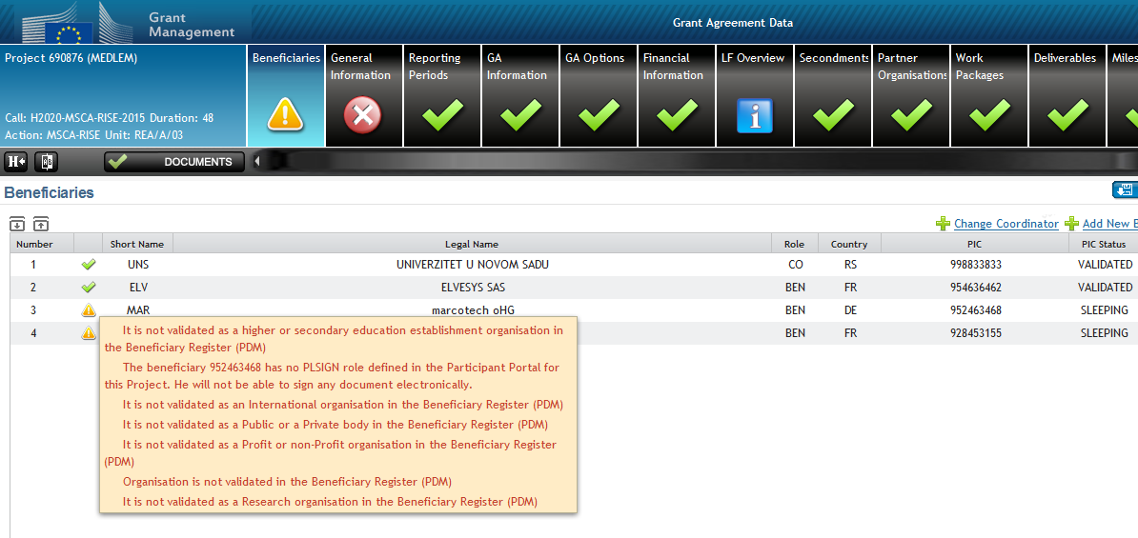

Slide 17
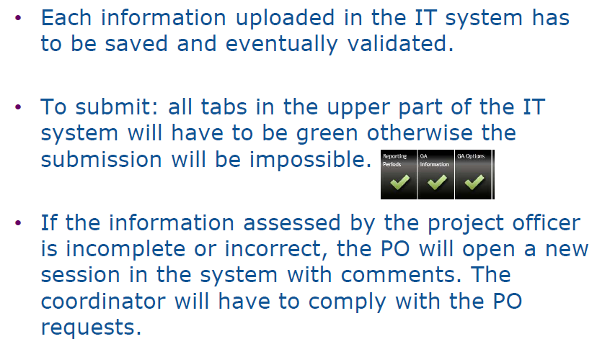

Slide 18
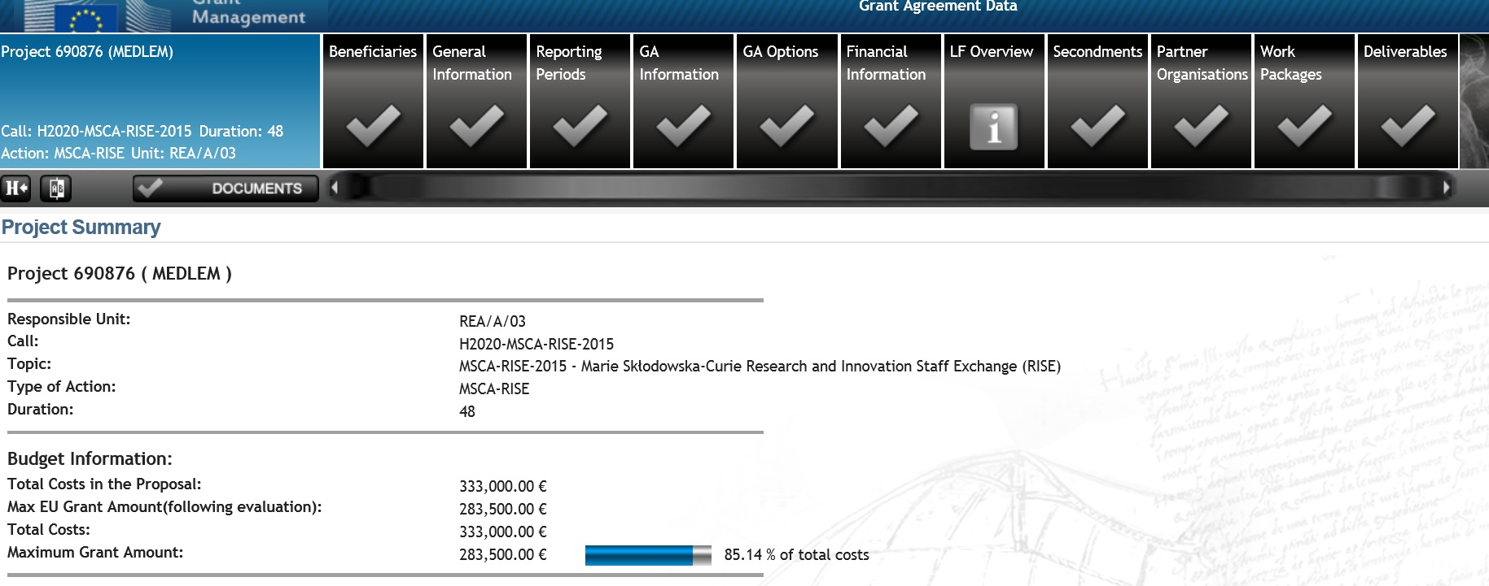

Slide 19
The project management phase includes several key activities to be undertaken by the project coordinator. The project coordinator monitors the progress and achievement of objectives in relation to work accomplished and the costs of the project. Moreover, the payments are made for the coordinating organisation, which is in charge of distributing the payments between the beneficiaries/partners. The coordinator is also responsible for submitting the technical and financial reports to the funder using the templates provided. Normally the reports need to be submitted in the language of the agreement.

Slide 20
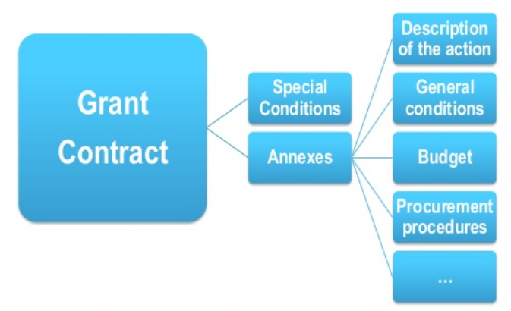
Some of cross-cutting activities of Project Implementation
Project monitoring
Evaluation
Dissemination
Reporting rules
Publicity rules
Lead partner principle
Meetings and events
Financial management
Audit

Slide 21
Project management is the application of knowledge, skills, tools and techniques to project activities in order to meet the project objectives. It includes:
Contract and financial management
Consortium management
Time management
Reporting, communication with EC and liaison with other initiatives and projects

Slide 22
Objectives of project management
Ensure the correct execution of the project’s work plan including its adaptation to necessities that may occur during the project
Guarantee efficient communication within the consortium
Assure the overall coordination of all activities among the project partners
Lead project steering with the objective to implement the project in a smooth and consolidated way, involving the partnership and also external stakeholders
Enabled timely reporting to the EC and the administrative and financial management of the project

Slide 23
A list of tasks that regularly appear in the Management/Coordination work packages depending on the Project
Administrative coordination
Setting up a total management structure (acting persons, responsibilities and teams).
Preparation of all project meetings.
Kick-off activities of the project and kick-off meeting (re-align vision, mission and focus on project outputs and related deliverables).
Generating a project management plan. The plan will describe the indicators, the reporting procedures, schedule and the management of the project progress. Monitoring accordingly.
Developing a quality assurance plan and monitoring deliverables/processes accordingly.
Risk management and contingency planning.
Legal and IPR coordination
IPR Management (managing and protecting IPR linked to the results developed in the project).
Drafting and signing a Consortium Agreement - CA
Financial coordination
Managing financial aspects, including payments, financial reporting, reallocations, and other financial activities in the project.
Coordination in the field of project (Scientific coordination for H2020, etc.)
Sustainability -Analysis and actions to make the project and its infrastructure sustainable (overview of the project’s sustainability scenarios; attracting stakeholders and public and private funding for the expansion of the project).
Communication
Internal communication within the consortium.
Communication with the EC.
Gender issues, ethical issues, social impact (horizontal issues).
Cooperation with other EC projects.

Slide 24
The PCM (Project Cycle Management) describes all management activities and decision making procedures applied during the life cycle of a project.
The cycle consists of five guiding phases. All five phases of the project cycle are structured according to the Logical Framework Approach.
1
PROJECT IDENTIFICATION
2
PROJECT PREPARATION, DESIGN AND PLANNING
3
PROJECT IMPLEMENTATION & MONITORING
4
PROJECT REVIEW & EVALUATION
5
IMPACT ASSESMENT

Slide 25
Contact Person - Lead Partner / Coordinator: Manager of the Project
Coordinator: the beneficiary which signs the grant agreement and has the responsibility of coordinating the action. As coordinator, this beneficiary becomes the contact point between the other beneficiaries and the Agency.
MANAGEMENT: Responsible for the implementation of the project
COMMUNICATION: Deals with all official communication from and to the Commission
REPORTING: Prepares all the reports for the Commission with the assistance of the co-beneficiaries
COORDINATION: Coordinates partners' work, Solves partnership problems
MONITORING: Monitors the implementation
Coordinator is responsible for the Project and contact point for the Commission
On-going coordination and management: Gather information and do your coordination work as an on-going process, also in terms of financial management
On-going accounting and financial management: Collect regularly the invoices, contracts, travel tickets, signed participation lists, etc., fully documented evidence during the project, not at the end of the project.

Slide 26
According to the Horizon 2020 Annotated Model Grant Agreement, the project coordinator must:
ensure that the action is implemented properly;
act as the intermediary for all communications between the beneficiaries and the EC;
request and review any documents or information required by the EC and verify their completeness and correctness before passing them on to the EC;
submit the deliverables and reports to the Participant Portal;
ensure that all payments are made to the other beneficiaries without unjustified delay;
inform the EC of the amounts paid to each beneficiary.

Slide 27
The Coordinator is the most responsible beneficiary in terms of the tasks listed above.
Coordinator monitors, requests and reviews documents, submit deliverables and reports, and ensures the payments are successfully completed. At times, drafting and finalising the minutes is not enough, so the project coordinator might use the coordination/ management diary in order to keep up with all necessary data.
In the case of conflict, the established conflict resolution procedures should aim to support the work of the project coordinator. The project coordinator also reports related to the grant agreement and EC liaison.
Towards the project coordinator. Periodic reports are prepared by the PC and they summarise the status of project work, use of resources, highlights and possible deviations between actual and planned scenarios.

Slide 28
Co-Beneficiaries (partners): Organisations that are parties to the grant agreement
Share part of the budget:
• Incur costs
• Receive part of the EU funding
• May contribute to the co-financing
Co-responsible for the implementation of the project:
• Manage their activities & related expenditure
• Cooperate with all partners towards achieving the aims of the project
• Report to the coordinator
• Collect evidence: deliverables, invoices, contracts, signed lists of participants, etc. and hand them all in on time!
• Provide the signed mandates in good time!

Slide 29
Partnership agreements, signed to clarify:
Cooperation rules
Financial arrangements (transfer of pre-financing and final payment)
Information requirements
Reporting documents
Intellectual property arrangements, etc.
Partnership agreement : is the base of your relationship
Clear description role and obligations of Partnership
Clear description of the budgetary and financial framework including the amounts of financial contributions and distribution of the Grant
Legal aspects such as duration of agreement, liability, breach of contract, termination of agreement, governing law and dispute resolution

Slide 30
Life Cycle and First Steps and Contractual Management
Goran Stojanović
09:45-11:00

Slide 31



EU Project Life Cycle
The Eligibility Period is the time during which costs can be incurred and covered by the European Union grant. The length of the eligibility period depends on the project duration. Planned project activities are carried out.
At mid-point of the project life cycle, beneficiaries are requested to submit a Interim Report, providing information on project implementation and expenditure incurred thus far. The report is assessed and only after its acceptance the second instalment can be paid (if any contractually foreseen)
Start
End
Closing of Project
Eligibility
Monitoring
Eligibility
A M E N D M E N T S
Proposal
Grant Agreement
Progress (Interim)
report
Final
Report
AUDIT
At the end of the project, a Final Report is submitted which provides information on project implementation, results achieved and expenditure incurred. The report will be assessed on its content and financial qualities. Once the project has closed, the EC may elect to carry out an audit within 5 years of the closure date.
Budget Review
Progress evaluation
Evaluation of Project
Applicants who have been successful in the selection process receive a grant decision/agreement from the Agency. The Decision/Agreement indicates the grant awarded and sets out the Financial rules to be applied. Payments are usually made in instalments.
Pre- financing payment
2nd Pre- financing payment (if applicable)
Final Payment

Slide 32
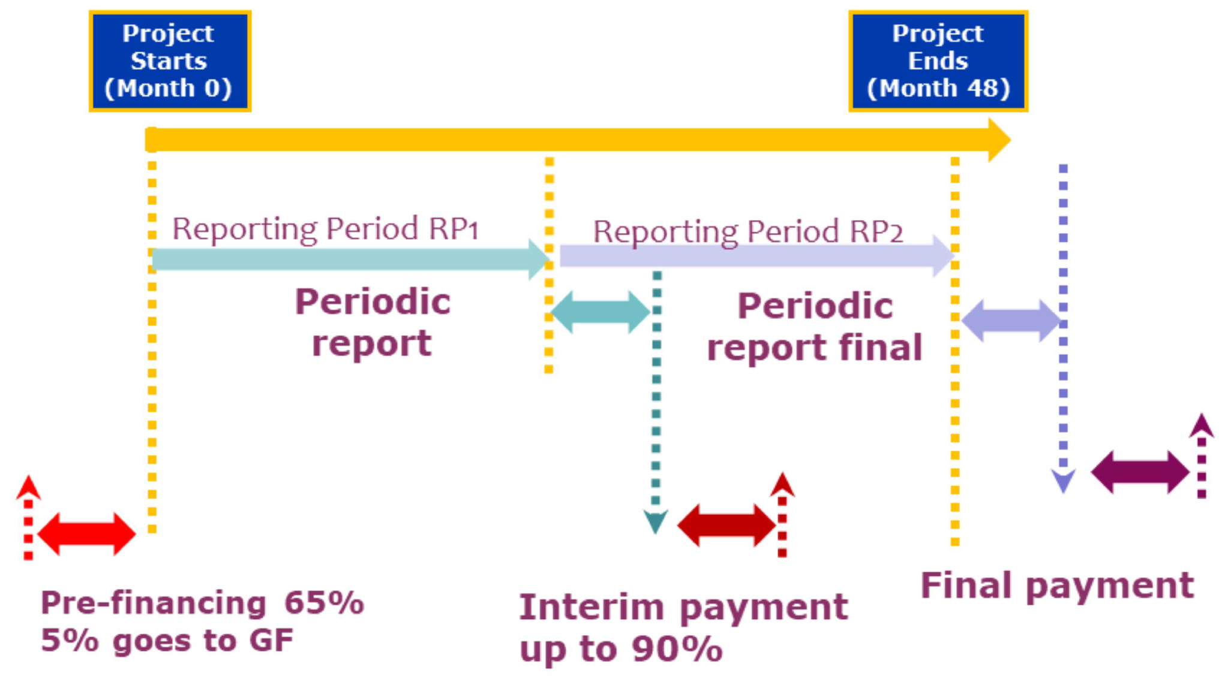
Notes:
32

Slide 33
Challenges in EU Projects:
Rigid administrative requirements, detail content, planning requirement in technical and financial part, obligation to comply with the original Project plan
Diversity of institutions and people
Virtual expectations
Quality expectations
Impact expectations

Slide 34
Past Present Future
Management Reporting
Application
Grant Agreement
Distribution of pre-financing
Project leader / coordinator
Partners / beneficiaries
EC
Implement activities foreseen in the work programme
Monitor
Notes:
Start with important aspects of the Grant agreement

Slide 35
Role of European Commission
Provide timely finance
Management and Technical Support
Monitor project implementation
To capture and report on lessons learnt

Slide 36
Start the activities: Examples of first steps
Arrange first Pre-financing instalments
Establish offices, personnel, management structure, financial administration
Project Kick-off meeting
Develop more detailed work plan and resource plan
Signing necessary agreements
Confirm roles and responsibilities
Plan internal monitoring
Agree on reporting obligations
Develop communication and visibility strategy

Slide 37

Design of the logo and motto for the project

Slide 38

Design of the logo and motto for the project

Slide 39

Design of the logo and motto for the project

Slide 40

Design of the logo and motto for the project

Slide 41
Kick-off meeting
The first meeting of the Project partners (consortium members)
Representatives of all partnering institutions are expected
For this Kick-off meeting it is necessary to define:
Date, place (usually coordinating institution)
Agenda (programme, 1 full day or 2 half days)
Promo materials have to be prepared (designed and printed)
Unified Templates of PPTs for all presentations
Attendance list
Photos
Someone who will write Minutes from this meeting
Establishing of the project management bodies in the framework of the project

Slide 42

Innovative bio-inspired sensors and microfluidic
devices for saliva-based theranostics of oral and
systemic diseases
Kick-off meeting
Novi Sad, 28/02/2020
Acronym: SALSETH
Grant No: 872370
Type of action: Marie Skłodowska-Curie Research
and Innovation Staff Exchange
(RISE) - Horizon 2020
Starting Date: 01/12/2019
Project Duration: 48 months
www.salsethproject.com

Slide 43
Kick-off meeting, Novi Sad, 28th February 2020
SALSETH – UNS presentation
Prof. dr Goran Stojanović, University of Novi Sad, Serbia
www.salsethproject.com

Slide 44
Title
Tekst...Tekst...Tekst...Tekst...Tekst...Tekst...Tekst...Tekst...Tekst...Tekst...Tekst...Tekst...Tekst...Tekst...Tekst...Tekst...Tekst...Tekst...Tekst...Tekst...Tekst...Tekst...Tekst...Tekst...Tekst...Tekst...Tekst...Tekst...Tekst...Tekst...Tekst...Tekst...Tekst...Tekst...Tekst...Tekst...Tekst...Tekst...Tekst...Tekst...Tekst...Tekst...Tekst...Tekst...Tekst...Tekst...Tekst...Tekst...Tekst...
www.salsethproject.com

Slide 45


Slide 46
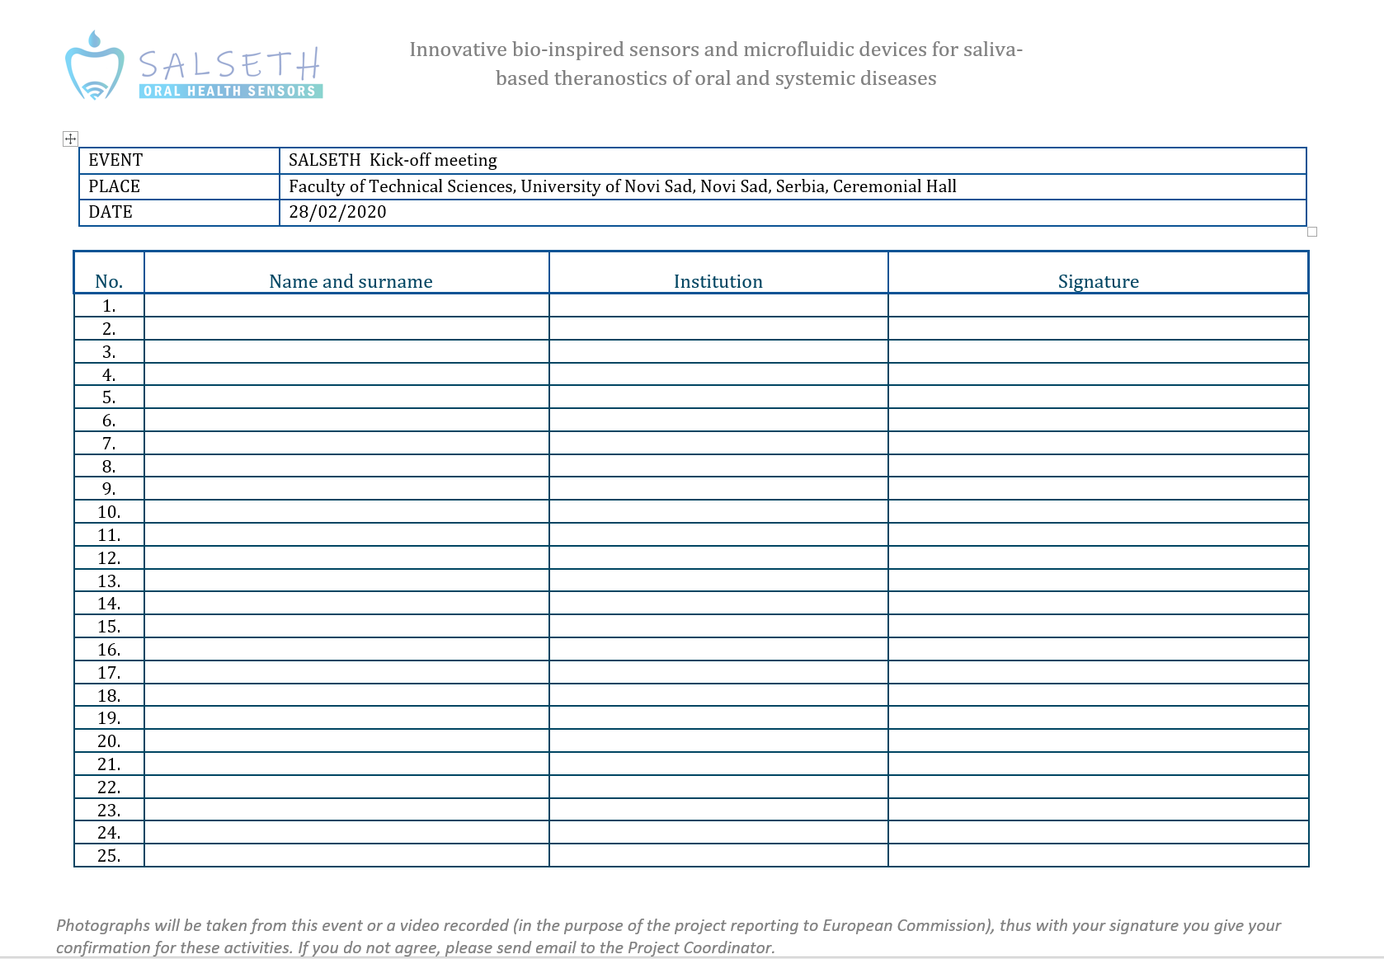

Slide 47


Slide 48
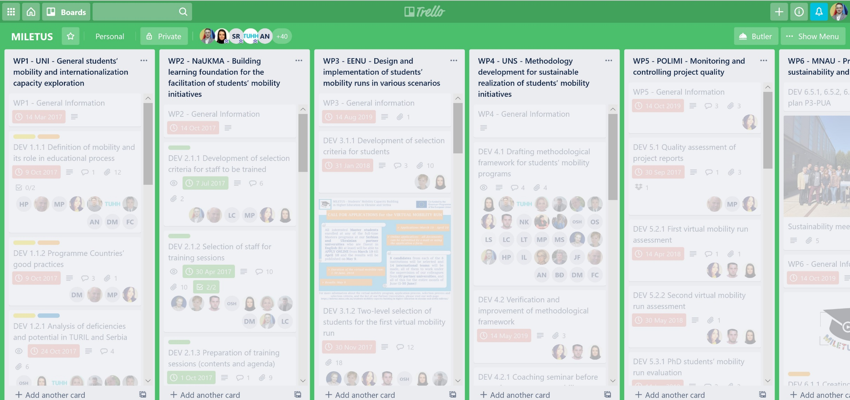
The project management - Trello

Slide 49
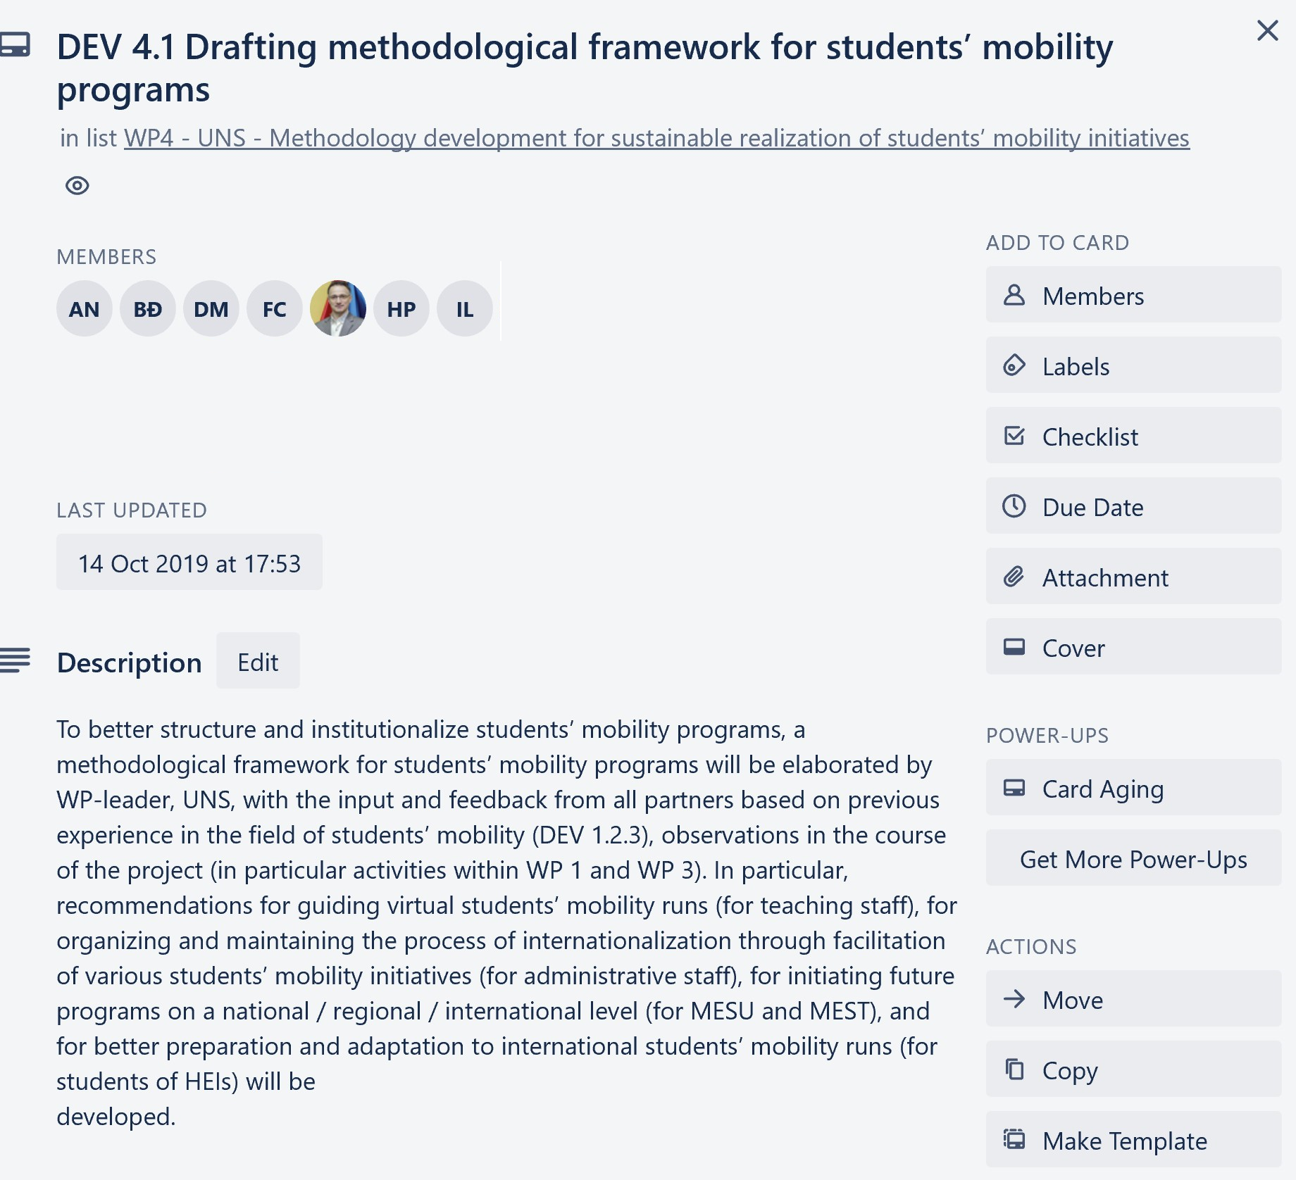
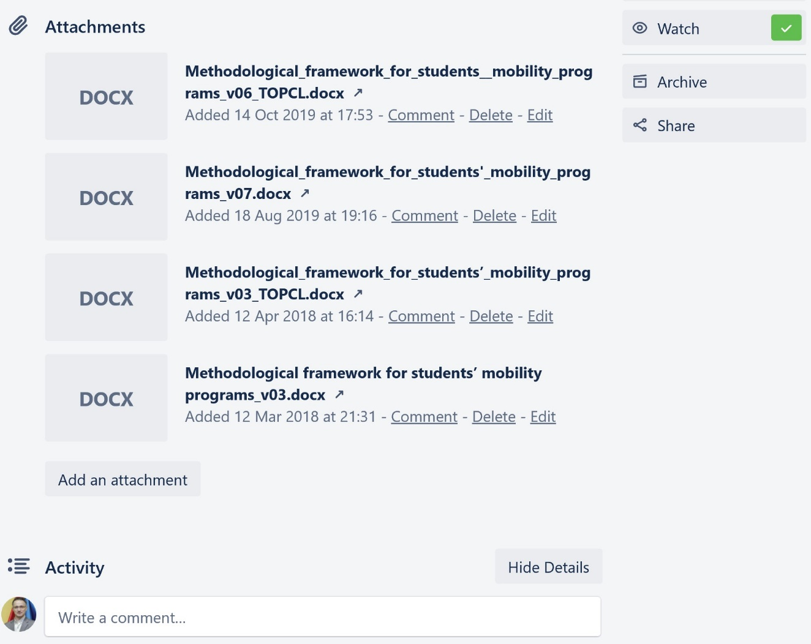
The project management - Trello

Slide 50
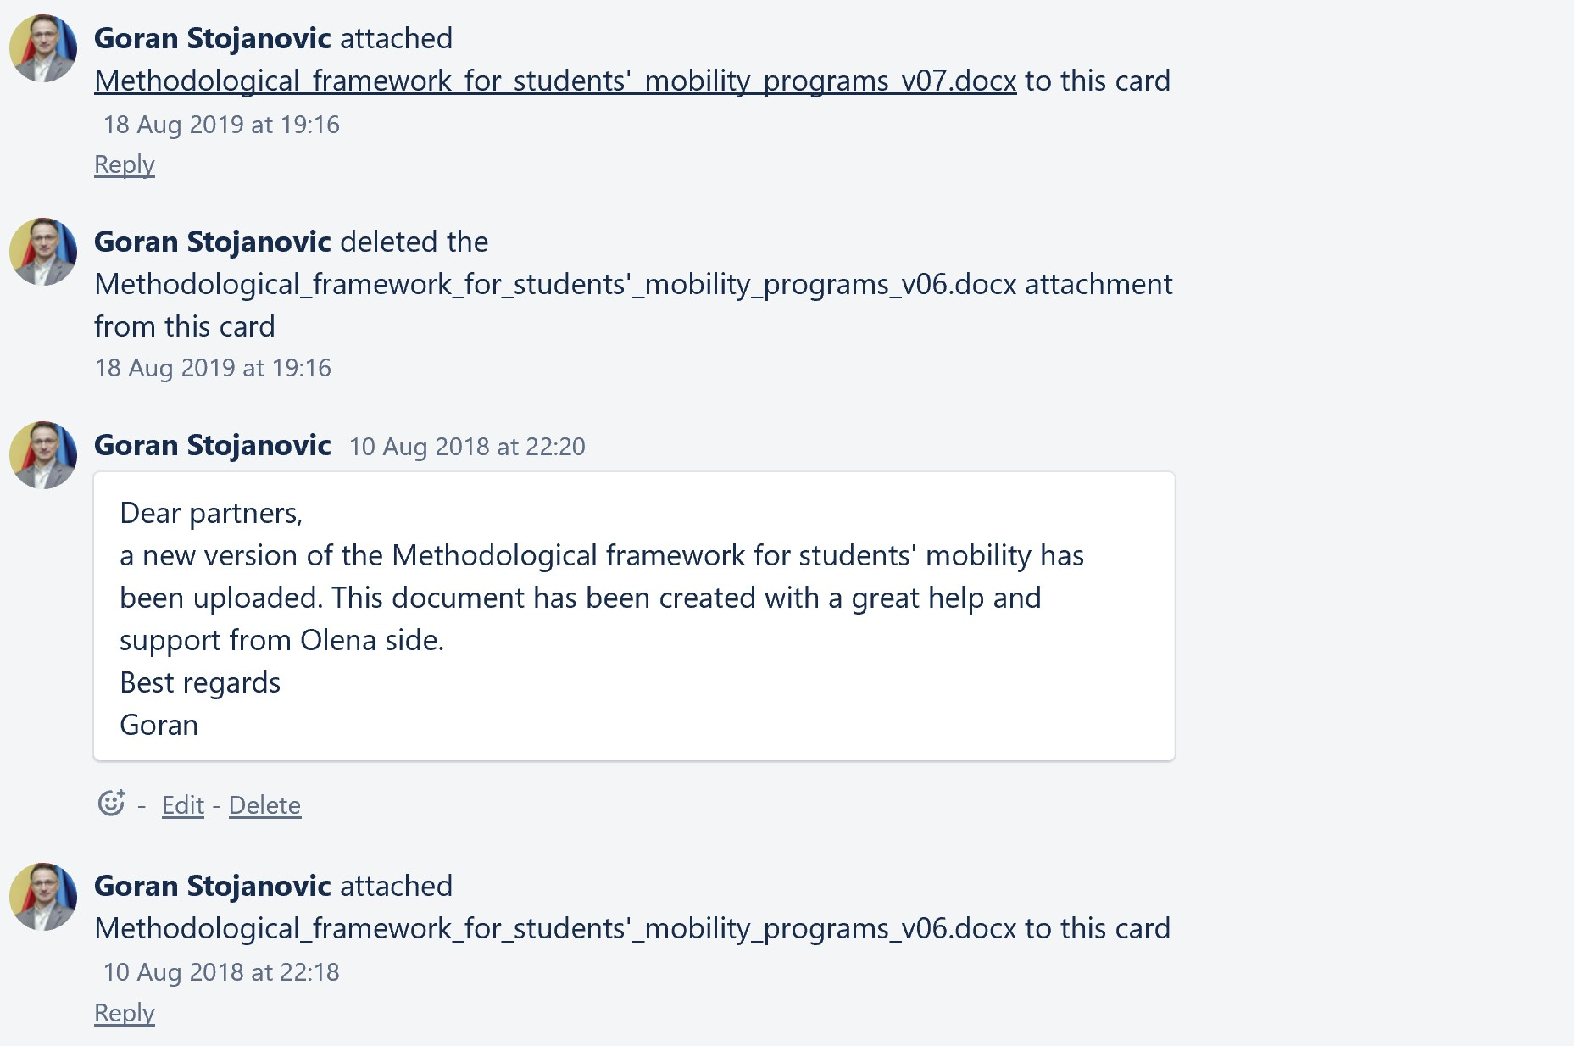
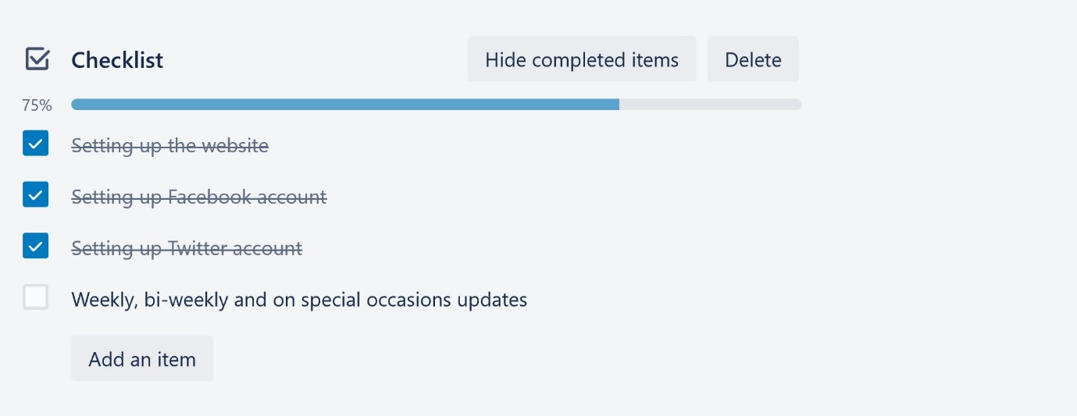
The project management - Trello

Slide 51
Once the grant agreement is signed, your project must be carefully managed until completion. Guidance is available at each step of the way, in the form of reporting templates and deadlines to keep to throughout the project.
Factors to take into account
Reporting - you must submit regular technical and financial reports to the Commission
Deliverables - you may have to submit deliverables (information, a special report, a technical diagram brochure, list, software milestone, etc.) identified in the grant agreement

Slide 52
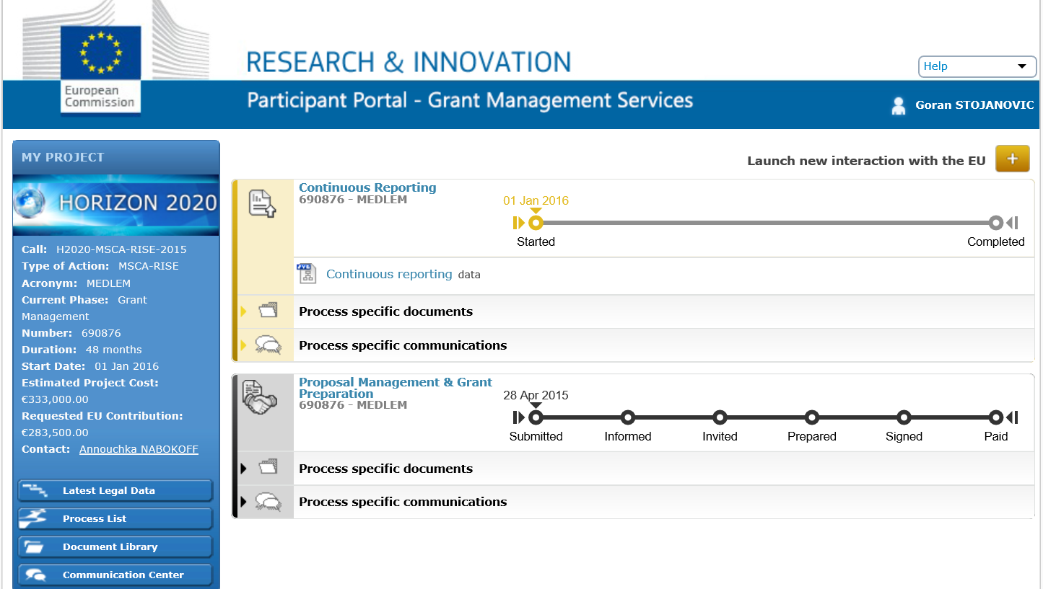

Slide 53
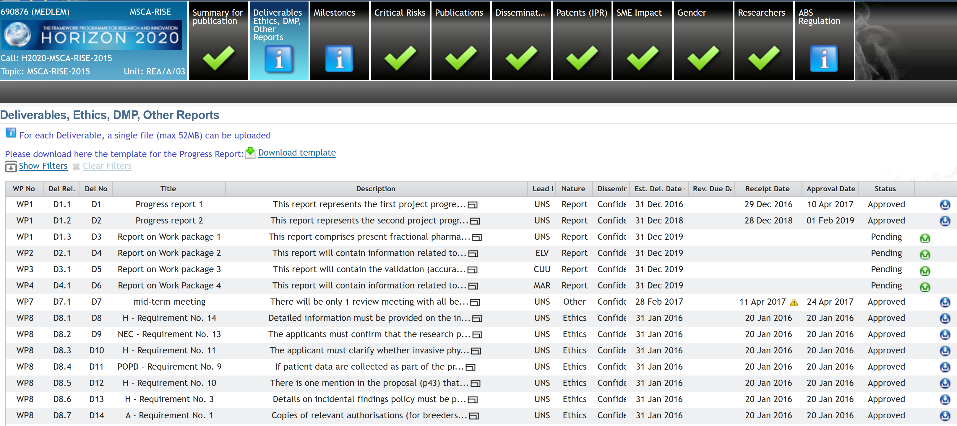

Slide 54
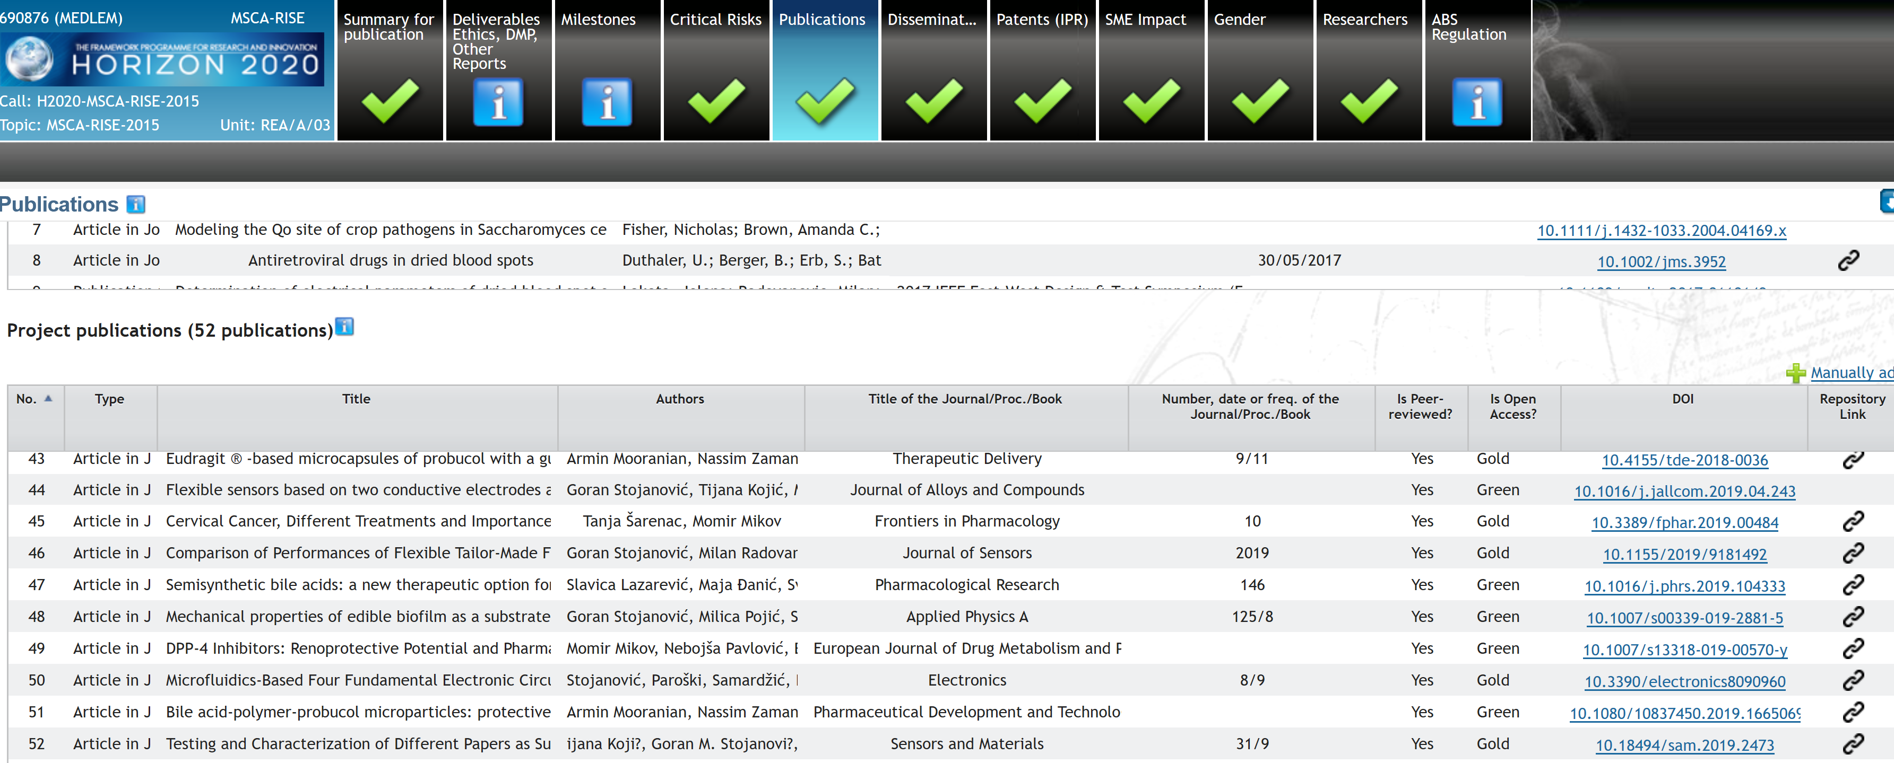

Slide 55
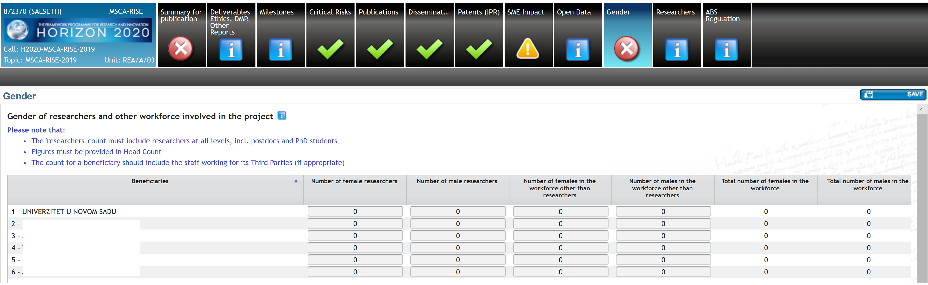

Slide 56
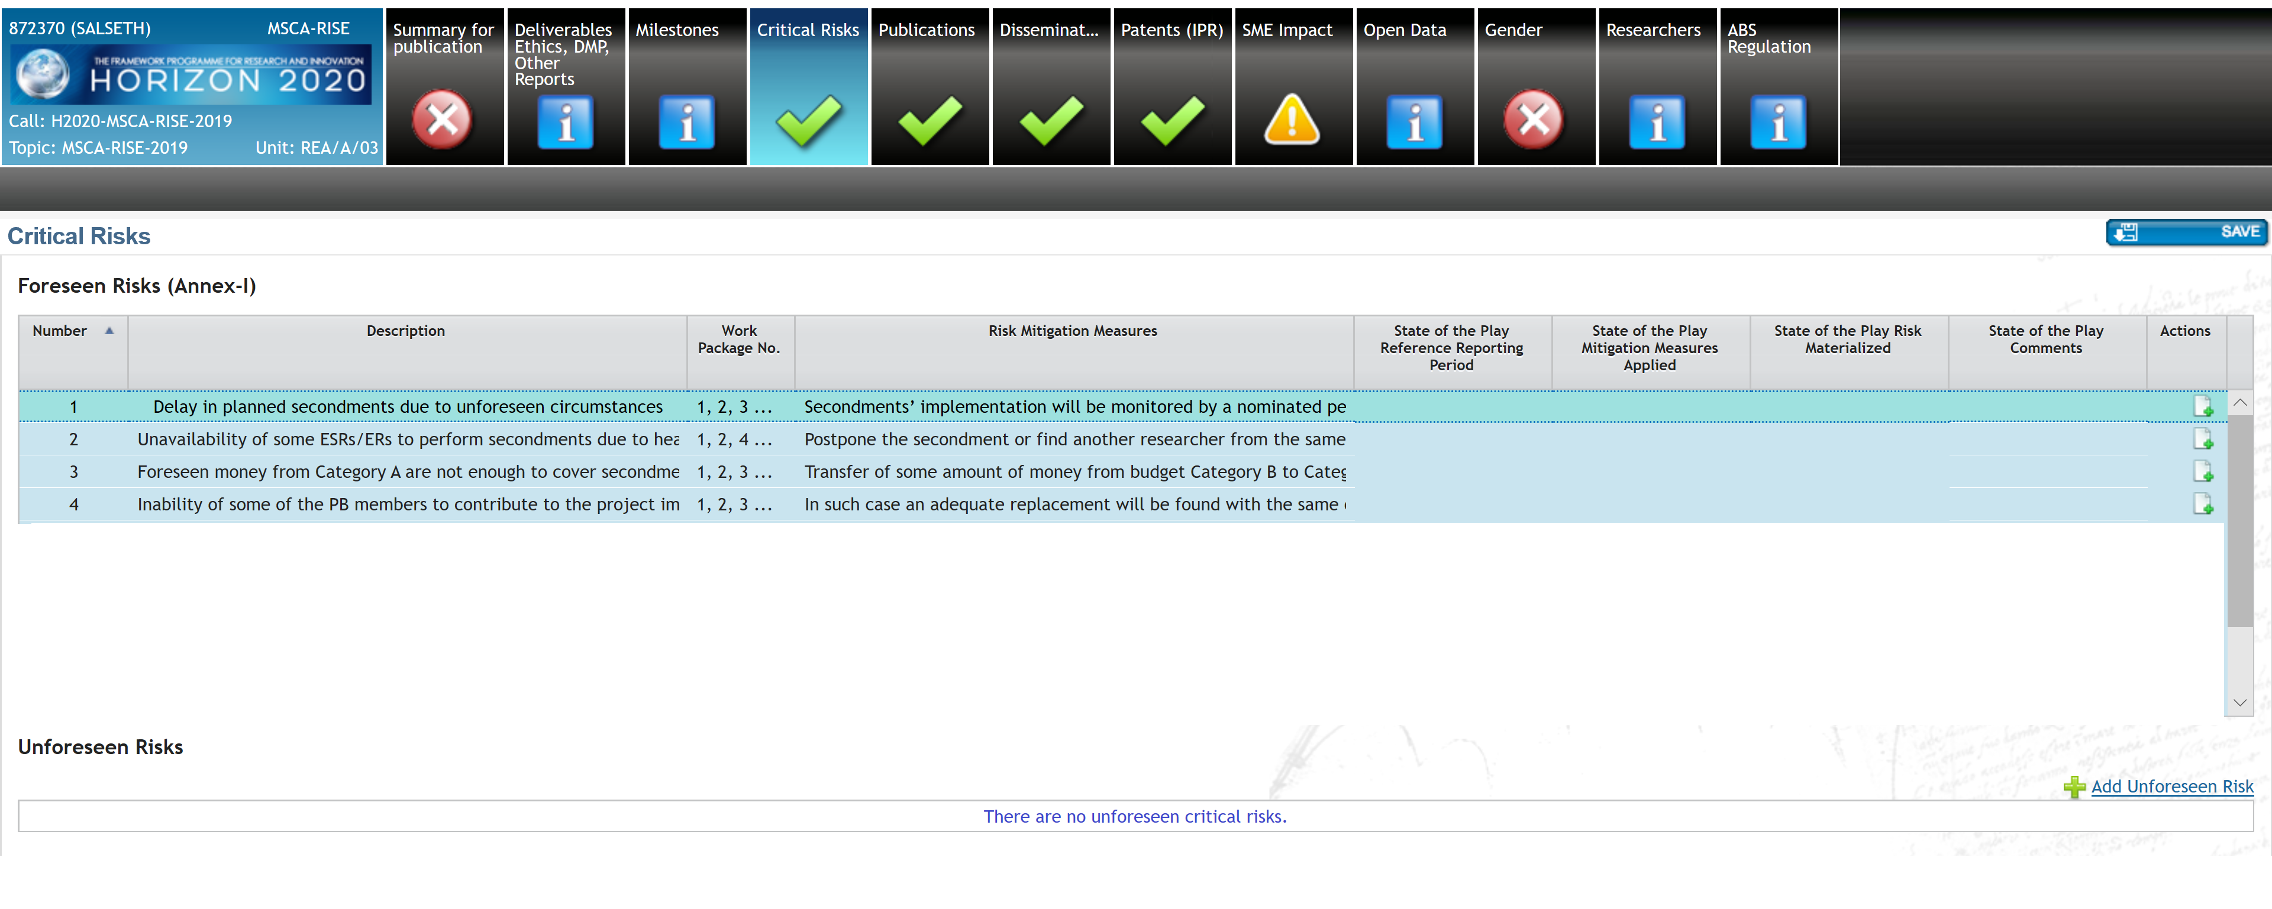

Slide 57
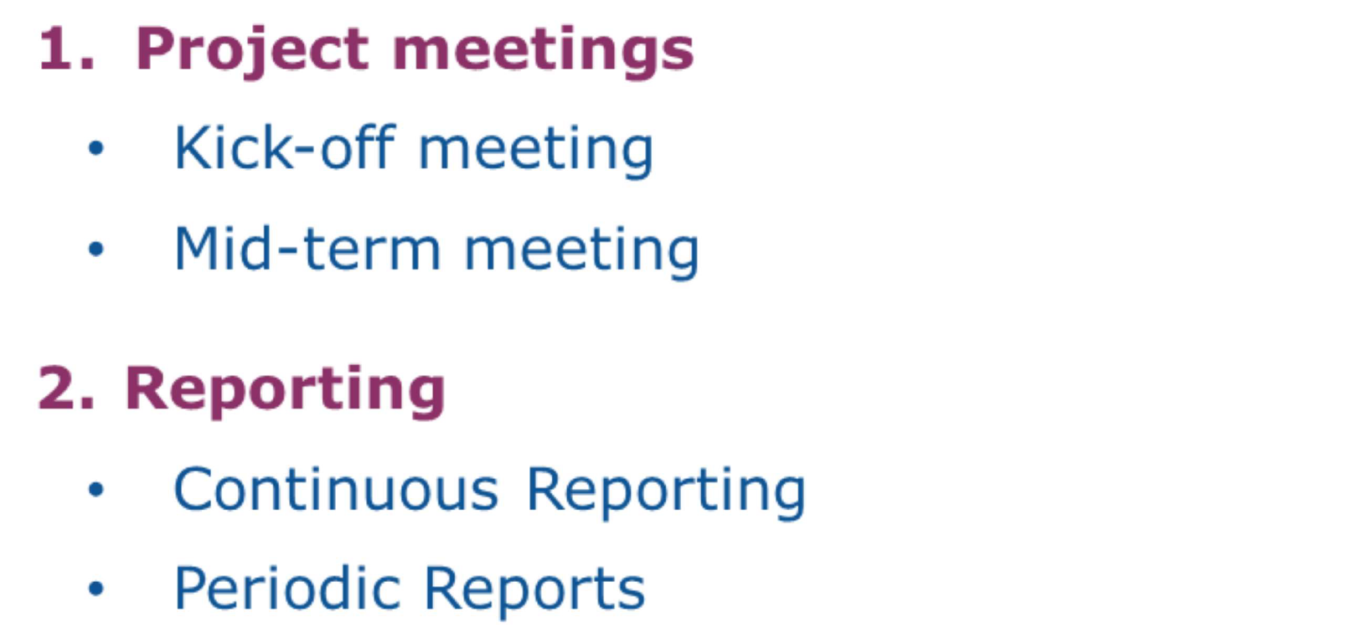

Slide 58
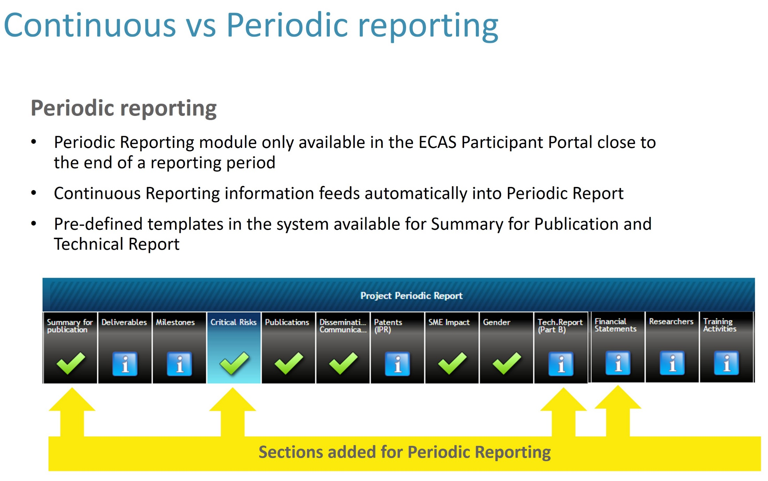
Notes:
58

Slide 59
Checks, audits and reviews
The Commission will monitor the implementation of project (during or afterwards) to ensure its compliance with the grant agreement. The process of checks, audits and reviews may involve: checking the action has been properly implemented in accordance with the grant agreement, including assessing whether deliverables and reports are consistent with the description and work plan financial audits on your accounts as the beneficiary, to verify the eligible costs incurred
Amendments
Your grant agreement may need to be amended if there are any changes to its terms and conditions.
Keeping records
It is important to keep records and other supporting documentation to prove that your project has been properly implemented. This includes keeping records on eligible costs and corresponding accounts. Beneficiaries must keep records and other supporting documentation in order to prove the proper implementation and the costs declared as eligible (For Lump Sum Pilot projects, beneficiaries do not need to keep records on their costs. They only need to keep appropriate and sufficient evidence to prove the proper implementation of the action).

Slide 60
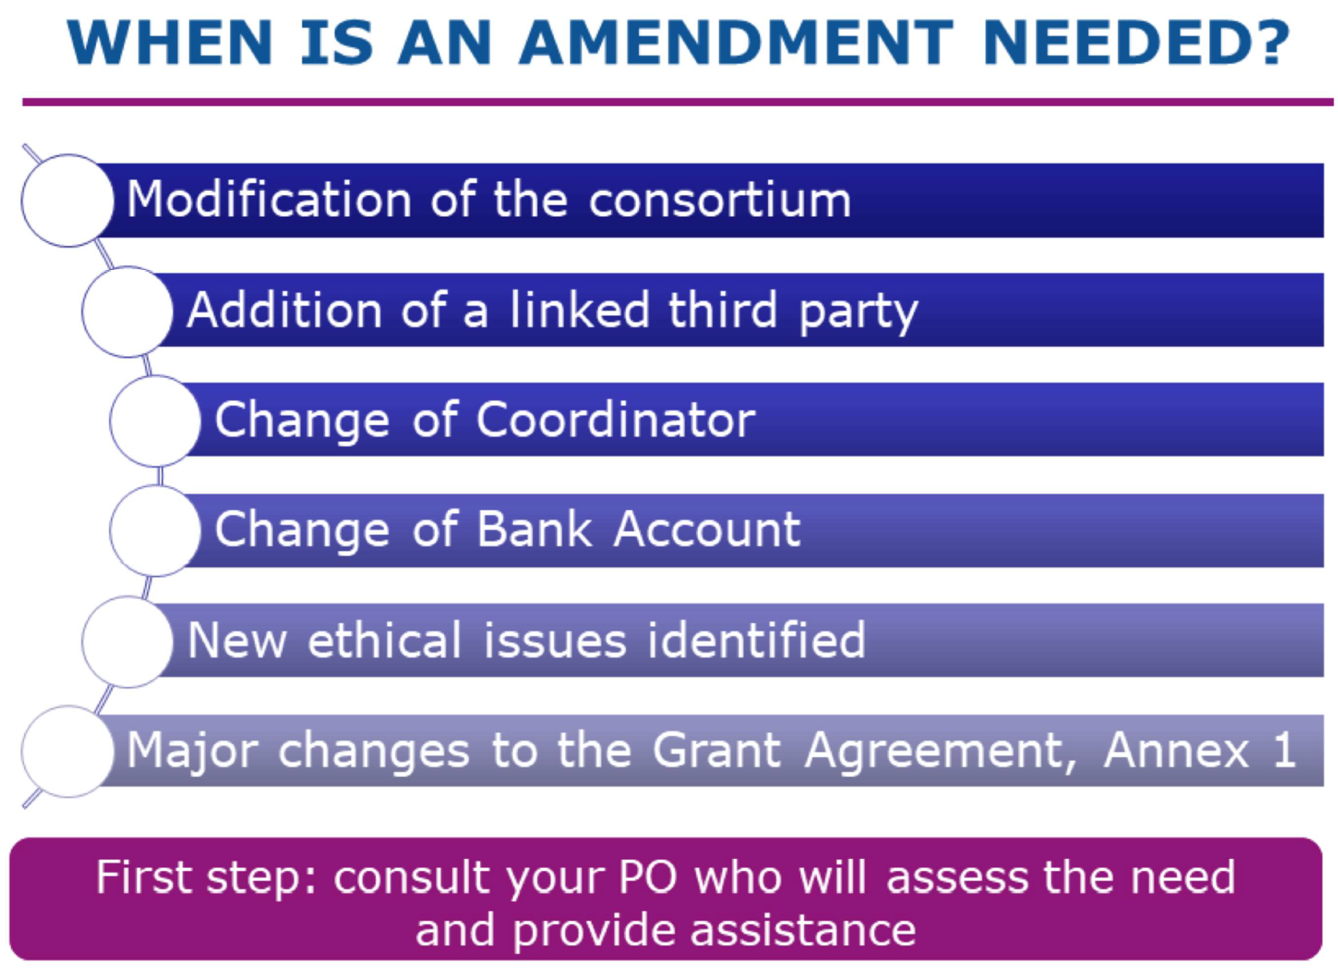
Amendments

Slide 61
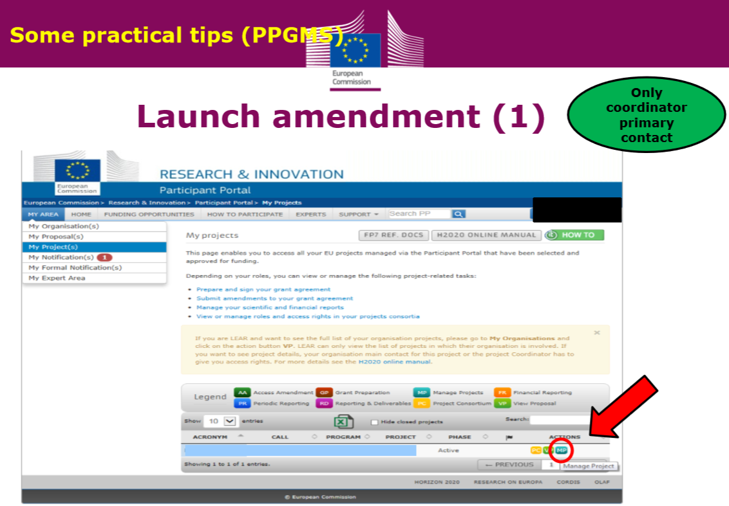

Slide 62
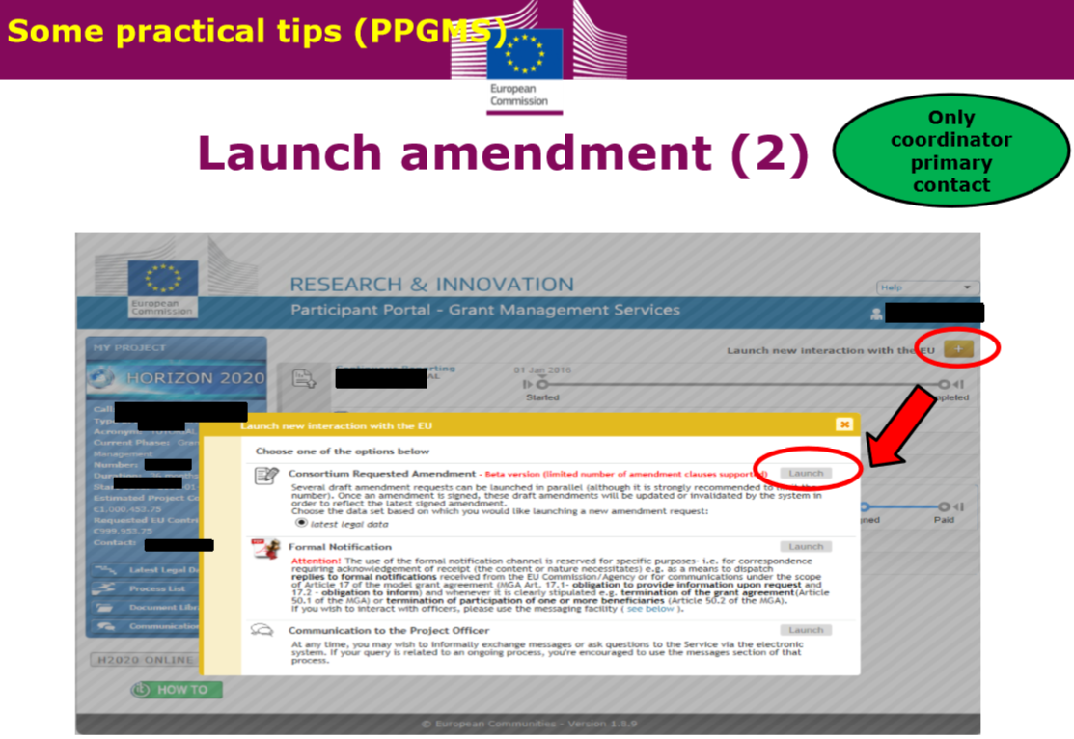

Slide 63
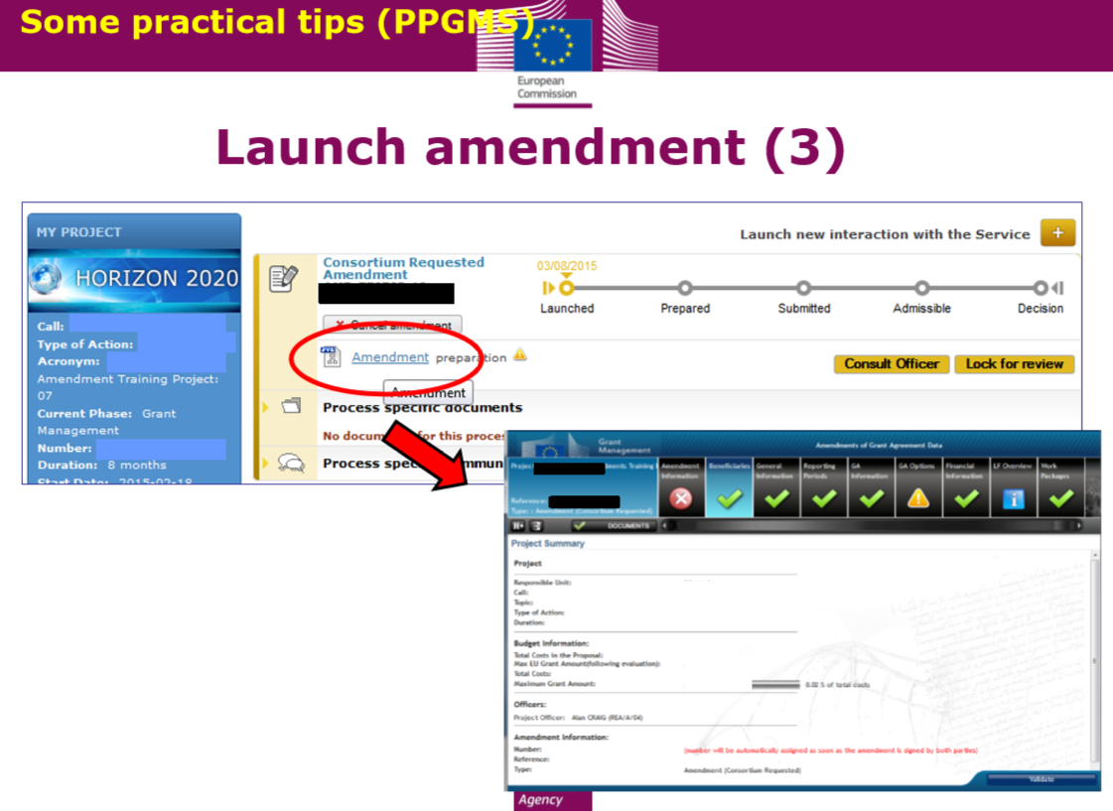

Slide 64
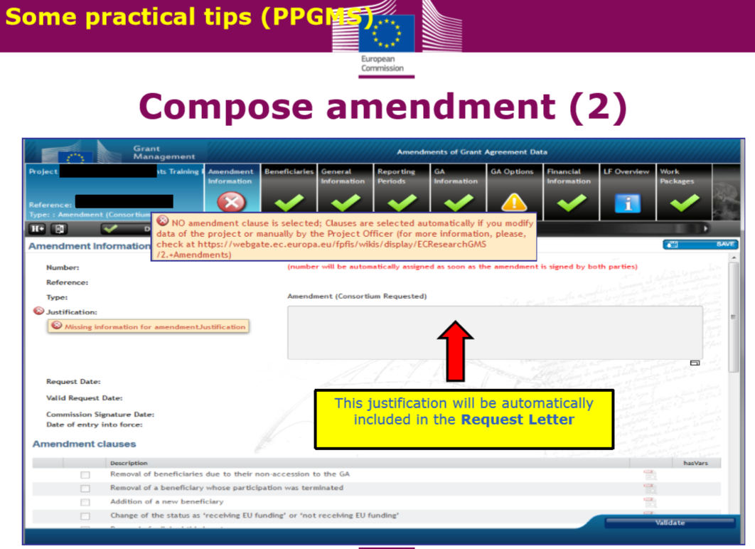

Slide 65
Amendment is an act modifying the grant conditions initially agreed or established in clauses of the grant agreement or grant decision. It requires that one party requests a change that the other party agrees to. Beneficiaries have to inform the Agency of any changes they wish to introduce in advance in order to allow the necessary time for the analysis of the request.
Administrative changes
Change to the planned activities
Change of eligibility dates
Change in the partnership
Budget amendments
In most cases, the amendment will be made by an exchange of letters which implies that the agreement between the two parties will not be reached by countersigning the very same document but by exchanging two separate documents (letters).

Slide 66
Before the end of the Project amendment can be requested when one of the following changes applies:
Changes involving beneficiaries & linked third parties
Adding a new beneficiary
Deletion of a beneficiary whose participation has been terminated because:
it has not signed the grant agreement
it has not provided a declaration on joint & several liability as requested
for some other reason
Change of beneficiary due to 'partial takeover'
Deletion or addition of linked third party Specific case: if a beneficiary's participation is terminated at the initiative of other beneficiaries Change involving the coordinator/principal beneficiary
Change of coordinator
Change in the bank account the coordinator uses for payments
Change in the ‘authorization to administer’ option
Changes affecting the project or its implementation
Change to Annex 1
Change in the title of the project or its acronym, starting date, duration or reporting periods
Resumption of project activities after a temporary suspension
H2020 Example

Slide 67
Changes involving the financial aspects of the grant
Change to Annex 2 or 2a
Change in the maximum grant amount, reimbursement rate(s), the estimated eligible costs of the project (if applicable, for example it is not applicable to lump sum pilot projects), the amount of pre-financing or the contribution to the Guarantee Fund
Change concerning specific cost categories (‘specific unit costs’)
Specific changes in other Model Grant Agreements (e.g. FPA/SGA, ERC, MSCA, etc.)
Amendments are NOT necessary
for certain budget transfers
if the name or address of a beneficiary, linked third party or coordinator changes
if a universal takeover results in a change of beneficiary
if there is a change in the name of the bank or the address of the branch where the coordinator has an account, or in the name of the account holder.
H2020 Example

Slide 68
Principles apply:
An amendment cannot question the decision to award the grant;
An amendment cannot result in unequal treatment of applicants;
An amendment can be made only in writing;
Amendments must be requested on time before they occur: at the latest one month before the end of the eligibility.
The modification to a grant agreement/grant decision has to be authorised by the same parties who have signed the initial agreement/decision.

Slide 69
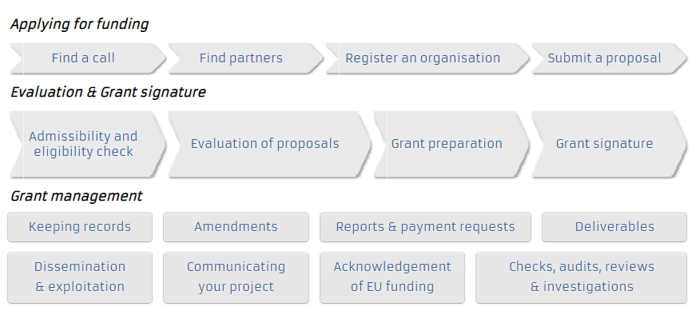
H2020 Example

Slide 70
Reporting is a contractual requirement of European projects. It serves the purpose of communicating project progress as well as triggering grant payments. Each European programme has its own reporting requirements. Check your grant and partnership agreements to identify the specific requirements for your project.
1/ Progress report In the application form, you had to outline the different objectives of your project and their outputs. For the progress report, you have to include this information and to update it in order to illustrate the progress of your project since it started. Moreover, you have to prepare a financial report for your project’s expenditures. Don’t forget to keep and provide any supporting document as requested by the managing authority. You will have to respect different deadlines to send your reports. Each European programme has its own rules, please refer to the guidelines for more details.
2/ Final report At the end of your project, you will have to submit a final report. You have to summarise the project’s main achievements. The final report should show the impact of your project since it was implemented, and what you have learnt from your experience. You also have to submit the last financial report up to the closure of the project. You have to send this last report to obtain the last payment of the grant. Each European programme has its own deadlines, you have to adhere to them
Grant Agreement: SPECIAL CONDITIONS
Annexes
General Conditions, Budget
Reports
Project Proposal

Slide 71
Project reporting obligations:
Deliverables (as described in DoA)
Periodic Report (within 60 days following the end of each reporting period)
Periodic technical report
Periodic financial report
Final Report (in addition to the periodic report for the last reporting period)
Final technical report – summary for publication
Final financial report – CFSs

Slide 72
Periodic report ⇨ submitted by coordinator 60 days after end of reporting period
Periodic Technical Report
Explanation of the work carried out
Overview of progress (milestones and deliverables)
Summary for publication
Plan for the exploitation and dissemination of results (if required)
Answers to the questionnaire
Periodic Financial Report
Financial Statement (individual & summary)
Explanation of the use of the resources

Slide 73
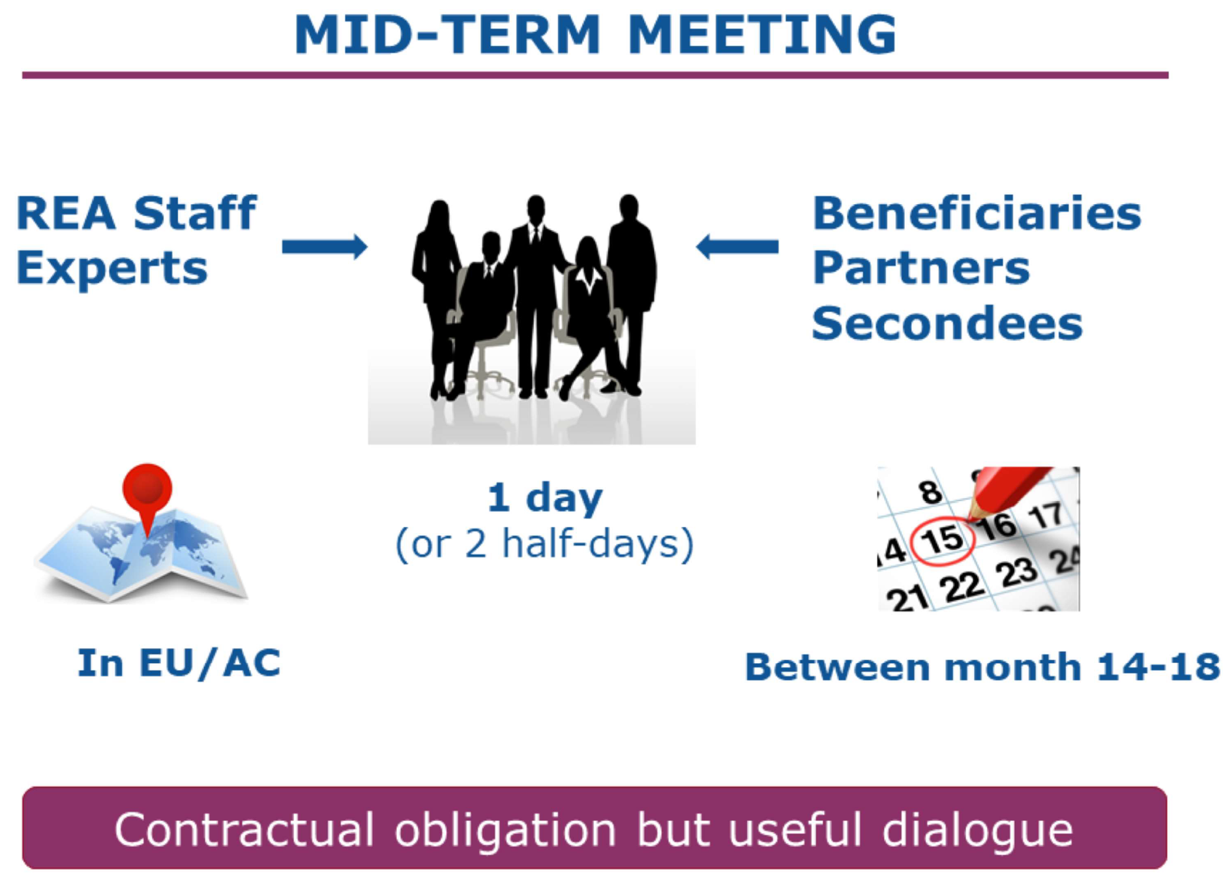
Mid-term review meeting

Slide 74

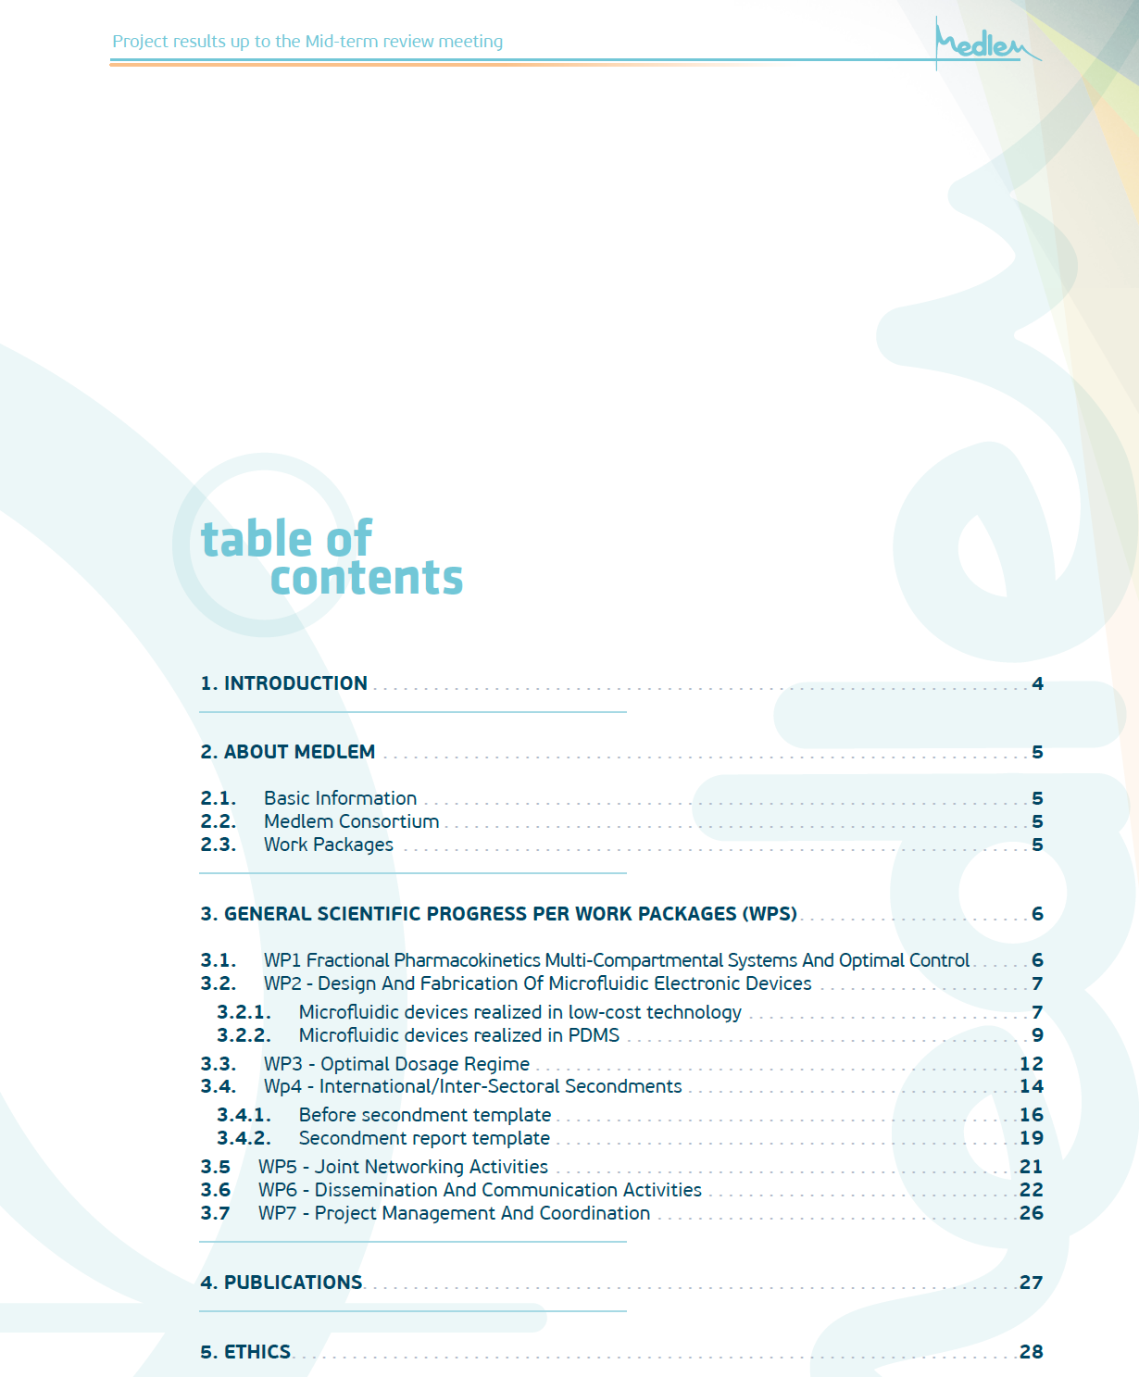
Mid-term review meeting
Contractual obligation
Meeting with Project Officer (and independent expert)
They decide about the future of your project if it will be continued to be implemented
Mobilization of all resources
Serious approach

Slide 75
Final report ⇨ submitted by coordinator 60 days after end of last reporting period
Final Technical Report
Summary for publication
Overview of results and their exploitation & dissemination
Conclusions of the action and socioeconomic impact
Final Financial Report
Summary Financial Statement
Certificate on Financial Statement (if needed)

Slide 76

Periodic Technical report (in 2 parts)
Part A structured tables from the grant management system:
cover page
summary for publication
web-based tables covering issues related to the project implementation (e.g. work packages, deliverables, milestones, etc.)
answers to the questionnaire about the economic and social impact, especially as measured against the Horizon 2020 key performance indicators and monitoring requirements.
Part B the free text, core part of the report that you must upload to the grant management tool under the Report Core tab, as a single PDF document with:
explanations of the work carried out by all beneficiaries and linked third parties during the reporting period
an overview of the progress towards the project objectives, justifying the differences between work expected under Annex I and work actually performed, if any.
Periodic Financial report -Consists of structured forms from the grant management system, including:
individual financial statements (Annex 4 to the GA) for each beneficiary (and third parties)
explanation of the use of resources and the information on subcontracting and in-kind contributions provided by third parties, from each beneficiary for the reporting period concerned
periodic summary financial statement including the request for interim payment.
H2020 Example

Slide 77
Final technical report is a publishable summary of the entire project
overview of the results and their exploitation and dissemination
conclusions on the project
its socio-economic impact of the project
an up-to-date link to the project website
project logos, diagrams, photographs and videos illustrating its work (if available).
Like the summaries for the periodic reports, the final summary must be written in a understandable style for a non-specialist audience. The coordinator must ensure that none of the material submitted for publication includes confidential or 'EU classified' information.
Final financial report
final summary financial statement that is automatically created by the system (consolidating the data from all individual financial statements for all beneficiaries and linked third parties, for all reporting periods) and that constitutes the request for payment of the balance
in some cases (and for some beneficiaries/linked third parties) it must be accompanied by a certificate on the financial statements - CFS (one certificate per beneficiary/linked third party).
H2020 Example

Slide 78
Ownership of results
• The results of the action, including industrial and intellectual property rights
• The reports and other documents are the property of the beneficiaries but the Commission has the right to use of them
Cover ownership rights in your partnership agreements
Ensure that publishing agreements acknowledge the Commission's rights

Slide 79

11:00-11:15

Slide 80
Financial Management and Liability
Vesna Mandić
11:15-12:15

Slide 81
Types of Financing, defined in GA

One pre-financing
€

€
One or several interim payments

€
One payment of the balance
€

Slide 82
Payments will be made to the coordinator to the bank account established in the grant agreement
Coordinator must distribute the payments to the beneficiaries without unjustified delay
The coordinator will inform about the distribution of the payments:
if the Commission/Agency requires it,
in the event of a recovery at payment of the balance,
if the participation of a beneficiary is terminated
If the Commission/Agency does not pay within the deadline, the beneficiaries are entitled to a late-payment interest

Slide 83
For each grant, pre-financing may be split into several instalments in accordance with sound financial management.
The request for a further pre-financing instalment shall be accompanied by a beneficiary’s statement on the consumption of previous pre-financing.
The instalment shall be paid in full if at least 70 % of the total amount of any earlier pre-financing has been consumed.
Otherwise, the instalment shall be reduced by the amounts still to be consumed until that threshold is reached.

Slide 84
One pre-financing payment – H2020
When
Within 30 days from the signature of the grant or 10 days before the starting date, whichever is latest
How much
Usually = maximum grant amount / number of periods
Characteristics
It remains the property of the EU until the payment of the balance
Retention 5 % of maximum grant for Guarantee Fund

Slide 85
An interim payment – H2020
When
90 days from reception of periodic reports
How much
EU contribution corresponding to the eligible costs incurred in the reporting period
Characteristics
Ineligible costs will be rejected and not taken into account for the payment
Limit = 90 % of the maximum grant amount

Slide 86
A payment of the balance – H2020
When
90 days from reception of final reports
How much
Reimburses the remaining part of the eligible cost incurred
Characteristics
If Ʃ payments made < final grant amount : payment
Includes the release of the Guarantee Fund (GF)
If applicable: receipts & reduction of the grant will be taken into account to determine the final grant amount
If Ʃ payments made > final grant amount : recovery → first by offsetting with GF released, if not enough, by a recovery order

Slide 87
Payment cycle – ERASMUS
Payment cycle (Član I.4)
1st pre-financing: 50%
After GA signing 
After spending 70% of the first installment
60 days after Final report approval
Statement of the costs
+
Request for Payment
Progress Report
Due date:
14/10/XX – 2 years
14/04/XX – 3 years
2nd pre-financing: 40%
 half-way through the project lifetime
balance: max 10%
Financial Statement
+
Request for Payment
Final Report
Due date:
14/12/XX – 2 years
14/12/XX – 3 years
Audit Report
Required for all grants
 Max 2 months after the project ends

Slide 88
The grant may not exceed the maximum amount authorized in the Grant Agreement
Final grant: determined following examination of financial reports (statements) and eligibility of activities implemented and declared expenses.
Declared unit costs/expenses identified as ineligible will be deducted from the total amount declared
Penalties related to the implementation of the action (if any)
Balance = final grant – pre-financings – penalties

Slide 89
Example 1
All costs eligible no penalties |  | Total declared expenditure
 | Grant awarded | = grant awarded | < total grant awarded UNDERSPENT | > total grant awarded OVERSPENT
I STAFF COSTS | 340.000 | 340.000 | 290.000 | 330.000
II TRAVEL COSTS | 150.000 | 150.000 | 165.000 | 150.000
III COSTS OF STAY | 150.000 | 150.000 | 165.000 | 160.000
IV EQUIPMENT | 160.000 | 160.000 | 170.000 | 170.000
V SUBCONTRACTING | 50.000 | 50.000 | 40.000 | 50.000
TOTAL GRANT (total I-V) | 850.000
TOTAL DECLARED |  | 850.000 | 830.000 | 860.000
FINAL GRANT |  | 850.000 | 830.000 | 850.000

Slide 90
Example 2
All costs eligible no penalties |  |  | Total declared expenditure |  | Total declared expenditure
 | Grant awarded | % TOTAL GRANT | = total grant awarded | % TOTAL GRANT AWARDED | = total grant awarded | % TOTAL GRANT AWARDED
I STAFF COSTS | 340.000 | 40% | 374.000 | 44% | 385.000 | 45,5%
II TRAVEL COSTS | 150.000 | 17,5% | 150.000 |  | 150.000 | 17,5%
III COSTS OF STAY | 150.000 | 17,5% | 100.000 |  | 130.000 | 15%
IV EQUIPMENT | 160.000 | 19% | 160.000 |  | 160.000 | 19%
V SUBCONTRACTING | 50.000 | 6% | 0 |  | 25.000 | 3%
TOTAL GRANT (total I-V) | 850.000
TOTAL DECLARED |  |  | 784.000 |  | 850.000 | (- 11.000 €)
FINAL GRANT |  |  | 784.000 |  | 839.000

Slide 91
Financial Management and Liability
In a multi-beneficiary grant agreement: common responsibility for implementing the project
Coordinator by signing the grant agreement and
co-beneficiaries by signing the mandates (Partnership agreement)
Joint financial liability towards the Commission: the Beneficiaries shall be jointly and severally liable for any amount
Every partner involved in the project must keep its own account up-to -date
The partnership must put in place a system for sending all the requested supporting documents to the lead partner in order to send the payment claims to the funder

Slide 92
Financial Management and Liability
EU grant amount and percentage of EU co-financing cannot increase
Pre-financing - paid to coordinator
Need to foresee how to transfer the grant to your partner
All pre-financing
Benefits: avoid several bank charges and exchange losses
Risks: ineligible costs if not covered by correct supporting document
In number of payments
Benefits: transfer made only if supporting documents received can make the eligible costs
Risks: beneficiaries must use first their own financial resources to incurred their expenses
Notes:
Did all of you have received their pre-finanancing?
If it is not specified, you shall discuss and adapt your partne agreement as for the finalpayment if may fbring to problems. Everybody shall be informed on how and when they will receive the money as from past experience we see that the majority of the problems arise from misunderstanding between partners specifically on allocation of the grant.
How to proceed if final result is a recovery order?

Slide 93
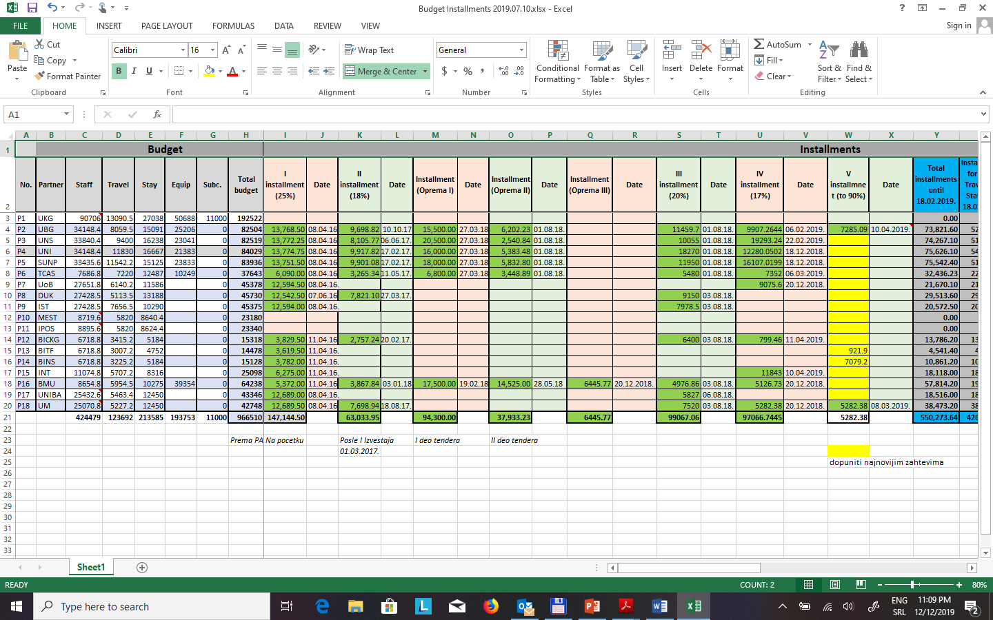
Financial Management and Liability
Example for monitoring of grant transfer to partners
Notes:
Did all of you have received their pre-finanancing?
If it is not specified, you shall discuss and adapt your partne agreement as for the finalpayment if may fbring to problems. Everybody shall be informed on how and when they will receive the money as from past experience we see that the majority of the problems arise from misunderstanding between partners specifically on allocation of the grant.
How to proceed if final result is a recovery order?

Slide 94
Financial Reporting
The reports must be in the language of the agreement: generally English
The financial reports must be in €
Linked third parties fill in a separate financial statement but only their beneficiaries can encode it in the IT system
Don´t forget to submit the Certificate on the financial statements (for beneficiaries and/or the linked third parties), if needed
Notes:
Keep track of your budget, as compared to your initial estimated budget. Only by doing this, you will be able to request a budget amendment on time.
Explain to your partners what you have experienced/learned here. Make everybody use the same template, do not develop others as we have worked to ease your financial tasks.
filling in Financial Statement with your expenses after each activity
at least at regular intervals (monthly??).
In order to keep track of your budget and to complete the financial statement properly, it is essential to keep good accounting records. Without reliable, up-to-date records, it is difficult for you to know the financial status of the project. Ensure that supporting documents are available (in each partner archives) to show that the costs claimed meet the conditions of the Grant Agreement.
Failure to do so may result in the Agency deciding to recover the unsubstantiated expenditure.
We recommend that you appoint one person to be responsible for the financial management of your project.
Please note that this is a time-consuming task which should not be underestimated.

Slide 95
Financial Reporting
Notes:
Keep track of your budget, as compared to your initial estimated budget. Only by doing this, you will be able to request a budget amendment on time.
Explain to your partners what you have experienced/learned here. Make everybody use the same template, do not develop others as we have worked to ease your financial tasks.
filling in Financial Statement with your expenses after each activity
at least at regular intervals (monthly??).
In order to keep track of your budget and to complete the financial statement properly, it is essential to keep good accounting records. Without reliable, up-to-date records, it is difficult for you to know the financial status of the project. Ensure that supporting documents are available (in each partner archives) to show that the costs claimed meet the conditions of the Grant Agreement.
Failure to do so may result in the Agency deciding to recover the unsubstantiated expenditure.
We recommend that you appoint one person to be responsible for the financial management of your project.
Please note that this is a time-consuming task which should not be underestimated.

Slide 96

In terms of Budget:
Follow the budget or request amendment if necessary
Establish the Financial Statement: Collecting supporting documents and Filling in the Financial Statement for each beneficiary and after each activity
Hire the appropriated Auditor to carry out the Report on factual funding for the final financial report
Keep the project financial accounting up-to-date.
Identify the problematic budget lines - Monitoring
Re-define the project budget and the grant allocation according to the budget lines when possible.
Bear in mind that some EU programmes provides a margin of error on the project budget compared with the initial budget in the bid - Adapting
Notes:
To be eligible, costs must have been foreseen in the estimated budget of the action, and must be incurred in connection with the project for which you receive funding.
Costs must be incurred by one of the Beneficiaries.
Costs incurred by any other person or organisation, not identified in the Grant Agreement, are not eligible unless they are reimbursed to this 'third party' by one of the Beneficiaries.
Costs must be incurred in relation to an activity taking place during the eligibility period of the project, with the exception of costs relating to the Report of Factual Findings on the Final Financial Report. For example, if you had a meeting before the start of the eligibility period, these costs would not be eligible. However, if you booked plane tickets before the start of the eligibility period, for a meeting taking place within the eligibility period, these costs would be eligible.
They must also be necessary, reasonable, justified and comply with the principle of sound financial management, in particular regarding economy and efficiency. In addition, they must comply with the requirements of the applicable tax and social legislation.
Finally, costs must be identifiable and verifiable. This means that they must be recorded in the accounting records of either the Project Leader or the Partners. This must be done with regard for the accounting standards of the country where they are located and using their accounting practices.
Please keep in mind that all invoices included in your final report must be paid when you submit it.

Slide 97
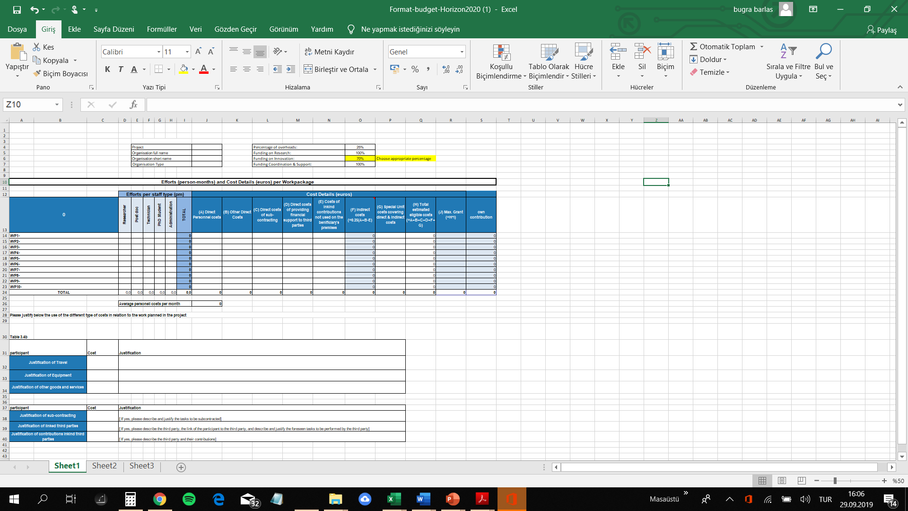
Budget for H2020
https://www.horizon2020.info/wp-content/uploads/2015/03/Format-budget-Horizon2020.xlsx
Notes:
To be eligible, costs must have been foreseen in the estimated budget of the action, and must be incurred in connection with the project for which you receive funding.
Costs must be incurred by one of the Beneficiaries.
Costs incurred by any other person or organisation, not identified in the Grant Agreement, are not eligible unless they are reimbursed to this 'third party' by one of the Beneficiaries.
Costs must be incurred in relation to an activity taking place during the eligibility period of the project, with the exception of costs relating to the Report of Factual Findings on the Final Financial Report. For example, if you had a meeting before the start of the eligibility period, these costs would not be eligible. However, if you booked plane tickets before the start of the eligibility period, for a meeting taking place within the eligibility period, these costs would be eligible.
They must also be necessary, reasonable, justified and comply with the principle of sound financial management, in particular regarding economy and efficiency. In addition, they must comply with the requirements of the applicable tax and social legislation.
Finally, costs must be identifiable and verifiable. This means that they must be recorded in the accounting records of either the Project Leader or the Partners. This must be done with regard for the accounting standards of the country where they are located and using their accounting practices.
Please keep in mind that all invoices included in your final report must be paid when you submit it.

Slide 98
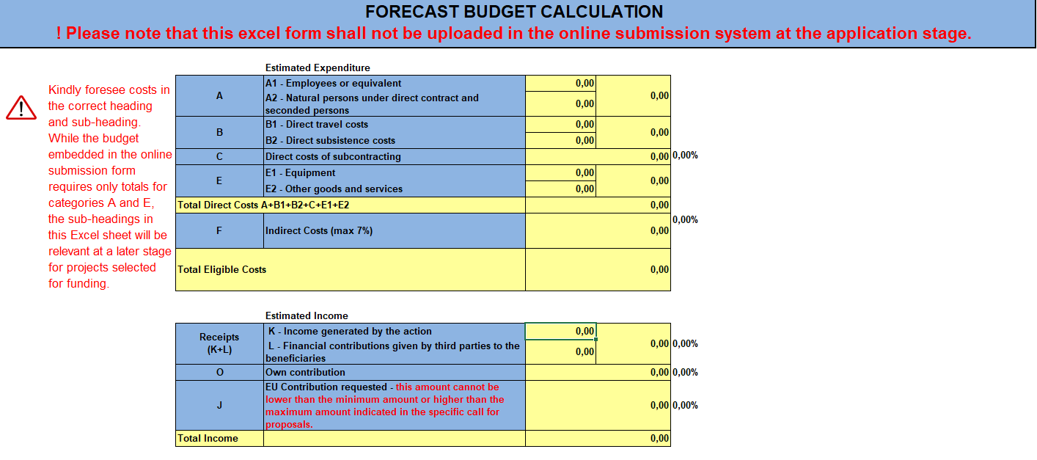
https://ec.europa.eu/research/participants/data/ref/other_eu_prog/common/just-rec-guide-budget-tpl_en.xls
Detailed budget template to facilitate the planning of your project
Notes:
To be eligible, costs must have been foreseen in the estimated budget of the action, and must be incurred in connection with the project for which you receive funding.
Costs must be incurred by one of the Beneficiaries.
Costs incurred by any other person or organisation, not identified in the Grant Agreement, are not eligible unless they are reimbursed to this 'third party' by one of the Beneficiaries.
Costs must be incurred in relation to an activity taking place during the eligibility period of the project, with the exception of costs relating to the Report of Factual Findings on the Final Financial Report. For example, if you had a meeting before the start of the eligibility period, these costs would not be eligible. However, if you booked plane tickets before the start of the eligibility period, for a meeting taking place within the eligibility period, these costs would be eligible.
They must also be necessary, reasonable, justified and comply with the principle of sound financial management, in particular regarding economy and efficiency. In addition, they must comply with the requirements of the applicable tax and social legislation.
Finally, costs must be identifiable and verifiable. This means that they must be recorded in the accounting records of either the Project Leader or the Partners. This must be done with regard for the accounting standards of the country where they are located and using their accounting practices.
Please keep in mind that all invoices included in your final report must be paid when you submit it.

Slide 99
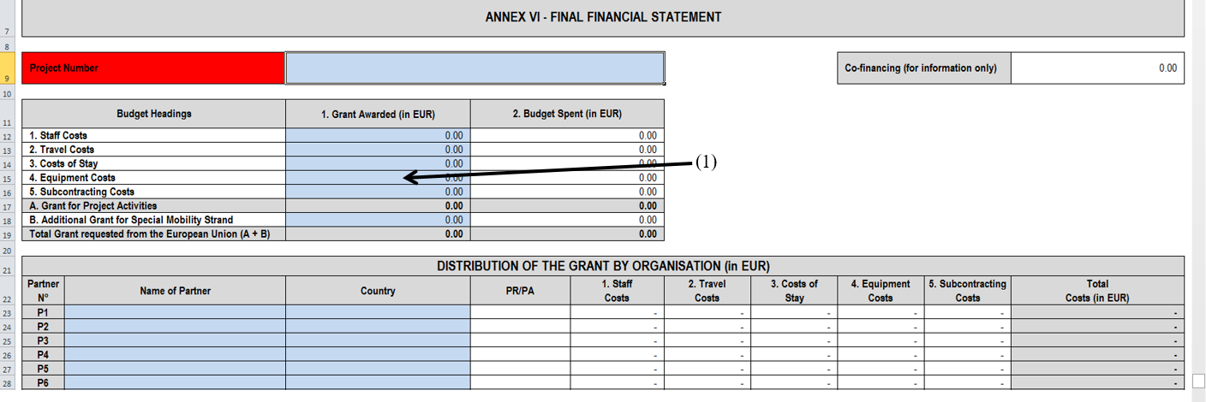
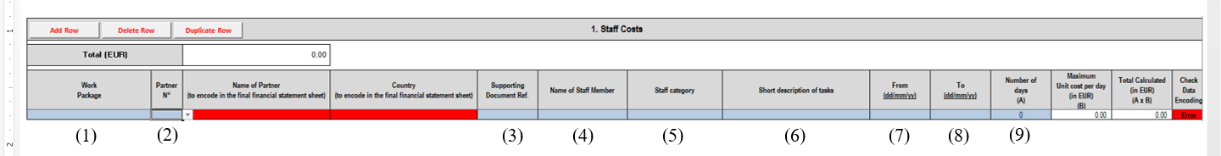
Notes:
To be eligible, costs must have been foreseen in the estimated budget of the action, and must be incurred in connection with the project for which you receive funding.
Costs must be incurred by one of the Beneficiaries.
Costs incurred by any other person or organisation, not identified in the Grant Agreement, are not eligible unless they are reimbursed to this 'third party' by one of the Beneficiaries.
Costs must be incurred in relation to an activity taking place during the eligibility period of the project, with the exception of costs relating to the Report of Factual Findings on the Final Financial Report. For example, if you had a meeting before the start of the eligibility period, these costs would not be eligible. However, if you booked plane tickets before the start of the eligibility period, for a meeting taking place within the eligibility period, these costs would be eligible.
They must also be necessary, reasonable, justified and comply with the principle of sound financial management, in particular regarding economy and efficiency. In addition, they must comply with the requirements of the applicable tax and social legislation.
Finally, costs must be identifiable and verifiable. This means that they must be recorded in the accounting records of either the Project Leader or the Partners. This must be done with regard for the accounting standards of the country where they are located and using their accounting practices.
Please keep in mind that all invoices included in your final report must be paid when you submit it.

Slide 100
In terms of Budget:
It is not possible to save money on the grant in the hope to keep the difference at the end of project implementation;
Where possible, always work with the Financial Services or a Finance officer within your organisation;
Bear in mind that the funder has set up some eligible and non-eligible expenses;
Always keep ORIGINAL proof of payment and the invoice for every expense made;
Organisations must be able to advance money as there could be some cash flow issues;
Notes:
To be eligible, costs must have been foreseen in the estimated budget of the action, and must be incurred in connection with the project for which you receive funding.
Costs must be incurred by one of the Beneficiaries.
Costs incurred by any other person or organisation, not identified in the Grant Agreement, are not eligible unless they are reimbursed to this 'third party' by one of the Beneficiaries.
Costs must be incurred in relation to an activity taking place during the eligibility period of the project, with the exception of costs relating to the Report of Factual Findings on the Final Financial Report. For example, if you had a meeting before the start of the eligibility period, these costs would not be eligible. However, if you booked plane tickets before the start of the eligibility period, for a meeting taking place within the eligibility period, these costs would be eligible.
They must also be necessary, reasonable, justified and comply with the principle of sound financial management, in particular regarding economy and efficiency. In addition, they must comply with the requirements of the applicable tax and social legislation.
Finally, costs must be identifiable and verifiable. This means that they must be recorded in the accounting records of either the Project Leader or the Partners. This must be done with regard for the accounting standards of the country where they are located and using their accounting practices.
Please keep in mind that all invoices included in your final report must be paid when you submit it.

Slide 101
To be eligible, costs must be:
Foreseen in the estimated budget
Incurred by a beneficiary, during the project duration
In relation to an activity taking place during the eligibility period
Identifiable and verifiable
Used for the sole purpose of achieving the objectives of the project – NO EXCEPTION!
Compliant with tax and social legislation requirements
Necessary, reasonable and justified
Paid
Notes:
To be eligible, costs must have been foreseen in the estimated budget of the action, and must be incurred in connection with the project for which you receive funding.
Costs must be incurred by one of the Beneficiaries.
Costs incurred by any other person or organisation, not identified in the Grant Agreement, are not eligible unless they are reimbursed to this 'third party' by one of the Beneficiaries.
Costs must be incurred in relation to an activity taking place during the eligibility period of the project, with the exception of costs relating to the Report of Factual Findings on the Final Financial Report. For example, if you had a meeting before the start of the eligibility period, these costs would not be eligible. However, if you booked plane tickets before the start of the eligibility period, for a meeting taking place within the eligibility period, these costs would be eligible.
They must also be necessary, reasonable, justified and comply with the principle of sound financial management, in particular regarding economy and efficiency. In addition, they must comply with the requirements of the applicable tax and social legislation.
Finally, costs must be identifiable and verifiable. This means that they must be recorded in the accounting records of either the Project Leader or the Partners. This must be done with regard for the accounting standards of the country where they are located and using their accounting practices.
Please keep in mind that all invoices included in your final report must be paid when you submit it.

Slide 102
In terms of Budget:
In multi-stakeholder projects, all beneficiaries have an independent role in financial matters and reporting.
The agreement/contract defines the general conditions for costs to be eligible.
The main categories in H2020 eligible costs are
actual costs,
unit costs,
flat-rate costs,
direct personnel costs,
direct costs for subcontracting, and
other direct costs (e.g. travel costs, equipment, other etc.).
Project-related invoices, accounting transfers and corrections are handled as other accounting matters, and in addition to instructions from the funding body
The same legislature and regulations apply as with accounting for companies.
Notes:
To be eligible, costs must have been foreseen in the estimated budget of the action, and must be incurred in connection with the project for which you receive funding.
Costs must be incurred by one of the Beneficiaries.
Costs incurred by any other person or organisation, not identified in the Grant Agreement, are not eligible unless they are reimbursed to this 'third party' by one of the Beneficiaries.
Costs must be incurred in relation to an activity taking place during the eligibility period of the project, with the exception of costs relating to the Report of Factual Findings on the Final Financial Report. For example, if you had a meeting before the start of the eligibility period, these costs would not be eligible. However, if you booked plane tickets before the start of the eligibility period, for a meeting taking place within the eligibility period, these costs would be eligible.
They must also be necessary, reasonable, justified and comply with the principle of sound financial management, in particular regarding economy and efficiency. In addition, they must comply with the requirements of the applicable tax and social legislation.
Finally, costs must be identifiable and verifiable. This means that they must be recorded in the accounting records of either the Project Leader or the Partners. This must be done with regard for the accounting standards of the country where they are located and using their accounting practices.
Please keep in mind that all invoices included in your final report must be paid when you submit it.

Slide 103
In terms of Budget:
All invoices for the project must include the relevant target area number and the information required by the funder as reference data.
The invoice address for invoices paid by the project (purchase invoices) is always the relevant partner organisation’s financial services.
Nowadays, an invoice request can be made using an electronic form.
Typically, invoices are approved by the project manager and checked by the financial officer.
For accounting purposes, all invoices must be accompanied with an adequate explanation about the reason for the cost in line with the EC’s instructions.
Notes:
To be eligible, costs must have been foreseen in the estimated budget of the action, and must be incurred in connection with the project for which you receive funding.
Costs must be incurred by one of the Beneficiaries.
Costs incurred by any other person or organisation, not identified in the Grant Agreement, are not eligible unless they are reimbursed to this 'third party' by one of the Beneficiaries.
Costs must be incurred in relation to an activity taking place during the eligibility period of the project, with the exception of costs relating to the Report of Factual Findings on the Final Financial Report. For example, if you had a meeting before the start of the eligibility period, these costs would not be eligible. However, if you booked plane tickets before the start of the eligibility period, for a meeting taking place within the eligibility period, these costs would be eligible.
They must also be necessary, reasonable, justified and comply with the principle of sound financial management, in particular regarding economy and efficiency. In addition, they must comply with the requirements of the applicable tax and social legislation.
Finally, costs must be identifiable and verifiable. This means that they must be recorded in the accounting records of either the Project Leader or the Partners. This must be done with regard for the accounting standards of the country where they are located and using their accounting practices.
Please keep in mind that all invoices included in your final report must be paid when you submit it.

Slide 104
What cost categories are applicable in H2020 programme?
Direct Costs (that can be attributed directly to the project)
Personnel costs (can also include “in-house consultants”)
Sub-contracting/Third Party Assistance e.g.: Costs for Financial Certificates
Other direct costs
Travel costs for personnel working on the project
Costs for consumables
Other costs
Purchase costs/renting costs of durable equipment (depreciation)
Indirect costs - all those costs which cannot be identified as attributed directly to the project (the “running” costs: electricity, heating, telephone, internet etc. – also called “overheads”)
Notes:
To be eligible, costs must have been foreseen in the estimated budget of the action, and must be incurred in connection with the project for which you receive funding.
Costs must be incurred by one of the Beneficiaries.
Costs incurred by any other person or organisation, not identified in the Grant Agreement, are not eligible unless they are reimbursed to this 'third party' by one of the Beneficiaries.
Costs must be incurred in relation to an activity taking place during the eligibility period of the project, with the exception of costs relating to the Report of Factual Findings on the Final Financial Report. For example, if you had a meeting before the start of the eligibility period, these costs would not be eligible. However, if you booked plane tickets before the start of the eligibility period, for a meeting taking place within the eligibility period, these costs would be eligible.
They must also be necessary, reasonable, justified and comply with the principle of sound financial management, in particular regarding economy and efficiency. In addition, they must comply with the requirements of the applicable tax and social legislation.
Finally, costs must be identifiable and verifiable. This means that they must be recorded in the accounting records of either the Project Leader or the Partners. This must be done with regard for the accounting standards of the country where they are located and using their accounting practices.
Please keep in mind that all invoices included in your final report must be paid when you submit it.

Slide 105
Staff direct costs should be calculated on a monthly pro rata basis, unless staff is employed full time on the project, in which case pay slip will be sufficient
You need to know the monthly staff cost of each member involved for the organisation (gross salary + national insurance + suppluments);
You need to know how many days have been worked in total during the month by each member of staff involved in the project;
You need to know how many working days have been dedicated to the project by each staff member involved.
Indirect costs are eligible under specific conditions as defined by the funder.
In any case, overheads costs must be directly linked to the project. These costs can be for heating, lighting, rent, communication, etc. You need to calculate real costs incurred for the project.
Notes:
To be eligible, costs must have been foreseen in the estimated budget of the action, and must be incurred in connection with the project for which you receive funding.
Costs must be incurred by one of the Beneficiaries.
Costs incurred by any other person or organisation, not identified in the Grant Agreement, are not eligible unless they are reimbursed to this 'third party' by one of the Beneficiaries.
Costs must be incurred in relation to an activity taking place during the eligibility period of the project, with the exception of costs relating to the Report of Factual Findings on the Final Financial Report. For example, if you had a meeting before the start of the eligibility period, these costs would not be eligible. However, if you booked plane tickets before the start of the eligibility period, for a meeting taking place within the eligibility period, these costs would be eligible.
They must also be necessary, reasonable, justified and comply with the principle of sound financial management, in particular regarding economy and efficiency. In addition, they must comply with the requirements of the applicable tax and social legislation.
Finally, costs must be identifiable and verifiable. This means that they must be recorded in the accounting records of either the Project Leader or the Partners. This must be done with regard for the accounting standards of the country where they are located and using their accounting practices.
Please keep in mind that all invoices included in your final report must be paid when you submit it.

Slide 106
Staff direct costs – Time recording in H2020 - example
Notes:
To be eligible, costs must have been foreseen in the estimated budget of the action, and must be incurred in connection with the project for which you receive funding.
Costs must be incurred by one of the Beneficiaries.
Costs incurred by any other person or organisation, not identified in the Grant Agreement, are not eligible unless they are reimbursed to this 'third party' by one of the Beneficiaries.
Costs must be incurred in relation to an activity taking place during the eligibility period of the project, with the exception of costs relating to the Report of Factual Findings on the Final Financial Report. For example, if you had a meeting before the start of the eligibility period, these costs would not be eligible. However, if you booked plane tickets before the start of the eligibility period, for a meeting taking place within the eligibility period, these costs would be eligible.
They must also be necessary, reasonable, justified and comply with the principle of sound financial management, in particular regarding economy and efficiency. In addition, they must comply with the requirements of the applicable tax and social legislation.
Finally, costs must be identifiable and verifiable. This means that they must be recorded in the accounting records of either the Project Leader or the Partners. This must be done with regard for the accounting standards of the country where they are located and using their accounting practices.
Please keep in mind that all invoices included in your final report must be paid when you submit it.

Slide 107
Indirect costs are eligible under specific conditions as defined by the funder.
In any case, overheads costs must be directly linked to the project.
These costs can be for heating, lighting, rent, communication, etc.
You need to calculate real costs incurred for the project.
Subcontracting, or procurement, might be necessary during project implementation.
The procurement of some of your project’s activities must be balanced and should represent a small part of the total activities of your project.
That is why it is necessary to include complementary partners within project’s partnership in order to limit the use of subcontractors
Notes:
To be eligible, costs must have been foreseen in the estimated budget of the action, and must be incurred in connection with the project for which you receive funding.
Costs must be incurred by one of the Beneficiaries.
Costs incurred by any other person or organisation, not identified in the Grant Agreement, are not eligible unless they are reimbursed to this 'third party' by one of the Beneficiaries.
Costs must be incurred in relation to an activity taking place during the eligibility period of the project, with the exception of costs relating to the Report of Factual Findings on the Final Financial Report. For example, if you had a meeting before the start of the eligibility period, these costs would not be eligible. However, if you booked plane tickets before the start of the eligibility period, for a meeting taking place within the eligibility period, these costs would be eligible.
They must also be necessary, reasonable, justified and comply with the principle of sound financial management, in particular regarding economy and efficiency. In addition, they must comply with the requirements of the applicable tax and social legislation.
Finally, costs must be identifiable and verifiable. This means that they must be recorded in the accounting records of either the Project Leader or the Partners. This must be done with regard for the accounting standards of the country where they are located and using their accounting practices.
Please keep in mind that all invoices included in your final report must be paid when you submit it.

Slide 108
Depreciation means the loss of value of a good purchased as part of the project over time. Depreciation is not a “traditional” expenditure but it has to be taken into account in your Project budget.
In order to calculate the depreciation of a good, you will need the following information:
Whole project duration in months
Date of purchase of the good
Purchasing cost of the good
Usage rate of the good
You need to calculate the number of months in one year only when you are using the good divided by the total duration of your project in months;
Multiply that result by the purchasing cost of the good (price with all taxes included for not-for profit organisations, price without taxes for businesses);
Notes:
To be eligible, costs must have been foreseen in the estimated budget of the action, and must be incurred in connection with the project for which you receive funding.
Costs must be incurred by one of the Beneficiaries.
Costs incurred by any other person or organisation, not identified in the Grant Agreement, are not eligible unless they are reimbursed to this 'third party' by one of the Beneficiaries.
Costs must be incurred in relation to an activity taking place during the eligibility period of the project, with the exception of costs relating to the Report of Factual Findings on the Final Financial Report. For example, if you had a meeting before the start of the eligibility period, these costs would not be eligible. However, if you booked plane tickets before the start of the eligibility period, for a meeting taking place within the eligibility period, these costs would be eligible.
They must also be necessary, reasonable, justified and comply with the principle of sound financial management, in particular regarding economy and efficiency. In addition, they must comply with the requirements of the applicable tax and social legislation.
Finally, costs must be identifiable and verifiable. This means that they must be recorded in the accounting records of either the Project Leader or the Partners. This must be done with regard for the accounting standards of the country where they are located and using their accounting practices.
Please keep in mind that all invoices included in your final report must be paid when you submit it.

Slide 109
Information required by the EC by cost category – in H2020
Notes:
To be eligible, costs must have been foreseen in the estimated budget of the action, and must be incurred in connection with the project for which you receive funding.
Costs must be incurred by one of the Beneficiaries.
Costs incurred by any other person or organisation, not identified in the Grant Agreement, are not eligible unless they are reimbursed to this 'third party' by one of the Beneficiaries.
Costs must be incurred in relation to an activity taking place during the eligibility period of the project, with the exception of costs relating to the Report of Factual Findings on the Final Financial Report. For example, if you had a meeting before the start of the eligibility period, these costs would not be eligible. However, if you booked plane tickets before the start of the eligibility period, for a meeting taking place within the eligibility period, these costs would be eligible.
They must also be necessary, reasonable, justified and comply with the principle of sound financial management, in particular regarding economy and efficiency. In addition, they must comply with the requirements of the applicable tax and social legislation.
Finally, costs must be identifiable and verifiable. This means that they must be recorded in the accounting records of either the Project Leader or the Partners. This must be done with regard for the accounting standards of the country where they are located and using their accounting practices.
Please keep in mind that all invoices included in your final report must be paid when you submit it.

Slide 110
Example – Procurement of goods or services – rules defined in ERASMUS
Principles of transparency, equal treatment of potential contractors, avoiding conflicts of interests
Relevant to the objectives of the project
The beneficiary shall apply the tendering procedure for the purchase of any kind of goods or services WHENEVER the amount of the purchase/sub-contract is between EUR 25.000 and 134.000
In that case the beneficiaries shall launch a tendering procedure and obtain competitive offers from at least three suppliers and retain the one offering best value for money,
If value of purchase/sub-contract exceeds EUR 134.000, national legislation will be applicable
It is not allowed to split purchase/sub-contract into smaller contracts below the threshold to avoid a tendering procedure!
Notes:
To be eligible, costs must have been foreseen in the estimated budget of the action, and must be incurred in connection with the project for which you receive funding.
Costs must be incurred by one of the Beneficiaries.
Costs incurred by any other person or organisation, not identified in the Grant Agreement, are not eligible unless they are reimbursed to this 'third party' by one of the Beneficiaries.
Costs must be incurred in relation to an activity taking place during the eligibility period of the project, with the exception of costs relating to the Report of Factual Findings on the Final Financial Report. For example, if you had a meeting before the start of the eligibility period, these costs would not be eligible. However, if you booked plane tickets before the start of the eligibility period, for a meeting taking place within the eligibility period, these costs would be eligible.
They must also be necessary, reasonable, justified and comply with the principle of sound financial management, in particular regarding economy and efficiency. In addition, they must comply with the requirements of the applicable tax and social legislation.
Finally, costs must be identifiable and verifiable. This means that they must be recorded in the accounting records of either the Project Leader or the Partners. This must be done with regard for the accounting standards of the country where they are located and using their accounting practices.
Please keep in mind that all invoices included in your final report must be paid when you submit it.

Slide 111
Cots categories applicable in ERASMUS programme – information required
Reimbursement basis | Budget Headings | Documents to retain with project accounts | Documents to be sent with the Final report
ACTUAL | Equipment | Invoices Bank statements Tendering procedure for expenses exceeding 25.000€ Proof that the equipment is recorded in the inventory of the institution | Invoices and three quotations from different suppliers for expenses exceeding 25.000€ Any prior authorisation from the Agency
 | Subcontracting | Subcontracts Invoices Bank statements Tendering procedure for expenses exceeding 25.000€ Tangible outputs/products* | Subcontracts, invoices and three quotations from different suppliers for expenses exceeding 25.000€ Any prior authorisation from the Agency
UNIT | Staff | Formal employment contract Staff convention Time sheets Agendas* Attendance / Participant lists* Tangible outputs/products* Minutes of meetings* | No supporting documents should be sent with the Final report, except for any prior authorisation from the Agency
 | Travel and Costs of Stay | Individual Travel Report (ITR) Invoices, receipts, boarding passes* Agendas* Attendance / Participant lists* Tangible outputs/products* Minutes of meetings* | No supporting documents should be sent with the Final report, except for any prior authorisation from the Agency
Notes:
To be eligible, costs must have been foreseen in the estimated budget of the action, and must be incurred in connection with the project for which you receive funding.
Costs must be incurred by one of the Beneficiaries.
Costs incurred by any other person or organisation, not identified in the Grant Agreement, are not eligible unless they are reimbursed to this 'third party' by one of the Beneficiaries.
Costs must be incurred in relation to an activity taking place during the eligibility period of the project, with the exception of costs relating to the Report of Factual Findings on the Final Financial Report. For example, if you had a meeting before the start of the eligibility period, these costs would not be eligible. However, if you booked plane tickets before the start of the eligibility period, for a meeting taking place within the eligibility period, these costs would be eligible.
They must also be necessary, reasonable, justified and comply with the principle of sound financial management, in particular regarding economy and efficiency. In addition, they must comply with the requirements of the applicable tax and social legislation.
Finally, costs must be identifiable and verifiable. This means that they must be recorded in the accounting records of either the Project Leader or the Partners. This must be done with regard for the accounting standards of the country where they are located and using their accounting practices.
Please keep in mind that all invoices included in your final report must be paid when you submit it.

Slide 112
Budget reallocations - amendments
When an amendment is/is not required for budget reallocations?

Slide 113
Budget reallocations - amendments
When an amendment is/is not required for budget reallocations?

Slide 114
Budget reallocations - amendments
Example 1 - Budget reallocations between forms of costs within personnel costs
Example 2 – Budget reallocation between partners

Slide 115
Budget reallocations - amendments
Example 3 - NO legal amendment
 | EUR | Budget transfer | % of budget heading | result | % of total grant
I STAFF COSTS | 340.000 |  |  | 340.000 | 40%
II TRAVEL COSTS | 150.000 |  |  | 150.000 | 17,5%
III COSTS OF STAY | 150.000 | -10.000 |  | 140.000 | 16,5%
IV EQUIPMENT | 160.000 | +10.000 | +6% of 160.000 | 170.000 | 20%
V SUBCONTRACTING | 50.000 |  |  | 50.000 | 6%
TOTAL GRANT (total I-V) | 850.000 |  |  | 850.000

Slide 116
Budget reallocations - amendments
Example 4 – legal amendment needed
 | EUR | Budget transfer | % of budget heading | result | % of total grant
I STAFF COSTS | 340.000 |  |  | 340.000 | 40%
II TRAVEL COSTS | 150.000 |  |  | 150.000 | 17,5%
III COSTS OF STAY | 150.000 | -10.000 |  | 140.000 | 16,5%
IV EQUIPMENT | 160.000 |  |  | 160.000 | 19%
V SUBCONTRACTING | 50.000 | +10.000 | +20% of budget heading | 60.000 | 7%
TOTAL GRANT (total I-V) | 850.000 |  |  | 850.000

Slide 117
Budget reallocations - amendments
Example 5 – Modification NOT ACCEPTED !!!!!
 | EUR | Budget transfer | % of budget heading | result | % of total grant
I STAFF COSTS | 340.000 | +45.000 | +13% of budget heading | 385.000 | 45,5%
II TRAVEL COSTS | 150.000 |  |  | 150.000 | 17,5%
III COSTS OF STAY | 150.000 | -20.000 |  | 130.000 | 15%
IV EQUIPMENT | 160.000 |  |  | 160.000 | 19%
V SUBCONTRACTING | 50.000 | -25.000 |  | 25.000 | 3%
TOTAL GRANT (total I-V) | 850.000 |  |  | 850.000

Slide 118
Cash flow in H2020 projects
The sum of pre-financing and all interim payments may not exceed 90% of the maximum grant amount during the project life cycle.
This means that during certain stages of the project, Beneficiaries can have a negative cash-flow.
Because of that, each Beneficiary must have the financial capacity to cover the costs in accordance with the project financial plan, regardless of inflows from the EC.

Slide 119
Cash flow in H2020 projects

Slide 120
Cash flow in ERASMUS projects Cash flow for Staff costs

Slide 121
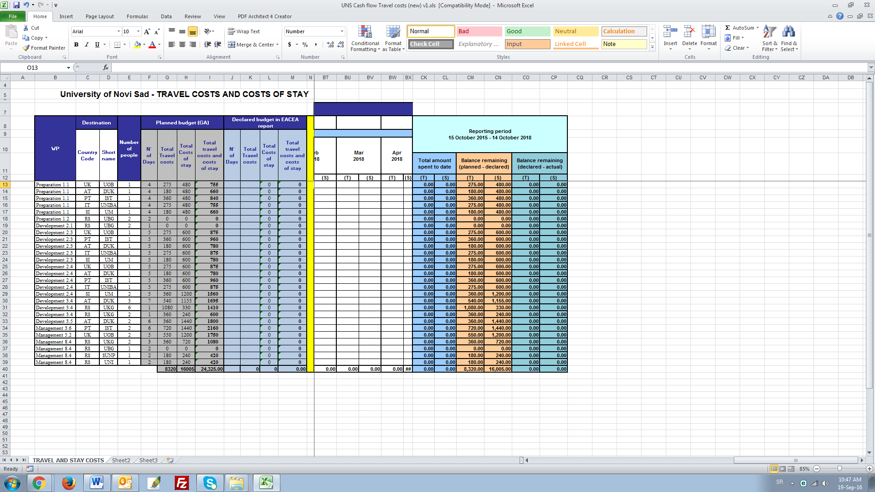
Cash flow in ERASMUS projects Cash flow for Travel costs and Cost of Stay

Slide 122
Typical mistakes in financial reporting (provided by the EC)
Costs claimed for people not directly employed nor paid by the beneficiary.
Personnel costs claimed based on budgeted, standard, estimated rates.
Average hourly rates used which differs significantly from actual ones.
Billable hours are used instead of number of workable hours.
For the calculation of the number of productive hours on the project, including time spent related to maintaining general expertise, administration and/or sales.
Absence of timesheets.
Timesheets not approved by a project leader.
For the calculation of the hourly personnel rate, by dividing the payroll costs by the number of productive hours on the project (only) instead of by the total number of productive hours.
Personnel costs claimed include overtime hours for which staff have not been paid.
Personnel costs claimed include the remuneration of an in-house consultant hired through a contract with a consultancy firm (no labour contract, no direct instructions, not 100% on the premises, commercial rate, etc).
Overhead costs included in the personnel cost calculation.
Notes:
To be eligible, costs must have been foreseen in the estimated budget of the action, and must be incurred in connection with the project for which you receive funding.
Costs must be incurred by one of the Beneficiaries.
Costs incurred by any other person or organisation, not identified in the Grant Agreement, are not eligible unless they are reimbursed to this 'third party' by one of the Beneficiaries.
Costs must be incurred in relation to an activity taking place during the eligibility period of the project, with the exception of costs relating to the Report of Factual Findings on the Final Financial Report. For example, if you had a meeting before the start of the eligibility period, these costs would not be eligible. However, if you booked plane tickets before the start of the eligibility period, for a meeting taking place within the eligibility period, these costs would be eligible.
They must also be necessary, reasonable, justified and comply with the principle of sound financial management, in particular regarding economy and efficiency. In addition, they must comply with the requirements of the applicable tax and social legislation.
Finally, costs must be identifiable and verifiable. This means that they must be recorded in the accounting records of either the Project Leader or the Partners. This must be done with regard for the accounting standards of the country where they are located and using their accounting practices.
Please keep in mind that all invoices included in your final report must be paid when you submit it.

Slide 123
Monitoring and Audits
Vesna Mandić
12:15-13:00

Slide 124
Monitoring
Monitoring is a standard part of the quality management cycle. In general, it should allow both the Agency and the coordinators to follow-up the project performance and results.
Monitoring can have different objectives. They aim principally to:
assess the implementation of successful project management strategies (legal aspects, regularity and sound financial management);
provide advice and support to the beneficiaries in the implementation of their project from both operational and financial perspectives; inform them of the practical rules of daily management;
monitor the correct execution of the projects, in line with the operational and financial plans;
identify any potential problems during the project implementation;
identify best practices and lessons learned, and demonstrate the European added value of the Programme;
contribute to the achievement of the EU policy priorities as described in the call.

Slide 125

Monitoring
Evaluations are useful for reporting the success of the project, building on experience and improving the management of the project.
Evaluation results are the basis for decision making regarding the current project or future projects.
Partners have to define the criteria by which the project will be assessed.
Those may relate to efficiency, impact, pertinence, reach, innovation, etc.
Keep partners informed of the evaluation results and the remedial actions taken

Slide 126
Monitoring
One or more of the following evaluation methods may be used:
External evaluator: a person from outside the partnership will assess the project. You have to pay for this method.
Internal evaluator: One of the partners will assess the project.
Assisted auto-evaluation: The partnership will be assessed by an evaluator or an evaluation agency. You have to pay for this method.
Cross-evaluation: Where you have two similar projects, a person from one project will evaluate the other one

Slide 127

Internal Quality Assurance
For the project by the project Not "limited to" internal QA of the participating HEIs
Concerns all dimensions of the project
Academic aspects, financial & administrative, management, outputs, visibility/dissemination, impact, relations with EU, etc.
Involves all parties concerned by the project
Academic, admin. staff, students, local stakeholders, etc.
Tools: roadmaps, dashboards, questionnaires, reports etc.

Slide 128
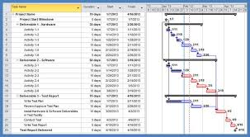

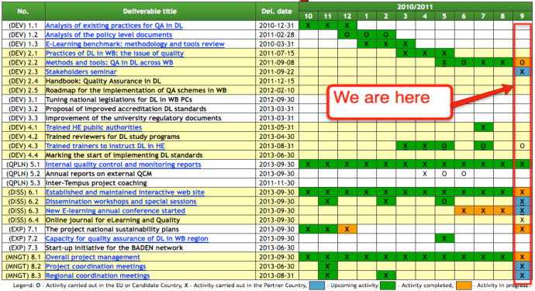
Internal Quality Assurance
Nominate team or person responsible for the monitoring of activities and outputs:
Regular assessment of LFM, Work plan and Budget
Progress reporting (Indicators of progress) – at project level or by work package / activity
Financial reviews
Analysis of Evaluation and Monitoring reports
Recommendations / Corrective actions

Slide 129

External Quality Assurance
Persons/bodies not involved in the project
Peer-review by experts not involved in the consortium
Representatives from local authorities / private companies
National QA Agencies
Same holistic approach as for internal QA (in terms of dimensions addressed and parties consulted).
Regular monitoring + recommendations

Slide 130
Quality Assurance Plan
The main objectives are to:
• Manage the interaction between the beneficiaries during the execution of work;
• Define the procedures for monitoring progress on a regular basis;
• Detail how and when the documentation and reporting have to be done/exchanged by the beneficiaries and with the EC;
• Set editorial/quality standards for project deliverables and document;
• Develop dissemination guidelines if a dissemination plan is not available;
• Provide supporting templates.

Slide 131

Quality Assurance Plan – Example in IF4TM Erasmus project
Quality control and monitoring manual developed by UKG
Manual defines
Quality expectations
Quality of project implementation
Quality of project deliverables
Quality of project management
General project guidelines
Amendments to the Manual
Internal monitoring
Project quality assurance strategy
Quality responsibilities
Quality feedback by target groups
Project risk management
External monitoring
Partners’ technical and financial monitoring
www.if4tm.kg.ac.rs

Slide 132
Quality Assurance Plan – Example in IF4TM Erasmus project
Quality assurance project team (QAPT) – five members
Local project teams – responsible for the management and quality assurance at the level of each participating institution
The Quality control and monitoring manual – defines processes for planning and realization of the project activities in terms of quality
Action plan – used for planning of forthcoming activities and monitoring of the achieved results
Trello platform – project communication and coordination, document management, etc.
Drop Box – dissemination and archiving of large files (PPTs, photos, etc.)
Project (internal) website – for archiving large files
LFM indicators – regularly monitored
Internal monitoring at the level of Rectorate
www.if4tm.kg.ac.rs

Slide 133
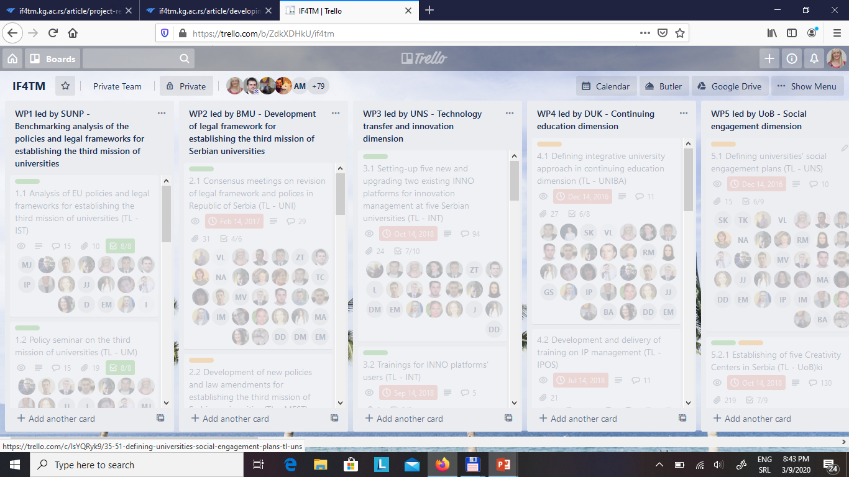
Quality Assurance Plan – Example in IF4TM Erasmus project
www.if4tm.kg.ac.rs

Slide 134
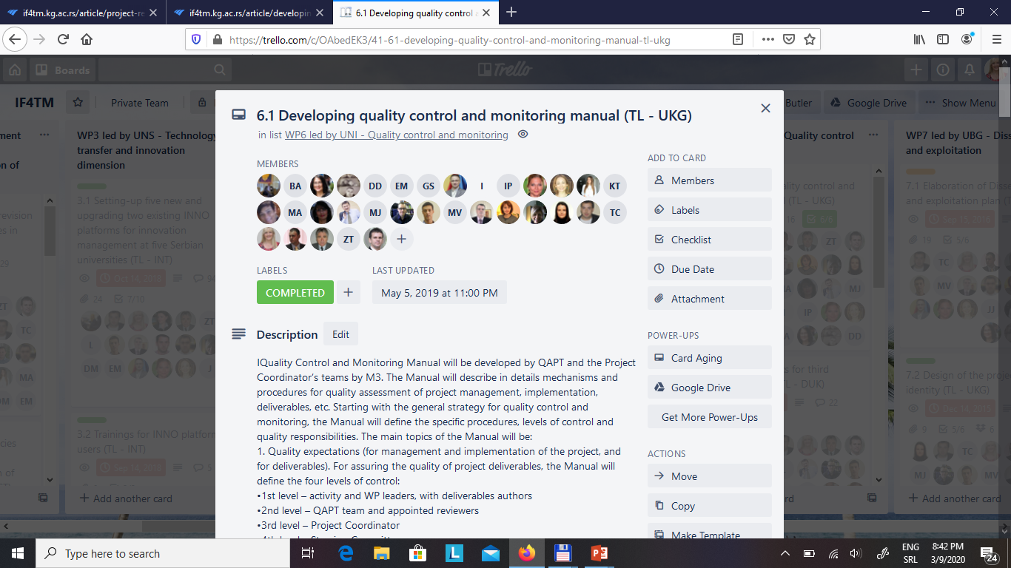
Quality Assurance Plan – Example in IF4TM Erasmus project

Slide 135
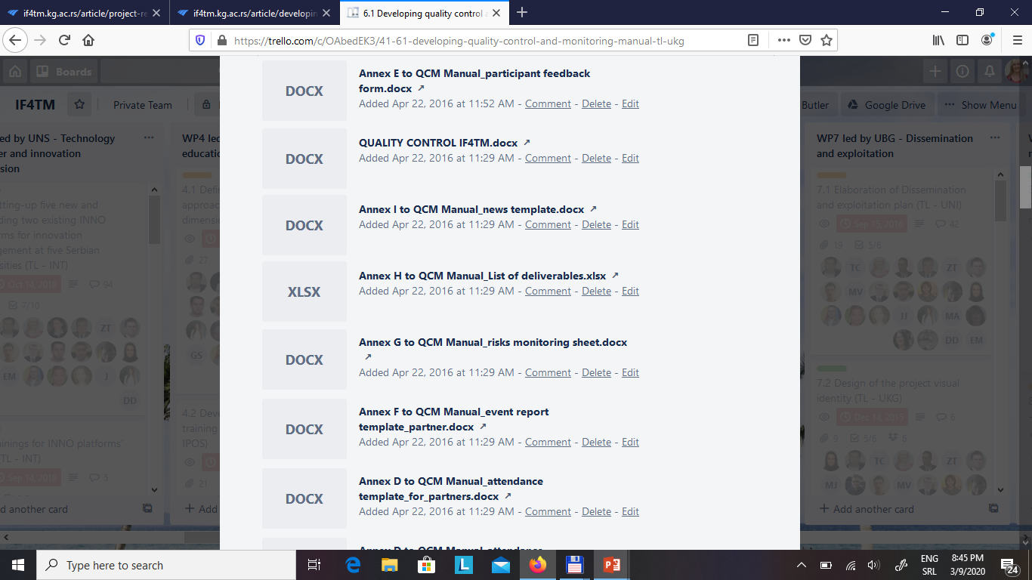
Quality Assurance Plan – Example in IF4TM Erasmus project

Slide 136
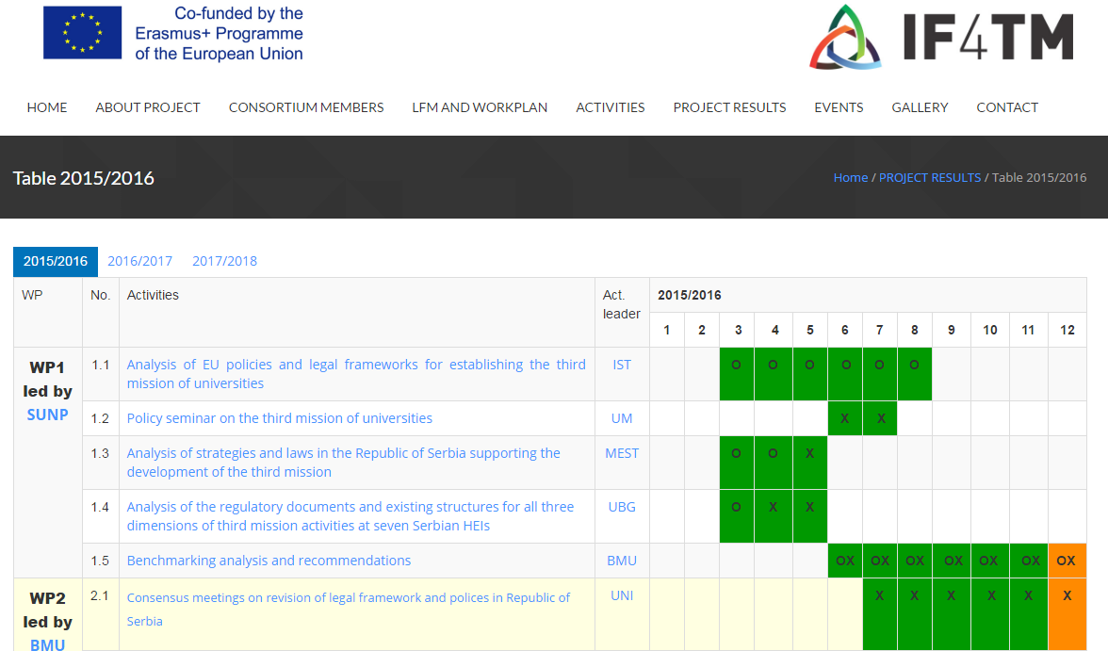
Quality Assurance Plan – Example in IF4TM Erasmus project
www.if4tm.kg.ac.rs

Slide 137

Audit
The European Commission may decide to audit a project during its implementation and up to five or ten years after the project closure (according to the EU programme).
The audit aims to check that the project expenses covered by the European grant comply with the eligibility rules as defined in the Grant Agreement signed between the project partnership and the managing authority
Commission, an audit firm or the Court of Auditors could audit the project
Either the project leader or a project partner (even a subcontractor) may be audited. In that case, the organisation has to make available the logistical means requested by the auditor who has been mandated by the European Commission.
The auditor must have full Access to every original supporting document of whatever nature

Slide 138

Audit
The supporting documents have to prove that the project has been carried out.
Lead partner have to keep all the original documents and organise these under budget lines and in chronological order, including accounting and tax records and Bank statements
Coordinator should also scan the documents in order to keep a copy in the case the original is lost.
The project leader has to put in place a system within the partnership in order to gather the supporting documents and prepare the payment claims to the competent authority

Slide 139

Audit Checklist for the supporting documents
INFRASTRUCTURE, BUILDING, REFURBISHMENT - Act of sale or rent receipts, Invoices and receipt
CAPITAL ITEMS - Invoices and receipts
STAFF - Monthly timesheets, Pay-slips, Copies of the diary for each member of staff involved in the project, Agenda and minutes for each participation to a meeting or a seminar, Signed attendance sheets
FINANCIAL AUDIT COSTS (where applicable) - Invoices and receipts
TRAVEL AND SUBSISTENCE - Bus, train and flight tickets, Invoices for accommodation and catering
TRANSLATION, INTERPRETATION AND DOCUMENTS - Invoices and receipts
COMMUNICATION AND DISSEMINATION - Invoices and receipts, Copies of communication items (e.g. presentations, publications, etc)
SUBCONTRACTING (Communication, audit, translation) - Invoices and receipts
OVERHEADS - Invoices and receipts, Proof that the method of calculation has been approved by the certifying authority
DEPRECIATION - Proof of the method of calculation, Invoice for each purchased good
CONSUMABLES - Invoices and receipts
Notes:
The Agency and the Commission may carry out technical and financial checks and audits in relation to the use of the grant. We may also carry out interim or final evaluations of the impact of the project measured against the objectives of the Creative Europe Programme.
These checks, audits or evaluations may be carried out either directly by staff or by any outside body authorised to do so on our behalf. The Anti-Fraud Office OLAF and the European Court of Auditors have the same rights as the Agency and the Commission.

Slide 140
In general the following must be archived at an organisational level by all partners:
Timesheets
Payslips
Invoices
Contracts
Reports, data sent to the Coordinator
Procurement documents (offers or full procurement documentation)
Official letters
Proof on dissemination
Proof on event attendance
Notes:
The Agency and the Commission may carry out technical and financial checks and audits in relation to the use of the grant. We may also carry out interim or final evaluations of the impact of the project measured against the objectives of the Creative Europe Programme.
These checks, audits or evaluations may be carried out either directly by staff or by any outside body authorised to do so on our behalf. The Anti-Fraud Office OLAF and the European Court of Auditors have the same rights as the Agency and the Commission.

Slide 141

Obligation to provide information on-the spot visits
Coordinator shall:
Provide all supporting documents
Clarify any information requested
Access to sites and premises
If not, costs will be considered as non-eligible!
Notes:
When a check, audit or evaluation is initiated, the Coordinator shall provide any information, including in an electronic format, requested by the Agency, the Commission or any other outside body authorised to do so. Where appropriate, we may also request such information to be provided directly by one of the Partners.
During an on-the-spot visit, you will have to provide us with access to the sites and premises where the project is or was carried out, and to all necessary information including in electronic format. If you do not comply with these obligations, the costs under verification may be considered as ineligible.
It is the Beneficiary’s responsibility to give the Auditor access to all documents and databases related to the technical and financial management of the project and to obtain the accounting documents necessary to enable the Auditor to verify costs incurred by the Co-Beneficiaries.

Slide 142

Technical and Financial Checks
Checks and audits related to the use of the Grant
Interim or final evaluation of the impact of the action
Carried out by:
Agency and/or Commission staff
Authorised external auditor
Notes:
The Agency and the Commission may carry out technical and financial checks and audits in relation to the use of the grant. We may also carry out interim or final evaluations of the impact of the project measured against the objectives of the Creative Europe Programme.
These checks, audits or evaluations may be carried out either directly by staff or by any outside body authorised to do so on our behalf. The Anti-Fraud Office OLAF and the European Court of Auditors have the same rights as the Agency and the Commission.

Slide 143

13:00-14:00

Slide 144
Risk Management
Vesna Mandić
14:00-14:45

Slide 145
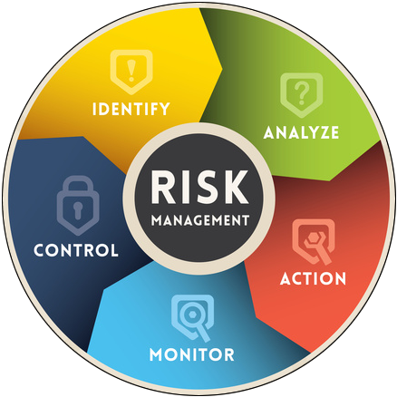

Risk management by definition is the identification, assessment, and prioritization of risks followed by coordinated and economical application of resources to minimize, monitor, and control the probability and/or impact of unfortunate events or to maximize the realization of opportunities.
The goal of the risk management is to establish the feasibility of the Project or any action taken within the organizational management structure, technology level, human resource capability, financial situation, and within the production and marketing level that limit its own business.
Risk management contains a set of continuous actions:
awareness,
identification,
evaluation, and
development of risk management methods,
decision making of suitable methods, implementation, and
post management.

Slide 146
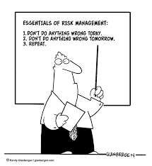

Risk management aims to reduce the risk areas in the project life cycle.
Proper risk management helps to avoid project crises and improve problem solving by managingrisks early in the project life cycle.
Typical steps of risk management:
• Identify the risk
• Evaluate the risk
• Identify the suitable responses to the risk
• Select the response measures
• Plan and evaluate
• Monitor and report (return to step 2)

Slide 147
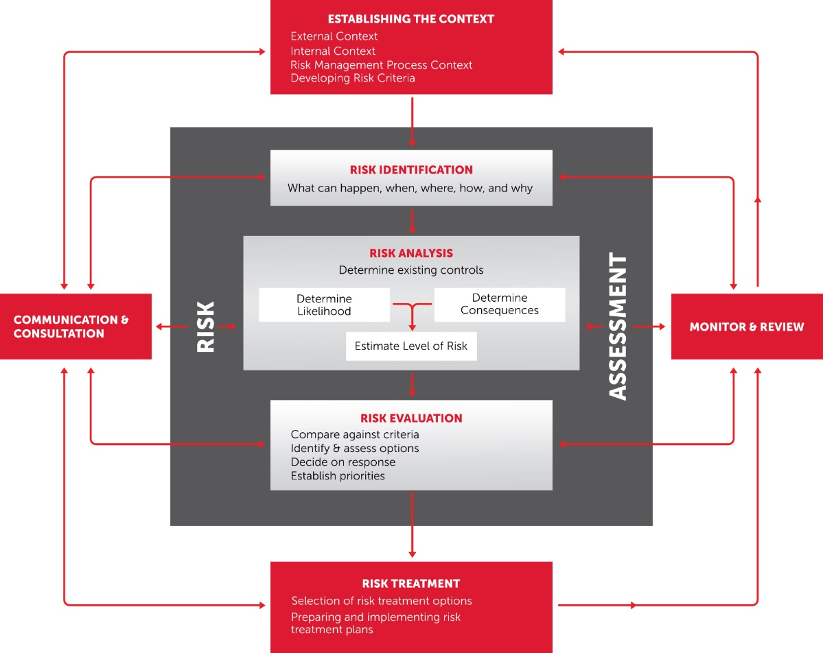

Slide 148

Communication and Consultation aims to identify who should be involved in assessment of risk (including identification, analysis and evaluation) and it should engage those who will be involved in the treatment, monitoring and review of risk. Identify the Risk Risk cannot be managed unless it is first identified. Once the context of the project has been defined, the next step is to utilise the information to identify as many risks as possible. The aim of risk identification is to identify possible risks that may affect, either negatively or positively. Analyse the Risk During the risk identification step, coordinator may have identified many risks and it is often not possible to try to address all those identified. The risk analysis step will assist in determining which risks have a greater consequence or impact than others. This will assist in providing a better understanding of the possible impact of a risk, or the likelihood of it occurring, in order to make a decision about committing resources to control the risk.

Slide 149
Evaluate the Risk It is important to be able to determine how serious the risks are that the project is facing. The coordinator must determine the level of risk that a project is willing to accept. Risk evaluation involves comparing the level of risk found during the analysis process with previously established risk criteria, and deciding whether these risks require treatment. Treat the Risk Risk treatment is about considering options for treating risks that were not considered acceptable or tolerable at previous step. Risk treatment involves identifying options for treating or controlling risk, in order to either reduce or eliminate negative consequences, or to reduce the likelihood of an adverse occurrence. Monitoring and Review Monitor and review is an essential and integral step in the risk management process. A coordinator must monitor risks and review the effectiveness of the treatment plan, strategies and management system that have been set up to effectively manage risk. Risks need to be monitored periodically to ensure changing circumstances do not alter the risk priorities.

Slide 150
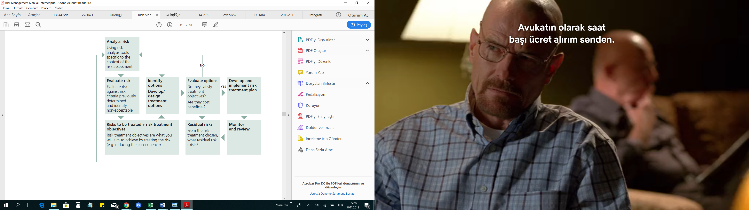

Slide 151
Risk management – example in Erasmus
Examples of Challenges | Possible contingency plans used in various projects
Commitment and motivation of partners | Expectations should constantly be communicated to partners. Delegate responsibilities to partners to increase their involvement in the project
Cultural differences, i.e. different ways to communicate and to deal with issues | Organise regular face-to-face meetings to know each other Cultural awareness to anticipate potential conflicts
Incomplete supporting documents | Project Handbook Training on Erasmus rules
Availability of staff (different academic years, conflict with other duties) | Have dedicated teams Plan well in advance

Slide 152
Risk management – example in Erasmus
Examples of challenges | Possible contingency plans used in various projects
Delays due to lengthy procedures: tendering, project registration, international accreditation, etc. | Prepare everything in advance, so that the activity can start as soon as the green light is given.
Visa issues | Plan meetings well in advance to allow time for the visa procedures
Political instability | Meetings relocated to safer location Contact EACEA in case of problems
Exchange rate issues | Keep project account in Euros Invoices paid by European coordinator/partners
Difficulty to make bank transfers | Use other means (Western Union type transfers, credit cards for partners) Cash payments not recommended

Slide 153
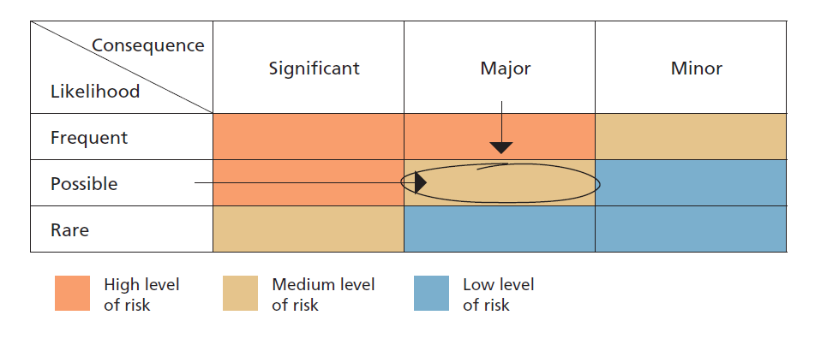

Slide 154


Slide 155

Intellectual Property
Goran Stojanović
14:45-15:00

Slide 156
Protecting your intellectual property has several benefits:
If you protect your invention, such as a new product, you become the only person with the right to use or reproduce it. Others cannot copy or reproduce what you have done without your permission.
When you protect your invention, the quality of the product is guaranteed and its origin is clear. This can be an advantage for your business, because customers may prefer to buy a product that has passed more restrictive checks (a controlled good).
You can earn money not only through direct use of IP, but also indirectly through licensing contracts. This is when you grant a licence to another company to use your IP protected subject matter for a certain period of time.
In some cases, such as for copyright and unregistered design, protecting your IP is automatic and doesn't require any formalities.
Owning a patent or a trade mark can increase your market value and make it easier for your business to find investors or other funding opportunities.

Slide 157

Describe which of the project outcomes:
You plan to patent
Or to sell licence
Or to protect as industrial design
Or as a standard, etc. etc.

Slide 158


Slide 159

COMMUNICATION and DISSEMINATION
Goran Stojanović
15:00-15:15

Slide 160
Communication plays an important role in making sure your project has a lasting impact! That's why communicating your project results is a requirement under virtually all EU programmes.
With the right strategic communication you will attract the interest of those who could benefit from your work – be it local or regional authorities, national governments, potential business partners or the research community.
Main aim should be forming a strong community of project partners, experts and investors who will exchange experiences, learn from each other and form new partnerships.
Communication is a broader concept. It includes information and promotion activities to raise awareness and enhance the visibility of the project’s activities in addition to the dissemination and exploitation of the project results. However, very often it is difficult to make a clear distinction between these areas. For this reason, planning an overall strategy framework covering both fields can be a more efficient way to make the most of the available resources. Dissemination and exploitation of results should form a crucial part of any communication activities taking place during the project’s lifetime.

Slide 161


Promotional materials for the project

Slide 162
The beneficiaries must promote the action and its results, by providing targeted information to multiple audiences (including the media and the public)
All beneficiaries shall take the necessary steps to ensure that the financial contribution of the EU is given adequate publicity.
Before engaging in a communication activity expected to have a major media impact, the beneficiaries must inform the Commission or agency

Slide 163
As an Example, with a little creativity, strategic communication in H2020 projects, can help publicise your work in such a way that you will profit. Suitably framed messages can help to:
Increase the success rate of your proposal (provided you have a good communication and dissemination plan);
Draw the attention of national governments, regional authorities and other public and private funding sources to the need for and ultimate benefits of (your) research;
Attract the interest of potential partners;
Encourage talented students and scientists to join your partner institutes and enterprises;
Enhance your reputation and visibility at local, national and international level;
Help the search for financial backers, licensees or industrial implementers to exploit your results;
Generate market demand for the products or services developed.

Slide 164
Communication Plan
(based on EU Communication & Visibility Manual)
Main Activities; that will take a place during the period covered by the communication and visibility Plan, includes details of:
The Nature of Activities
The responsibilities for delivering the activities
Target Group/Audience
Communication Tools chosen (Online, Offline, Media, Events, Promotional Materials)
Key messages
Completion of Communication Objectives
Provisions for Feedback
Human Resources:
Person/days required to implement the activities;
Members of Management team responsible for activities
Financial Resources: Budget required to implement the cımmunication activities

Slide 165

Dissemination, communication, exploitation

Slide 166
Recommendations for good communication
Start at the beginning of the project, continue through the entire project's lifetime
Plan strategically
Identify/Set clear communication objectives
Target audiences beyond own community
Choose pertinent messages, according to the audience
Use the right medium and means
Communicate research in a way that is understood by non-specialist, e.g. the media and the public.
All beneficiaries should be involved in the outreach activities.
Document the outreach activities (with short articles, blogs, photos, tweets, etc.).
Be innovative and think out of the box.

Slide 167
Some examples of communication activities:
Interact/Follow EU social media channels
Public talks, TV-talks, podcasts and articles
Leaflet, brochures, newsletters and E-Newsletters
Promotional items
Events and visits
Press releases
Participate to related fairs, workshops, seminars and Info Days
Multimedia releases, photographs, Project videos and/or animations
Active WebSites and blogging,
Participate to the campaigns promoted by the EU

Slide 168

Facebook
www.salsethproject.com

Slide 169

Twitter

Slide 170

Instagram

Slide 171

Linkedin

Slide 172

Communication Strategy – A Checklist
Ensure good management | Have resources been allocated (time and money)?
 | Are professional communicators involved?
 | Is continuity ensured?
Define your goals and objectives | Are there any goals and objectives set?
 | Are your goals and objectives neither too ambitious nor too weak?
Pick your audience | Is your audience well defined?
 | Does it include all relevant target groups
Choose your message | Why do we need to know? What will change? What solutions are you offering?
 | Are you connecting to what your audience wants to know? See through your audience's eyes
 | Are you connecting to your own communication objectives?
Use the right medium and means | Do they reach the audience?
 | Do they go beyond the obvious?
Evaluate your efforts | Have they been reached?
 | What lessons have you learned?

Slide 173



Slide 174

Communication | Dissemination
About the project and results | About results only
Multiple audiences Beyond the project's own community (include the media and the public) | Audiences that may use the results in their own work e.g. peers (scientific or the project's own community), industry and other commercial actors, professional organisations, policymakers
Inform and reach out to society, show the benefits of the project | Enable use and uptake of results
Starts at the beginning of the project | When results are available and even after the end of the project

Slide 175
Dissemination is a planned process of providing information on the results of programmes and initiatives to key actors. It occurs as and when the result of programmes and initiatives become available. Making others aware of the project will impact on other organisations in the future and will contribute to raising the profile of the organisation carrying out the project. To effectively disseminate results, an appropriate process at the beginning of the project needs to be designed. This should cover why, what, how, when, to whom and where disseminating results will take place, both during and after the funding period.
Exploitation is (a) a planned process of transferring the successful results of the programmes and initiatives to appropriate decision-makers in regulated local, regional, national or European systems, on the one hand, and (b) a planned process of convincing individual end-users to adopt and/or apply the results of programmes and initiatives, on the other hand. Results should be developed in such a way that they can be tailored to the needs of others; transferred to new areas; sustained after the funding period has finished; or used to influence future policy and practice.

Slide 176
Dissemination and exploitation goals may be to:
raise awareness;
extend the impact;
engage stakeholders and target groups;
share solutions and know how;
influence policy and practice;
develop new partnerships.

Slide 177
Dissemination and exploitation are distinct but closely related to one another. The first goal of dissemination and exploitation is to spread projects' results. The second goal is to contribute to the implementation and shaping of national and European policies and systems. Beneficiaries should develop their own way of achieving this goal. Developing ideas for dissemination and exploitation is important for every project funded by EU. Participating organisations should discuss the aims and objectives of the activities/plan and decide on the best activities and approaches as well as share the tasks among partners taking into account the particular specifics of the project.

Slide 178
The next step is to identify what to disseminate and exploit. The results of the project may be of diverse nature and consist of both concrete (tangible) results as well as of skills and personal experiences that both project organisers and participants to the activities have acquired (intangible results).
Tangible results may include for example:
an approach or a model to solve a problem;
a practical tool or product, such as handbooks, curricula, e-learning tools;
research reports or studies;
good practice guides or case studies;
evaluation reports;
recognition certificates;
newsletters or information leaflets.
Intangible results are often more difficult to measure. The use of interviews, questionnaires, tests, observations or self-assessment mechanisms may help to record this type of result.

Slide 179
Identifying target groups, both at different geographical levels (local, regional, national, European) and in the own field of the beneficiary (colleagues, peers, local authorities, other organisations leading the same type of activity, networks, etc.) is essential. Activities and messages have to be tailored appropriately taking into account audiences and target groups, for example:
end-users of the project activities and deliverables;
stakeholders, experts or practitioners in the field and other interested parties;
decision-makers at local, regional, national and European level;
press and media;
general public.

Slide 180
In order to reach as many people as possible, it is advisable to translate as many communication materials and project outputs in as many languages as possible. It is recommended to cover all languages of the partnership and English; the cost of these translations could be included in the grant request if necessary. There are many different ways to disseminate and exploit results. Beneficiaries could use:
programme Website or platforms;
project or organizational websites;
meetings and visits to key stakeholders;
dedicated discussion opportunities such as information sessions, workshops, (online) seminars, training courses, exhibitions, demonstrations, or peer reviews;
targeted written material such as reports, articles in specialised press, newsletters, press releases, leaflets or brochures;
audiovisual media and products such as radio, TV, YouTube, Flickr, video clips, podcasts or apps;
social media;
public events;
project branding and logos;
existing contacts and networks.

Slide 181
Dissemination and exploitation of results are an integral part of the projects throughout its lifetime: from the beneficiary's initial idea, during the project and even after European funding has ended. Setting up a timetable of activities together with the partners involved and allocating appropriate budget and resources is necessary. The plan shall:
agree realistic targets and deadlines with partners to monitor progress;
align dissemination and exploitation activities with key stages of the project;
offer sufficient flexibility to respond to the needs of the target group as well as wider developments in policy and practice.
Examples of activities at different stages of the project cycle are:
Before the project starts
drafting the dissemination and exploitation plan;
definition of the expected impact and deliverables;
consideration of how and to whom dissemination and exploitation outcomes will be disseminated.

Slide 182
During the Project
contacting relevant media e.g. at local or regional level;
conducting regular activities such as information sessions, training, demonstrations, peer reviews;
assessing the impact on target groups;
involving other stakeholders in view of transferring results to end users/ new areas/policies.
adding a banner with a link to project card within the Erasmus+ Project Platform on the project website
At Final Report Stage
uploading the final project results and an update of the project description on the Erasmus+ Project Results Platform.
After the Project
continuing further dissemination (as described above);
developing ideas for future cooperation;
evaluating achievements and impact;
contacting relevant media;
contacting policy-makers if relevant
cooperate with the European Commission by providing useful inputs to its dissemination and exploitation efforts.

Slide 186

Notes:
186

Slide 187

Notes:
187

Slide 188

Notes:
188

Slide 189

After the project reporting
Notes:
189

Slide 190
How to assess success?
The impact assessment is an essential part of the process. It evaluates achievements and generates recommendations for future improvements. Indicators could be used to measure progress towards goals. These are signs that help to measure performance. Indicators can be both quantitative relating to numbers and percentages as well as qualitative relating to the quality of the participation and experience. Questionnaires, interviews, observations and assessments could also be used to measure the impact. Defining indicators relating to the different project activities should be foreseen at the start of the project and part of the overall dissemination plan.

Slide 191


Slide 192
Some examples:
Facts and figures related to the website of project organisers (updates, visits, consultation, cross referencing);
Numbers of meetings with key stakeholders;
Numbers of participants involved in discussions and information sessions (workshops, seminars, peer reviews); follow-up measures;
Production and circulation of products;
Media coverage (articles in specialised press newsletters, press releases, interviews, etc.);
Visibility in the social media and attractiveness of website;
Participation in public events;
Links with existing networks and transnational partners; transfer of information and know-how;
Impact on regional, national, EU policy measures;
Feedback from end-users, other stakeholders, peers, policy-makers

Slide 193
Promotional video from one of our projects
7 minutes for watching a promotional video

Slide 194
https://ec.europa.eu/europeaid/node/17974 Communication and Visibility Requirements for EU External Action
http://ec.europa.eu/europeaid/prag/document.do?nodeNumber=1.1 contract procedures for European Union external action (PRAG)

Slide 195
Publicity responsibilities
All publications, any other dissemination activity and all promotion materials produced within the framework of the project (e.g. articles, reports, seminars and workshop programmes, PowerPoint presentation, attendance lists, promotional items, websites, etc.) must always make clear reference to the funder (i.e. the EU, the fund and/or the programme co-funding the project).
The European flag; You have to use the European flag every time, whatever the European programme is.
The programme logo; You have to use the logo of the European programme which co-finances your project. Each logo is available on the programme’s website.
The reference to the fund (if necessary)

Slide 196

All European projects shall use the European emblem (flag) to acknowledge the support received under EU programmes.
The emblem shall be associated to a sentence. The most standard one is 'Co-funded by the European Union'. You can also be more specific and indicate the name of the programme your project has received funding from: Horizon 2020, LIFE, COSME or EMFF. You will find some guidelines in your grant agreement.
The typeface to be used in conjunction with the EU emblem can be any of the following: Arial, Calibri, Garamond, Trebuchet, Tahoma, Verdana.
Please do not use the European Commission's logo!
The European emblem can be downloaded from
https://europa.eu/european-union/about-eu/symbols/flag_en

Slide 197
On publications, communication means, websites, products and deliverables add also the following “Disclaimer”:
" This publication has been produced with the financial support of the <name of the programme> Programme of the European Union.
The contents of this publication are the sole responsibility of <name of the author/contractor/implementing beneficiary> and can in no way be taken to reflect the views of the European Commission."

Slide 198
PRAG RULES
Vesna Mandić
15:15-15:30

Slide 199
Practical Guide (PRAG) for procurement procedures applying to all EU external actions financed from the EU general budget (the EU budget) and the European Development Fund (EDF)
The PRAG provides users with the comprehensive information on procurement or grant procedures, including:
Guidelines for award procedures (from tender announcement to signature) and for contract execution (implementation phase)
Templates/ formats for use:
PRAG Annexes: (cover both the award phase and the execution phase).

Slide 200
Applicable regulations:
Financial Regulation No 966/2012 of 25 October 2012 as amended
CIR Regulation (Common Rules and Procedures for the Implementation of the Union's instruments for External Action), adopted March 2014
IPA Regulations (IPA, IPA II)
Legal Framework (Regulations applicable)
http://ec.europa.eu/europeaid/prag/document.do?nodeNumber=7.1

Slide 201
When PRAG is not applicable
European Commission - when it acts as contracting authority on its own account and in its sole interest (Vade-mecum on Public Procurement)
PRAG does not apply to humanitarian crisis management aid, civil protection operation and humanitarian aid operations carried out by ECHO
PRAG does not apply when the Contracting Authority is from a partner country, or is an international organisation and/ or is a national body which the European Commission has authorised to use its own procurement/grant award procedures
PRAG does not apply to institution building under Twinning contracts with Member States public administration (Common Twinning Manual)

Slide 202

PRAG rules and instructions | Directive 24/2014/EU Financial Regulation (FR)
Rules of Nationality and Origin List of eligible countries in PRAG for each specific EU instrument | Not applicable; Defined in the basic act of the respective instrument
Requirements for publication and transparency | Directive 24/2014/EU: Section 2: Publication and transparency
Exclusion criteria from participation/ award in public procurement/ grants | Fully identical: Article 106, 107 of FR Article 57 of Directive 24/2014/EU:
Technical Specifications/ Terms of Reference | Article 42 of Directive 24/2014/EU
Procurement procedures (list) | Article 104 of FR Article 26-36 of Directive 24/2014/EU
Selection criteria & Award criteria | Directive 24/2014/EU: Article 58 and 67; Article 110 (Financial Regulation)

Slide 203
PRAG Contents
Theoretical part (Basic rules and procedures)
Basic rules
Detailed procedures: Services/ Supplies/ Works/ Grants
http://ec.europa.eu/europeaid/prag/document.do?nodeNumber=1
Annexes (Templates)
http://ec.europa.eu/europeaid/prag/document.do?isAnnexes=true
General
Services
Supplies
Works
Grants

Slide 204
Q&A

Slide 205


